Slide 1
Garbage Collection

Slide 2
Terminology
Heap – a finite pool of data cells, can be organized in many ways
Roots - Pointers from the program into the Heap.
We must keep track of these.
All pointers from global varaibles
All pointers from temporarys (often on the stack)
Marking – Tracing the live data, starting at the roots. Leave behind a “mark” when we have visited a cell.

Slide 3
Things to keep in mind
Costs – How much does it cost as function of
All data
Just the live data
Overhead – Garbage collection is run when we have little or no space. What space does it require to run the collector?
Complexity – How can we tell we are doing the right thing?

Slide 4
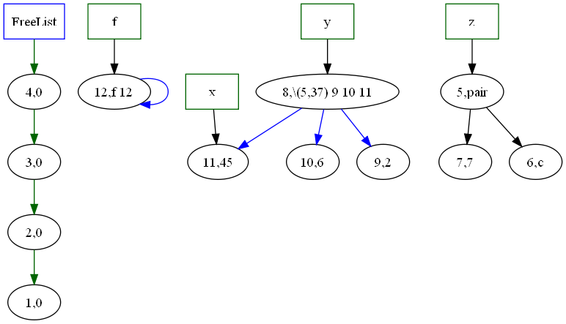
Structure of the Heap
Things to note in a Mark and sweep collector
The Freelist
The Roots
Links from function closures
Links from data (like pair or list)
Constants

Slide 5
Structure of the Heap
(fun f (x) (+ x 7))
(val x 45)
(val y
(let (val x 6)
(val y 2)
in (\ (a)
(+ x (+ y a)))))
(val z (pair 7 'c'))

Slide 6
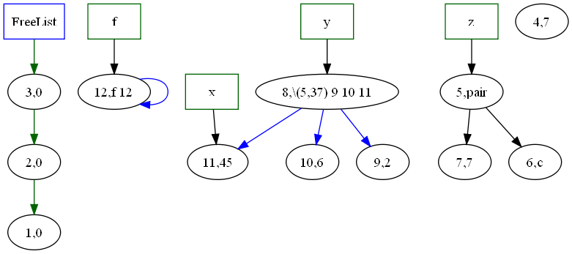
Changes in the heap
Intermediate result computation
(@ f (fst z))
Assignment to things
Garbage collection

Slide 7
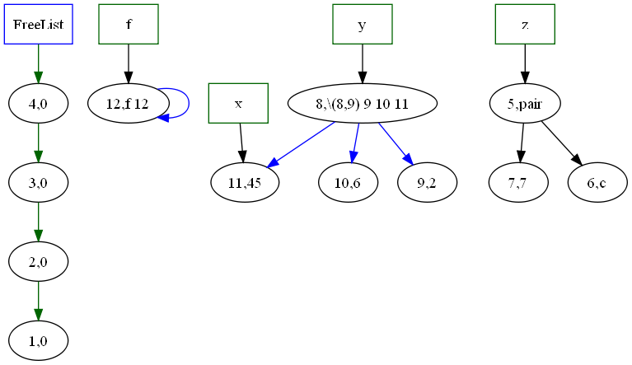
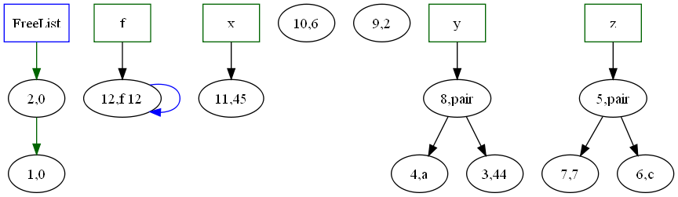
Changes in the heap
Intermediate result
computation
Assignment to things
(:= y (pair 44 ‘a’))
Garbage collection

Slide 8
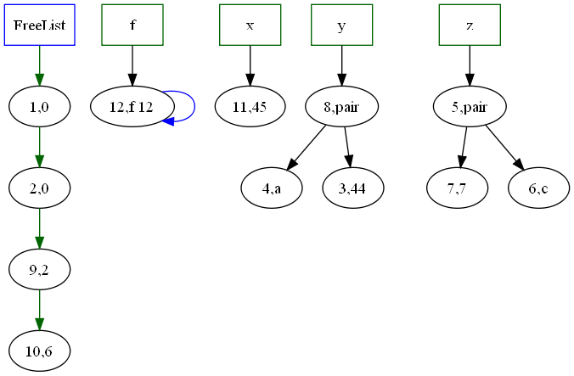
Garbage Collection

Slide 9
Mark and Sweep
Cells have room for several things beside data
data HCell a = Cell { mark::(IORef Bool)
, key :: Int
, payload :: IORef a
, allocLink:: IORef (HCell a)
, allLink:: HCell a }
| NullCell
All cells start linked together on the free list
Allocation takes 1 (or more cells) from the free list
Garbage collection has two phases
Mark (trace all live data from the roots)
Sweep (visit every cell, and add unmarked cells to free list)

Slide 10
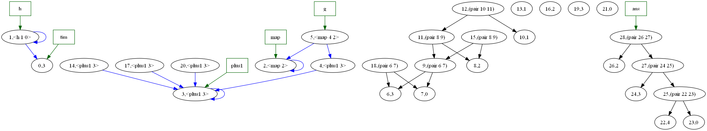
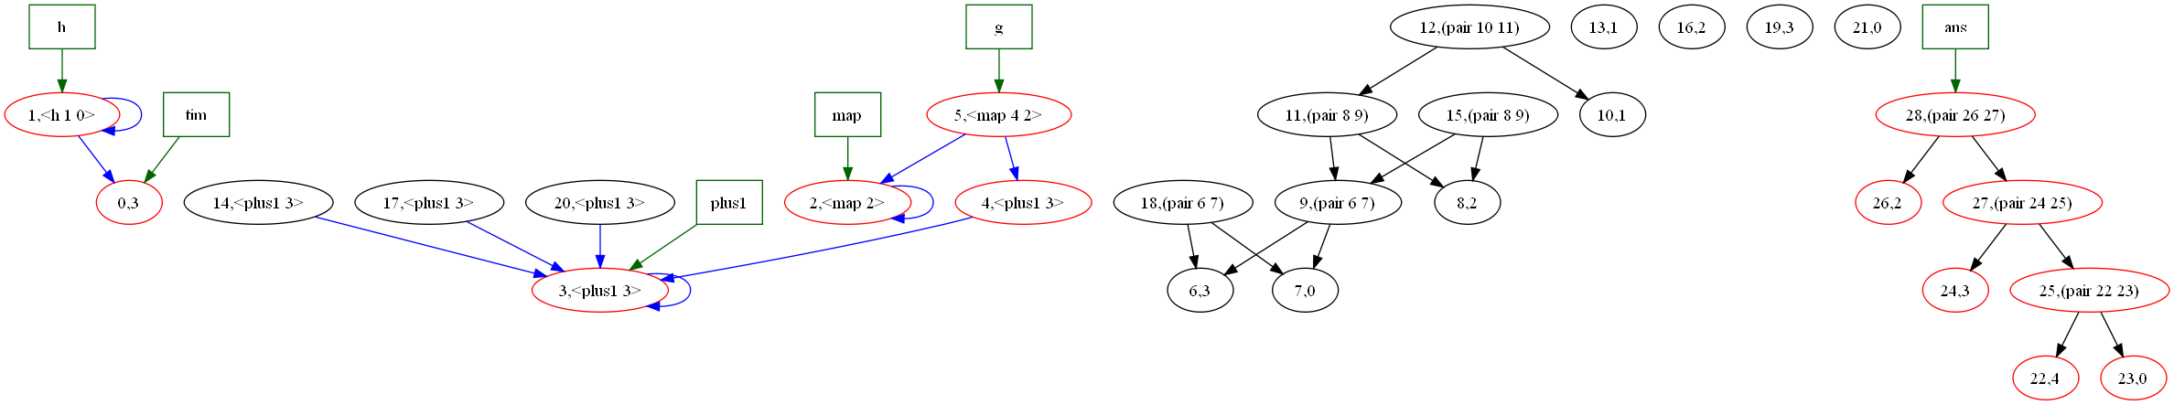
Mark phase (turns cells red in this picture).

Slide 11
Where do links into the heap reside?
In the environment
interpE :: Env (Range Value) -- the variables in scope
-> State -- the heap
-> Exp -- exp to interpret
-> IO(Value,State)
Inside data values
data Value
= IntV Int
| CharV Char
| ConV String Int (Range Value)
| FunV Vname (Env (Range Value)) [Vname] Exp

Slide 12
Mark a cell
markCell markV NullCell = return NullCell
markCell markV (cell@(Cell m id p l1 l2)) =
do { b <- readIORef m; help b }
where help True = return cell
help False =
do { writeIORef m True
; v <- readIORef p
; v2 <- markV
(markRange markV) v
; writeIORef p v2
; return cell}

Slide 13
Sweeping through memory
sweep (H all free) NullCell = return (H all free)
sweep (H all free) (c@(Cell m id p l more)) =
do { b <- readIORef m
; if b then do { writeIORef m False
; sweep (H all free) more }
else do { -- link it on the free
writeIORef l free
; sweep (H all c) more }}

Slide 14
Mark phase (turns cells red in this picture).

Slide 15
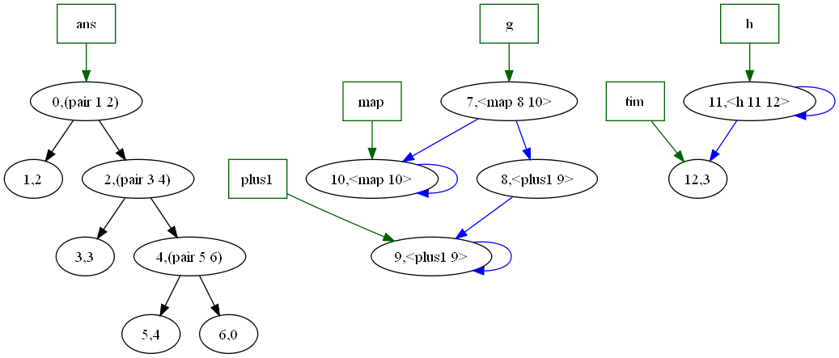

Slide 16
Two space collector
The heap is divided into two equal size regions
We allocate in the “active” region until no more space is left.
We trace the roots, creating an internal linked list of just the live data.
As we trace we compute where the cell will live in the new heap.
We forward all pointers to point in the new inactive region.
Flip the active and inactive regions

Slide 17
A heap Cell
data HCell a =
Cell { mark :: Mutable Bool
, payload :: Mutable a
, forward :: Mutable Addr
, heaplink:: Mutable Addr
, showR:: a -> String }

Slide 18
The Heap
data Heap a =
Heap
{ heapsize :: Int
, nextActive :: Addr
, active :: (Array Int (HCell a))
, inactive:: (Array Int (HCell a))
, nextInActive:: Mutable Addr
, liveLink:: Mutable Addr }

Slide 19
(val tim (+ 1 2))
(fun h (x) (+ x tim))
(fun map (f xs) (if (ispair xs)
(pair (@ f (fst xs))
(@ map f (snd xs)))
xs))
(fun plus1 (x) (+ x 1))
(val g (@map plus1))
(val ans (@g (pair 1 (pair 2 (pair 3 0)))) )
in
ans { should yield (2.(3.(4.0))) }

Slide 20
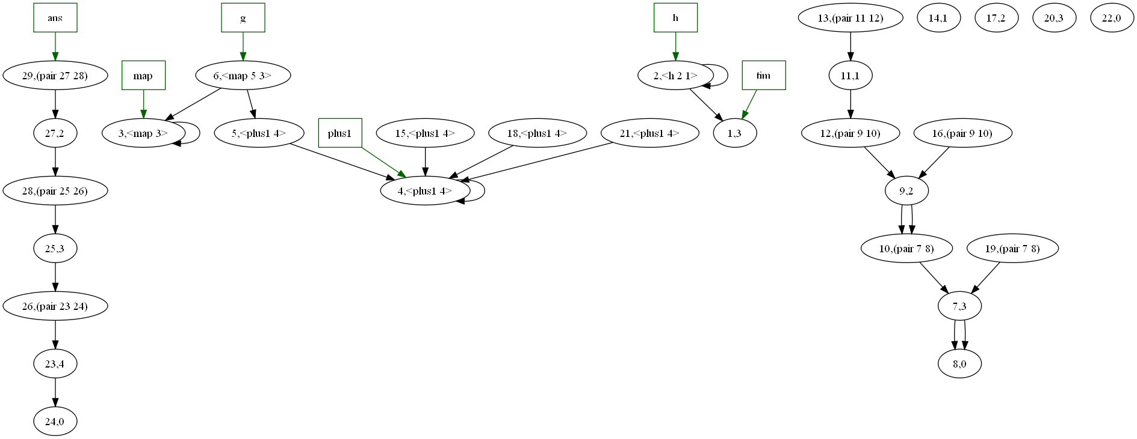
(val tim (+ 1 2))
(fun h (x) (+ x tim))
(fun map (f xs) (if (ispair xs)
(pair (@ f (fst xs))
(@ map f (snd xs)))
xs))
(fun plus1 (x) (+ x 1))
(val g (@map plus1))
(val ans (@g (pair 1 (pair 2 (pair 3 0)))) )
in
ans { should yield (2.(3.(4.0))) }

Slide 21
markAddr :: (GCRecord a) -> Addr -> IO Addr
markAddr (rec@(GCRec heap markpay showV )) index = mark cell
where cell = active heap ! index
nextFreeInNewHeap = nextInActive heap
markedList = liveLink heap
mark (Cell m payld forward reachable showr) =
do { mark <- readIORef m
; if mark
then do readIORef forward
else do {
-- Set up recursive marking
; new <- fetchAndIncrement nextFreeInNewHeap
; next <- readIORef markedList
; writeIORef markedList index
-- Update the fields of the cell, showing it is marked
; writeIORef m True
; writeIORef forward new
; writeIORef reachable next
-- recursively mark the payload
; v <- readIORef payld
; v2 <- markpay (markRange rec) v
-- copy payload in the inactive Heap with
-- all payload pointers relocated .
; writeIORef (payload ((inactive heap) ! new)) v2
-- finally return the Addr where this cell will be relocated to.
; return new }}

Slide 22
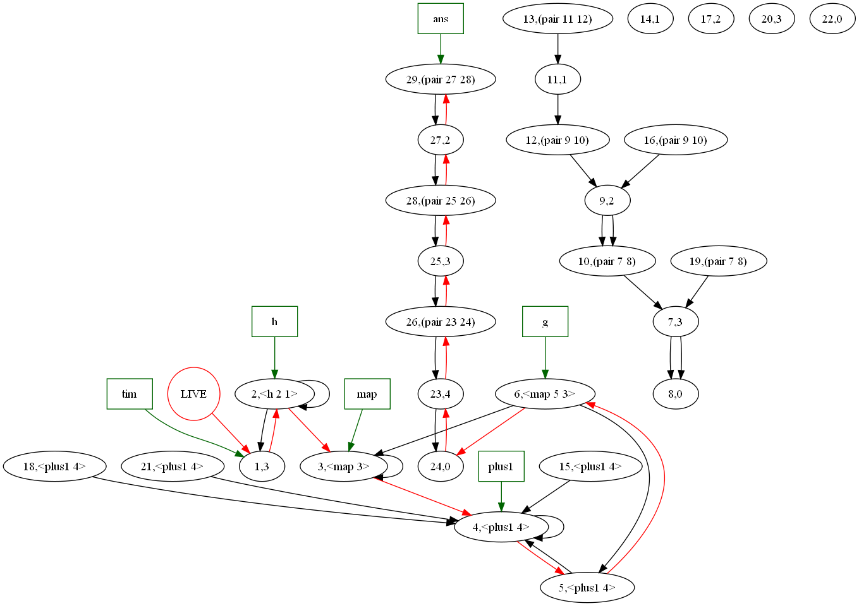

Slide 23
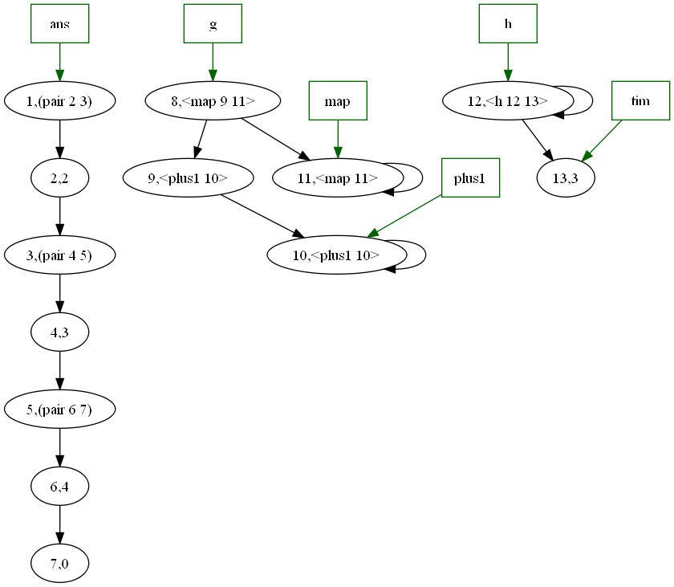

Slide 24
Kinds of collectors
Mark and sweep
Two space collectors
Relocating collectors
Reference counting collectors
Generational collectors

Slide 25
Reference counting collectors
Every cell contains a reference count.
It is incremented whenever a new pointer is added to a cell, and decremented whenever a pointer is changed from pointing at the cell to some other cell.
Cells whose reference counts drop to zero are garbage and are reclaimed.

Slide 26
Reference Counting
Advantages
Simple
Garbage is collected incrementally when it becomes free
Disadvantages
Circular structures are never collected
No upper bound on performing a pointer operation. (A cell may become free, and then all the cells it points to must be decremented, and they may become free)
Live cells become fragmented in memory (little spatial locality)

Slide 27
Generational Collectors
Assumptions
Most newly allocated cells become garbage quickly
Cells that survive 1 or 2 collections tend to be long lived
Old cells seldom (if ever) point to newer cells.
No need to spend time tracing pointers to old cells as one can assume that they are still reachable

Slide 28
Strategy
Divide memory into (different sized) regions.
Each region holds cells of approximately the same age.
Allocate cells in the newest region (usually relatively small, often called the nursery)
When space in the newest region runs out, collect cells in only that region
Only trace the roots into the newest region
Assume everything in older regions is reachable
Special code to handle pointers from old regions to newer regions
Collect reachable cells in the newest region and promote them to an older region.

Slide 29
Program Roots
backward pointers don’t need to be traced
Most garbage is in the newest region.
Only backward pointers within the collecting region need to be traced.
Forward pointers into the collecting region must be handled just like program roots
Forward pointers are rare

Slide 30
Generational
Advantages
Disadvantages
Small collection times
Tracing only the live data
In only a (relatively small) region
No need to touch unreachable cells
Compacts live cells for better special locality
Code can be complex
Many forward pointers can wreck the otherwise good performance

Slide 31
Other issues
Concurrent Collection
Separate processes
Race conditions
Approximate collection can be liveable
Finalization
When an object becomes garbage, it may free up other cells. Sometimes this can be done automatically, but other time specialized knowledge is needed. Finalizers allow programmers to add this knowledge

Slide 32
Overall Advantages of Garbage collectors
Relieves programmers of an error prone task
Removes dangling pointers
Stops memory leaks
Avoids “double frees”
Freeing a cell already freed (and subsequently re-allocated)
Efficient implementation of “persistent” data structures
immutable data structures, can keep around old versions in case they are needed

Slide 33
Overall Disadvantages
Stop-the-world mentality
At any time the system may pause for GC
Timing and duration of GC times is unpredicatable
Unpredictable performance of the same code on the same data

Slide 34
Comparisons
Mark and trace is simple but can have long pauses. Tracing times are proportional to memory size
Reference Count systems are simple but can’t deal with cyclic structures, and all pointer manipulation operations can have unbounded upper limits
Two space collectors have times proportional to live memory. Can compact memory for better spatial locality, but use twice as much space.

Slide 35
Comparisons continued
Generational collectors can have the smallest pause times (proportional to live memory that is traced). Compact memory. With small nurserys don’t have as much spatial overhed as two space collectors.
Concurrent collectors. Run continuously. Code complicated to deal correctly with race conditions. Safe to leave some garbage uncollected if one can collect it later (when race conditions no longer apply).

