Slide 1
Nihonmachi or Japantown
Portland, Oregon

Slide 2
Chronology
1845 Portland Town site
1851 Portland Incorporated
1857: Oregon legislature requires special licenses for Chinese immigrants working in mines or commercial activities
1867: Chinese immigrants open a place of worship on Alder street
1873: Portland council passes “cubic air ordinance”

Slide 3
1875: Oregon Pioneer names Bing Cherry after his Chinese Foreman
1878: In Portland, effigies of Pres. Hayes and a Chinese man are burned
1882: Chinese Exclusion Act

Slide 4
1885: Japanese Immigrants begin to arrive on the West Coast, coinciding with the rise of anti-Chinese legislation and violence including:
Formation of anti-Chinese societies
Chinese residents from Tacoma forcibly loaded on a ship and sent to Portland
1886: Anti-Chinese riots break out in Seattle
1889: Shintaro Takaki opens the first Japanese business in Oregon

Slide 5
1890: Oregon Short Line becomes first railroad to employ Japanese workers
1893: Portland Japanese Methodist Church established
1899: Japanese daily newspaper Japonica Portland is first published
1910: Japanese picture brides arrive in Portland
1925: Japanese driven out of Toledo, Oregon by a mob

Slide 6
1927: State constitutional provision denying suffrage to African-Americans, and Chinese is repealed.
1931: Dr. K.T. Koo of Peking speaks at Reed College on the topic of the Japanese in Manchuria
1932: A group of Portland Chinese students graduate from aviation school and go to China to fight the Japanese.

Slide 7
1942: Executive Order 9066 forces the evacuation of persons of Japanese Ancestry from the West Coast
1945: Chinese War Bride Act passed in Congress
First Japanese Business reopens after the war
1965: The last building housing Chinese establishments at SW 2nd and Oak is razed.

Slide 8
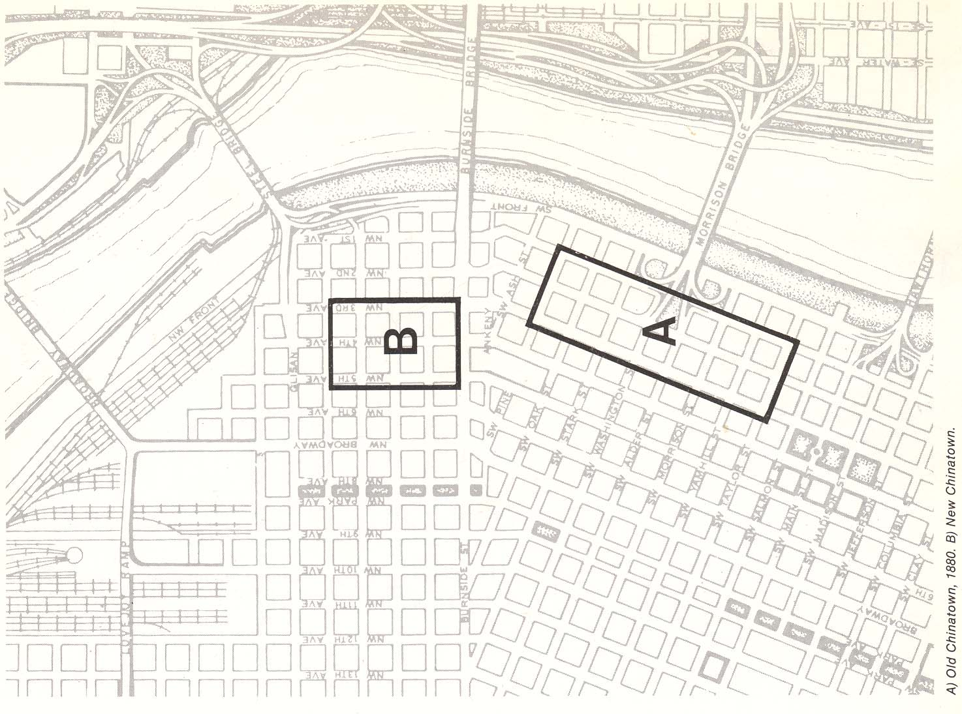

Slide 9
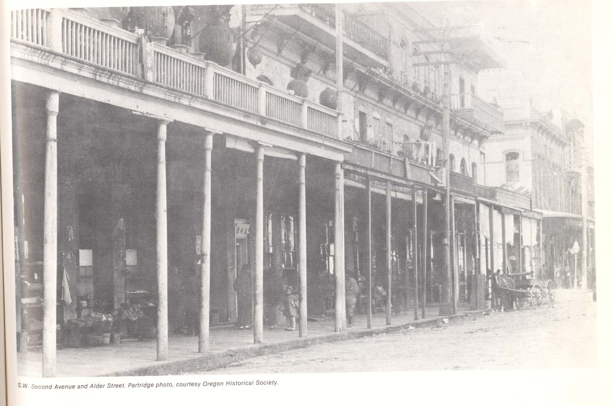

Slide 10
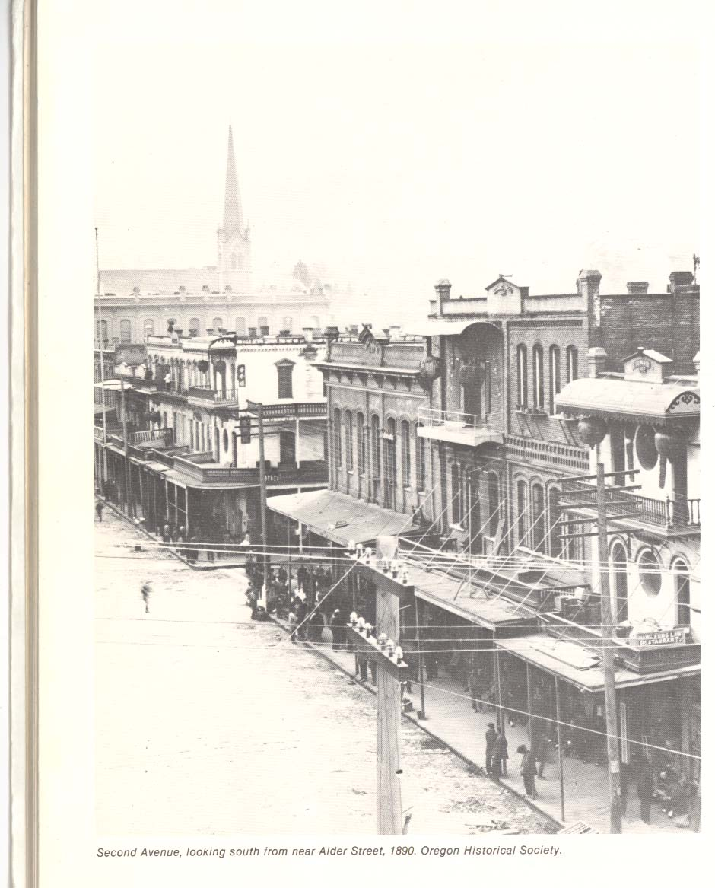

Slide 11
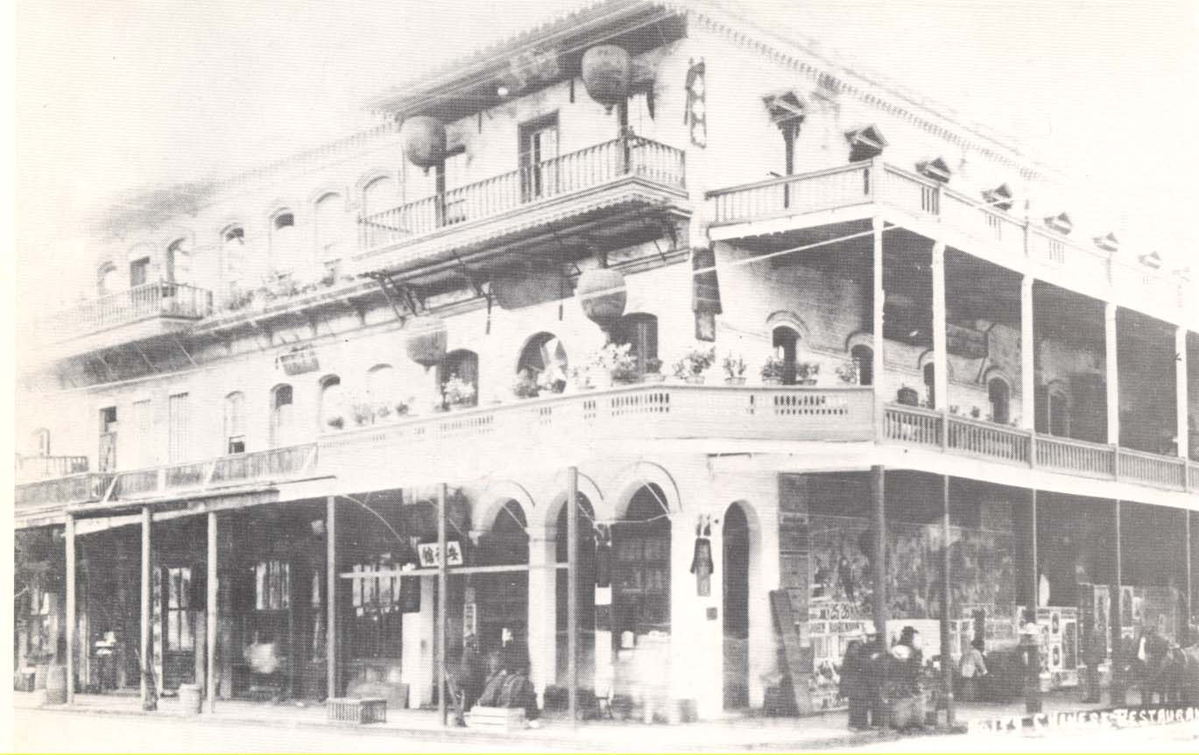


Slide 12
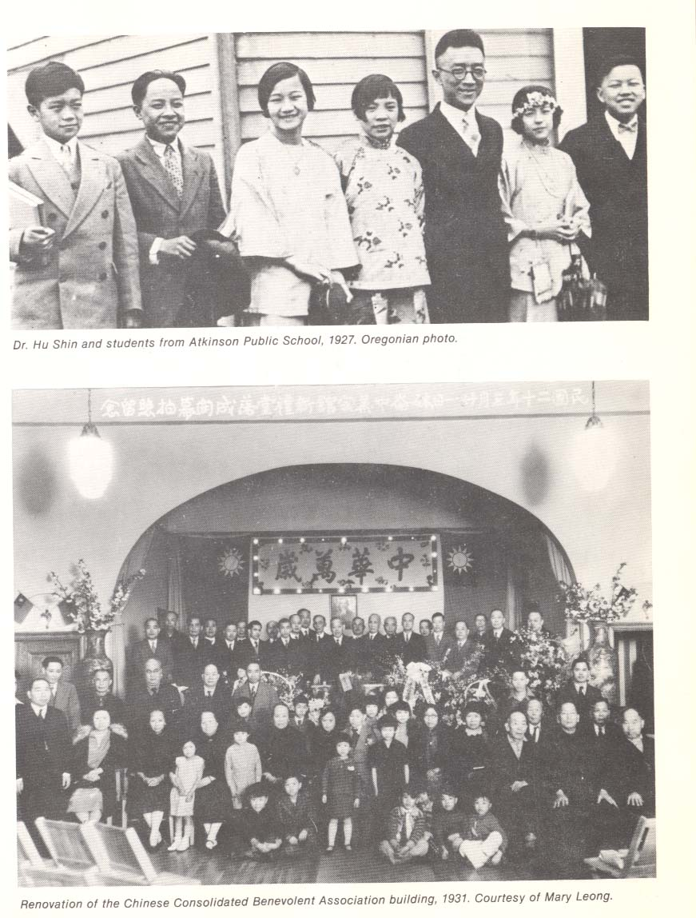

Slide 13
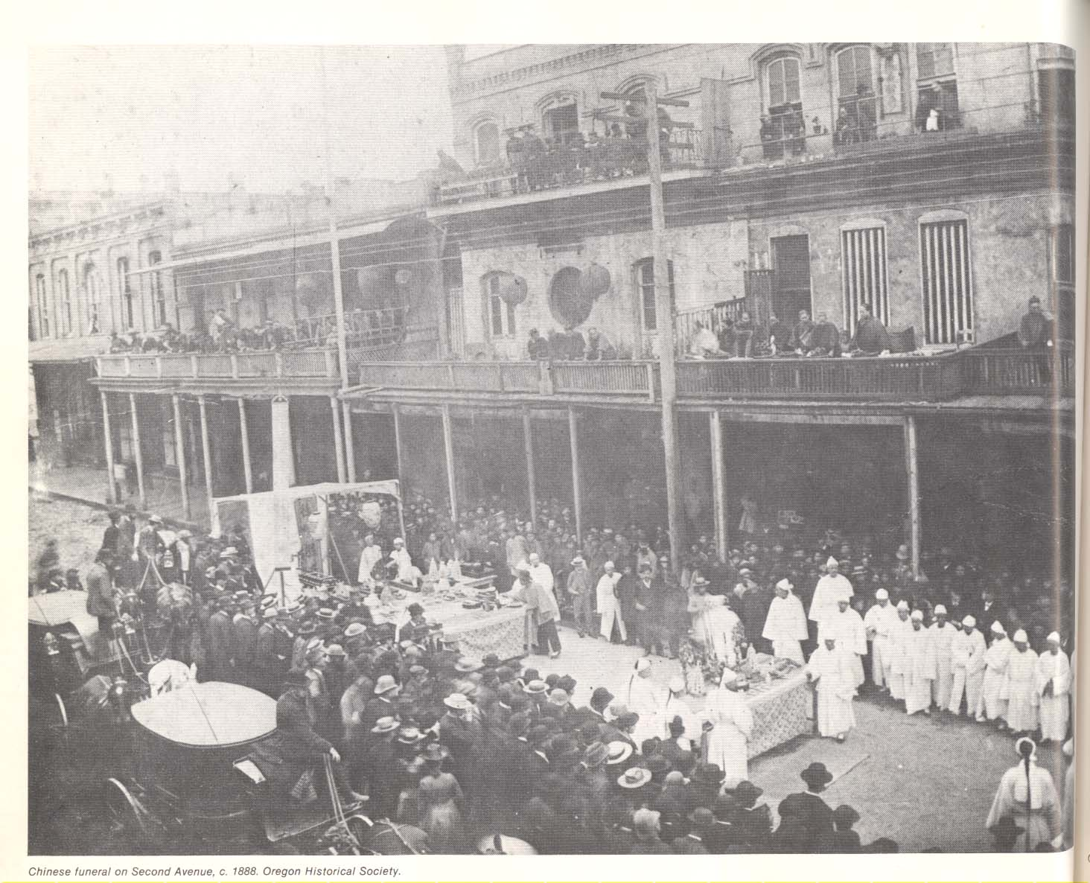

Slide 14
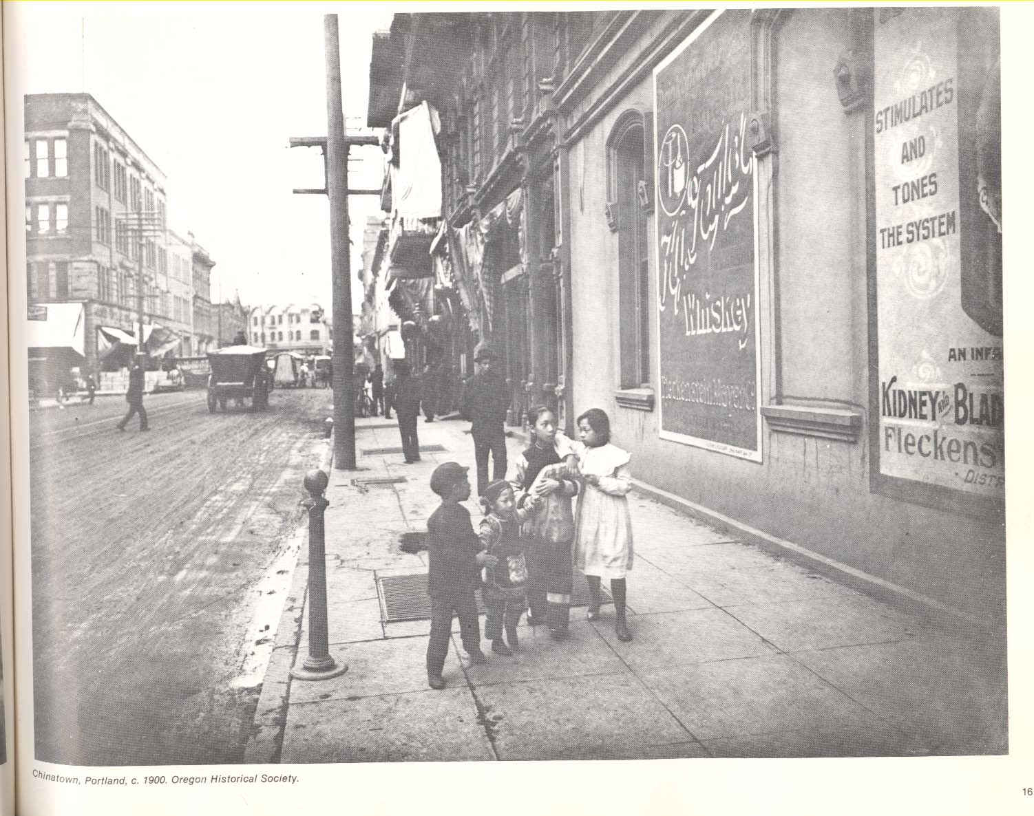

Slide 15
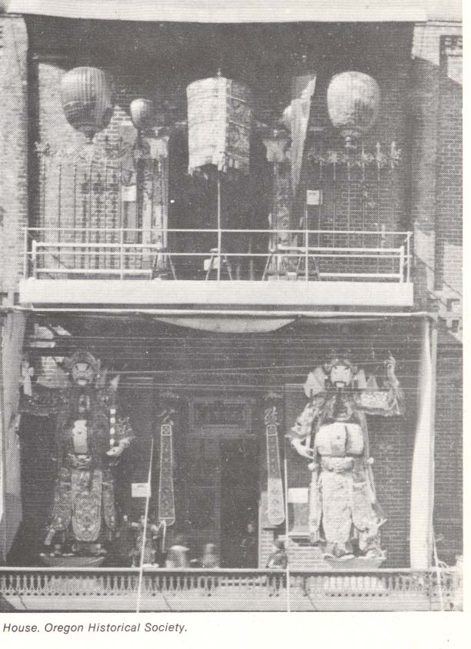

Slide 16
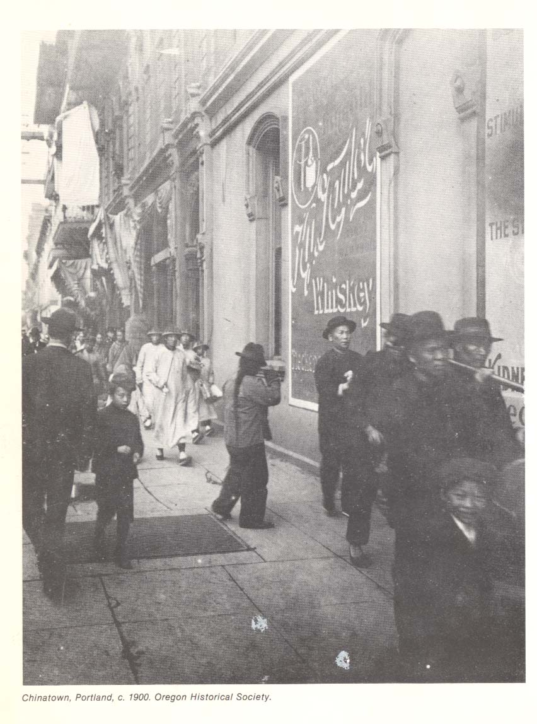

Slide 17
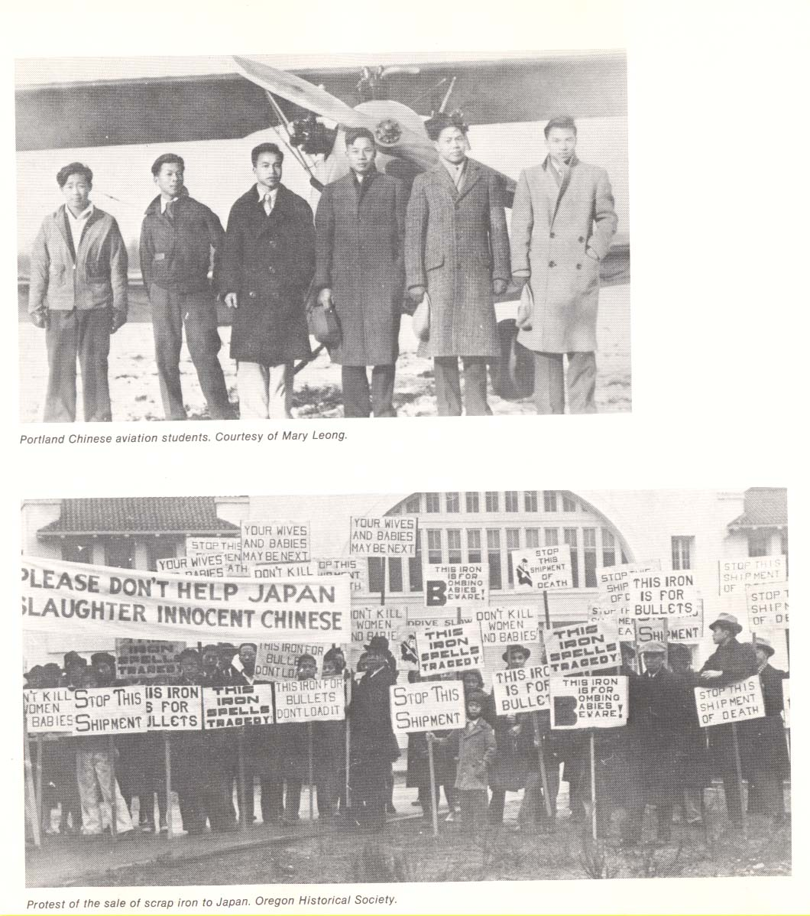

Slide 18
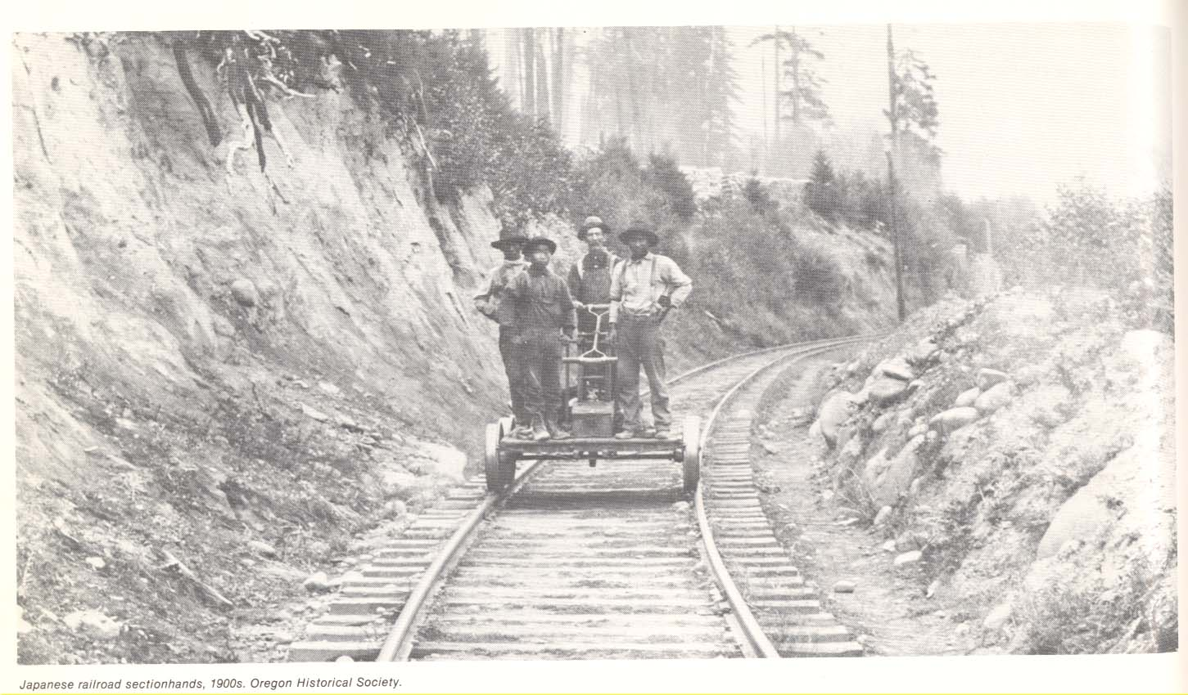

Slide 19
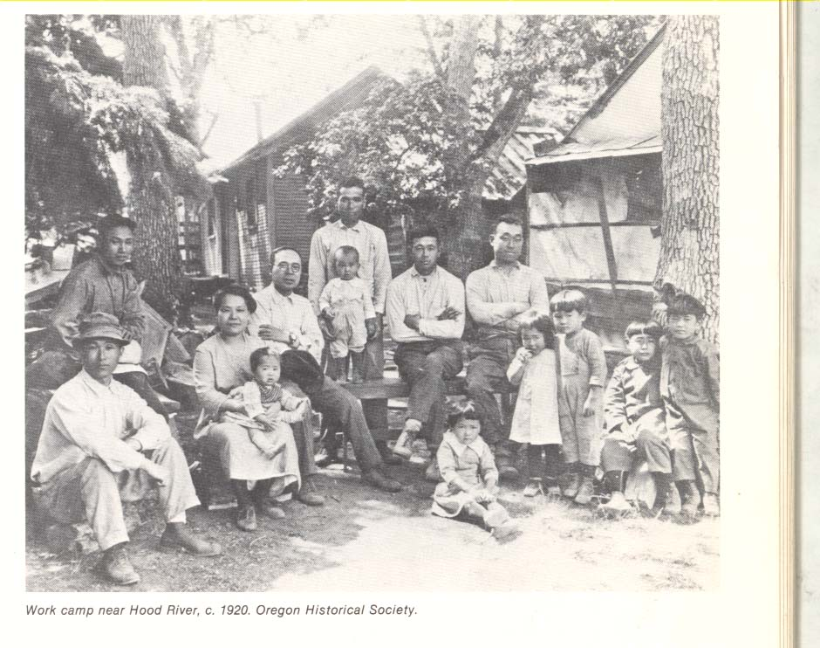

Slide 20
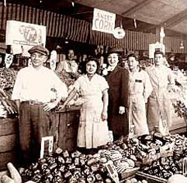
Produce stand in “Japantown”

Slide 21
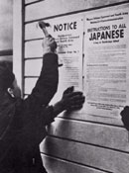
Executive Order 9066 forces 110,000 persons of Japanese ancestry to ‘relocate’ to internment camps.
A 29 April 1942 headline in The Oregonian newspaper proclaimed that Portland would be the first U.S. city to rid itself of Japanese Americans.

Slide 22
Let me begin my story from the Assembly Center, the former Pacific International Exposition Building on Marine Drive. This was the place we entered in May of 1942. We were housed in a barn where the animals had been placed for the exhibition show. Our compartment had plywood flooring covering the entry way. The only furniture was the six cots for our family of six.
        -Mae Ninomiya, Kenton resident since 1933

Slide 23
May 5, 1942. The Evacuation Order was announced on the 28th of April. In a great hurry, we packed up all our household goods and finally, in the three days from May 2 (Saturday) to May 5, everyone in the Portland area, to Montavilla and 120th was evacuated. One-fifth of the people had left on Saturday.
We met Mrs. Hodge and Miss Gates and left at 10:30 a.m., arriving here in two separate cars. A soldier was standing guard at the entrance. It was cloudy as we made our way to the stockyard, but though the weather was not favorable, it also did not rain.
On arriving, I found the facilities better than I had expected and to my surprise, the beds and mattresses were new and comfortable. It was after two o'clock in the afternoon when the inspector came to check our luggage. The signal for mealtime was a whistle. Lunch was served in a large dinning hall and consisted of bread, jelly and coffee, with spinach, hashbrowns and pudding on the side.
To add a more "homey" atmosphere to our room, I made a shelf and hung a mirror up on the wall.
"Portland Assembly Center: Diary of Saku Tomita," courtesy of the Oregon Historical Society Research Library,

Slide 24
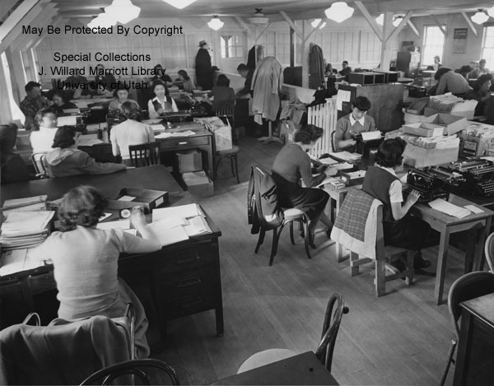

Slide 25
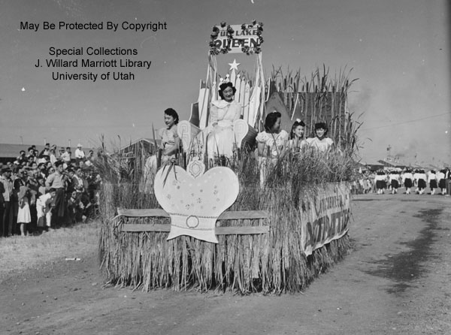

Slide 26
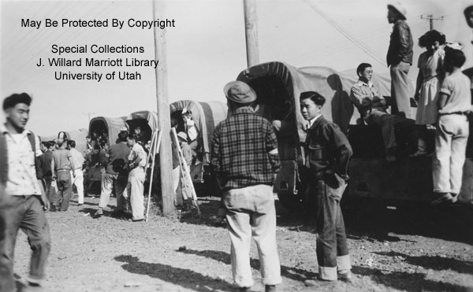

Slide 27
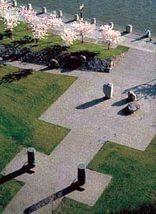
The Japanese-American Historical Bill of Rights Plaza was dedicated in 1990.
The work was a collaboration between a poet, a sculptor and a landscape architect.

