Slide 1
Lecture #19, Dec 1 & 6, 2004
Todays Topics
  Haskore System
  The Music datatype
  MIDI Instruments
  Pitch & absolute Pitch
  Composing Music
    Delay
    Repeating
    Transposing
  Presentation and the MIDI file format

Slide 2
Using the Haskore Library on your machine
The Haskore library must be installed to work on your machine.
Down load the zip file from the web.
  http://web.cecs.pdx.edu/~sheard/course/CyberMil/Code/Haskore.zip
Unzip it into a temporary directory.
  You will get a directory named Haskore, with many files in it
Find your Hugs installation directory
  Usually some thing like C:\Program Files\WinHugs
Open this directory, there should be a directory called packages.
Copy the complete Haskore directory into the packages directory
You have now installed Haskore!!

Slide 3
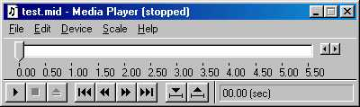
Haskore
Haskore is a Haskell library for constructing digital music
  It supports an abstract high-level description of musical concepts
  Maps into the Midi (Musical Instrument Digital Interface) standard
    a low-level binary bit based encoding of music
    can be “played” by “Media-Players”
Haskell
Haskore
Haskore
Abstract
High Level
Implementation
independent
MIDI
low level
bit based
implementation
standard
presentation

Slide 4

Musical Basics in Haskore
type Pitch = (PitchClass, Octave)
data PitchClass =
Cf | C | Cs | Df | D | Ds | Ef | E
| Es | Ff | F | Fs | Gf | G | Gs | Af
| A | As | Bf | B | Bs
type Octave = Int
Middle C
Octave 2
Octave 3
Octave 4
Cs Ds Fs Gs As
Df Ef Gf Af Bf
Cf
Ff Es
Cf Bs
C D E F G A B C

Slide 5






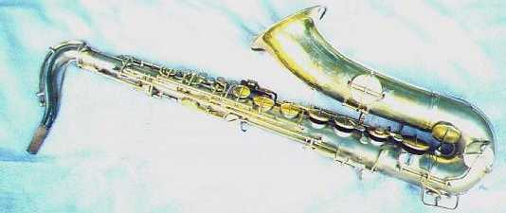
Music
data Music
= Note Pitch Dur [NoteAttribute]
| Rest Dur
| Music :+: Music
| Music :=: Music
| Tempo (Ratio Int) Music
| Trans Int Music
| Instr IName Music
| Player PName Music
| Phrase [PhraseAttribute] Music

Slide 6
First Notes
Our first piece of music
m1 = Note (C,5) 1 []
m2 = Note (D,5) 1 []
m3 = m1 :+: m2

Slide 7
Short hands
cf,c,cs,df,d,ds,ef,e,es,ff,f,fs,gf,g,gs,af,a,as,bf,b,bs ::
Octave -> Dur -> [NoteAttribute] -> Music
cf o = Note (Cf,o); c o = Note (C,o); cs o = Note (Cs,o)
df o = Note (Df,o); d o = Note (D,o); ds o = Note (Ds,o)
ef o = Note (Ef,o); e o = Note (E,o); es o = Note (Es,o)
ff o = Note (Ff,o); f o = Note (F,o); fs o = Note (Fs,o)
gf o = Note (Gf,o); g o = Note (G,o); gs o = Note (Gs,o)
af o = Note (Af,o); a o = Note (A,o); as o = Note (As,o)
bf o = Note (Bf,o); b o = Note (B,o); bs o = Note (Bs,o)
These functions have the same names as the constructors of the PitchClass but they’re not capitalized.
Compare
  Note (C,5) 1 [] with c 5 1 []

Slide 8
Duration
type Dur = Ratio Int
  -- fractions of Integers such as 3 /4. We write (3 % 4) in Haskell.
wn, hn, qn, en, sn, tn :: Dur
dhn, dqn, den, dsn :: Dur
wn = 1 -- whole
hn = 1%2 -- half
qn = 1%4 -- quarter
en = 1%8 -- eight
sn = 1%16 -- sixteenth
tn = 1%32 -- thirty-second
dhn = 3%4 -- dotted half
dqn = 3%8 -- dotted quarter
den = 3%16 -- dotted eighth
dsn = 3%32 -- dotted sixteenth

Slide 9
Compare
m1 = Note (C,5) 1 []
m2 = Note (D,5) 1 []
m3 = m1 :+: m2
n1 = c 5 wn []
n2 = d 5 wn []
n3 = n1 :+: n2

Slide 10
Generic Music - Rests
wn, hn, qn, en, sn, tn :: Dur
dhn, dqn, den, dsn :: Dur
wnr = Rest wn -- whole
hnr = Rest hn -- half
qnr = Rest qn -- quarter
enr = Rest en -- eight
snr = Rest sn -- sixteenth
tnr = Rest tn -- thirty-second
dhnr = Rest dhn -- dotted half
dqnr = Rest dqn -- dotted quarter
denr = Rest den -- dotted eighth
dsnr = Rest dsn -- dotted sixteenth

Slide 11

Lets Write Some Music!
Example 1
cscale = c 4 qn [] :+: d 4 qn [] :+:
e 4 qn [] :+: f 4 qn [] :+:
g 4 qn [] :+: a 4 qn [] :+:
b 4 qn [] :+: c 5 qn []
chord1 = (c 4 hn [] :=: e 4 hn [])
Note the change
in Octave

Slide 12
More shorthands
line, chord :: [Music] -> Music
cscale2 = line
[c 4 qn [], d 4 qn [], e 4 qn [],
f 4 qn [], g 4 qn [], a 4 qn [],
b 4 qn [], c 5 qn [] ]
chords = chord [ (Rest (3%4) :+: cscale)
, cscale ]

Slide 13
Getting rid of those annoying [ ]’s
-- All three compute the same thing, but some are
-- easier to write than others
cscale3 = line2 [c 4 qn, d 4 qn, e 4 qn,
f 4 qn, g 4 qn, a 4 qn,
b 4 qn, c 5 qn ]
cscale = c 4 qn [] :+: d 4 qn [] :+: e 4 qn [] :+:
f 4 qn [] :+: g 4 qn [] :+: a 4 qn [] :+:
b 4 qn [] :+: c 5 qn []
cscale2 = line
[c 4 qn [], d 4 qn [], e 4 qn [],
f 4 qn [], g 4 qn [], a 4 qn [],
b 4 qn [], c 5 qn [] ]

Slide 14
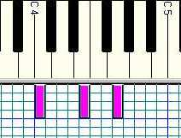



More Examples
  cMaj = [ n 4 hn [] | n <- [c,e,g] ]
  cMin = [ n 4 wn [] | n <- [c,ef, g] ]
Example 2
  cMajArp = line cMaj
Example 3
  cMajChd = chord cMaj
Example 4
  ex4 = line [ chord cMaj, chord cMin ]

Slide 15


Time Delaying Music
delay :: Dur -> Music -> Music
delay d m = Rest d :+: m
ex5 = cscale :=: (delay dhn cscale)

Slide 16
Transposing Music
ex6 = chord [line cMajor
,Trans 12 (line cMajor)]
12 tone
difference

Slide 17
Where are the notes?
f 6 qn []
d 6 qn []
b 5 qn []
g 5 qn []
e 5 qn []
c 5 qn []
e 6 qn []
c 6 qn []
a 5 qn []
f 5 qn []
d 5 qn []
B 4 qn []
Middle C

Slide 18
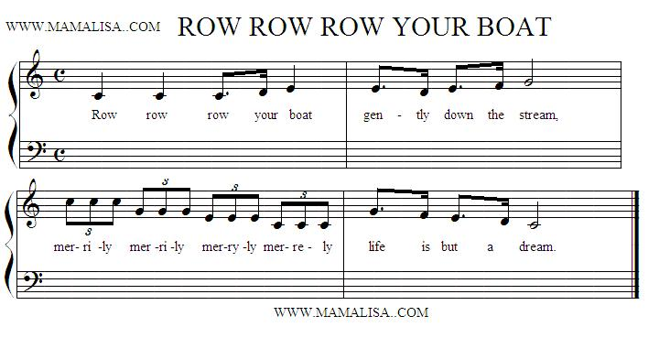
Create a masterpiece
row = line2 [c 5 qn, c 5 qn, c 5 den, d 5 sn, e 5 qn
,e 5 den, d 5 sn, e 5 den, f 5 sn, g 5 hn
,triplet (c 6 qn), triplet (g 5 qn),
triplet (e 5 qn), triplet (c 5 qn)
,g 5 den, f 5 sn, e 5 den, d 5 sn, c 5 hn]
triplet n args =
Tempo 3 (n args) :+: Tempo 3 (n args) :+: Tempo 3 (n args)

Slide 19
Adding more value
row1 = testNT row
row2 = testNT (Tempo 2 row)
row3 = testNT
(Tempo 2 (row :=: (Rest wn :+: row)))
row4 = testNT
(Tempo 2 (voice1 :=: voice2 :=: voice3))
where voice1 = row
voice2 = (Rest wn :+: row)
voice3 = (Rest (wn * 2) :+: row)

Slide 20
Midi Standard supports lots of instruments
"Acoustic Grand Piano" "Bright Acoustic Piano" "Electric Grand Piano" "Honky Tonk Piano"
"Rhodes Piano" "Chorused Piano" "Harpsichord" "Clavinet"
"Celesta" "Glockenspiel" "Music Box" "Vibraphone"
"Marimba" "Xylophone" "Tubular Bells" "Dulcimer"
"Hammond Organ" "Percussive Organ" "Rock Organ" "Church Organ"
"Reed Organ" "Accordion" "Harmonica" "Tango Accordion"
"Acoustic Guitar (nylon)" "Acoustic Guitar (steel)" "Electric Guitar (jazz)" "Electric Guitar (clean)"
"Electric Guitar (muted)" "Overdriven Guitar" "Distortion Guitar" "Guitar Harmonics"
"Acoustic Bass" "Electric Bass (fingered)" "Electric Bass (picked)" "Fretless Bass"
"Slap Bass 1" "Slap Bass 2" "Synth Bass 1" "Synth Bass 2"
"Violin" "Viola" "Cello" "Contrabass"
"Tremolo Strings" "Pizzicato Strings" "Orchestral Harp" "Timpani"
"String Ensemble 1" "String Ensemble 2" "Synth Strings 1" "Synth Strings 2"
"Choir Aahs" "Voice Oohs" "Synth Voice" "Orchestra Hit"
"Trumpet" "Trombone" "Tuba" "Muted Trumpet"
"French Horn" "Brass Section" "Synth Brass 1" "Synth Brass 2"
"Soprano Sax" "Alto Sax" "Tenor Sax" "Baritone Sax"
"Oboe" "Bassoon" "English Horn" "Clarinet"
"Piccolo" "Flute" "Recorder" "Pan Flute"
"Blown Bottle" "Shakuhachi" "Whistle" "Ocarina"
"Lead 1 (square)" "Lead 2 (sawtooth)" "Lead 3 (calliope)" "Lead 4 (chiff)"
"Lead 5 (charang)" "Lead 6 (voice)" "Lead 7 (fifths)" "Lead 8 (bass+lead)"
"Pad 1 (new age)" "Pad 2 (warm)" "Pad 3 (polysynth)" "Pad 4 (choir)"
"Pad 5 (bowed)" "Pad 6 (metallic)" "Pad 7 (halo)" "Pad 8 (sweep)"
"FX1 (train)" "FX2 (soundtrack)" "FX3 (crystal)" "FX4 (atmosphere)"
"FX5 (brightness)" "FX6 (goblins)" "FX7 (echoes)" "FX8 (sci-fi)"
"Sitar" "Banjo" "Shamisen" "Koto"
"Kalimba" "Bagpipe" "Fiddle" "Shanai"
"Tinkle Bell" "Agogo" "Steel Drums" "Woodblock"
"Taiko Drum" "Melodic Drum" "Synth Drum" "Reverse Cymbal"
"Guitar Fret Noise" "Breath Noise" "Seashore" "Bird Tweet"
"Telephone Ring" "Helicopter" "Applause" "Gunshot"

Slide 21
Adding instruments
row5 = testNT (Tempo 2 (voice1 :=: voice2 :=: voice3))
where voice1 = Instr "Tenor Sax" row
voice2 = Instr "English Horn"
(Rest wn :+: row)
voice3 = Instr "Harpsichord"
(Rest (wn * 2) :+: row)
-- Is there a pattern?
row6 = testNT (voice "Violin" 0 :=:
voice "Flute" 1 :=:
voice "Tubular Bells" 2)
where voice i part =
Tempo (3%2)
(Instr i (Rest (wn * part) :+: row))

Slide 22

Repeating Music
repeatM :: Music -> Music
repeatM m = m :+: repeatM m
nBeatsRest n note =
line ((take n (repeat note)) ++ [qnr])
ex7 =
line [e 4 qn [], d 4 qn [], c 4 qn [], d 4 qn [],
line [ nBeatsRest 3 (n 4 qn []) | n <- [e,d] ],
e 4 qn [], nBeatsRest 2 (g 4 qn []) ]

Slide 23
Music Presentation
Music is a highlevel, abstract representation
We call the playing of Music its Presentation
Presentation requires “flattening” the Music representation into a list of low level events.
  Events contain information about
    pitch
    start-time
    end-time
    loudness
    duration
    instrument etc.
The MIDI standard is a file format to represent this low level information.

