Slide 1
Cyborg Millenium
Mock 10 minute presentation
Easter Island

Slide 2
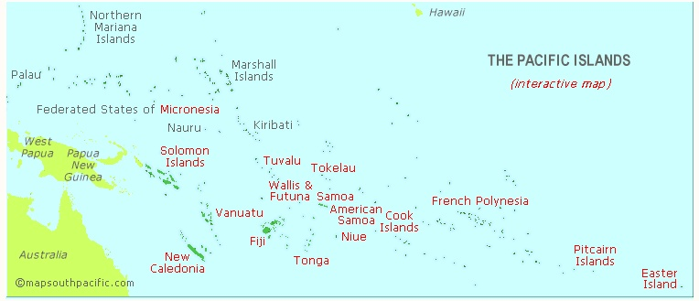
Easter Island
Easter Island is the westernmost of the Pacific Islands. It is small, isolated, and remote.

Slide 3
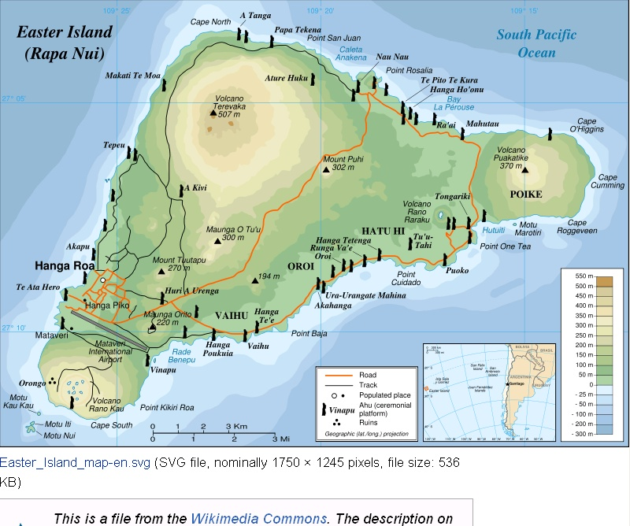
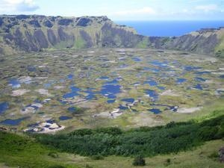
Geography
Roughly triangular in shape has 3 major volcanoes.

Slide 4
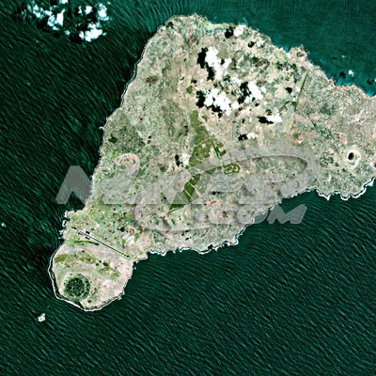
It is barren, has few trees.

Slide 5
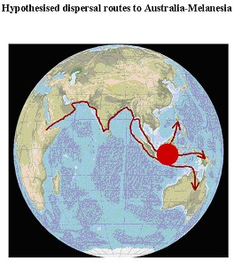
Where did the Easter Islanders come from
The Pacific Islands were settle by a dispersal from Africa, in a route that runs along the south of Asia through Melanesia, then to Australia and Micronesia.

Slide 6
Settlement of the Pacific Islands
1000 B.C.
600 A.D.
500 B.C.
600 A.D.
1200 A.D.
800 A.D.
900 A.D.
The Pacific Islands were settled from the northwest, probably from Asia and Melanesia, in a series of waves in westerly, then northerly (Hawaii) and southerly (New Zealand) directions

Slide 7
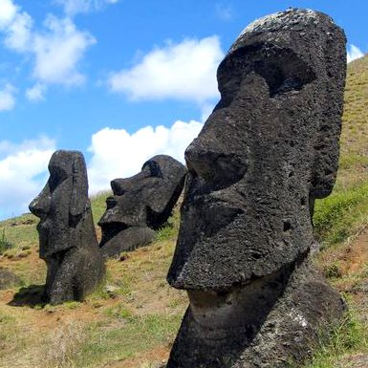
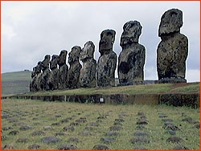
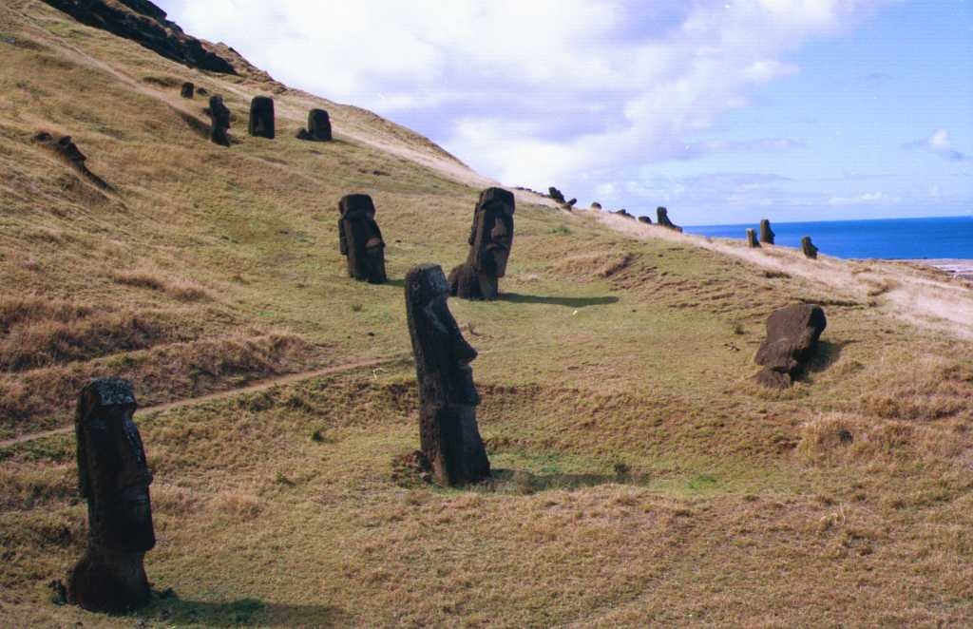
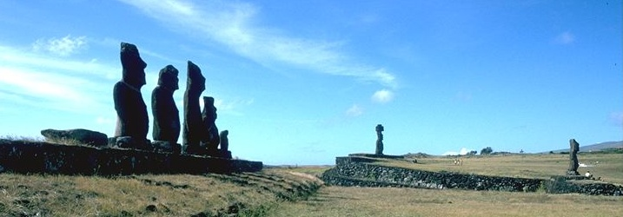
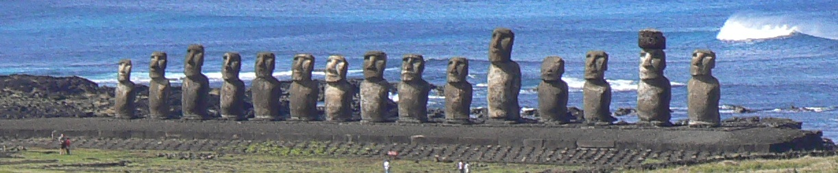
Moai
Easter Island has hundreds of large stone statues (moai).
  13-32 feet tall
  10-87 tons in weight

Slide 8
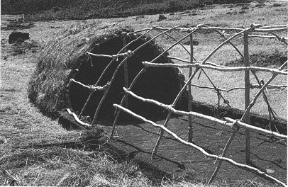
Thriving Population
Evidence suggests that Easter Island had a large and rich thriving society.
  Many house foundations (enough for 20-30K people)
  Agricultural Intensification (large composting pits, water dams, stone chicken houses, stone windbreaks) suggests a lot of food was needed and grown.
  Society was broken into
  11-12 territories or clans
  (not likely with a smaller population).

Slide 9
A statue based economy
Constructed in 3 waves 1100 A.D.
Statues grew larger and more elaborate as time went by.
Economy centered around statue building
  Many roads
  Clan based niches in statue production
  Food production concentrated to free up labor for statue construction

Slide 10
Why so overboard
The stone on Easter Island is the best carving stone in the Pacific
Society was isolated, so the energy expended in other Pacific societies (trading, raiding, exploration, and colonization) was directed inward
Chiefs got stature not by inter-island interaction but by competing for status by a game of statue one-upman-ship
  Later ones had a pukao, or large stone “hat”
Clan based society, let each clan “specialize” so while each group had a monopoly on some item, trade between groups was the norm.

Slide 11
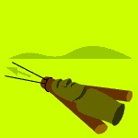
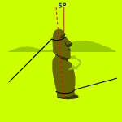
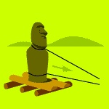
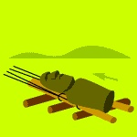
How were they moved?
Theorist: Thor Heyerdahl
  sledge
Theorist: Pavel Pavel
  walked
Theorist: Charles Love
  upright roll
Theorist: Jo Anne Van Tilburg
  horizontal roll
Most rely on wood and logs
  http://www.pbs.org/wgbh/nova/easter/move/past.html

Slide 12
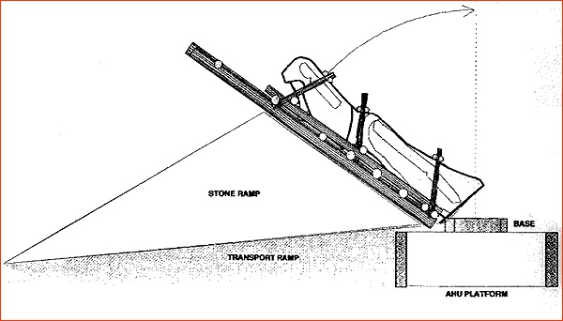
How were they raised?
Transport, Raising, and Food Production issues suggest that many trees were cut down to provide for statue production and to clear land for food production.
When discovered in the early 1800’s there were no trees on Easter Island
Did Deforestation lead to the collapse?

Slide 13
An Abrupt end
Statue building, and the complex Easter Island society ended abruptly about 1600 A.D.
  Incomplete statues still embedded in quarry
    Total number of moai on Easter Island: 887
    Total number of maoi that were successfully transported to their final ahu locations: 288 (32% of 887)
    Total number of moai still in the Rano Raraku quarry: 397 (45%)
    Total number of moai lying 'in transit' outside of the Rano Raraku quarry: 92 (10%)
  Stone carving tools left to lie
  Chicken houses abandonded
  Roads left in disrepair
What happened?

Slide 14
Collapse
Forests Gone
  No trees on island when discovered by Europeans
  Pollen analysis shows that indigenous palm trees were grown in the time of early settlers
  large areas given over to food production (upland farms)
Food supply limited
  upland farms abandonded
  midden analysis shows large game birds disappeared
  Large fish and seal bones also disappeared (no trees, no canoes, no deep water fishing)
Fuel supply limited
  carbon tested early fires were trees, later fires were grasses
Erosion
  soil eroded from base of statues,
Unrest
  In the last days statues of rival clans were torn down

