Slide 1
Rights Based Ethics
By: Chris Howard, Eileen Chadbourne, Dina Ramku, David Moe, Victor McClintock

Slide 2
What are Right Based Ethics?
Natural & Conventional
Moral Rights
Government’s Obligation to Citizens
  Respect rights without interference
  Protect equality of law
  Carry out procedures (UN)

Slide 3
Rights Based Policies of the UN
Right to life UN, EU
Right to liberty and security of person UN, EU
Right not to be enslaved UN, EU
Right not to be tortured UN, EU
Right to privacy UN, EU
Right to freedom of thought, conscience and religion UN, EU
Right to freedom of opinion and expression UN, EU
Right to social security UN
Right to work UN
Right to equal pay for equal work UN
Right to rest and leisure UN
Right to a standard of living adequate for health and well-being UN
Right to education UN
Right to participate in cultural life and the arts UN

Slide 4

Facts of Octo-mom Case
Receives disability pay, food stamps, welfare
Overwhelming debt for taxpayers
Unemployed
Unhealthy environment for children

Slide 5
Why The Controversy?
Federal IVF Regulation
Future of Children
Burden on tax payers
Doctors ethics

Slide 6
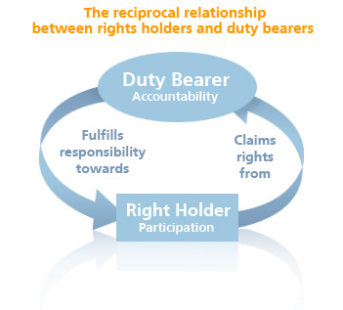
Who Cares?
Mother
Children
Future IVF Patients
Doctors involved
Child Protection
agencies
Media

Slide 7
What should be done?
New IVF regulations/laws
  Background checks by agency
  People need to be approved before they can get IVF
  Doctors not held responsible
  Federally funded program

Slide 8
Solution for Octo-mom
Children up for adoption
Follow up on children: make sure they are in adequate conditions
Counseling made necessary by state.

Slide 9
Sources
http://www.logical-operator.com
http://civilliberty.com
www.unfpa.org
http://rationalactor.wordpress.com

