Slide 1
Knowledge & Tools for website design

Slide 2
Goals
Understand the difference between absolute and relative links.
Create .html documents with both absolute and relatative links
Understand what publishing does
Use the File Transfer Software to publish

Slide 3
[C,4] is an absolute address
Go to the intersection Ave C and Street 4.
1
2
3
4
5
6
7
8
9
10
11
12
A
B
C
D
E
F
G
H
I
J
K
L
{South 5, East 4} is a relative address

Slide 4
Absolute vs Relative
Absolute – A fixed position according to the global grid (or position system)
Relative – Directions to somewhere from your current starting position.

Slide 5
Grids are not the only position system
[45 degrees, 4 inches]
45º

Slide 6
Trees
root
absolute{3/1/3}
1
2
3
relative{../5/1}

Slide 7
URLs are trees
http://cs.pdx.edu/~sheard/courses/d&s/index.html
root
com
net
edu
pdx
cs
~sheard

Slide 8
Reading a URL
http://cs.pdx.edu/~sheard/courses/d&s/index.html
http:
com
root
edu
pdx
cs
~sheard
courses
d&s
index.html
net
edu
protocol
http://
means a web page
pdx
cs
~sheard
courses
research
home.html
d&s

Slide 9
Example Links
<A HREF="../index.html">Back to the class page.</A>
<A HREF="http://www.eeoc.gov/index.html">EEOC page</A>
<A HREF="Docs/5minList.html">presentations</A>
<A HREF="Knowledge&Tools4Website.ppt">here</A>
If it starts with http:// its is an absolute link.
Anything else is a relative link.
What does the … mean?

Slide 10
Creating pages
We can create pages with a tool
  Front Page
  Dream Weaver
  Iweb
  Publisher
Or we can edit .html files.
Its worth knowing how to read some html, because this helps you debug

Slide 11
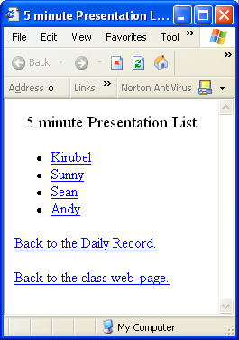
Example
<title>5 minute Presentation List</title>
<CENTER>
<BIG>5 minute Presentation List</BIG>
</CENTER>
<p>
<UL>
<LI> <A HREF="5min/Kirubel.ppt">Kirubel</A>
<LI> <A HREF="5min/Sunny.ppt">Sunny</A>
<LI> <A HREF="5min/Sean.ppt">Sean</A>
<LI> <A HREF="5min/Andy.ppt">Andy</A>
</UL>
<p>
<A HREF="../DailyRecord.html#Today">Back to the Daily Record.</A>
<p>
<A HREF="../index.html">Back to the class web-page.</A>

Slide 12
Why do we need to publish
Every web page is reachable from the web root (http:// for the pages we will build)
The H drive is not accessible.
The public_html on the odin machines are
  e.g. odin.pdx.edu/~sheard
  the public_html is implicit (we don’t have to write it down).

Slide 13
Tools for publishing
To publish we need to create a set of files and directories reachable from the www root.
The public_html directory in your unix home directory is set up to be reachable
  e.g. odin.pdx.edu/~sheard
Copy files by using
  File Transfer Tool (see next few slides)
  Myfiles (only works on windows)

Slide 14
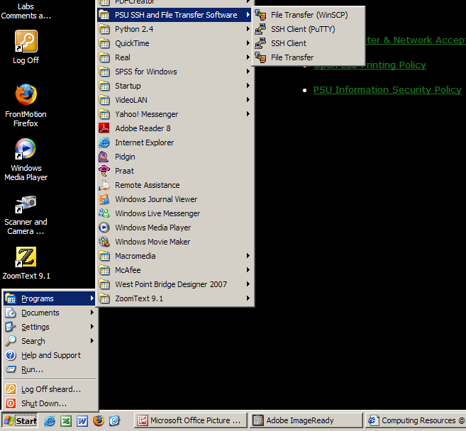
File Transfer Software
File transfer software
To start up
Start
  Programs
  PSU SSH and File Transfer Software
  File Transfer (WinSCP)

Slide 15
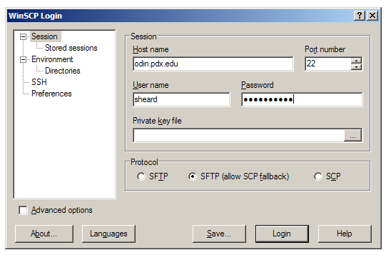
Logging in
To Login
The host is odin.pdx.edu
Use your login name
and your password

Slide 16
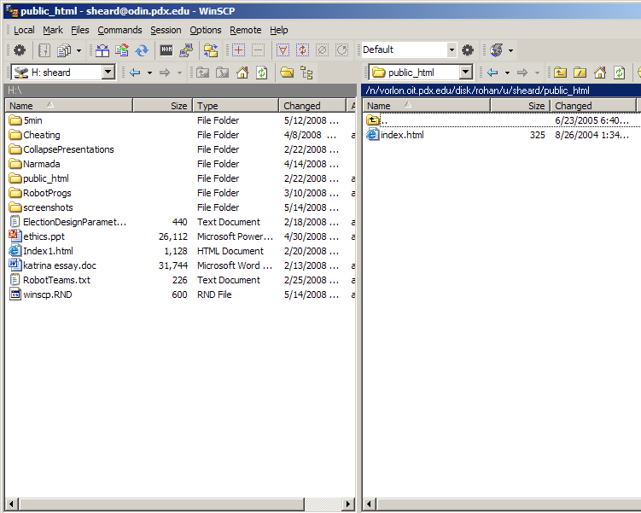
The interface
Drag and Drop
from H drive
to public_html

Slide 17
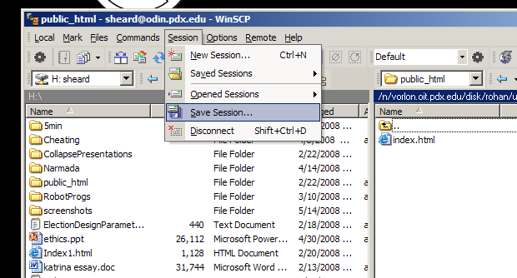
Saving your session
Save your session
The next time you
don’t have to type
all the hostname
login name
password stuff

