Slide 1
Translating to .html
tools for web page creation

Slide 2
Plugins
Several common document types are displayed using “plugins” in your browser
  word documents *.doc
  powerpoint presentations *.ppt
  portable document format *.pdf
Both *.doc and *.ppt can be converted to html so no plugins are needed

Slide 3
Why?
Advantages
  browsers without plugins can display them
  They don’t cause “pauses” while the plugins load
  Sources are uniform in their types (all html)
Disadvantages
  Some structure may be lost

Slide 4
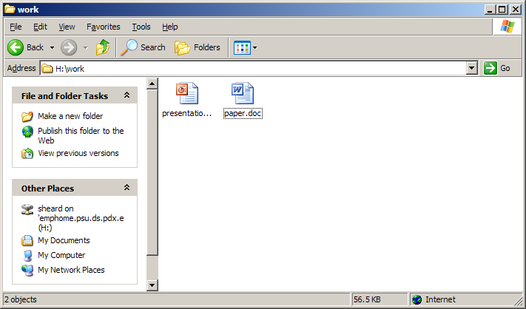
Preliminaries
First create a new directory
Make a copy of the files you want to translate.

Slide 5
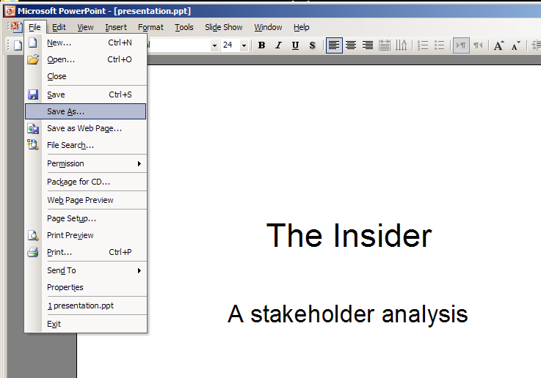
Translating powerpoint step 1
Open the powerpoint file
Choose the “save as” option in the file tab

Slide 6
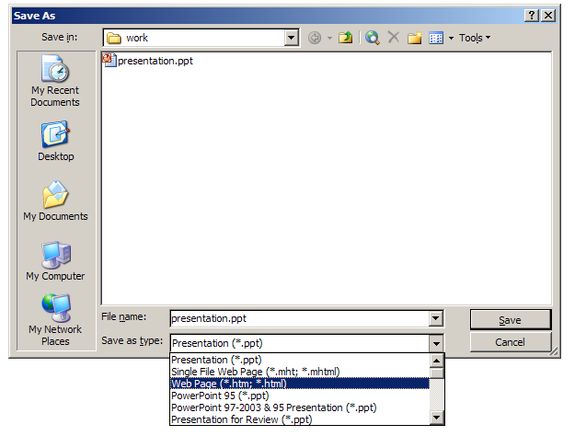
Translating powerpoint step 2
In the choose a file window that pops up select the “save as webpage” format

Slide 7
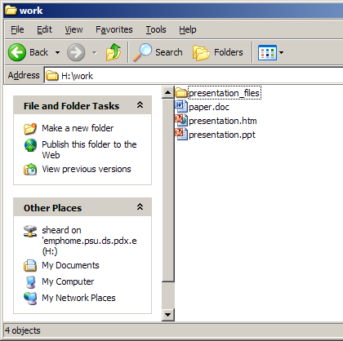
Translating powerpoint step 3
Note two things are aded to the directory
a directory called “presentation_files”
a file called “presentation.html”

Slide 8
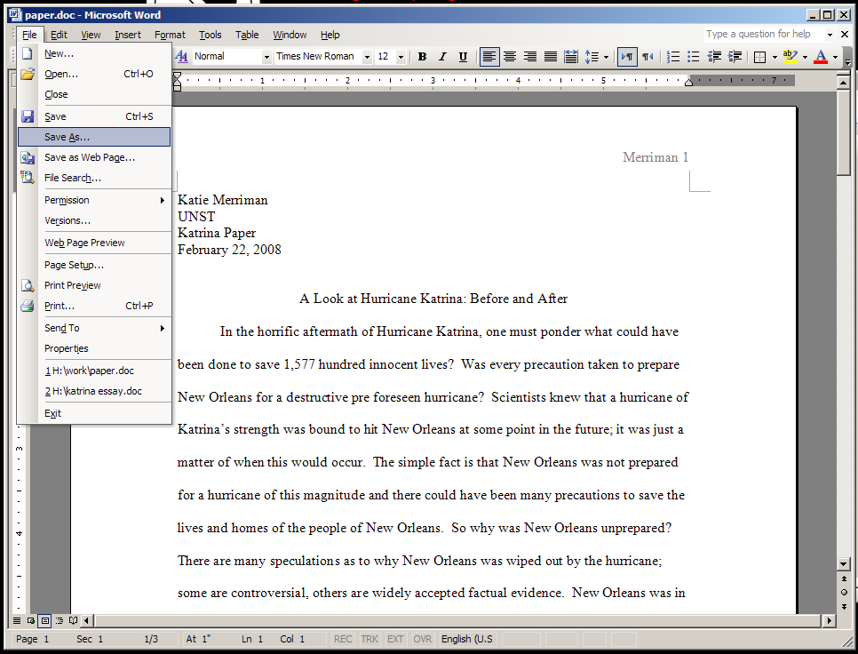
Translating word step 1
Open the word document then select the save as option from the file tab.

Slide 9
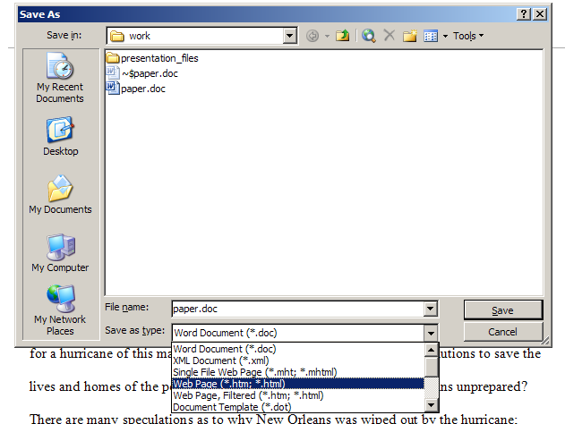
Translating word step 2
In the file selection window choose “save as webpage”

Slide 10
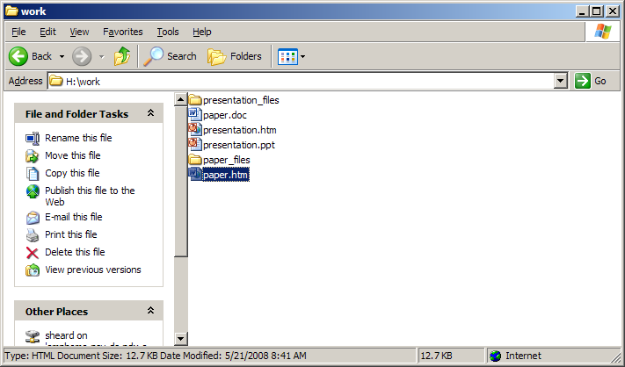
Translating word step 3
Note creation of “paper.htm” and directory “paper_files”

Slide 11
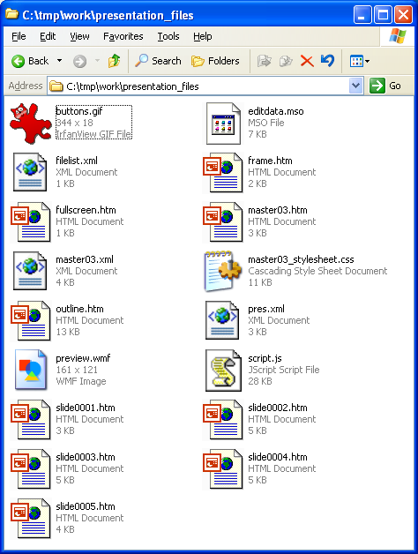
What’s inside the directories
All kinds of things.
Many are pointed to from in the file “presentation.htm” using absoulute links.
You must move the directory and the file together when you publish.

Slide 12
Using the newly created files
<title>Practice Translating</title>
<CENTER>
<BIG>Practice Translating</BIG>
</CENTER>
<p>
<UL>
<LI> <A HREF="paper.htm">paper as html</A>
<LI> <A HREF="presentation.htm">presentation as html</A>
</UL>
<p>
<A HREF="../DailyRecord.html#Today">
Back to the Daily Record.</A>
<p>
<A HREF="../index.html">
Back to the class web-page.</A>
create a html file and put links to the created files.
The links can be absolute or relative.
I used relative links because my html file is in the same directory as the translated files

Slide 13
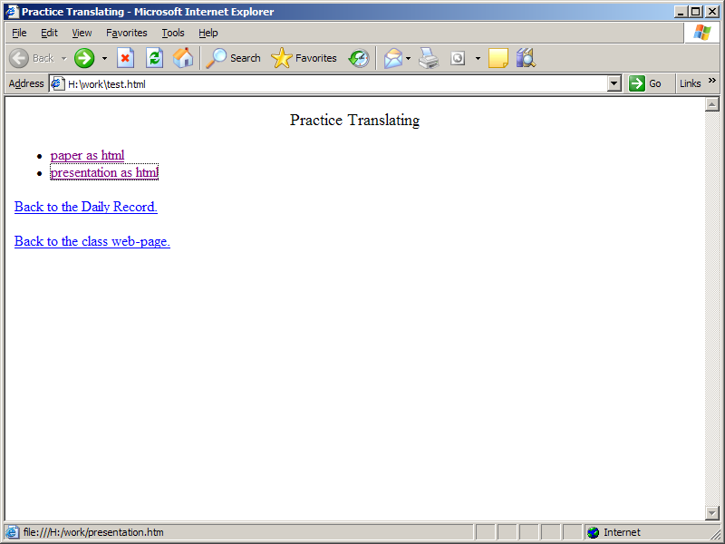
What’s it look like?

