Slide 1
Design and Society
Lecture 2
Tim Sheard

Slide 2
Tips for the day
PSU students get in free at the 5th Ave cinema.
Check the availability of labs using
  http://www.oit.pdx.edu/irs/tl/services.phtml

Slide 3
Learn the facts
Be sure you know how the following work.
Registration
Grading options
Gen Ed requirements
Choosing a major
  Course planning to get in the major of your choice
Advising
Financial aid
Over the next few weeks we will discuss each of these in turn.

Slide 4
Grading Options
A-F
  counts towards major requirements
  You are expected to do all assignments and exams
Pass – No Pass
  counts towards credit requirements, but might not count towards your major
  You are expected to do all assignments and exams
Audit
  You pay for it, but does not contribute towards graduation.
  You do not need to do any assignments.
  Essentially you buy the privilege to sit in class.
  The last day in Fall 2007 to change grading option is Nov. 9, 2007.

Slide 5
Course Planning
Have a plan
Not every class is offered every term
Follow the prerequisites
There are lots of rules
  Every department has different rules
  Ask about them when deciding what to major in.
  Rules are summarized in the “Blue-Sheets”
  One can summarize one’s own progress through the rules by using the DARS system.

Slide 6
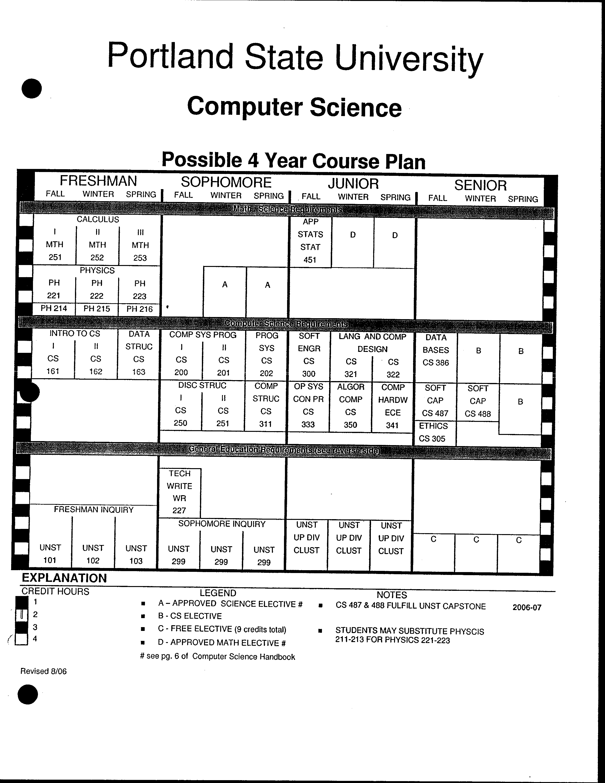
Blue
Sheets

Slide 7
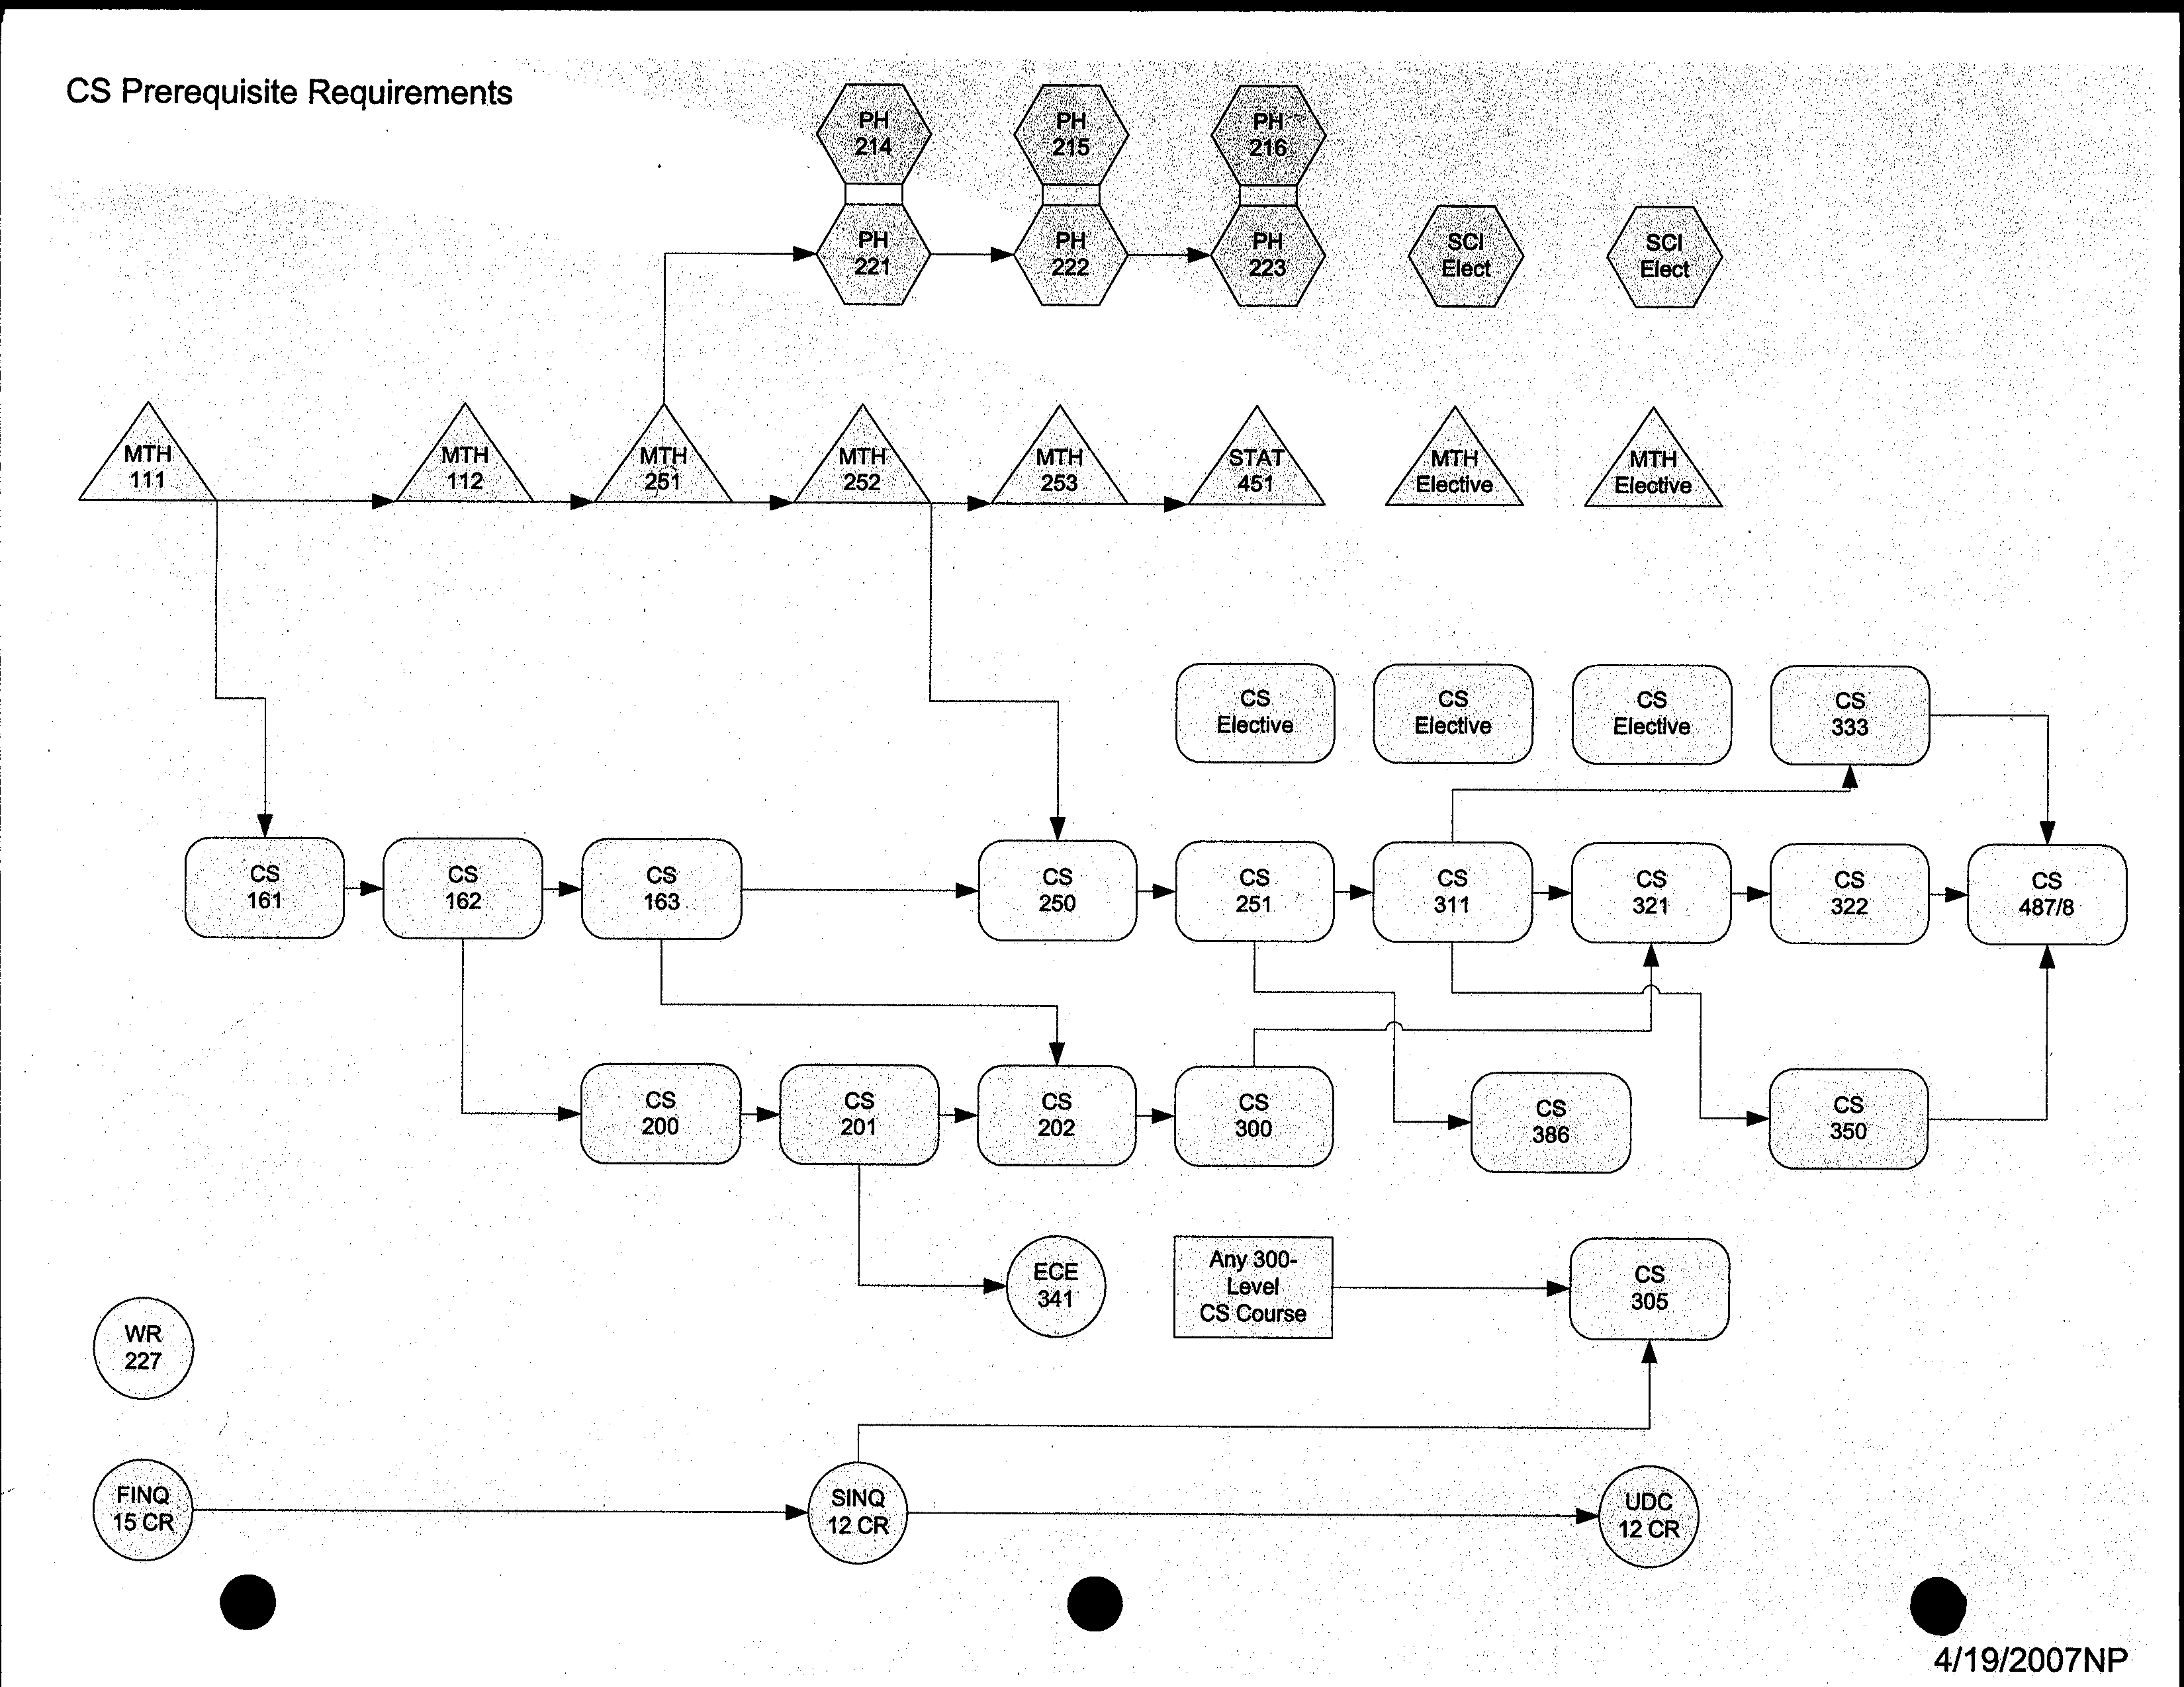
Prerequisites

Slide 8
Core Rules for Better Writing
Good writing is clear, concise, and simple.
Good writing is easy to read. A good paper educates the reader without frustrating him or her. Write to be understood, not to impress.
The “Core Rules” on the next few slides will help you write better. The rules do not cover everything that we will talk about. They do provide several important guidelines that, if followed, will dramatically improve your writing.

Slide 9
USE ACTIVE VOICE
PASSIVE VOICE: It is felt that you should re-write your final report.
  (Notice that the subject is missing.)
ACTIVE VOICE : Professor Sheard feels you should re-write your final report.
  . (The subject is explicit, so the sentence is more informative.)
PASSIVE: The glass was broken by Tim.
ACTIVE: Tim broke the glass.
  Notice that this is more concise than passive voice.)
PASSIVE: Using a probabilistic approach, speech features can be mapped using a Gaussian mixture model.
  (Again, the subject is missing.)
ACTIVE: Stylianou et al. [22] use a probabilistic approach to map speech features.
  (Including the subject is more informative.)

Slide 10
USE ACTIVE VOICE
PASSIVE: My first visit to Boston will always be remembered by me.
ACTIVE: I will always remember my first visit to Boston.
  (More concise and more forceful.) [e.g. from Strunk and White]
PASSIVE: There were a great number of dead leaves lying on the ground.
ACTIVE: Dead leaves covered the ground.
  (More concise and more forceful.) [e.g. from Strunk and White]
PASSIVE: To get advice, an expert must be consulted.
  (Subject is missing.)
ACTIVE: To get advice, you must consult an expert.
  [Dupre] (Active voice is more direct.)

Slide 11
USE ACTIVE VOICE
Active voice is more specific, and therefore more informative and clearer than passive voice. (In passive voice, the subject is often missing.)
Active voice is frequently more concise than passive voice.
Active voice is more direct and forceful.
IF YOU DO NOTHING MORE THAN CONCENTRATE ON USING ACTIVE VOICE, YOUR WRITING WILL IMPROVE!

Slide 12
ORGANIZE TO HELP THE READER
Put Key Ideas in Lead Position
Within sections of a paper (except the introduction):
Put KEY IDEAS in LEAD POSITION. The introductory paragraph in a section should summarize the key ideas in that section. The following paragraphs get more specific about the details of the key ideas. Thus the paragraphs within a section move from the general to the more specific, from the most important to the least important.

Slide 13
ORGANIZE TO HELP THE READER
Put Key Ideas in Lead Position
Within each paragraph
Put KEY IDEAS in LEAD POSITION. The first sentence in a paragraph should carry the most important ideas. The following sentences flesh out the particulars of the ideas. Thus, sentences within a paragraph move from general to more specific.

Slide 14
ORGANIZE TO HELP THE READER
Put Key Ideas in Lead Position
3.2 Application of Poisson Spike Trains. Following the diagonal arrows in the scheme, P is upregulated at each postsynaptic spike proportional to P(S-U), and downregulated at each presynaptic release proportional to (1-P)(S-U). The expected change of P at time t is obtained from the kinetic scheme according to ...
3.2 Application of Poisson Spike Trains. Next we investigate the average behavior of our spike-based learning rule when applying nonstationary Poisson spike trains. Following the diagonal arrows in the scheme, P is ...

Slide 15
ORGANIZE TO HELP THE READER
Put Key Ideas in Lead Position
The fly’s optomotor response is interesting from an engineering standpoint because it extracts relevant information from a dynamic, unstructured environment on the basis of passive sensors. The system is implemented in biological hardware that is many orders of magnitude smaller and more power efficient than charge-coupled device (CCD) imagers coupled to a conventional digital microprocessor. Flies use this visual motion information to estimate self-rotation and generate a compensatory torque response to maintain stability during flight.

Slide 16
ORGANIZE TO HELP THE READER
Put Key Ideas in Lead Position
Flies use visual motion information to estimate self-rotation and generate a compensatory torque response to maintain stability during flight. The fly’s optomotor response is interesting from an engineering standpoint because it extracts relevant information ...

Slide 17
ORGANIZE TO HELP THE READER
Put Key Ideas in Lead Position
Putting key ideas in lead position
  Helps prepare the reader for what’s coming
  Allows the reader to skim efficiently.
    Good writing is clear, concise, and simple.
    Good writing is easy to read. A good paper educates the reader without frustrating him or her.

Slide 18
DON’T MAKE
UNSUBSTANTIATED STATEMENTS
Statements of belief or of fact should be backed up either by i) a specific result of your own work or ii) explicit citations to the literature.

Slide 19
DON’T MAKE
UNSUBSTANTIATED STATEMENTS
Don’t use phrases like
“It is common knowledge ...” or “It is generally believed ...”, or “Several researchers have shown ...”.
Instead use constructs like “Hartman [23], Goolickan [24], and Brotman [25] show that ...” or “Recently several researchers have shown that ... [23,24,25].” or “Many researchers [see for example 23,24,25] believe that ...”

Slide 20
BE CONCISE
Avoid wordiness.
Instead of these Use these
due to the fact that because
in light of the fact that since
in order to to
in view of since
on behalf of for
after this is accomplished then
in case if
along the lines of like

Slide 21
BE SIMPLE
Avoid “fancy” words
Instead of these Use these
subsequently next
modification change
necessitate require
endeavor try
demonstrate show
utilize use

Slide 22
USE A CONSISTENT LEXICAL SET
Use the same word to refer to a concept throughout the paper. Don’t use “swoondigger” in one place, and “pomponicator” in another place, unless they are generally accepted synonyms. Although it may be obvious to you that these are synonymous, the reader may have doubts.

Slide 23
USE A CONSISTENT LEXICAL SET
When you make an exception and use several terms to refer to the same concept, make sure you tell your reader that you are using the terms synonymously:
“Here we use a swoondigger, or pomponticator, to force coherence between ...”

Slide 24
DEFINE TERMS WHEN
FIRST INTRODUCED
Don’t make the reader guess what you mean until the last section of the paper, where you finally get specific about your meaning of a term.

Slide 25
DEFINE TERMS WHEN FIRST INTRODUCED
Types of definitions:
  Full sentence
    The term has more than one meaning or the audience probably does not know the term, the definition is controversial (no agreed standard definition)
  Phrases
    The term has more than one meaning and you are clarifying which meaning you adopt. The audience probably does know the term, but you are including a definition to avoid ambiguity. The definition was controversial in the past.

Slide 26
AVOID SINGLE SENTENCE PARAGRAPHS
Single sentence paragraphs are usually an indication that there’s a problem with organization. Figure out where the idea belongs.
It may be that it’s not important enough to develop into its own paragraph, but doesn’t fit in one of the existing paragraphs. If that is the case, then remove it!

Slide 27
Re-Write
When you re-write (especially a section, paragraph, or sentence that you know is difficult to read) keep asking yourself “what do I really mean?” Allow yourself several passes to get rough spots really concise, really simple, and really clear.
A good way to get more concise is to ask yourself if words in a sentence, or sentences in a paragraph are helping you make the key points, or can they be discarded.

Slide 28
Core Rules for Better Writing
(Pin them to your monitor so they’re in front of you as you write!)
Use active voice.
Put KEY IDEAS in LEAD POSITION of sections and paragraphs.
Don’t make unsubstantiated statements.
Be concise.
Be simple.
Use a consistent lexical set.
Define terms when first used.
Avoid single sentence paragraphs.
Rewrite with an intent to make things simpler, more concise, and clearer.

Slide 29
Home work.
See the webCT page
Design an object, constructed using paper, scissors, a pencil, and scotch tape. The paper is 8.5" x 11.0" white copy paper. Example objects include: a paper airplane, an envelope, a greeting card, a game board, a paper cube or die, other 3- dimensional shapes, etc. Use your imagination, within the limits imposed by how much you can clearly describe in 2 pages.
Write a 2 page document describing how you can construct your design.
Following the instructions, build the design. We will do this at a later date. (Though you might want to try this at home).

