Slide 1
Design & Society
Lecture 3
The Design Process

Slide 2
Next time
On Wednesday we will do an in-class exercise on design. It will span both class and mentor sessions.
  Be prepared to go outside the class room for 30 minutes.
  Bring tools for taking notes: clipboard, pencil, etc.
  Bring a digital camera if you have one from which we can easily download pictures.
Special Opportunity
  A designer from MetroBoard will talk at 9:30 and 2:30 about the design of electric skate boards. Room TBA

Slide 3
Writing Assignment #3
I have graded the first writing assignment: Two Goals and Strategies
Writing assignment Three is to rewrite your paper, paying attention to the comments I wrote on each paper.

Slide 4
Tip of the Day
The Writing Center
  For students who need extra assistance this quarter, please recall that you can use the writing center for assistance. In addition to drop in and appointments, they have Friday workshop times, 11:00am - 1:00pm in Cramer 101.
  Students can also sign up for WR 199. This is a one credit class where they will have a standing weekly appointment with a writing center tutor. If you would like to do this you should visit the center and sign up right away.
Get in free at a PSU footbal game

Slide 5
Readings
Donald Norman's Time for a Change
Dieter Rams' Omit the Unimportant
Earnest Elmo Calkin's What Consumer Engineering Really Is
Explore our 3x5 cards
New reading assignment
  Thirty-Something (Million): Should They Be Exceptions?

Slide 6
What is Design?
Designs are the instructions, based on knowledge, that turn resources into things people use and value.
  This quote, and the following few slides are from a lecture by Carliss Y Baldwin
  http://www.cs.virginia.edu/~sullivan/SODPI07/

Slide 7
Implications of Carliss’ Definitions
Designs are not “the thing itself” they are the instructions for making it
Designs are information
Designs are part of human knowledge
  But not all knowledge is design
  Designs are what make knowledge useful
There are partial designs
  design is a process of decision making
  as we make decisions, we limit possibilities for future decisions

Slide 8
Carliss’ notion of Design Search Space
A design space comprises the set of all possible variants of a set of designs
Design spaces are bounded by prior design decisions
  Mug … w/ cap
  Pentium chip … w/ out-of-order, superscalar microarchitecture

Slide 9
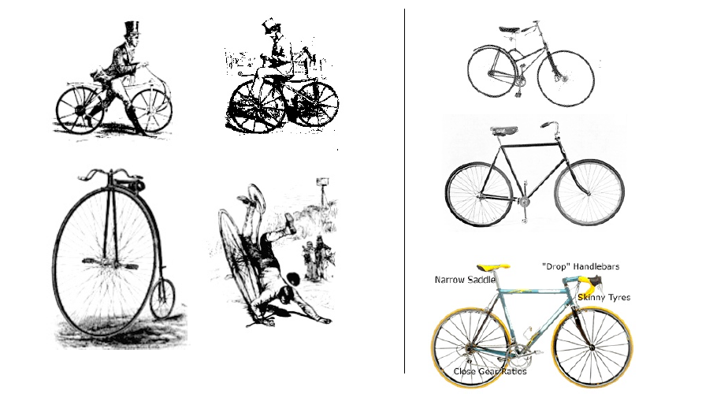
The newer the artifact, the less we know, the more exploration

Slide 10
What’s the best way to explore a design space?
Video: The Deep Dive
The following slides thanks to Betsy Natter

Slide 11
Design as a Skill
Design is a complex technique that can be studied and perfected.
“To regard thinking as a skill rather than a gift is the first step towards doing something to improve that skill.”
- Edward de Bono, Practical Thinking

Slide 12
IDEO’s Design Process
Market
Client
Technology
Constraints
Understand
Later challenge perceived
constraints.
Observe
Real people in real situations
Visualize
New-to-the-world concepts and
customers. Simulate.
Evaluate and Refine
Prototype
Quick iterations. Series of
Improvements.
Implement
Ready for commercialization.

Slide 13
Our version of IDEO’s Design Process
Our Outputs
Market
Client
Technology
Constraints
Understand
Problem Statement
Observe
User Needs Determine Criteria
Design Alternatives
Prototypes or sketches
Visualize
Evaluate and Refine
Prototype
Use Pugh Process to Evaluate and Refine. Select best alternative.
Implement
Document final design
and process.

Slide 14
Step 1: Understand
Understand: Market, client, technology and constraints
Do not assume the solution.
  Bad statement: “design a toy vacuum”
  Good statement: “Kids have lots of little toys all over the floor. They need an easy way to pick them up and store them.”
Focus on action. Verbs.
  What does it need to DO?
Get agreement from stakeholders.
Output = Problem Statement

Slide 15
Ideas
Document idea list. Each should have a problem statement.
  Not “thermos”, but
  “need to transport hot liquids and be able to drink at school”
The chosen idea needs a few sentences of explanation.

Slide 16
Step 2: Observe
Observe real users in real-life situations.
  Focus on actions.
  Consider the environment.
  See what comes naturally to people.
Don’t
  ask people what they do or what they want.
  rely on market surveys or focus groups.
  Assume you already know the solution
There are no dumb questions.
Find rule breakers. Who does it differently?
Document observations. Photos, descriptions, summaries.

Slide 17
Good observations
Photos are the easiest and most effective way to document observations.
Descriptions should be specific and should be what you actually saw. Not what you think.
  Younger woman getting on bus. Carrying purse and with large backpack on back. Set purse down at her feet, took backpack off awkwardly and searched through front pocket to find change. Carried backpack by top handle in the same hand as purse strap as she moved to a seat. Sat down and placed backpack at her feet and purse on lap.

Slide 18
Observations ➔ Criteria
Observation | Criteria
Kids have little hands. | Need large buttons, etc.
Kids don’t like picking up. | Needs to be fun and easy.
Hard to pick up little things like Legos. | Quickly pick up small items.
Kids don’t read directions. | Operations must be self-evident. Can’t let kids get hurt if they do the wrong thing. Easy. Safe.
Short attention span. Easily distracted. | Same as above. Easy and quick.
Smaller kids use larger motions (i.e. hands instead of fingers.) | Large buttons.

Slide 19
Other criteria
Always consider Universal Design Principles. Only discard if they don’t match at all.
  Define what they mean to your design.
  Equitable use: kids of different sizes or ages, adults, kids in wheelchairs, blind, …?
Always consider cost.
Always consider safety.
Usually consider aesthetics. (Looks, etc.)

Slide 20
Universal Design
The design of products and environments to be usable by all people, to the greatest extent possible, without the need for adaptation or specialized design.

Slide 21
Universal Design
Equitable Use
The design is useful and marketable to people with diverse abilities.
Flexibility in Use
The design accommodates a wide range of individual preferences and abilities.
Simple and Intuitive Use
Use of the design is easy to understand, regardless of the user's experience, knowledge, language skills, or current concentration level.

Slide 22
Universal Design
Perceptible Information
The design communicates necessary information effectively to the user, regardless of ambient conditions or the user's sensory abilities.
Tolerance for Error
The design minimizes hazards and the adverse consequences of accidental or unintended actions.

Slide 23
Universal Design
Low Physical Effort
The design can be used efficiently and comfortably and with a minimum of fatigue.
Size and Space for Approach and Use
Appropriate size and space is provided for approach, reach, manipulation, and use regardless of user's body size, posture, or mobility.

Slide 24
Step 3: Visualize
To “visualize” IDEO uses things like storyboards, videos, prototypes, etc.
The result is design alternatives.
Very effective, but may not be practical for this brief exercise.
We’ll mostly use sketches to document our design alternatives. A model, prototype, Photoshop image, or CAD rendering would be excellent if you prefer.

Slide 25
Design Alternatives
A design alternative is not a feature.
Features: Big buttons. Automatic turn-off. Shaped like rocket. Removable containers for storage.
An alternative includes various features.
  Alternative 1: Rocket shaped toy vacuum with removable containers for storage.
  Alternative 2: Rolling scoop made of plastic.
  Alternative 3: Scoop connected to detachable storage.
  Alternative 4: Small version of shop vac.
To fully convey description and a sketch.2

Slide 26
Step 4: Evaluate and Refine
How to judge which alternative is the best?
Need to evaluate objectively and communicate the results clearly to client.
  Use well-defined criteria.
Optimization of Numerical Criteria. (i.e. cost should be as low as possible)
Weighting of Subjective Criteria (how do you judge looks? How important?)
Decision Making Process: Pugh process

Slide 27
1-5, 1=best | Rocket Vacuum | Rolling scoop | Scoop w/ storage | Mini shop-vac
Cost | 4 | 1 | 2 | 3
Safety | 3 | 1 | 1 | 3
Looks | 1 | 4 | 4 | 2
Easy | 3 | 1 | 2 | 2
Picks up toys quickly | 1 | 3 | 2 | 1
Fun for kids | 1 | 4 | 3 | 2
Total | 13 | 14 | 14 | 13

Slide 28
Evaluation
These results are not helpful, as everything looks the same.
I wanted the rocket vacuum to win. Why didn’t it?
Because in my mind I think that fun, easy and quick are the important things. Otherwise it won’t get used and will be pointless.
So maybe I should weight those more heavily.
Also, I may need to re-design the rocket vac alternative so that it is just as easy to use.
I also may need to add safety features.
Then re-evaluate.

Slide 29
Try again
1-5, 1=best | Rocket Vacuum | Rolling scoop | Scoop w/ storage | Mini shop-vac
Cost (1-5) | 4 | 1 | 2 | 3
Safety (1-5) | 3 | 1 | 1 | 3
Looks (1-5) | 1 | 4 | 4 | 2
Easy (1-5) | 2 | 1 | 2 | 2
Picks up toys quickly (1-10) | 1 | 6 | 8 | 2
Fun for kids (1-10) | 1 | 6 | 8 | 3
Storage capability (1-5) | 1 | 5 | 3 | 5
Total | 13 | 24 | 28 | 20

Slide 30
Step 5: Implement
Importance of documentation:
  Needed to convey all information to the client.
  Shows how and why the decisions were made.
  Allows feedback on inputs as well as outputs.
  More choices, more likely to get good results.
Typically each step will be documented and reviewed.
Record of Problem Definition, Solution Generation, Decision Making stages
Our Outputs: Written Documentation and Design Show Advertisement

