Slide 1
Design and Society
Lecture 5
Tim Sheard

Slide 2
Reading
Thirty-Something (Million): Should They Be Exceptions?
3x5 cards - discussion

Slide 3
IDEO’s Design Process
Market
Client
Technology
Constraints
Understand
Later challenge perceived
constraints.
Observe
Real people in real situations
Visualize
New-to-the-world concepts and
customers. Simulate.
Evaluate and Refine
Prototype
Quick iterations. Series of
Improvements.
Implement
Ready for commercialization.

Slide 4
Step 4: Evaluate and Refine
How to judge which alternative is the best?
Need to evaluate objectively and communicate the results clearly to client.
  Use well-defined criteria.
Optimization of Numerical Criteria. (i.e. cost should be as low as possible)
Weighting of Subjective Criteria (how do you judge looks? How important?)
Decision Making Process: Pugh process

Slide 5
1-5, 1=best | Rocket Vacuum | Rolling scoop | Scoop w/ storage | Mini shop-vac
Cost | 4 | 1 | 2 | 3
Safety | 3 | 1 | 1 | 3
Looks | 1 | 4 | 4 | 2
Easy | 3 | 1 | 2 | 2
Picks up toys quickly | 1 | 3 | 2 | 1
Fun for kids | 1 | 4 | 3 | 2
Total | 13 | 14 | 14 | 13

Slide 6
Evaluation
These results are not helpful, as everything looks the same.
I wanted the rocket vacuum to win. Why didn’t it?
Because in my mind I think that fun, easy and quick are the important things. Otherwise it won’t get used and will be pointless.
So maybe I should weight those more heavily.
Also, I may need to re-design the rocket vac alternative so that it is just as easy to use.
I also may need to add safety features.
Then re-evaluate.

Slide 7
Try again
1-5, 1=best | Rocket Vacuum | Rolling scoop | Scoop w/ storage | Mini shop-vac
Cost (1-5) | 4 | 1 | 2 | 3
Safety (1-5) | 3 | 1 | 1 | 3
Looks (1-5) | 1 | 4 | 4 | 2
Easy (1-5) | 2 | 1 | 2 | 2
Picks up toys quickly (1-10) | 1 | 6 | 8 | 2
Fun for kids (1-10) | 1 | 6 | 8 | 3
Storage capability (1-5) | 1 | 5 | 3 | 5
Total | 13 | 24 | 28 | 20

Slide 8
Step 5: Implement
Importance of documentation:
  Needed to convey all information to the client.
  Shows how and why the decisions were made.
  Allows feedback on inputs as well as outputs.
  More choices, more likely to get good results.
Typically each step will be documented and reviewed.
Record of Problem Definition, Solution Generation, Decision Making stages
Our Outputs: Written Documentation and Design Show Advertisement

Slide 9
Variations in the Process
Do all designs follow this exact process?
  Every “design process” looks slightly different.
  More or less detail may be required.
  Good design processes will have multiple feedback loops. Almost never a linear process.
Many commonalities do exist across various design fields and throughout the history of design.
A systematic and defined design process will generally lead to better and more well-considered solutions than a random method.
These techniques apply equally well to other types of problem solving.

Slide 10
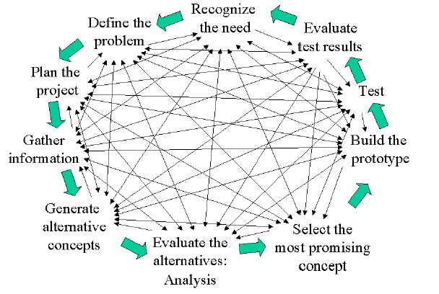
Another Version of a Design Loop
Document the Process
From Introductory Engineering Design

Slide 11
The Systems Approach
Objectives
Criteria
Resources
Constraints
-Do not assume the problem.
-Agreement between stakeholders
on the problem statement.
Define Problem
ID Alternatives
-Do not reject any solution
without documentation.
Evaluate Alternatives
-Iterative screening with stricter
criteria.
-Trade studies between solutions.
-Decision making process
Select Solution
-Risk of producing right solution
for wrong problem increases if
method undocumented.
-Original decisions may not be valid.
-Problem may not be static.
Document Process
Next Step
Define Problem

Slide 12
IDEO vs System Approach
Objectives
Criteria
Resources
Constraints
Market
Client
Technology
Constraints
Define Problem
Understand
ID Alternatives
Observe
Evaluate Alternatives
Visualize
Select Solution
Evaluate and Refine
Prototype
Document Process
Implement
Next Step
Define Problem

