Slide 1
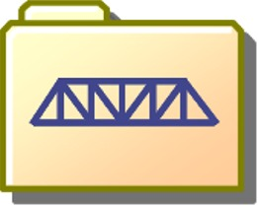
Designing and Building
File-Folder Bridges as an Introduction to Engineering Design
Much of the material from:
COL Stephen Ressler, P.E., Ph.D.
Department of Civil & Mechanical Engineering
U.S. Military Academy, West Point

Slide 2
Why Study Bridges?
Apply design process.
Large structures need additional design steps, primarily for safety concerns.
  Cannot build multiple real structures to test.
  Cannot test until finished building.
Designs like this need:
  Computer simulation using physical principles to allow quick and inexpensive testing of alternate designs.
  Real world data to put into computer model (e.g. strength of materials) to ensure accuracy.
  Models to verify that computer simulation is correct.
  Means of comparing the model data to the real structure.
Learn more about forces.

Slide 3
Why use file folders?
Inexpensive.
Easy to work with.
Can make tubes, bars, and gussett plates that look and act like bridge structures.
Behavior is predictable and compares surprisingly well to steel.
Members are stronger than joints, like in real bridges.

Slide 4
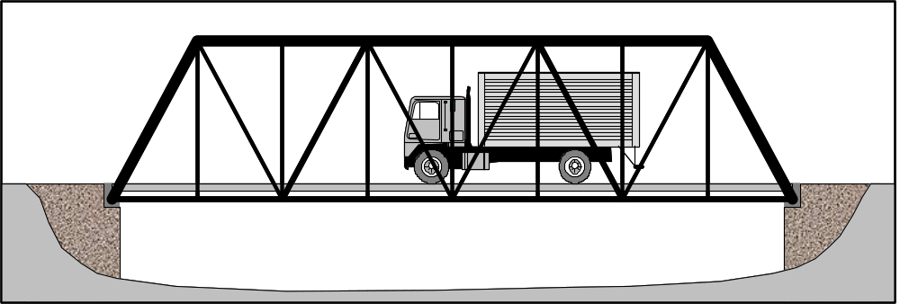
What is a Truss?
A structure composed of members connected together to form a rigid framework.
Usually composed of interconnected triangles.
Members carry load in tension or compression.

Slide 5
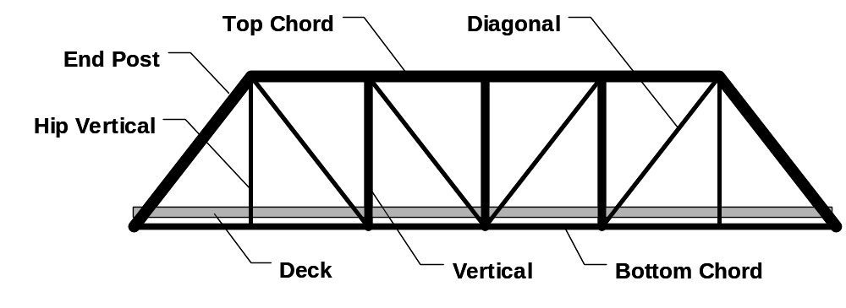

Component Parts
Support (Abutment)

Slide 6
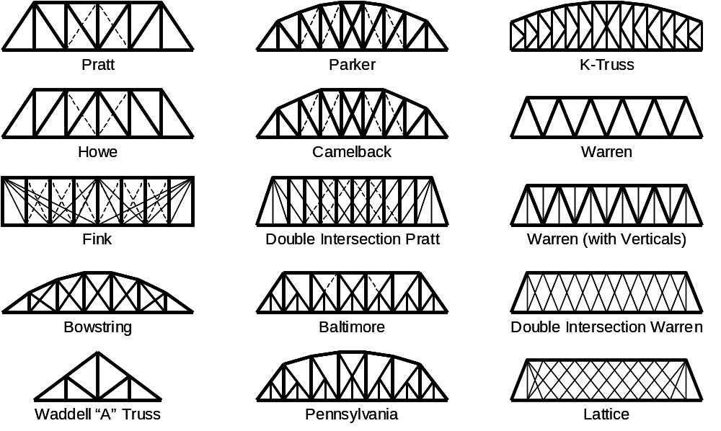
Standard Truss Configurations

Slide 7
Overall Plan
Activity #1: Build a model of a truss bridge using file folders.
Activity #2: Test the strength of structural members.
Activity #3: Analyze and evaluate a truss. (Extra credit.)
Activity #4: Design a truss bridge with a computer.
Activity #5: Build a model truss bridge using your own design.

Slide 8
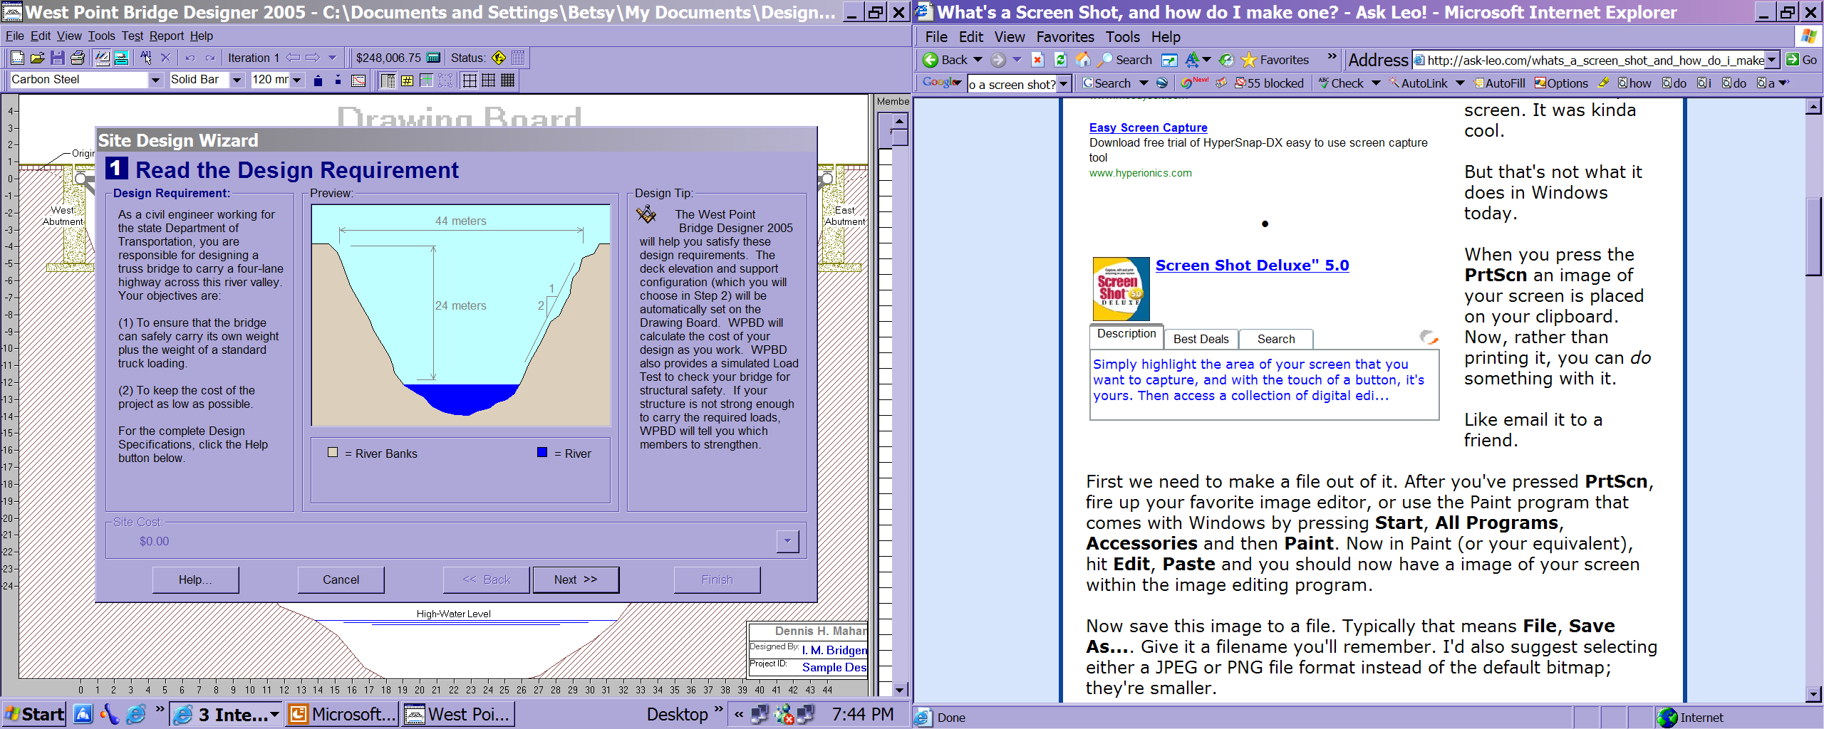

Slide 9
Activity 1
Activity #1: Build a model of a truss bridge using file folders.
  Learn bridge terminology.
  Learn construction techniques.
    How to construct members.
    How to follow plan.
    How to turn into 3-D design.
  Important when designing and building your own bridge.

Slide 10
Activity 2
Activity #2: Test the strength of structural members.
  Make structural members out of cardboard.
    Different size tubes.
    Different size bars.
  Test the strength under compression and tension. (Test to failure.)
  Analyze and plot data.
  Learn what affects strength.
  Data will be used in scaling your final design from steel to paper to ensure your bridge can carry the load.

Slide 11
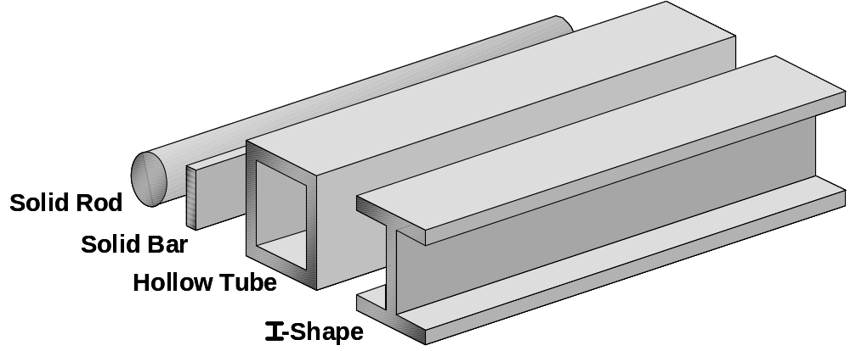
Types of Structural Members
These shapes are called
cross-sections.

Slide 12
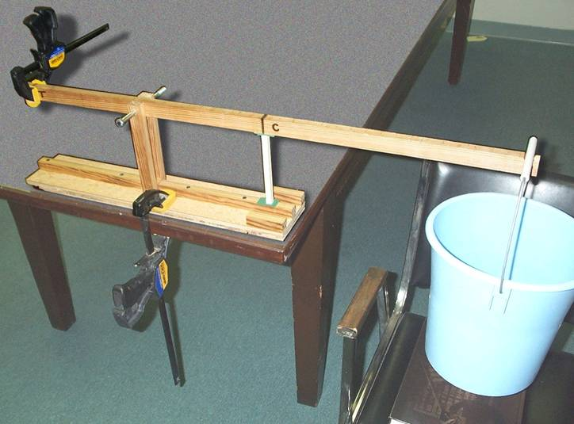
Testing Compressive Strength
The test setup.

Slide 13
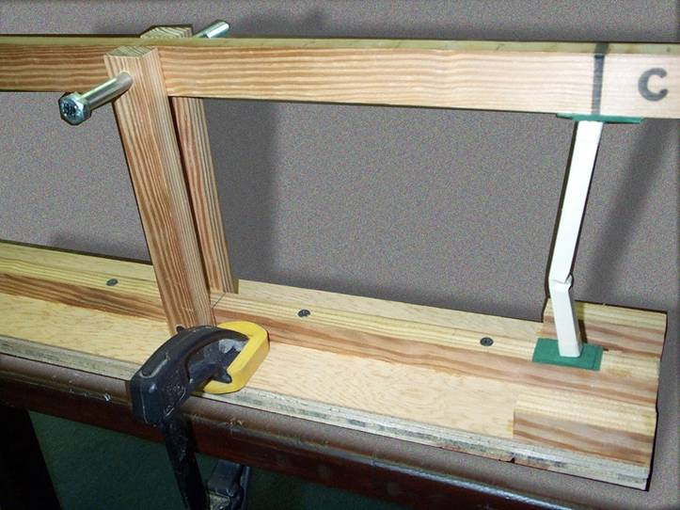
Testing Compressive Strength
A compression specimen at failure.

Slide 14
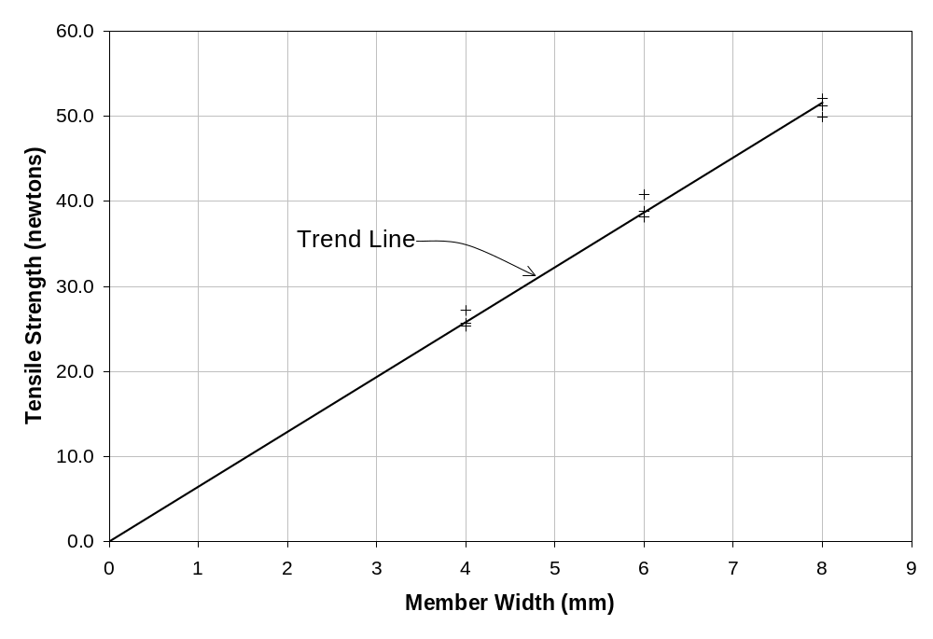
Graph the Results
Data analysis results summarized
in memo to the city.

Slide 15
Forces, Loads, & Reactions
Force – A push or pull.
Load – A force applied to a structure.
Reaction – A force developed at the support of a structure to keep that structure in equilibrium.
Self-weight of structure, weight of vehicles, pedestrians, snow, wind, etc.
Forces are represented mathematically as
VECTORS.

Slide 16
Activity 3: Analyze and Evaluate a Truss
May not do, but will at least discuss.
Determine internal forces of compression and tension in the members of a bridge.
Evaluate the safety of a bridge by comparing these forces to the strength of materials we found in Activity 2.
The software will do this analysis for us when we design our own bridges.

Slide 17
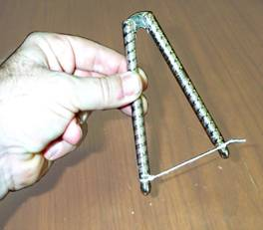
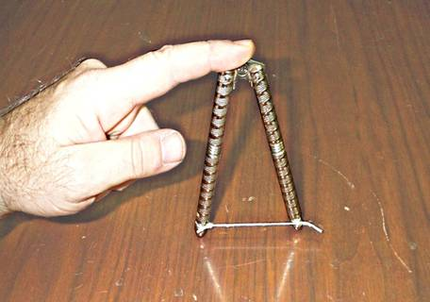
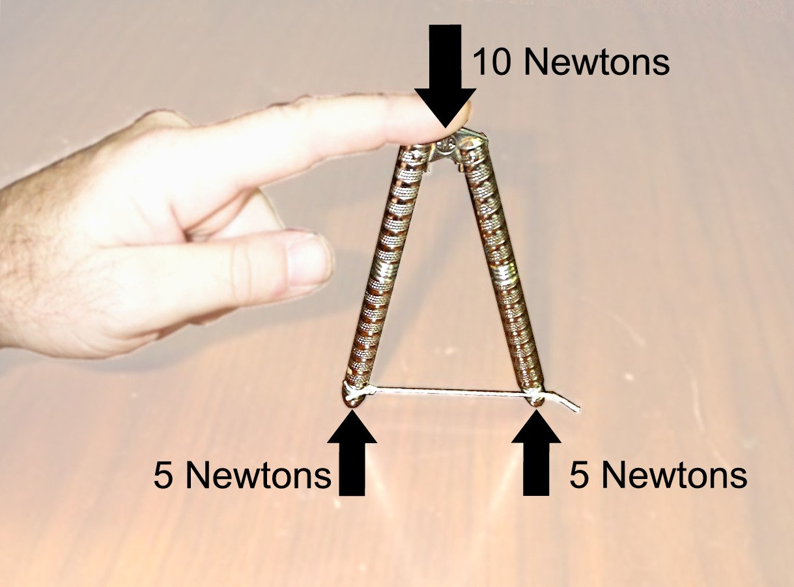
Equilibrium
Newton’s First Law:
An object at rest will remain at rest,
provided it is not acted upon by an unbalanced force.
A Load...
...and Reactions

Slide 18
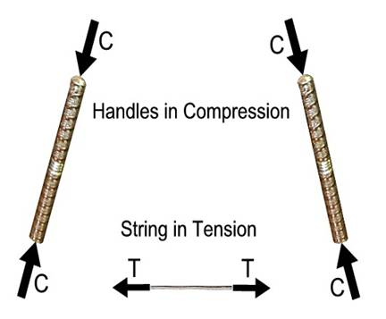
Tension and Compression
EXTERNAL FORCES and INTERNAL FORCES
Must be in equilibrium with each other.

Slide 19
Tension and Compression
An unloaded member experiences no deformation
Tension causes a member to get longer
Compression causes a member to shorten

Slide 20
Activity 4: Design a truss bridge with a computer
Use West Point Bridge Designer Software.
  Allows for quick and easy design of truss bridges.
  Specific goal given. (Span, weight, cost, etc.)
  Performs test to see if bridge fails.
  Shows the forces in different members to allow identification of weak points.
We will generate multiple successful designs.
After comparing designs each team will choose the best.

Slide 21
The West Point Bridge Designer
Look and feel of a standard CAD package.
Easy to create a successful design.
Hard to create a highly competitive design.
Highly successful:
  Over 150,000 copies downloaded since 2000.
  Two major national software awards.
  Formally endorsed as an educational tool by the American Society of Civil Engineers.
Runs on Windows 95 (or later) PC.
Can download to your own computer.

Slide 22
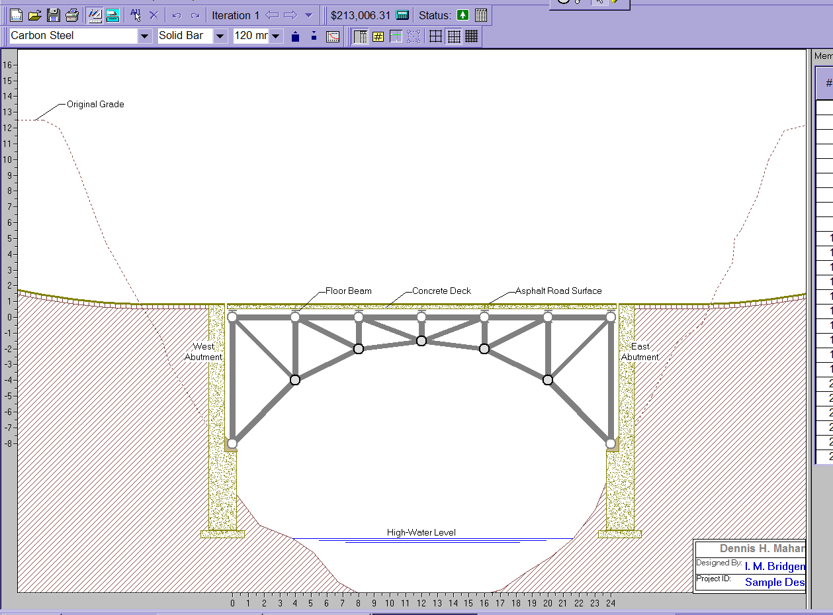
Design bridge by choosing location of members.
Also choose type (cross-section) and size of members.

Slide 23
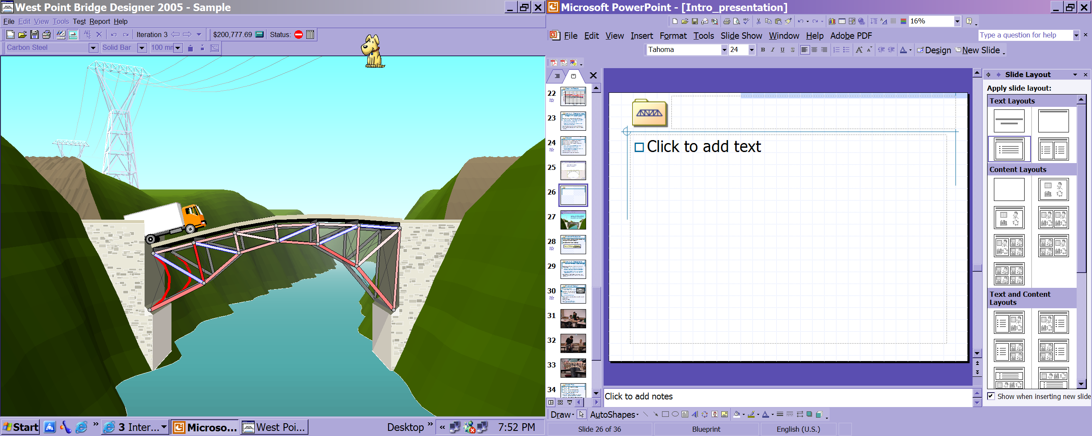
Program tests behavior under load
and calculates the maximum force
experienced by each member.
Woops! Some members weren’t
strong enough.

Slide 24
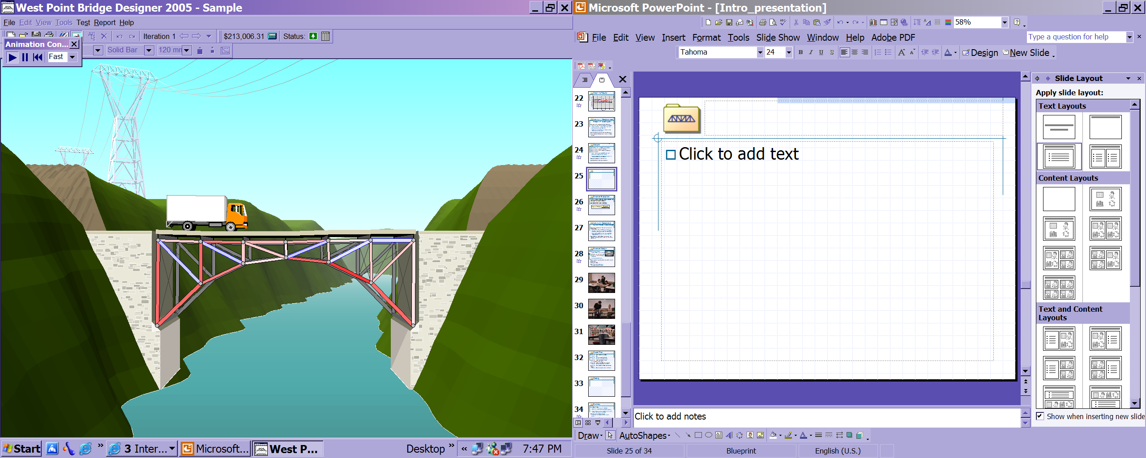
Easy to optimize with quick iterations.
I strengthened the members that failed.

Slide 25
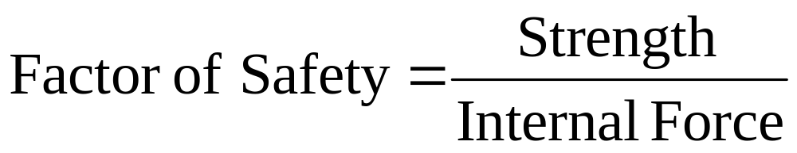
Structural Evaluation
Our paper isn’t exactly the same as steel.
We need to determine if our model bridge can carry the weight before building!
Is the internal member force less than the strength for each member?
Calculate the Factor of Safety:

Slide 26
Activity 5: Design and build a model truss bridge
Using our own designs from Activity 4 we will build bridges.
  Same construction techniques as in Activity #1.
  Use data from Activity #2 to ensure that individual members will not break under the applied force.
  Data analysis needed to scale from a steel bridge with trucks driving across to a paper bridge with applied weight.
Test bridges. (Will be done finals week. No final, but will need to be in class for the testing and party.)

Slide 27
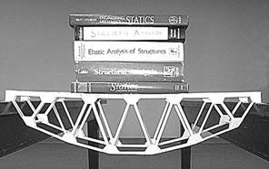
Structural Design
Design Requirements:
  Span, loading, factor of safety
Decide on truss configuration.
Perform a structural analysis.
  Reactions
  Internal member forces
Select member sizes based on required strength.
Draw plans.
Build the bridge.
Test – Can the bridge carry
the required loading safely?

Slide 28
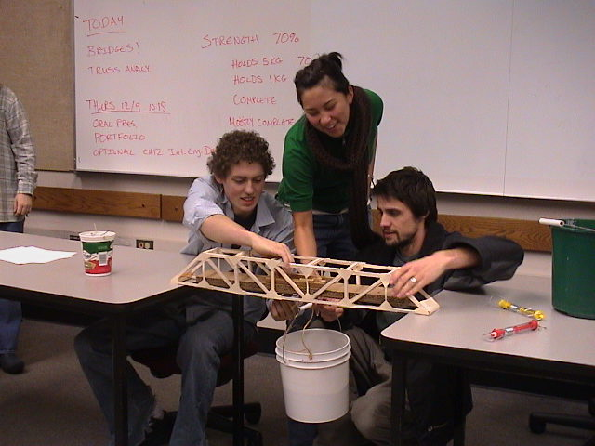

Slide 29
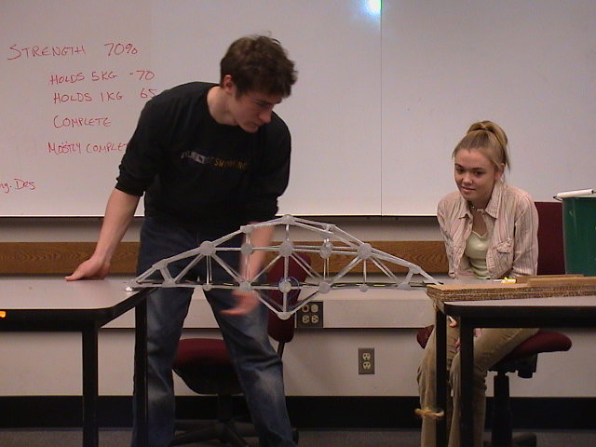

Slide 30
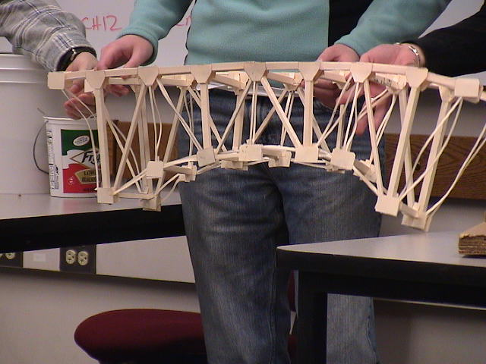

Slide 31
Grading
 | Output | Grade
Activity 1: Model | Bridge | 5% (team)
Activity 2: Test members | Component Memo | 25% (individual)
Activity 4: Design bridge. | Pugh evaluation | Graded with final output.
Activity 5: Build and test. | Bridge Web document | 10% 30% (team)
 | Participation | 10% team 10% individ.
 | Reflection | 10% (individ.)

Slide 32


Summary
File-folder bridges:
  Accurate representation of real bridges
  Vehicle for learning engineering design concepts.
  Design based on authentic applications of math, science, and computer technology.
The West Point Bridge Designer:
  Experience the engineering design process.
  Free!
The West Point Bridge Design Contest:

