Slide 1
Using the Bridge Designer
Scaling your Bridge
Design and Society
Nov 19, 2007
Tim Sheard

Slide 2
Writing course to consider
Next term's introductory writing course offerings are listed below. In addition, the Writing Center will continue to offer the 1-credit WR199 -- one-on-one tutoring for one hour each week. To register, students should contact Matthew Hein at hein@pdx.edu.
44247 WR 115 001 INTRO COLLEGE WRIT MWF10:15-11:20
44248 WR 115 002 INTRO COLLEGE WRIT TR10:00-11:50
44250 WR 115 003 INTRO COLLEGE WRIT MW14:00-15:50
44619 WR 115 F01 INTRO COLLEGE WRIT MWF09:00-10:05 44251 WR 121 001 COLLEGE WRITING TR10:00-11:50
44255 WR 121 002 COLLEGE WRITING MWF11:30-12:35
44256 WR 121 003 COLLEGE WRITING TR12:00-13:50
44252 WR 121 004 COLLEGE WRITING MW16:40-18:30
44257 WR 121 005 COLLEGE WRITING MWF10:15-11:20
44620 WR 121 006 COLLEGE WRITING TR14:00-15:50
44254 WR 121 F01 COLLEGE WRITING MWF14:00-15:05
44258 WR 199 005 SPST: GRAMMAR REFRESHER 14:00-15:50

Slide 3
Today’s Lecture
Overview of the design project
Using the “Bridge Designer” software
Scaling your bridge
Tips for building your bridge

Slide 4
Overview of the design project
Activity 4.
  Design a bridge according to the rules laid out in the assignment.
Activity 5.
  Transfer and scale your design, so it can be made out of paper.
Record the steps you take so you can use the design in your write up.
A detailed Assignment will be posted on the daily record.

Slide 5
Activity 4
Design requirements: Steel bridge
Loads. Bridge must carry:
  Weight of reinforced concrete deck.
  Weight of 5-cm thick asphalt wearing surface.
  Weight of steel floor beams and bracing members (12.0 kN at each joint.)
  Weight of main trusses. (see cost sheet)
  Weight of standard H20-44 truck loading.
  Note that the bridge designer takes these into account for you.

Slide 6
Design requirements: Steel bridge
No piers! Must be self-supporting between the ends.
Design 32m span in bridge designer.
  To get this you need to excavate.
  Deck elevation will be 12 meters.
Reinforced concrete deck 15cm thick, supported by transverse floor beams spaced at 4m intervals.
Must have a row of joints spaced 4 meters apart at the level of the deck.
  This is the default on the program.
Bridge 16m wide to accommodate 4 lanes of traffic.
Factor of safety >=2.
Want low cost (material, connections, product, site)
  See book or help for optimation techniques.
You must choose this
The program does this
Your job

Slide 7
Activity 5:
Build a model truss bridge
(from your design from Activity 4)
Using our own designs from Activity 4 we will build bridges.
  Same construction techniques as in Activity #1.
  Use data from Activity #2 to ensure that individual members will not break under the applied force.
  Data analysis needed to scale from a steel bridge with trucks driving across to a paper bridge with applied weight.
Test bridges. (Will be done finals week. No final, but will need to be in class for the testing and party.)

Slide 8
Turning your design into a Paper bridge
Turn into 0.8m bridge in paper (1/40 reduction)
Bridge must hold at least 5kg.
We’ll design the bridge to hold 10kg which will automatically give us the safety factor of 2.
  Note that the book scales the individual members.
Materials: file folders and glue only. Must use size/shapes available in software.
Cross-sections: solid bars or hollow tubes, rectangular cross-section only.
Construction techniques should be essentially the same as for Activity 1, but optimization of technique is possible.

Slide 9
Documentation Requirements
You must document the process as well as the final result. This will appear in your write up.
Remember to save your final 4 design alternatives (this is across your team).
  Save actual design to your h: drive.
  Save screen prints. (e.g. in Word file)
  Save output tables (in Excel, or copy into Word)
Compare alternatives (Pugh process).
Justify (in words) your selection and how you chose and weighted the different criteria.
Your bridge must match your documentation.
You will need to take some pictures.
A detailed description will be posted on the Daily Record.

Slide 10
Activity 5 Overview
Decide on a truss configuration.
Create the structural model.
Bridge designer will:
  Check static determinacy and stability.
  Calculate reactions.
  Calculate internal member forces.
Determine member sizes. (iterative)
Check member sizes for constructability and strength.
Draw plans.
Create a schedule of truss members and a schedule of gusset plates.
Build members.
Assemble the bridge.

Slide 11
Activity 4:
Using the Bridge Designer
There are several sources of help
  This set of notes
  The book that you can download free
  The demonstration in class today
  Your classmates in sessions on Wednesday where a large portion of class time will be devoted to using the software.

Slide 12
Design a truss bridge with a computer
Use West Point Bridge Designer Software.
  Allows for quick and easy design of truss bridges.
  Specific goal given. (Span, weight, cost, etc.)
  Performs test to see if bridge fails.
  Shows the forces in different members to allow identification of weak points.
Each team will generate multiple successful designs. Each person must develop at least 1 design. Each write up will compare 4 designs.
  Save designs! Use h: drive.
  Save screen print and load test results.
After comparing designs using the Pugh process each team will choose the best to build.

Slide 13
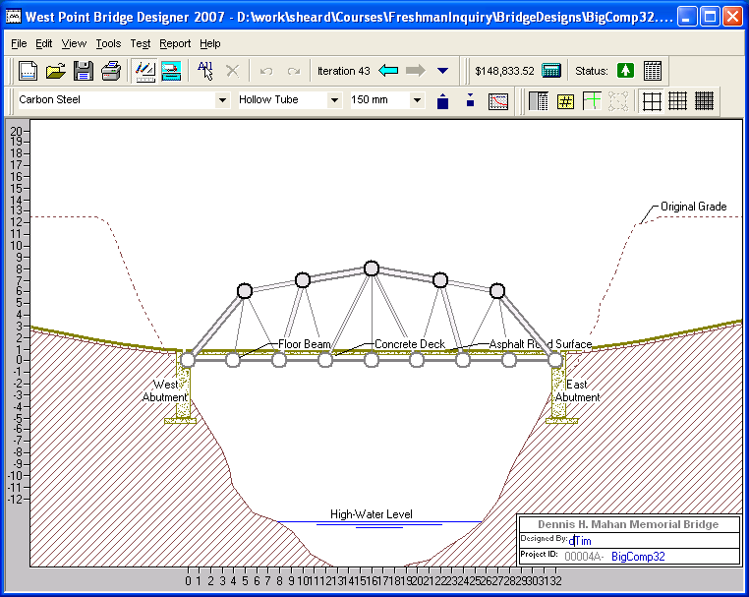
Design bridge by choosing location of members.
Also choose type (cross-section) and size of members.

Slide 14
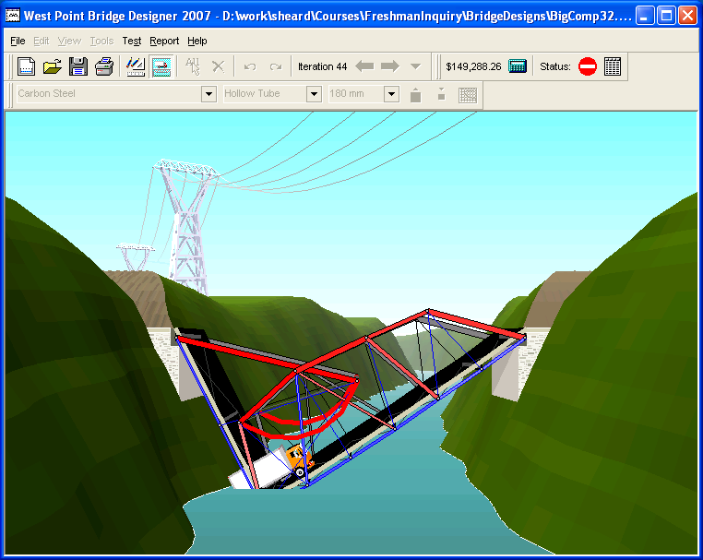
Program tests behavior under load and calculates the maximum force experienced by each member.
Woops! Some members weren’t strong enough.

Slide 15
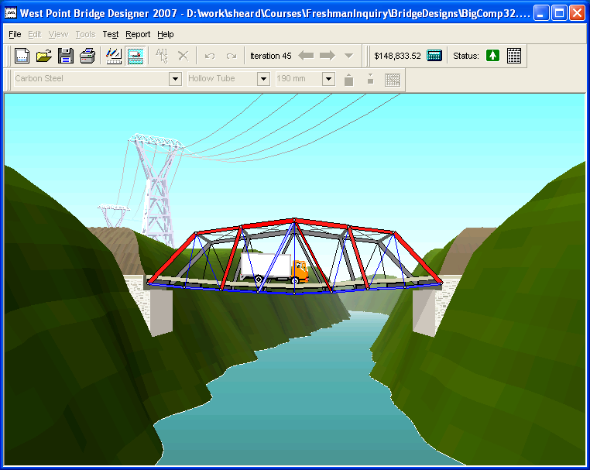
Easy to optimize with quick iterations.
I strengthened the members that failed.

Slide 16
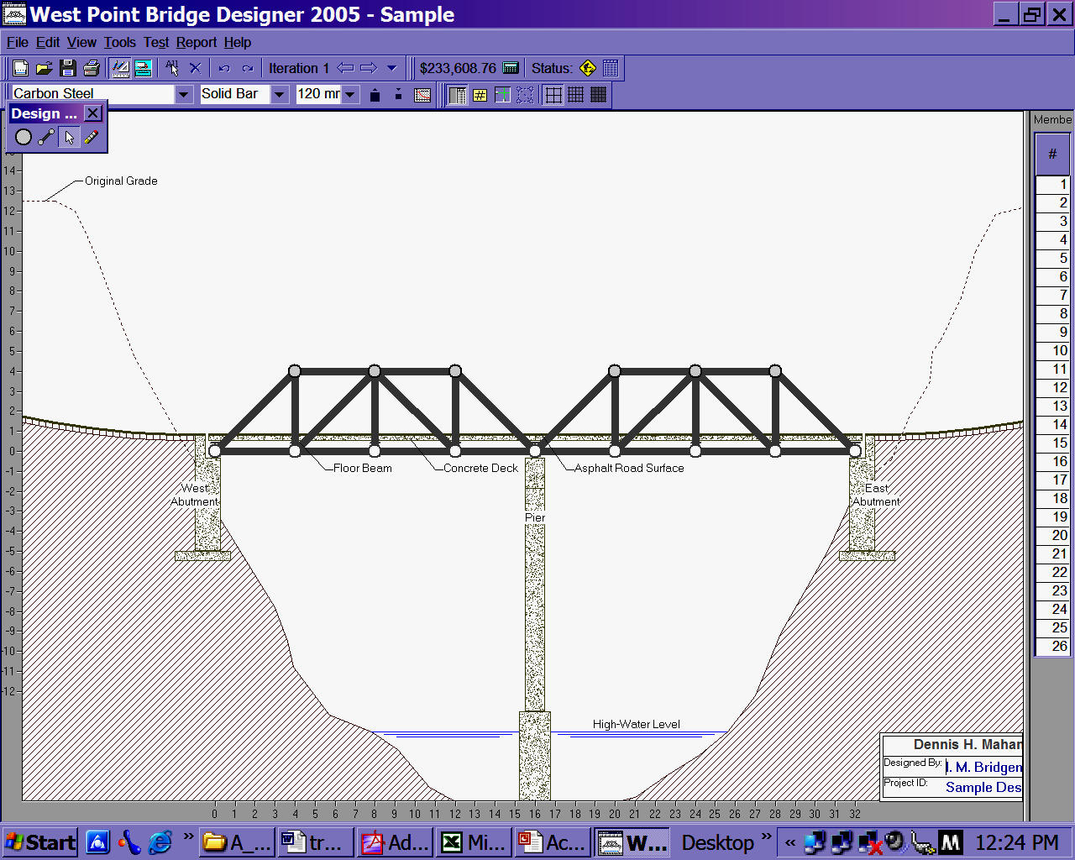
Sample bridge: why isn’t this OK for us?
Do load test.
Then view report.
Cost
Member 1

Slide 17

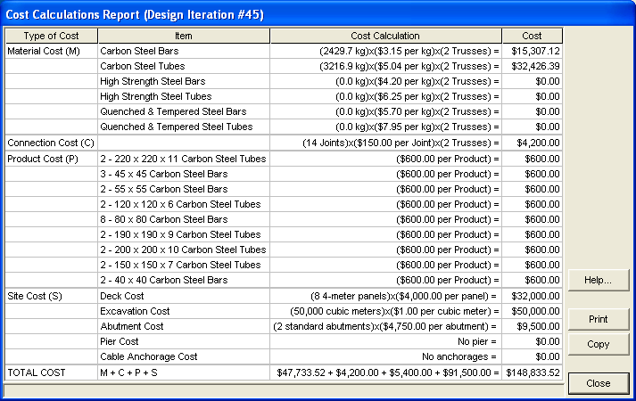
Cost and bridge mass
Under ”report”
Or the cost icon
Add these and multiply by 2

Slide 18
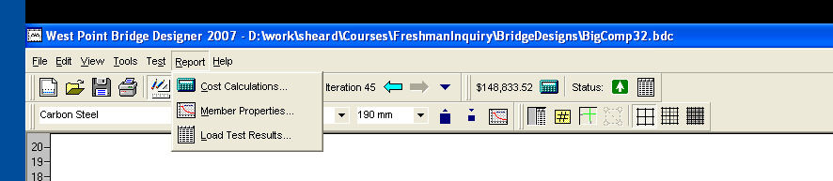
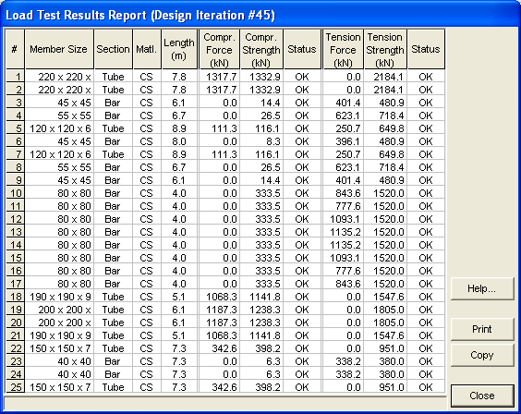
Load test results
Under
report
or load
test icon

Slide 19
Tips
Follow flow charts in book.
Select multiple members using the CTRL key or by dragging a box around them.
Can sort member list. For example to help you get consistent sizes.
Use tubes for compression and bars for tension to optimize strength/cost ratio.
Consider construction issues: uniform sizes, how many to build, does the size fit the file folder, not using tubes when not necessary.
Use design iterations. You can go back to a previous iteration within the same session.

Slide 20
Scaling your Activity 4 design to turn it into a paper design
We need to scale the bridge designed in activity 4
We need to scale in two dimensions
  Size from 32 meters to 0.8 meters
  Load from 185 KNewt to 10 kilograms

Slide 21
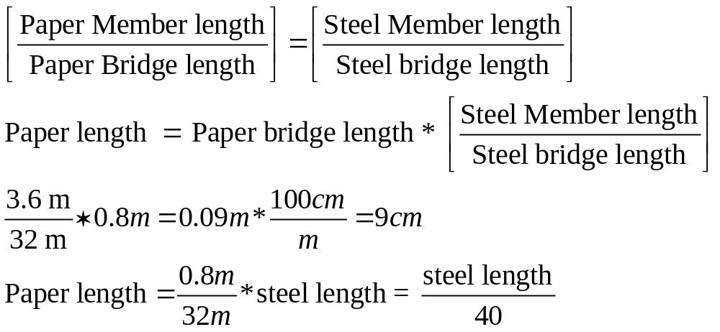
Scaling distance
Scaling distance:
  The designed bridge is 32 meters (m) long.
  Our paper bridge is 0.8 m long.
  We get the Steel member length from the report.

Slide 22
Scaling force
See math details below.
Scaling the applied load is very similar to scaling distance.
  But, the bridge designer includes extra things like the weight of the bridge and deck, which in our case are non-existent or negligible.
  Details of bridge loading are needed for scaling.
  You don’t need to understand the following details, but you should understand what factors are considered and why.

Slide 23
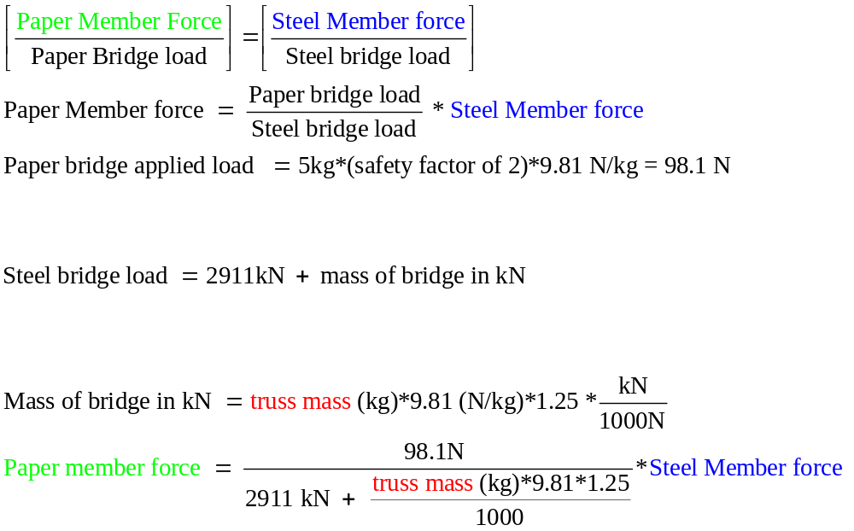
Scaling force
includes, truck, deck, etc.
2 times sum of weight from cost report

Slide 24
Mass of Bridge
(2429.7 + 3216.9) * 2 = 11293.2 kg

Slide 25
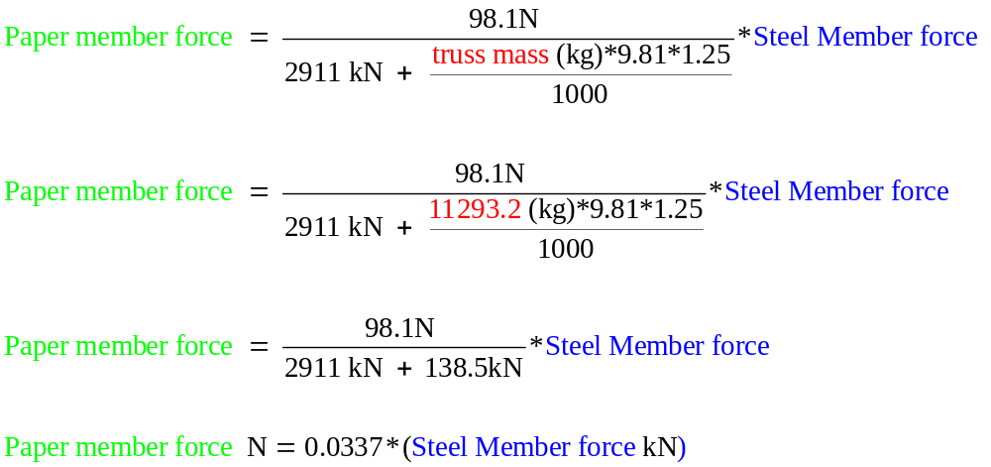
This is different for every bridge

Slide 26

Scaling Force
Be sure and use “Force” and not “Strength”
Length =
(7.8 m / 40) = 0.195 m =
19.5 cm
Force =
(1317 kN * 0.0337) =
44.4 N

Slide 27

Creating the Spread Sheet for Scalling
Open the “Load Test Results Report”
Push the “Copy” button
  This copies the numbers onto the clip-board so they can be pasted into Excell.
Open a fresh Excell spread sheet.

Slide 28
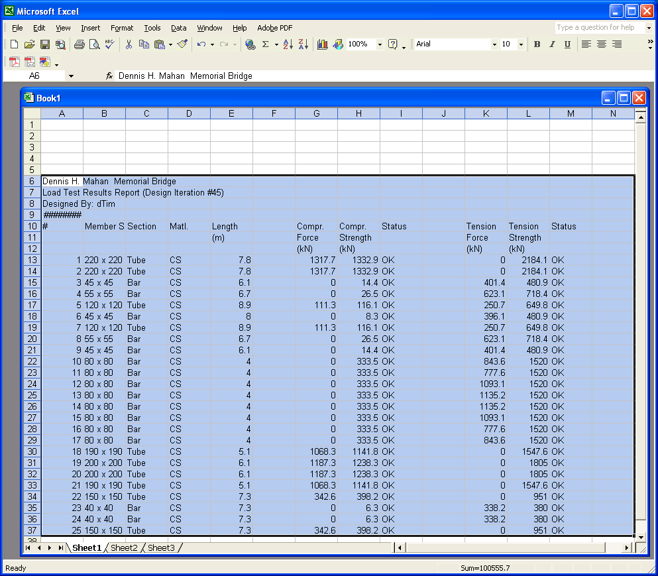
To delete a column, right-click in the “letter” box and select delete
Paste into a blank Excell Spread – sheet
Put the cursor in row 5 or 6 so there are a few blank lines above
Delete non-essential columns – D,F,H,I,J,L M

Slide 29
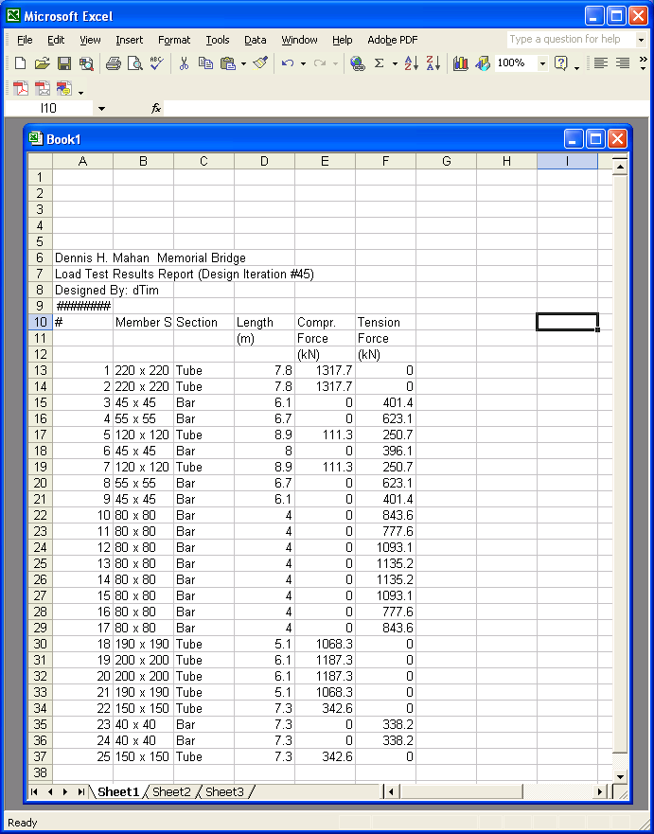
Add a cell for the weight of your bridge in KG in the top rows. Get the weight from the cost report. Sum all the weights and multiply by two
Label the length, compression, and tension with “steel”
Also add new columns for paper length, compression and tension. Be sure to add the correct units (cm for length) and (Newtons for compression and tension)
See the next slide for what the chart should now look like.

Slide 30
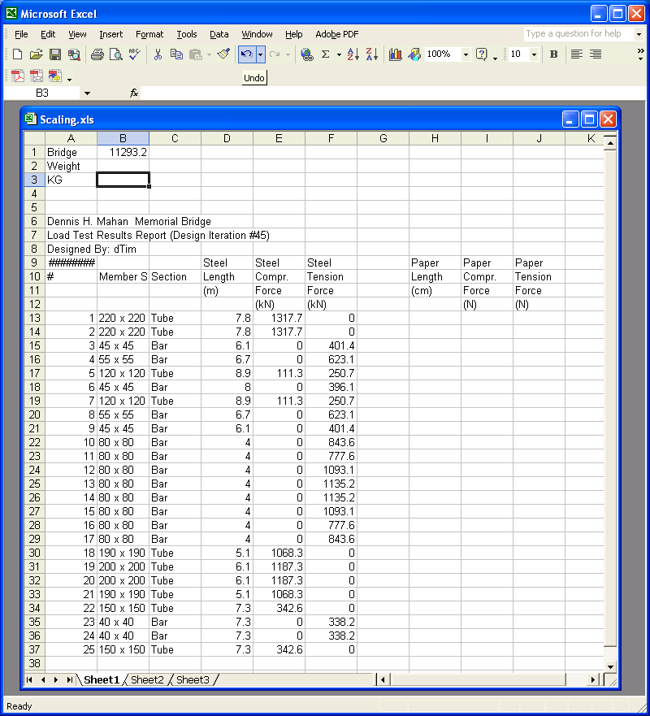
Add a cell that computes the “force” scaling factor from the weight. Use the formula
force scale factor =
98.1 / (2911 +((B1 * 9.81 * 1.25) / 1000))
The B1 is because the weight is in cell B1

Slide 31
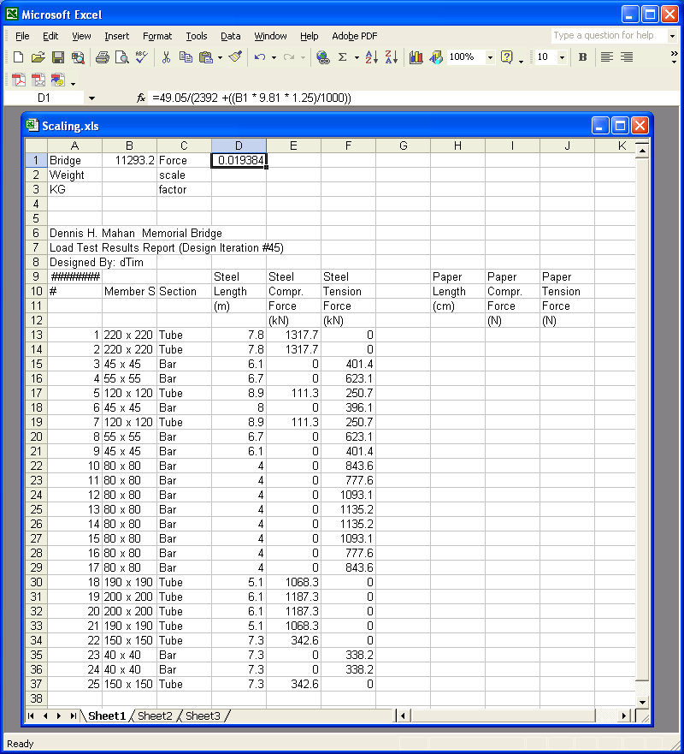
Fill in formula for the paper length
=(D13 / 40) * 100
We multiply by 100 to turn meters into centimeters

Slide 32
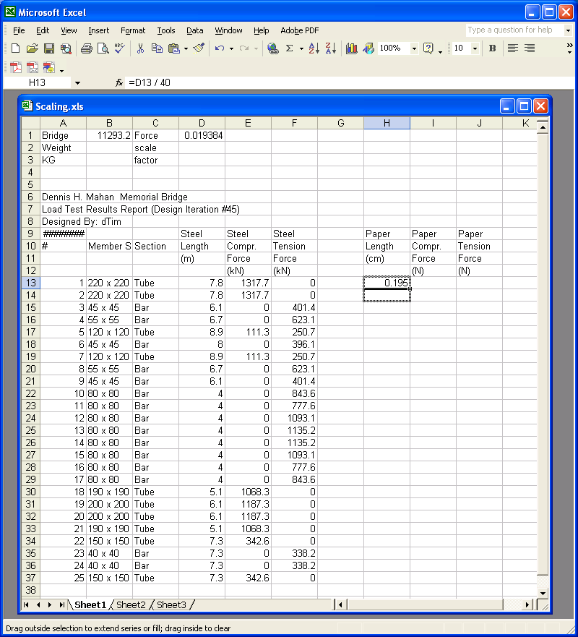
Grab the little box in the lower left corner and pull it down to replicate the formula for the whole H column

Slide 33
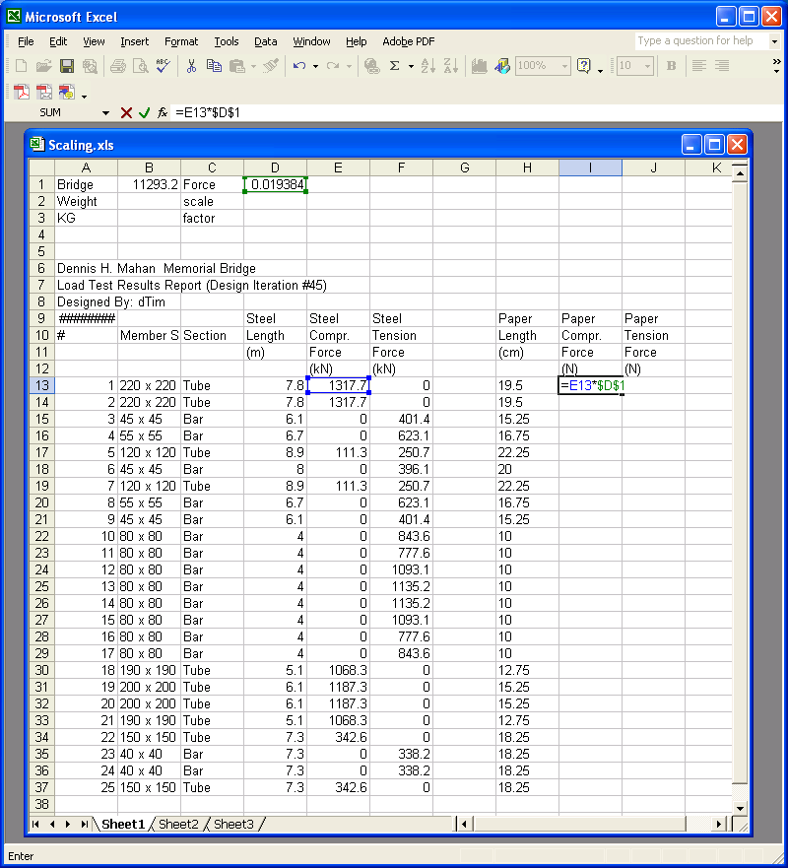
Set up the formula for the compression force. Use
=(E13*$D$1)
The $ means the exact cell B1 rather than a cell relative to the formula cell.
Pull it down for the whole row I

Slide 34
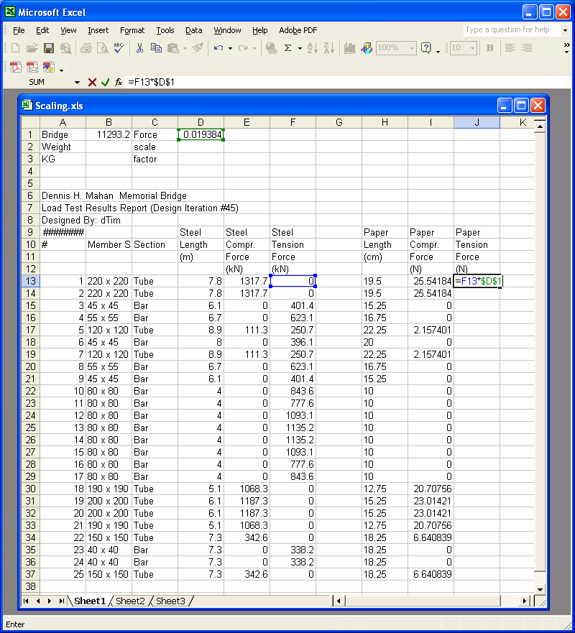
Do the same for the tension force

Slide 35
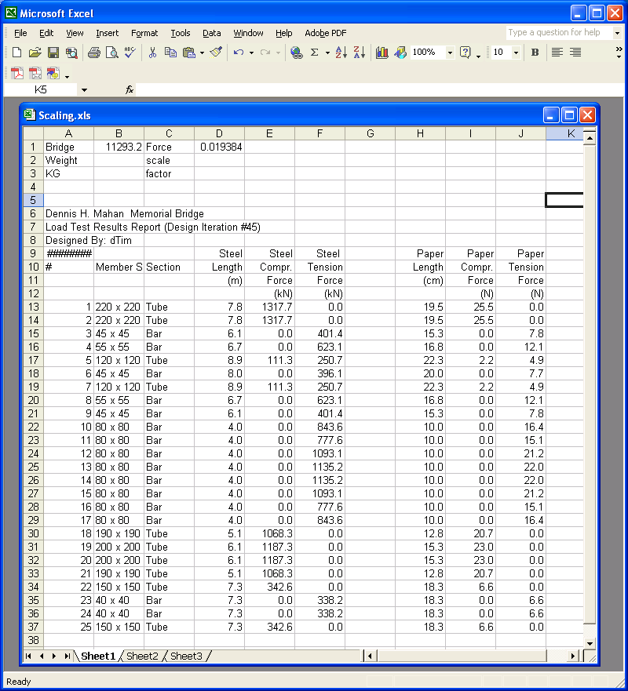
Final Result

Slide 36
Choosing the right size paper member
Is the internal member force less than the strength for each member?
We have already built a factor of safety of 2 into our design by assuming a load twice as big as the actual load.
So we can look directly at our graphs to see if the strength is greater than the force.

Slide 37
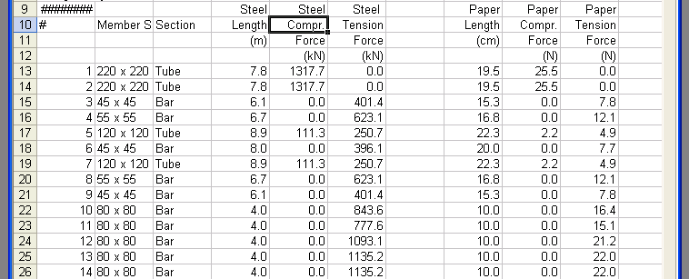
Consider a member that is under 22 Newtons of tension
What size paper strip do we use?

Slide 38
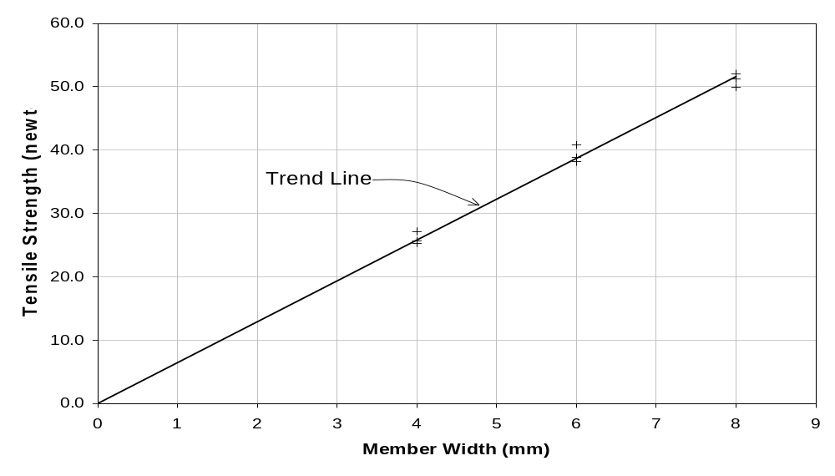
Tensile Strength of Member 22N
22 N
Approximately 3.7 mm width paper bar, round up to 4mm.
Since our design calls for double strips of paper, 2mm strips suffice.
This (2mm) may be too small to handle, so use the minimum size (that we tested) bar larger than necessary size

Slide 39
Consider a member that is under a 25.5 Newtons of compressive force, and is 19.5 cm long
What size paper tube do we use?

Slide 40
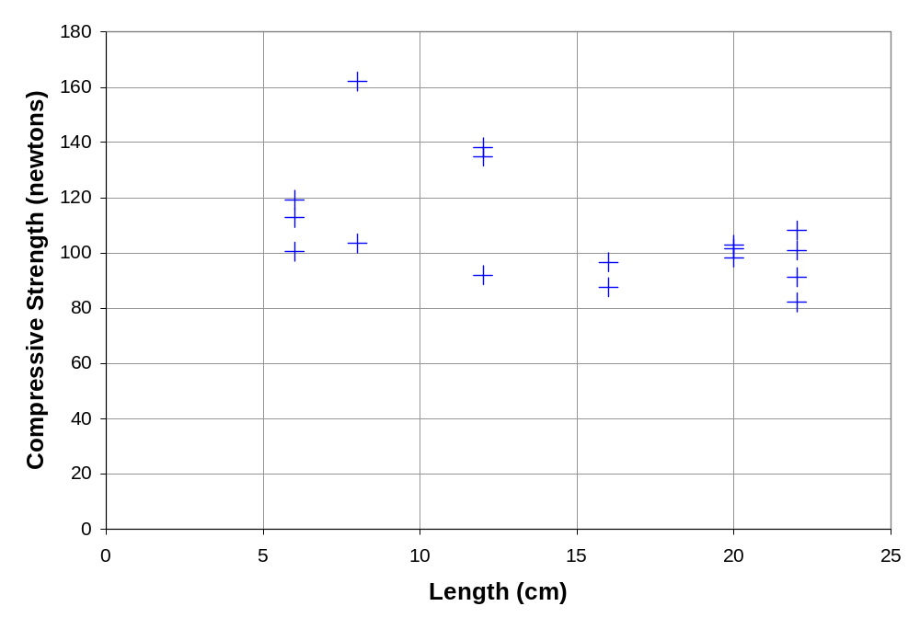
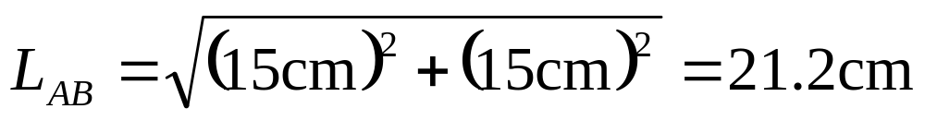
Strength of Member AD
“95% confidence” curve
81 N
19.5

Slide 41
A 10 mm x 10 mm tube 19.5 cm long can hold about 81 Newtons.
We only need to hold 25.5 newtons. We should choose a smaller tube.
Perhaps a 6mm x 10mm tube. We need to compare it on the 6mm x 10mm chart

Slide 42
Draw plans
Paper: 30cm x 65cm
  Can buy large graph paper or tape together carefully smaller graph paper.
    If you have access, use a computer program to draw template
  T-square or triangles helpful for drawing.
Lay out center lines. Label intersections.
  Make drawing the EXACT size of final bridge.
  Check lengths against schedule.
  Make sure center lines intersect.
Draw members to correct width.
Design gusset plates with 2cm “welds”
Reinforce gusset plates at ends.

Slide 43
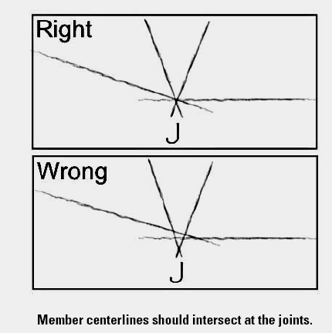
Check centerlines

Slide 44
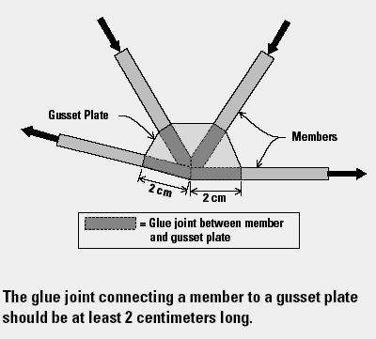
2cm “welds”

Slide 45
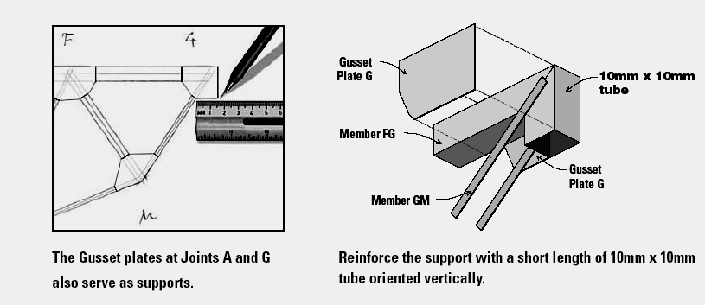
Gusset plates at ends

Slide 46
Draw plans continued
Lay out lateral bracing.
  Centerlines of top chords 10mm apart.
  Total bridge width at outside edges 11mm.
Struts are also floor beams. Suggest 6mmx10mm tubes.
Create schedule of members.
  Check against layout and bridge designer output.

Slide 47
Build the bridge
Use the same construction techniques.
Pay careful attention to things like joints and cross-bracing.
Follow your plans.
  Your bridge should look exactly like your plans, including member widths as well as member lengths.
  If you choose to use larger members than your design you must change your design and re-calculate costs, etc.
  Rounding errors can be ignored.

Slide 48
What is realistic about WPBD?
Design is an open-ended process with many possible solutions.
Design is constrained by real-world conditions and restrictions. e.g. specific span lengths and support configurations and materials.
Design is inherently an iterative process.
  Make assumptions, then check and revise.
  Consider many alternatives and select the best.

Slide 49
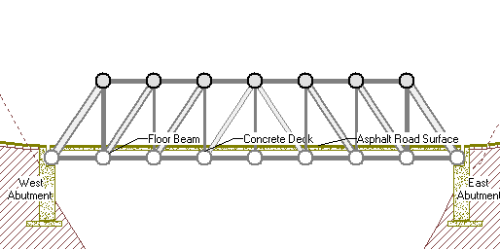
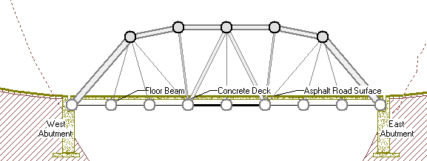
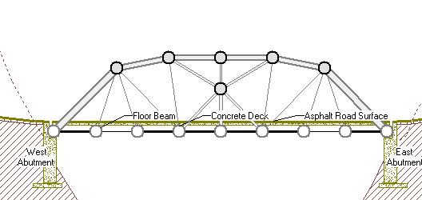
$182,590
$148,001
$145,789

