Slide 1
Creating a Template
Design and Society
Nov 26, 2007
Tim Sheard

Slide 2
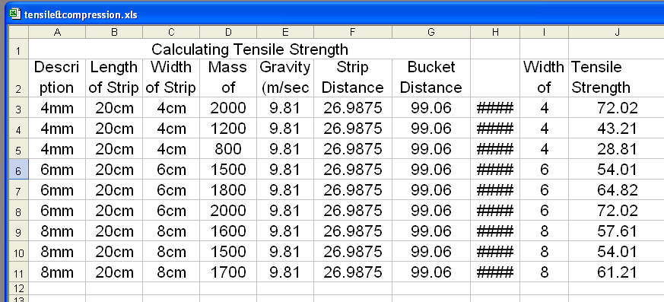

Slide 3
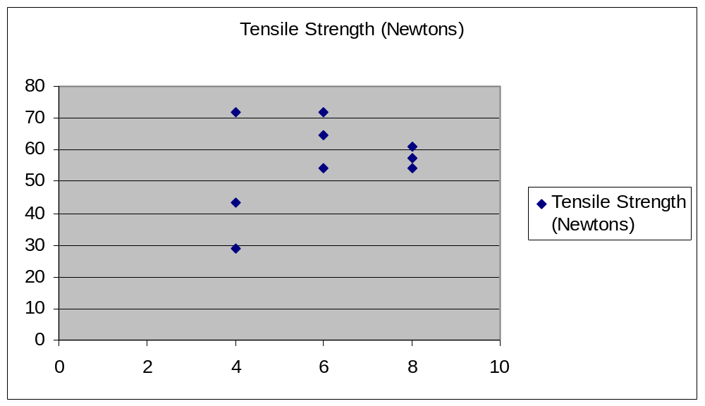
Our experimental results

Slide 4
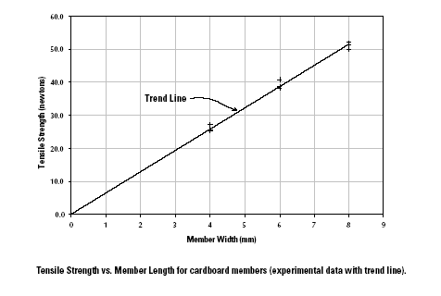
Books results for Tension

Slide 5
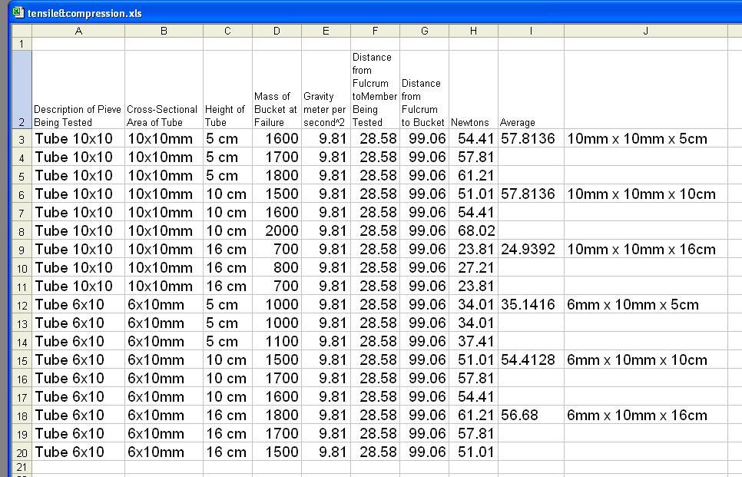
Our results

Slide 6
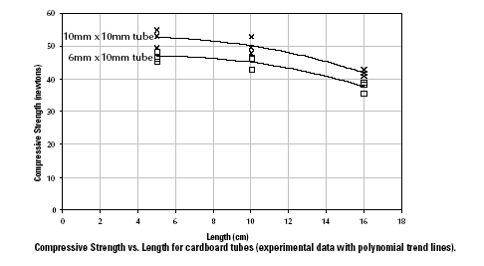
Book Compression Results

Slide 7
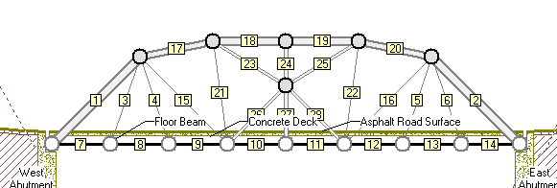
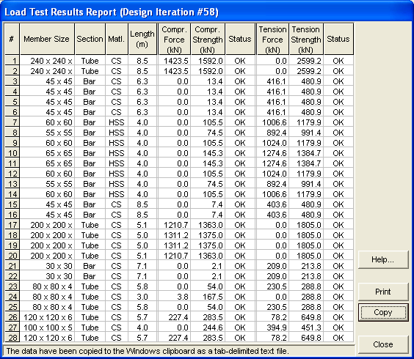

Slide 8
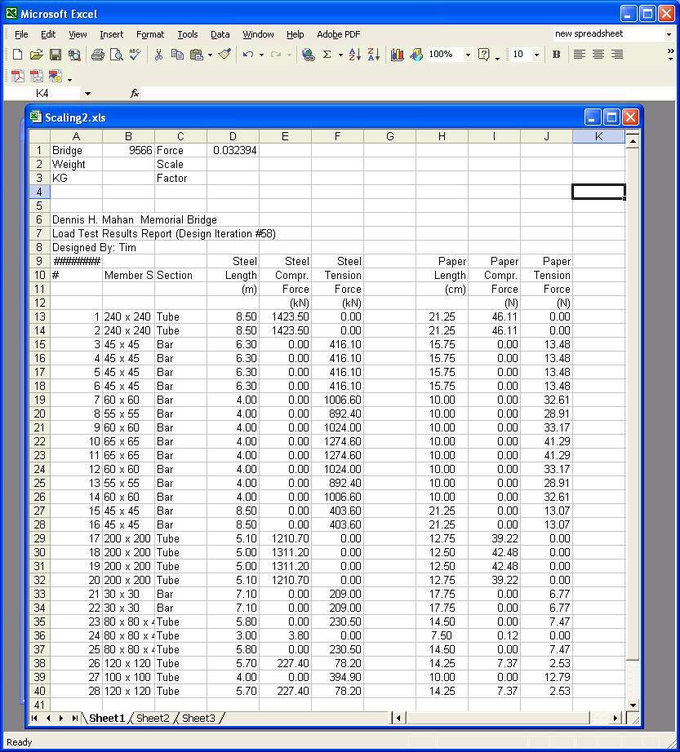
Spread Sheet

Slide 9
length, force
We need a
6 x 10 tube

Slide 10
length, force
We need a 10x10 tube

Slide 11
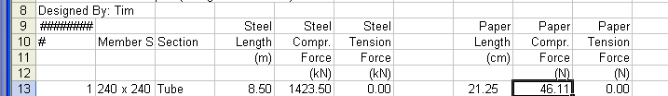
We need a bigger tube
(21.25, 46.11)

Slide 12
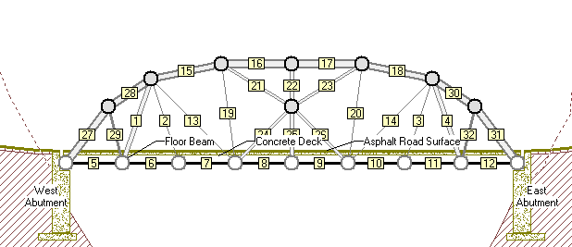
This member is too long
Make it 2 shorter pieces

Slide 13
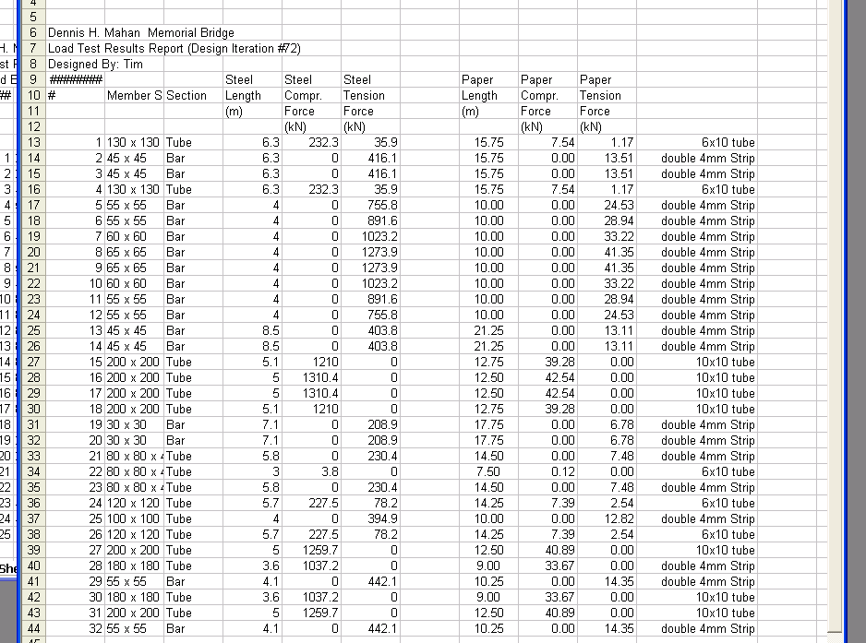
New Spread Sheet

Slide 14
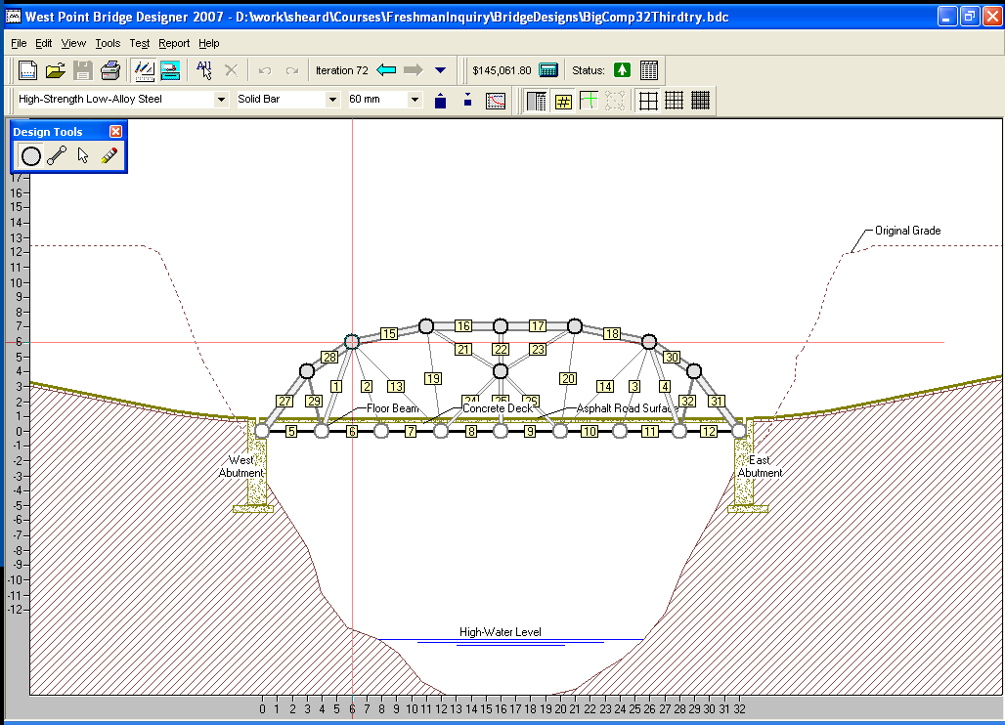
Drawing
use the Joint tool, tells where each joint is

Slide 15
Make a List
Deck joints
(0,0) (0,4) (0,8) (0,12) (0,16) (0,20) (0,24) (0,28) (0,32)
Arch Joints
(0,0) (4,3) (6,6) (7,11) (7,16) (7,21) (6,26) (4,29) (0,32)
Internal Joint (4,16)

Slide 16
Plot the Points on Graph Paper
(0,0)
Deck joints
(0,0) (0,4) (0,8) (0,12) (0,16) (0,20) (0,24) (0,28) (0,32)
Arch Joints
(0,0) (4,3) (6,6) (7,11) (7,16) (7,21) (6,26) (4,29) (0,32)
Internal Joint (4,16)

Slide 17
Draw the members the computed size

