Slide 1
Notes on
Cradle to Cradle by
McDonough and Braungart
Design and Society

Slide 3
Design a system of production that
Puts billions of pounds of toxic material into the air, water, and soil every year
Produces some materials so dangerous they will require constant vigilance by future generations
Results in gigantic amounts of waste puts valuable materials in holes al lover the planet,where they can never be retrieved
Requires thousands of complex regulations - not to keep people and natural systems safe, but rather to keep them from being poisoned too quickly
Measures productivity by how few people are working
Creates prosperity by digging up or cutting down natural resources and then burying or burning them
Erodes the diversity of species and cultural practices.

Slide 4
What’s Wrong
From Cradle to Grave
  a Blender
One size fits all
  washing soap
A culture of Monoculture
  Housing deveopment

Slide 5
Activity = Prosperity
Maximizing Economic activity is the goal
What about an Oil Spill?
What about Hospital stays
  Cancer
  Toxic poisoning

Slide 6
“Less Bad” is not good
Reduce
Avoid
Minimize
Sustain

Slide 7
The 4 R’s
Reduce
  is growth bad?
Reuse
Recycle
  Down-cycling
Regulate
  Admitting there was a design failure

Slide 8
Is growth good or bad?
What do we want to grow?
  Trees
  Children
  Pollution
The question is how do we grow the right things?
Design things so that they get bigger and better in a way that replenishes and nourishes the rest of the world

Slide 9
Waste = Food
Biological and the technical nutrients
Not cradle to grave, but Cradle to Cradle
Today
  We get rid of waste by making it someone else problem

Slide 10
The Monstrous Hybrid
Shoes
  leather and tanning
  shoe soles and rubber
    soles abraid and become part of the environment
What about Automobiles?

Slide 11
The Product of Service Economy
Don’t sell shoes, show feet
  when products become no-longer usefull they are collected and their components are reused to make new objects
What are the advantages?

Slide 12
Respect Diversity
Where do you want to live?
What music do you want to listen to?
The fittingest survive
All sustainability is local

Slide 13
The Ant Design Problem
safely and effectively handle their own material wastes and those of other species
Grow and harvest their own food while nurturing the ecosystem of which they are a part
Construct houses, farms, dumps, cemeteries, living quarters, and food-storage facilities from materials that can be truly recycled
Create disinfectants and medicines that are healthy, safe, and biodegradable .
Maintain soil health for the entire planet.

Slide 14
New Design Problem
Buildings that, like trees, produce more energy than they consume and purify their own waste water
Factories that produce effluents that are drinking water
Products that, when their useful life is over, do not become useless waste but can be tossed onto the ground to decompose and become food for plants and animals and nutrients for soil; or, alternately, that can return to industrial cycles to supply high-quality raw materials for new products
Billions, even trillions, of dollars' worth of materials accrued for human and natural purposes each year
Transportation that improves the quality of life while delivering goods and services
A world of abundance, not one of limits, pollution, and waste.

Slide 15
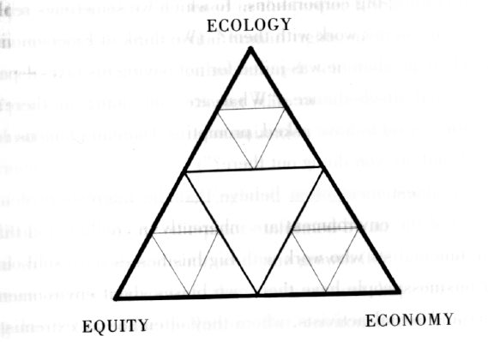
The Triple Top Line

