Slide 1
Design and Society
Easter Island

Slide 2
Notes
LING 115, writing for non-native English speakers, still has several openings.
  This is a great class for students struggling with language fluency issues and the faculty have been very willing to work with frinq students and assignments.
  CNCLD LING115 001 WRITING/N-NATIVE RES 4MW 14:00-15:50STAFF
  45334 LING115 002 WRITING/N-NATIVE RES 4TR 14:00-15:50SEH 107 Chapin R.
Extra Credit Opportunity
  Jonathan Demme's latest documentary, New Home Movies from the Lower 9th Ward
    7 pm, Friday January 18 and Saturday January 19
    5th Avenue Cinema (Hall & 5th SW)
    Free Admission

Slide 3
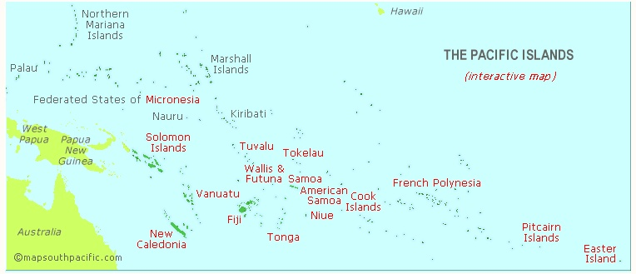
Easter Island
Easter Island is the westernmost of the Pacific Islands. It is small, isolated, and remote.

Slide 4
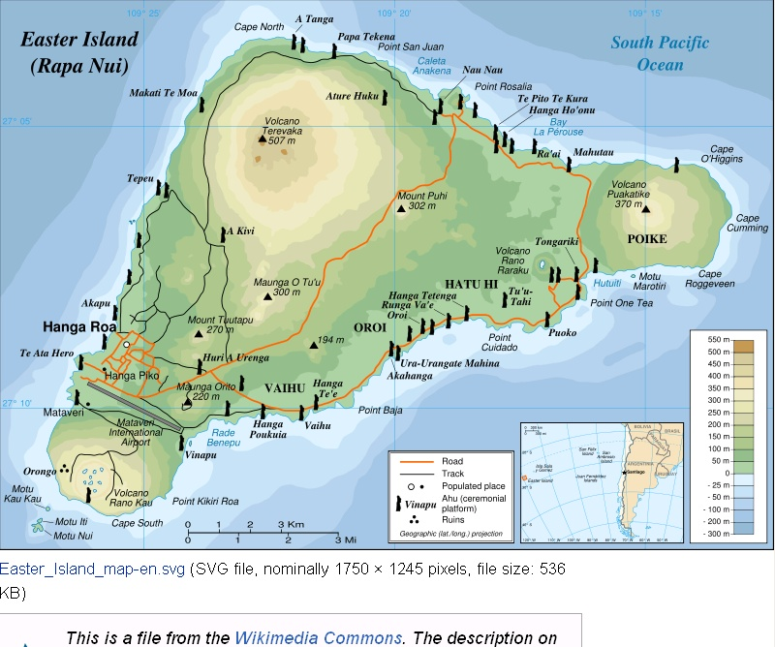
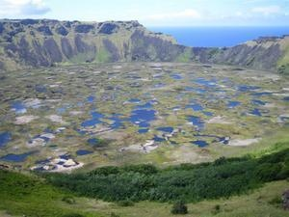
Geography
Roughly triangular in shape has 3 major volcanoes.

Slide 5
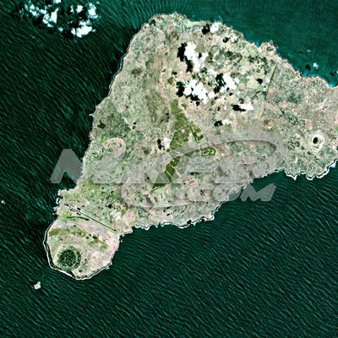
It is barren, has few trees.

Slide 6
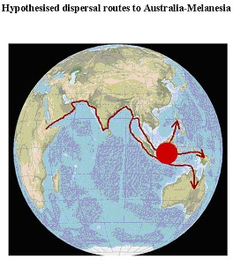
Where did the Easter Islanders come from
The Pacific Islands were settle by a dispersal from Africa, in a route that runs along the south of Asia through Melanesia, then to Australia and Micronesia.

Slide 7
Settlement of the Pacific Islands
1000 B.C.
600 A.D.
500 B.C.
600 A.D.
1200 A.D.
800 A.D.
900 A.D.
The Pacific Islands were settled from the northwest, probably from Asia and Melanesia, in a series of waves in westerly, then northerly (Hawaii) and southerly (New Zealand) directions

Slide 8
Organized Settlement
Easter Island was the last of Pacific Islands to be settled.
Evidence suggests that the settlement was well organized.
  bones in midden, or garbage dumps show that animal and plant foodstuffs, not native to Easter Island, were amongst the earliest sources of nutrition, suggesting that the settlers brought these items with them in a well organized manner.

Slide 9
Isolation
After settlement Easter Island remained isolated, and a society with roots from Micronesia, but with unique traditions arose.
Stone tools (made out of rock unique to particular Islands) are found throughout the south Pacific, suggesting trade between the Islands.
  “But no stone of Easter Island has been found on any other island or vice versa.” This suggests that Easter Island society was effectively isolated.

Slide 10
Thriving Population
Evidence suggests that Easter Island had a large and rich thriving society.
  Many house foundations (enough for 20-30K people)
  Agricultural Intensification (large composting pits, water dams, stone chicken houses, stone windbreaks) suggests a lot of food was needed.
  Society was broken into 11-12 territories or clans, not likely with a smaller population.

Slide 11
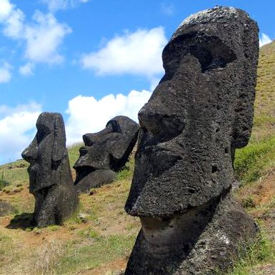
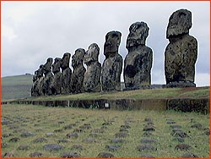
Moai and Ahu
Easter Island has hundreds of stone platforms (ahu) that support large statues (moai).
  13-32 feet tall
  10-87 tons in weight
  One basic style, but made of different kinds of stone

Slide 12
A statue based economy
Constructed in 3 waves 1100 A.D.
Statues grew larger and more elaborate as time went by.
Economy centered around statue building
  Many roads
  Clan based niches in statue production
  Food production concentrated to free up labor for statue construction

Slide 13
Why so overboard
The stone on Easter Island is the best carving stone in the Pacific
Society was isolated, so the energy expended in other Pacific societies (trading, raiding, exploration, and colonization) was directed inward
Chiefs got stature not by inter-island interaction but by competing for status by a game of statue one-upman-ship
  Later ones had a pukao, or large stone “hat”
Clan based society, let each clan “specialize” so while each group had a monopoly on some item, trade between groups was the norm.

Slide 14
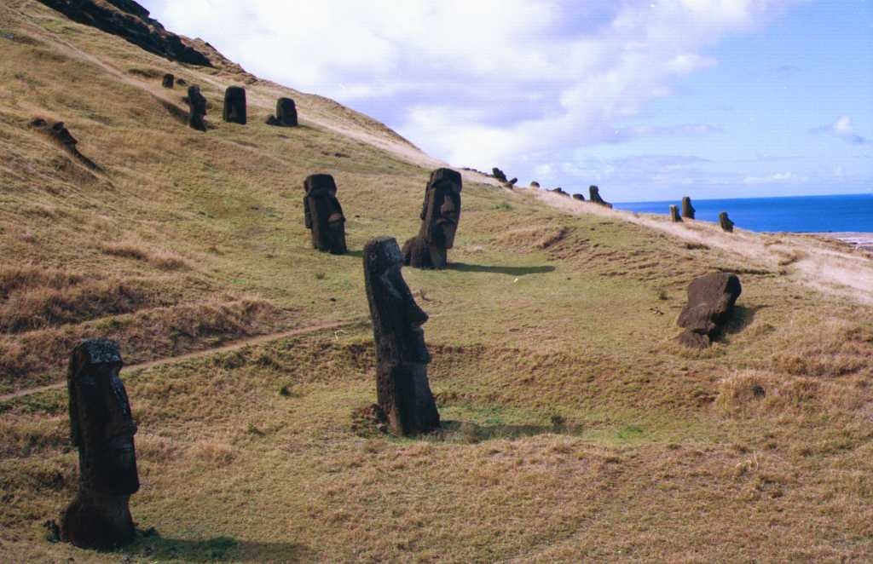
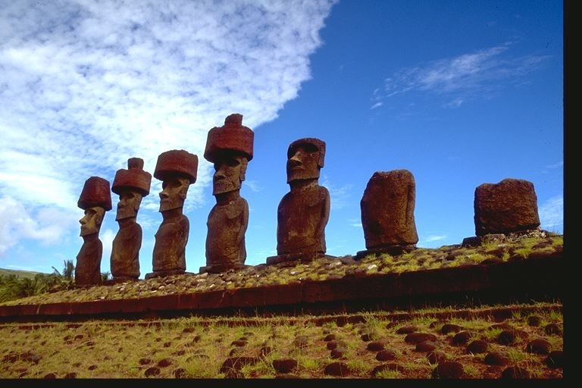
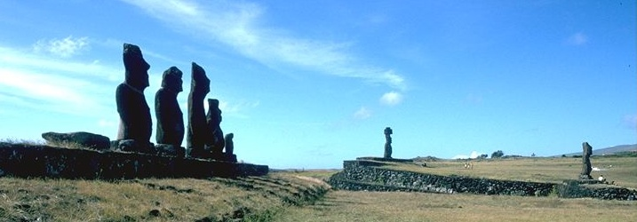
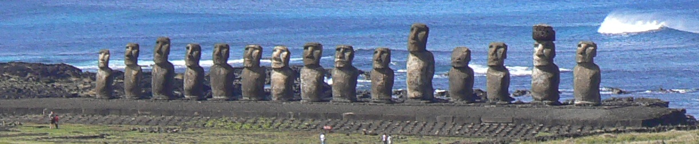

Slide 15

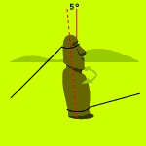
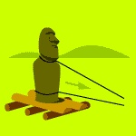
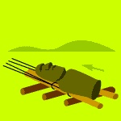
How were they moved?
Theorist: Thor Heyerdahl
  sledge
Theorist: Pavel Pavel
  walked
Theorist: Charles Love
  upright roll
Theorist: Jo Anne Van Tilburg
  horizontal roll
Most rely on wood and logs
  http://www.pbs.org/wgbh/nova/easter/move/past.html

Slide 16
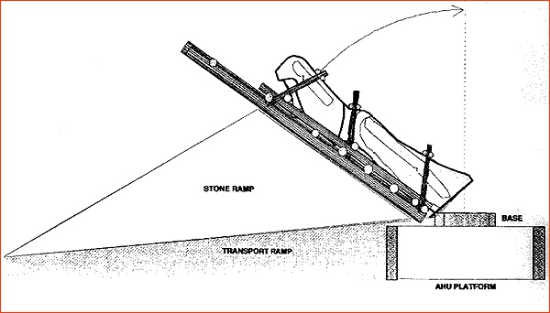
How were they raised?
Transport, Raising, and Food Production issues suggest that many trees were cut down to provide for statue production and to clear land for food production.
When discovered in the early 1800’s there were no trees on Easter Island
Did Deforestation lead to the collapse?

Slide 17
An Abrupt end
Statue building, and the complex Easter Island society ended abruptly about 1600 A.D.
  Incomplete statues still embedded in quarry
    Total number of moai on Easter Island: 887
    Total number of maoi that were successfully transported to their final ahu locations: 288 (32% of 887)
    Total number of moai still in the Rano Raraku quarry: 397 (45%)
    Total number of moai lying 'in transit' outside of the Rano Raraku quarry: 92 (10%)
  Stone carving tools left to lie
  Chicken houses abandonded
  Roads left in disrepair
What happened?

Slide 18
Collapse
Forests Gone
  No trees on island when discovered by Europeans
  Pollen analysis shows that indigenous palm trees were grown in the time of early settlers
  large areas given over to food production (upland farms)
Food supply limited
  upland farms abandonded
  midden analysis shows large game birds disappeared
  Large fish and seal bones also disappeared (no trees, no canoes, no deep water fishing)
Fuel supply limited
  carbon tested early fires were trees, later fires were grasses
Erosion
  soil eroded from base of statues,
Unrest
  In the last days statues of rival clans were torn down

Slide 19
5 point framework analysis
Damage to the environment
  definitely yes
Climate change
  a precipitating event that tipped the scales?
Hostile neighbors
  no, isolation
Decreased support by friendly neighbors
  no, siolation and no signs of trade
The society’s responses to its own problems
  status instead of survival?

Slide 20
Presenting a chapter
Background
  where is it? (geography)
  History
  context of society (how was it organized)
  interactions with other societies
  What was it like at its peak?
What happened
  broad picture
  precipitating events
Five point analysis

Slide 21
Details
Use graphs, pictures, visuals
Give evidence (support your claims)
  results of experiments
  observations
  facts and figures
Go beyond the chapter
  research
  ideas of others
Tell a story

Slide 22
Presentation Guidelines
A presentation is a tool that helps you explain to others what you have done.
  Most of the information is in your comments. The poster gives you something to refer to, and reminds you of important points.
Keep visuals simple and uncluttered
  Restrict text to 4-8 lines per page.
  Use color and font changes to carry a message (e.g. related concepts or experimental results in the same colors), not arbitrarily.
  Use LARGE fonts.
Use graphics rather than words where possible.
Put keywords on poster to help you remember script.

