Slide 1


Slide 2
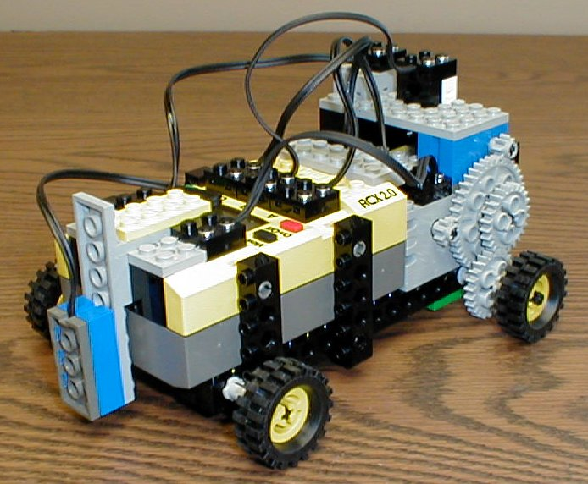
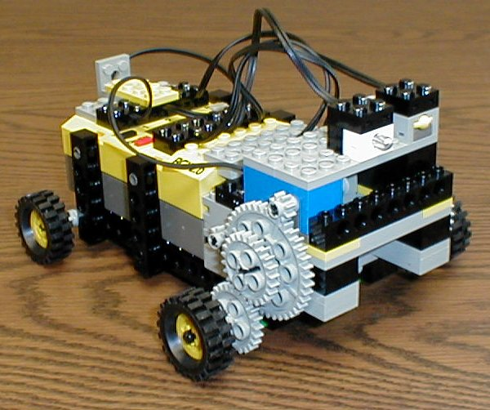
Robot Design
gears
lamp
touch sensor
right motor
left motor
light sensor
rotational sensor

Slide 3
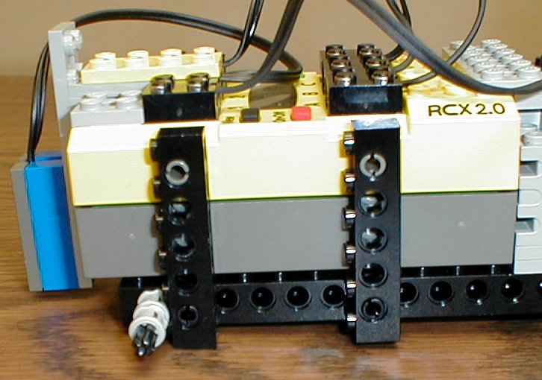
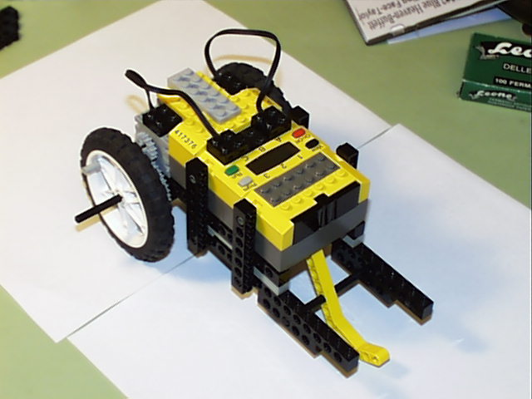
RCX Securely Attached
Use cross braces to securely attach the RCX to the robot’s body.

Slide 4
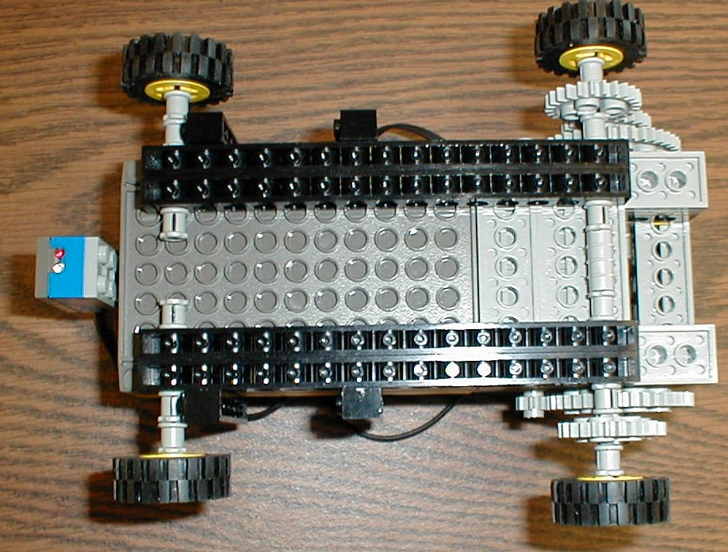
RCX Securely Attached
Use double beams on the underside for a better grip on the bottom of the RCX.

Slide 5
Light Sensor Low
If you use a light sensor be sure its low as possible to the ground so different room lighting conditions wouldn’t affect it.

Slide 6
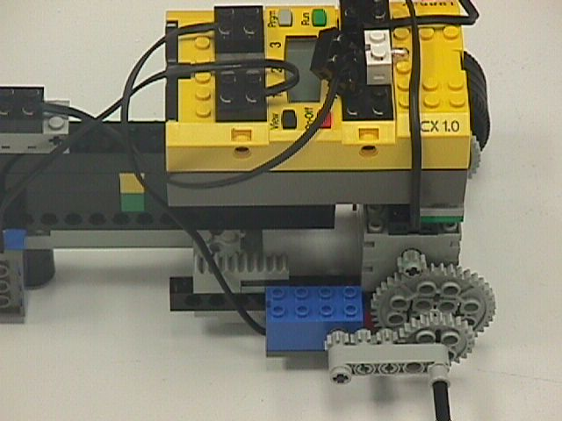
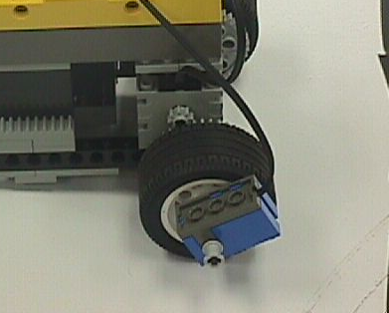
Increased Accuracy by securing your sensors
Reduced Gear Ratio
A fixed sensor(one that doesn’t move) gives an accurate reading.
Inaccuracy, sensor is loose

Slide 7
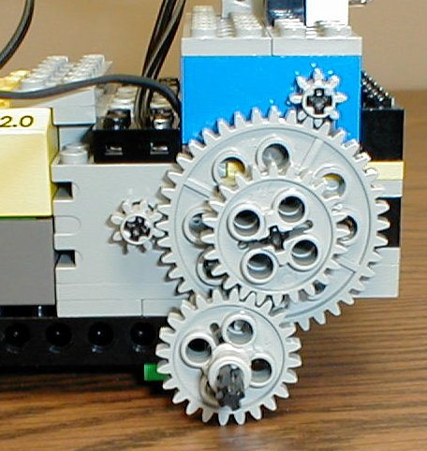
Gears
Use gears to slow down your robot.
Gears also give your robot more strength (torque).
The wheel spins 5 times slower than the motor.

Slide 8
Some Math - Gear Ratios
40 teeth
It takes 5 revolutions of the 8 tooth gear to make the 40 tooth gear go around once.
40 / 8 = 5.
The gear ratio is 5 to 1.
8 teeth

Slide 9
Some Math - Gear Ratios
24 teeth
The 40 tooth gear is on the same axle as the 24 tooth gear.
It is meshed with another 24 tooth gear.
Gear ratio =
24 /24 = 1 to 1.
24 teeth

Slide 10
Some Math - Gear Ratios
The total gear ratio is...
(5 / 1) x (1 / 1) =
5 to 1.
The wheel spins 5 times slower than the motor and has 5 times the torque (strength).

Slide 11
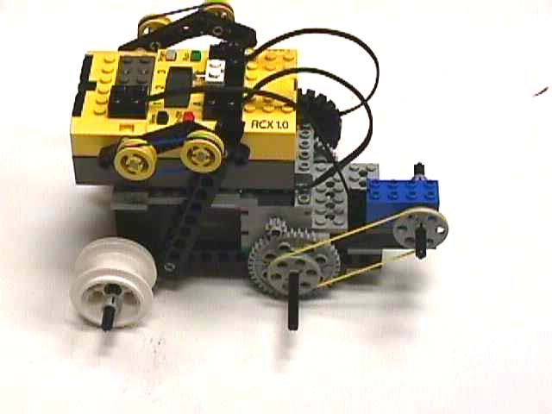
Using a pulley
Rotational Sensor

Slide 12
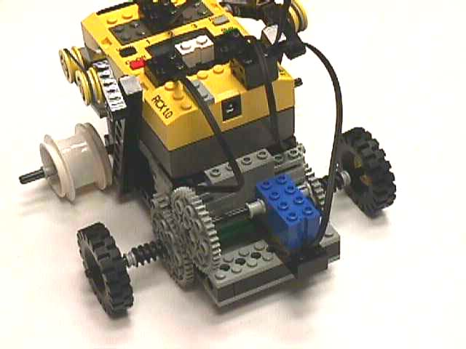
Using an idler gear
Rotational Sensor

Slide 13
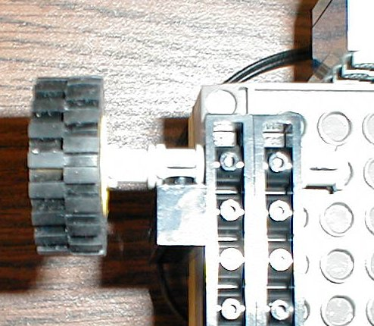
Friction = BAD
Make sure all of your wheels can spin freely.
Make sure the bushings or gears aren’t pressed to tightly against the beams.

Slide 14
Didn’t Drive Straight
Because one side of this robot had slightly more friction than the other when it would move, it would drift slightly to one side.

Slide 15
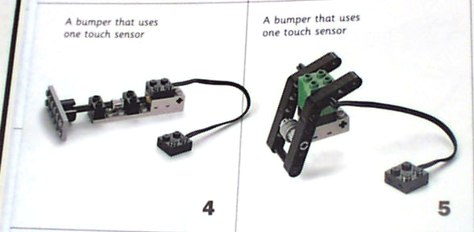
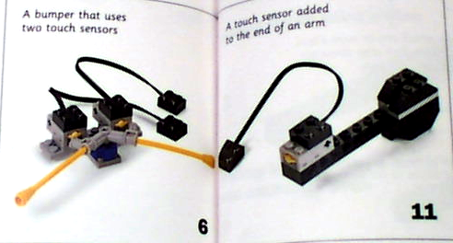
Touch sensors

