Slide 1
Sensors For Robotics
Robotics Academy 2002. All Rights Reserved.

Slide 2





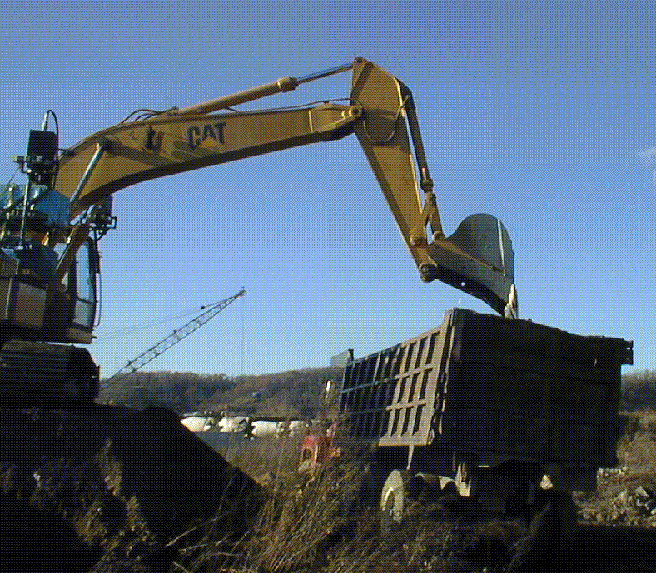
What makes a machine a robot?
Robotics Academy 2002. All Rights Reserved.

Slide 3
What is sensing?
Sensing is converting a quantity that you
want to measure into a useable signal
(usually electronic).
Perception is the interpretation or under-
standing of these signals.
Example:
Sensing: Sound waves -> vibrating eardrums -> signals to brain
Perception: Understanding that I am talking to you about sensors.
Robotics Academy 2002. All Rights Reserved.

Slide 4

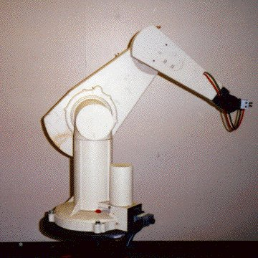


Why do robots need sensors?
Robotics Academy 2002. All Rights Reserved.

Slide 5




Why do robots need sensors?
Robotics Academy 2002. All Rights Reserved.

Slide 6




Why do robots need sensors?
Robotics Academy 2002. All Rights Reserved.

Slide 7

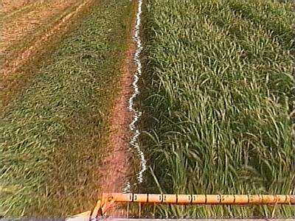
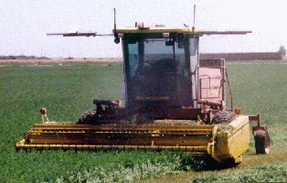

Sensing for specific tasks
Robotics Academy 2002. All Rights Reserved.

Slide 8

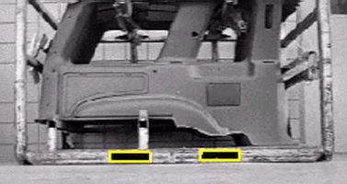

Sensing for specific tasks
Robotics Academy 2002. All Rights Reserved.

Slide 9

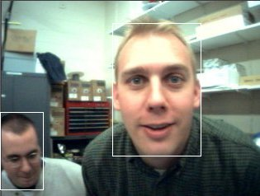

Sensing for specific tasks
Robotics Academy 2002. All Rights Reserved.

Slide 10
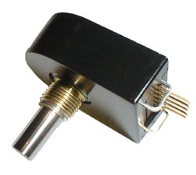
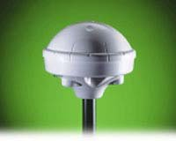
Common Sensors in Robotics
Rotation sensors (also called encoders) measure the rotation of a shaft or axle. They are used to measure the angle of a robotic arm, or how far a mobile robot’s wheel has turned.
Global Positioning Systems (GPS) receive signals from orbiting satellites that pinpoint the location of an outdoor robot on the Earth.
Robotics Academy 2002. All Rights Reserved.

Slide 11
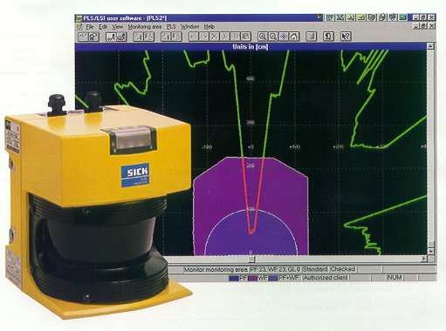
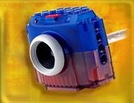
Common Sensors in Robotics
Laser range finders use laser beams to measure the distance to objects. They are used for obstacle detection and navigation.
Cameras are a very common sensor. Computer Vision is the field of study of interpreting camera images for a variety of purposes.
Robotics Academy 2002. All Rights Reserved.

Slide 12
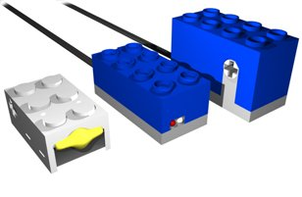
Lego Sensors
We will be using 3 types of Lego sensors.
Rotation sensor
Light sensor
Touch sensor
Robotics Academy 2002. All Rights Reserved.

Slide 13
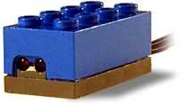
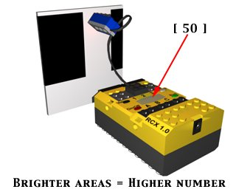
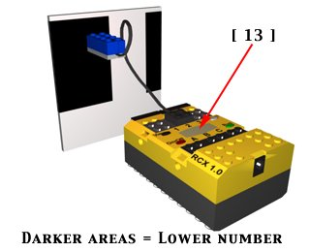
Light Sensor
Measures the level of light as a
number between 0% (total darkness)
and 100% (very bright).
Can differentiate light
levels reflected from
bright and dark
surfaces.
Robotics Academy 2002. All Rights Reserved.

Slide 14

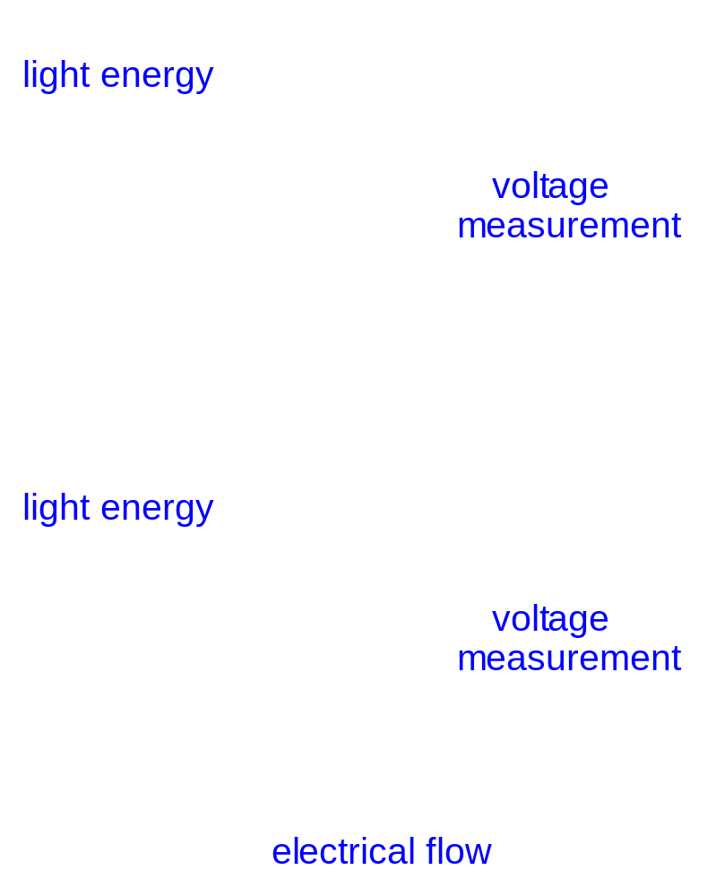
Light Sensor
Inside the light sensor
is a photo-transistor.
The photo-transistor acts
like a valve for electricity.
The more light energy it
senses, the more electricity
flows.
low light
bright light
Robotics Academy 2002. All Rights Reserved.

Slide 15
Light Sensor
Uses:
Navigation - follow a black line on a white surface (or vice versa).
FireflyBot - find a very bright object in a room or area (light bulb).
Color sorter - tell the difference between black Lego bricks and yellow Lego bricks.
Input Device - different colors or gray levels on a piece of paper.
Robotics Academy 2002. All Rights Reserved.

Slide 16
Touch Sensor
Uses:
Detect contact between the robot and external objects like walls.
Detect contact with internal moving parts in the robot (arm or gripper).
TableBot - detect contact with the ground so the robot doesn’t fall off the table.
Input Device - push button or “remote” control.
Robotics Academy 2002. All Rights Reserved.

Slide 17

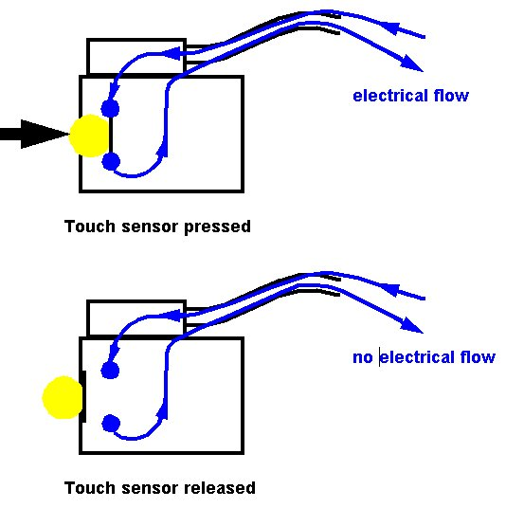
A touch sensor works like a light switch in your house.
When the button is pressed, an electrical circuit is closed inside the sensor. This lets electricity flow.
When the button is released, the circuit is broken and no electricity flows.
The RCX can sense this flow of electricity, so it knows if the touch sensor if pressed or released.
Robotics Academy 2002. All Rights Reserved.

Slide 18
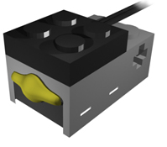
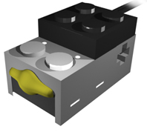
Connections
It is important to connect the cable to the touch sensor in the correct way.
Which one of these is right?
Robotics Academy 2002. All Rights Reserved.

Slide 19


Touch sensors are programmed to detect when their buttons have been pushed in or released.
You need to specify which sensor port a touch sensor is connected to.
This icon causes the program to wait forever until the touch sensor on port 1 has been pushed in.
Robotics Academy 2002. All Rights Reserved.

Slide 20

This icon waits until the touch sensor has been released.
Robotics Academy 2002. All Rights Reserved.

Slide 21
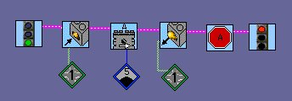
Touch sensors can be used to control the motors.
This program waits forever until the touch sensor has been pushed in.
When this happens, motor A is commanded to turn on.
Motor A continues to run until the touch sensor has been released, and motor A is commanded to stop.
Robotics Academy 2002. All Rights Reserved.

Slide 22

Touch sensor forks (more advanced)
The touch sensor fork
can be used to have the program do different things depending on if the touch sensor is pushed in or released.
Robotics Academy 2002. All Rights Reserved.

Slide 23
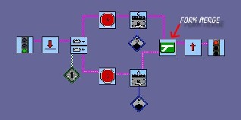
In this program, if the touch sensor is pushed in, then motor A is turned on and motor C is commanded to stop.
If the touch sensor is released, then motor C is turned on and motor A is stopped.
Remember that a fork statement needs a fork merge at the end of the decision.
Robotics Academy 2002. All Rights Reserved.

Slide 24
Lesson 3: Sensor Wait-for’s
Troubleshooting Tips

Slide 25
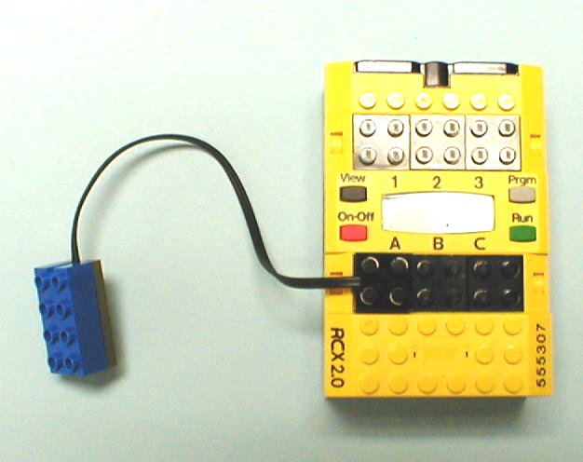
Problem 3a
Why won’t the light sensor work?
This is a
motor port.

Slide 26
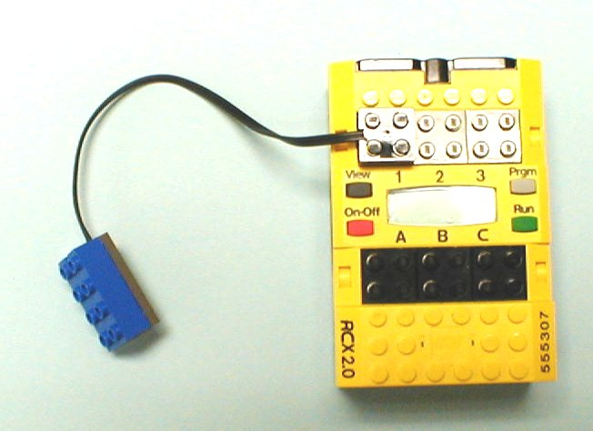
Solution 3a
Sensors need to be connected to Sensor ports 1, 2 or 3.
Sensor ports

Slide 27
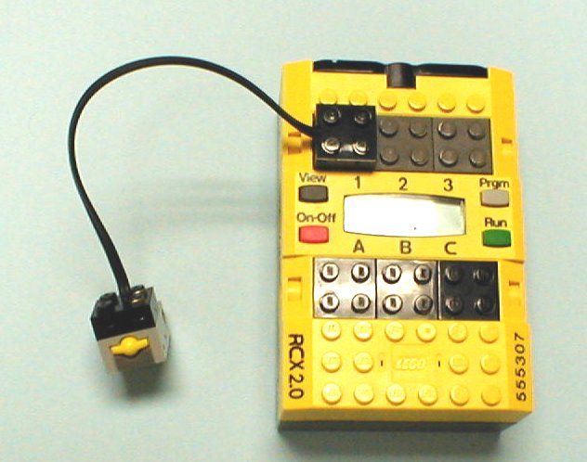
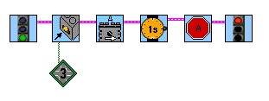
Problem 3b
What’s wrong with this set up?
The touch sensor is
connected to port 1.
But the software says the
touch sensor is on port 3.

Slide 28
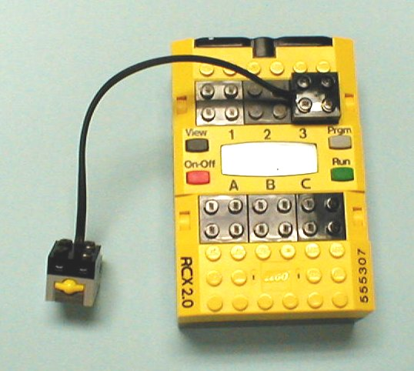
Solution 3b
Connect the touch sensor to port 3.
Or, change the port number in the software.

Slide 29
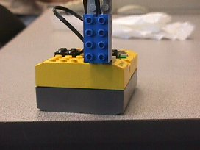
Problem 3d
What isn’t too great about the way the light sensor is mounted?

Slide 30
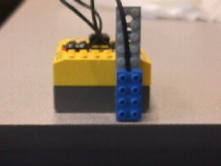
Solution 3d
If the light sensor is too high, it has a harder time distinguishing between black and white. Mounting it lower to the ground will help.

Slide 31
Work Cited
Most of this from Carnegie Mellon University, Robots Academy (open source) http://www.rec.ri.cmu.edu/education/content/products/index.html (12/7/2004)
Format and layout changed to fit Power Point.
Robotics Academy 2002. All Rights Reserved.

