Slide 1
Robots Week 3a
Lego Light Sensors
Betsy Natter
Design & Society

Slide 2

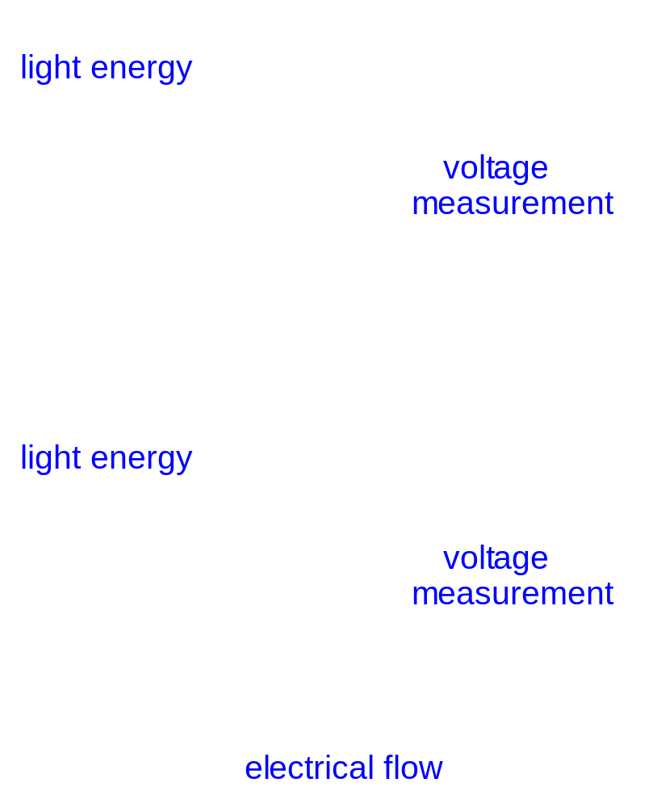
Light Sensor
Inside the light sensor
is a photo-transistor.
The photo-transistor acts
like a valve for electricity.
The more light energy it
senses, the more electricity
flows.
low light
bright light

Slide 3
Physics
Light sensors are made of semiconductors such as silicon or gallium arsenide, which have a moderate amount of conductivity under normal conditions.
  This is because there is always some electrons and holes available at room temperature. (~10¹⁰ cm⁻³)
Light breaks covalent bonds in the crystal creating electron/hole pairs. Depending on the material and the amount of light this can be a huge increase (10x to 10,000x)
More charge carriers mean greater conductivity (or lower resistivity).

Slide 4
Lego Light sensors
The light sensor measures the intensity of the light in visible and infrared (heat) wavelengths.
The light source can be external.
  E.g. find or follow a flashlight.
The light source can be internal.
  The sensor has a red LED, so...
  It can measure the reflected light off a surface.
  E.g. following a line.

Slide 5
Reflective Mode
Amount of light measured will depend on:
  Color.
  Surface roughness.
  Ambient (background) light.
Controlling the ambient light (room lights, windows) can be important.
Note that mentor rooms have different light than classrooms. (Most have no windows.)

Slide 6
Ambient Mode
Measures the intensity of an external light source.
Challenges:
  The red LED is always on, and close to the sensor.
  IR sources (lights, computers, and other heat sources.)
It is usually best to use the relative reference (i.e. an increase or decrease in the light by a percentage.

Slide 7
Light Sensor Programming
Carnegie Mellon University, Robots Academy http://www.rec.ri.cmu.edu/education/content/products/index.html (12/7/2004)

Slide 8
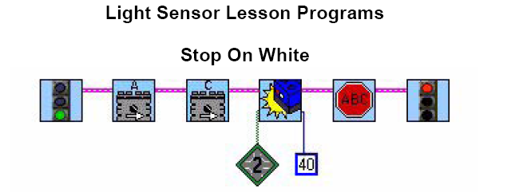

Slide 9
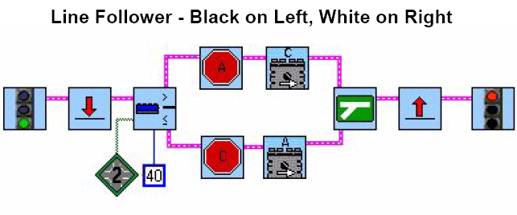

Slide 10
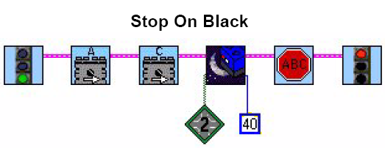

Slide 11
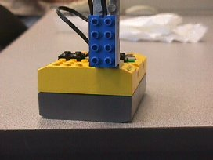
Problem 3d
What isn’t too great about the way the light sensor is mounted?

Slide 12
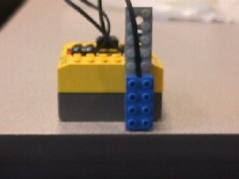
Solution 3d
If the light sensor is too high, it has a harder time distinguishing between black and white. Mounting it lower to the ground will help.

Slide 13
Wallace and Grommit
We will be following the challenge as outlined in the text, although scoring is a bit different.
  Sensors must be used.
  Programs must be displayed on the blog.
Bonus points are available for those teams which have the jam hit Wallace in the face after he lands at the kitchen table.
I’m open to other creative projects inspired by the film. One team did a great job with walking trousers which pulled Grommit in a wagon.
BUT—you have to use sensors, and have your robot respond to the sensors in some way.

Slide 14
Work Cited
All pictures from Carnegie Mellon University, Robots Academy (open source) http://www.rec.ri.cmu.edu/education/content/products/index.html (12/7/2004)
Format and layout changed to fit Power Point.

