Slide 1
Robots Week 3a
Programming Lesson 2: Modifiers, Loops and Jumps
Programming Solutions

Slide 2
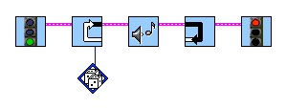
Exercise 1: Solution
Play a beep for a random number of times.
Put the Play Sound icon in a loop
The dice modifier
gives a random number

Slide 3
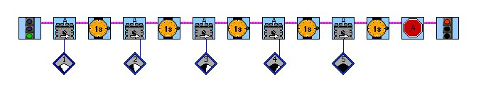
Exercise 2: Solution
Turn on motor A in the forward direction at power level 1 for 1 second, then on power level 2 for 1 second, etc. Continue this pattern up to power level 5 for 1 second, then stop the motor.

Slide 4
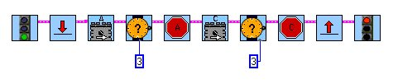
Exercise 3: Solution
Turn on motor A in the forward direction for 3 seconds, then stop the motor. Then turn on motor C in the forward direction for 3 seconds, then stop the motor. Repeat this forever.
…it jumps back to here.
This makes it repeat forever.
When the program
reaches here...
To get 3 seconds, you need a
numeric constant modifier

Slide 5
Lesson 2: Modifiers, Loops and Jumps
Troubleshooting Tips

Slide 6
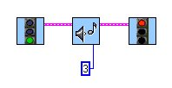
Problem 2a
Write a program that plays a beep three times in a row.
This plays sound #3, NOT 3 sounds.

Slide 7


Solution(s) 2a
Use 3 Play Sound icons, or use a loop that loops 3 times.

Slide 8

Problem 2b
Turn on motor A at power level 1.
This is a numeric constant modifier NOT a
power level modifier. (Strangely enough, it does
not show a bad wire. Hmmmm…..)

Slide 9
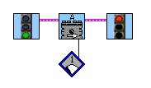
Solution 2b
Use a Power Level 1 modifier.

Slide 10

Problem 2c
Write a program that beeps forever. What’s wrong?
But this is a red land
This is a yellow jump

Slide 11

Solution 2c
Make sure jump and land pairs are the same color.

Slide 12

Problem 2d
Write a program that beeps forever. What’s wrong now?
Jump to
green land
Start
Land here
End
Oops!

Slide 13

Solution 2d
Be careful not to mix up the order of your jumps and lands!

Slide 14
Jumps
Jumps are like GoTo commands in other languages.
Program “jumps” on up arrow and “lands” on down arrow.
Can create a loop. But it makes an infinite loop, which goes on forever.
It is better to use the loop command for that and to use jumps with forks.

Slide 15
Loops
Loops are conditionals (“if” statements).
  They allow you to repeat sections of your program over and over.
  All start with a start loop command.
  All terminate with an end loop command.
  Can specify the number of times to repeat.
  Default is to loop twice.
  Can nest loops.

Slide 16
Forks
Forks are equivalent to “if-then-else” in other languages.
All fork commands require a merge fork be used later. (like end if)
All use a greater than/less than condition.
  You must wire a threshold value.
  Touch sensors do not require a threshold, they are just pushed in or not.

Slide 17
Equal forks
Icon on the far right of the forks sub-menu.
Equal forks are the same as standard forks but the conditional statement is “equal to/not equal to” instead of “greaterthan/less than”

Slide 18
Tips
Displaying data to the LCD panel is a common way of debugging a program.

