Slide 1
Lesson 3: Sensor Wait-for’s
Programming Solutions

Slide 2
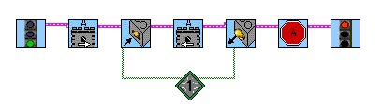
Exercise 1: Solution
Turn on motor A in the forward direction. When the touch sensor is pressed and held, reverse the motor direction. When the touch sensor is released, stop the motor.
Turn on
forward
Wait for
press
Wait for
release
Reverse
Stop
Notice you can string several icons to the same sensor port

Slide 3
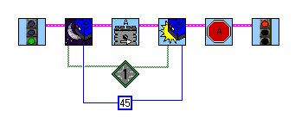
Exercise 2: Solution
Start by holding the light sensor over the white piece of paper. When the light sensor is moved over the black piece of paper, turn on motor A in the forward direction. Turn off the motor when the light sensor is moved back over the white piece of paper.
Wait until sensor
sees the black paper
Wait until sensor
sees the white paper
Use a threshold
that is halfway
between white
and black.
Your light
level may
vary.

Slide 4
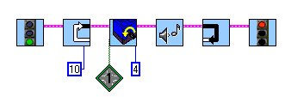
Exercise 3: Solution
Write a program that beeps once every time the rotational sensor is turned 1/4 rotation. Do this 10 times.
The program resets the number
of ticks to 0 every time through the loop.
Use a loop to do
this 10 times.
Remember: There are 16 ticks
per 1 revolution so 4 ticks = 1/4 rev.

Slide 5
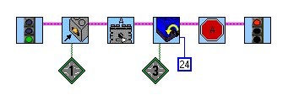
Exercise 4: Solution
When the touch sensor is pressed, turn on motor A in the forward direction. Then, turn the rotational sensor 1 1/2 rotations to turn the motor off.
IMPORTANT: Different sensors
must be on different ports.
24 ticks = 1 1/2 rotations

Slide 6
Lesson 3: Sensor Wait-for’s
Troubleshooting Tips

Slide 7
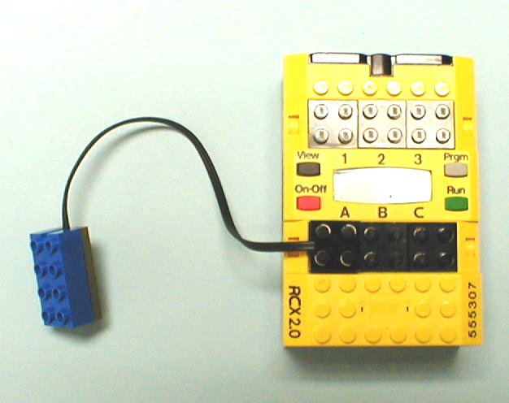
Problem 3a
Why won’t the light sensor work?
This is a
motor port.

Slide 8
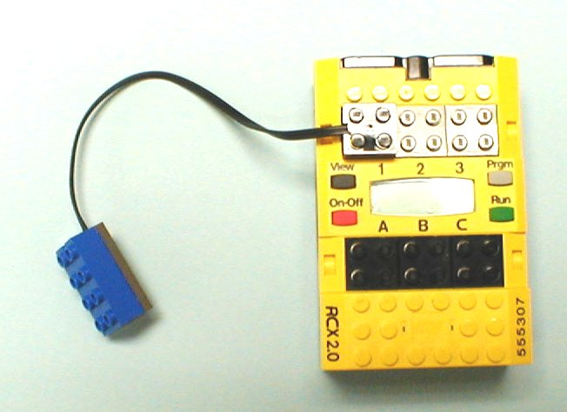
Solution 3a
Sensors need to be connected to Sensor ports 1, 2 or 3.
Sensor ports

Slide 9
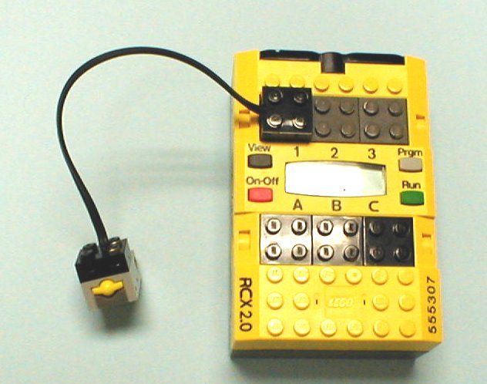
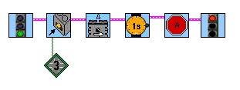
Problem 3b
What’s wrong with this set up?
The touch sensor is
connected to port 1.
But the software says the
touch sensor is on port 3.

Slide 10
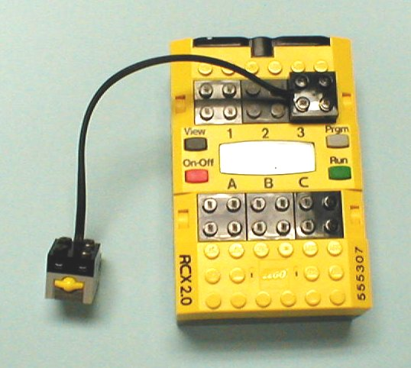
Solution 3b
Connect the touch sensor to port 3.
Or, change the port number in the software.

Slide 11
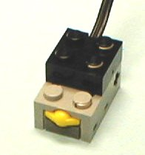
Problem 3c
Why won’t the touch sensor work?

Slide 12
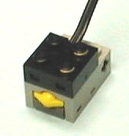
Solution 3c
Make sure the cable is connected to the front of the touch sensor.
WRONG RIGHT

Slide 13
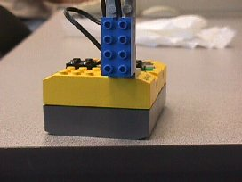
Problem 3d
What isn’t too great about the way the light sensor is mounted?

Slide 14
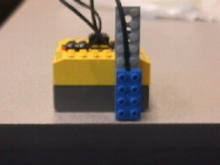
Solution 3d
If the light sensor is too high, it has a harder time distinguishing between black and white. Mounting it lower to the ground will help.

Slide 15

Problem 3e
What’s wrong with this program?
What is the default port?
What is the default port?

Slide 16
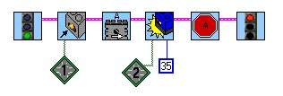
Solution 3e
Remember: Different sensors MUST be on different ports in the software. If a port is not specified, it assumes Port 1.

Slide 17
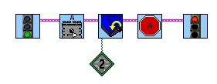
Problem 3f
This program should turn on motor A until the rotational sensor has turned 2 revolutions, then turn off the motor. Why doesn’t it work?
Hint: What is the default number of ticks
in a Wait-for Rotation icon?

Slide 18
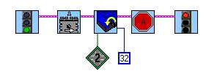
Solution 3f
The default number of ticks is 16, or 1 revolution. For 2 revolutions, you must specify the number of ticks with a numeric constant modifier.
32 ticks = 2 revolutions

