Slide 1
Scholarship Skills
Tim Sheard and Todd Leen
2006 PSU - OHSU
Lecture 3: Library Resources
All material ©2006
Tim Sheard

Slide 2
Acknowledgement
Many thanks to
Carol Rescoe at OGI’s library for most of the information contained in this document.
Michael Bowman at PSU’s library for additional advice.

Slide 3
Libraries
Libraries organize units of information
  Books
  Serials or periodicals (Journals)
  Conference Proceedings
  Dissertations
  Technical reports
  Pre-prints
  Web information
Classification
  bibliographic information
    Author
    Title
    Key words
  subject headings
  call numbers
    Useful for browsing in person

Slide 4
Efficient Search
Your search is most efficient if you understand the organization of the library,
Determine the probable format of the information that you seek. E.g.
  Book
  Journal
  Thesis

Slide 5
Kind of knowledge
Are you looking for a specific known item?
Are trying to gather information on a new subject?
A broad, general topic
A piece of data
A specific fact or explanation.

Slide 6
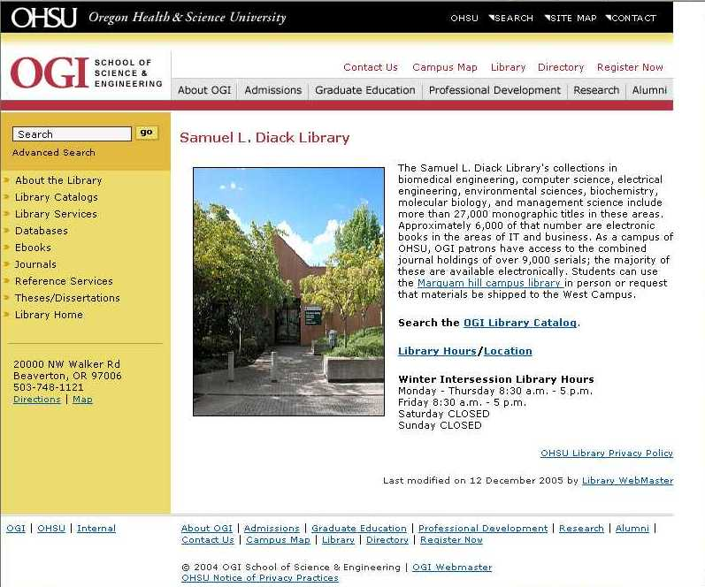
OGI's Library http://www.ogi.edu/library/

Slide 7
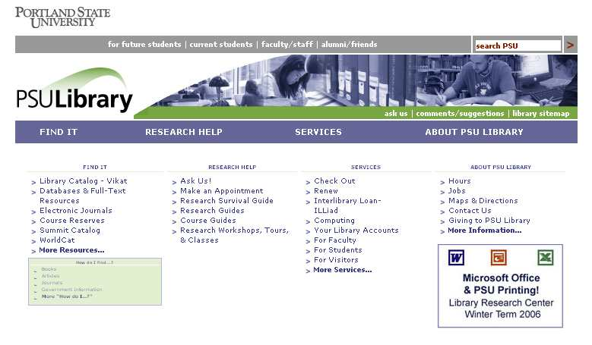
PSU Library http://www.pdx.edu/library/

Slide 8
Library Organization
Catalog
  Library specific
  Itemizes the holdings of the library
Databases
  Area specific
  Often list items not physically in the library
  Maintained by external entities

Slide 9
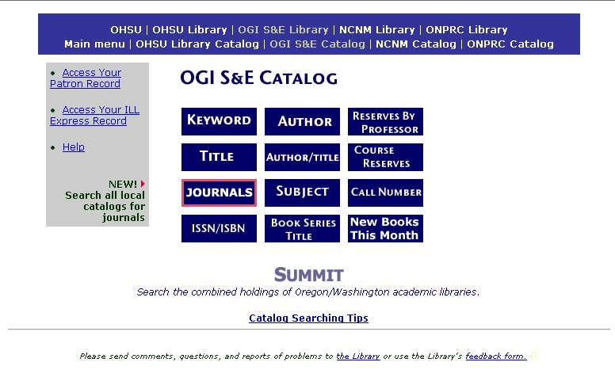
OGI’s Online Catalog: Sadicat http://catalogs.ohsu.edu/search~S2

Slide 10
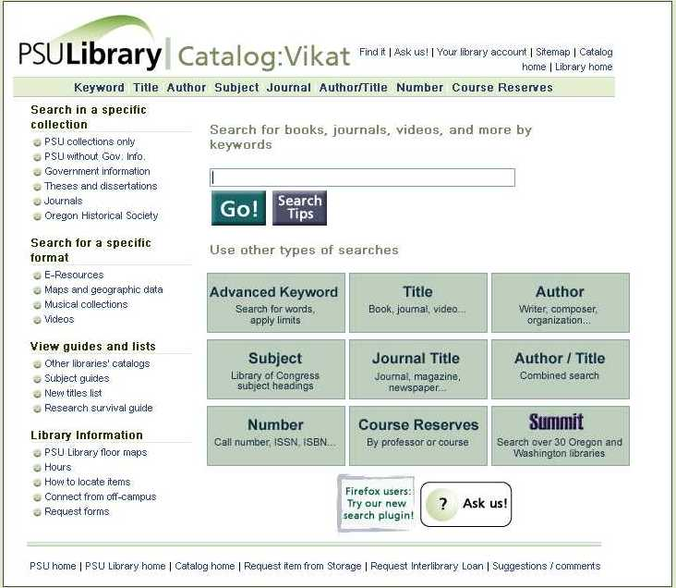
PSU's Online Catalog: Vikat http://vikat.pdx.edu/

Slide 11
BOOK INFORMATION
Go the library’s catalog page and search on Author, title, subject etc.
OGI’s SADICAT gives status of book as well as bibliographic information.

Slide 12
JOURNAL INFORMATION
Catalogs tell what journal’s are owned (e.g. New Generation Computing) and what issues are available, but do not list the contents of these journals.
Use databases, indexes and abstracting sources to find information contained in journals.
A majority of these sources are online files and most are web accessed databases.

Slide 13
Journals
Consulting journal lists will tell you which journals the libraries own and which issues they have received.
OGI Library Journal Information
  http://catalogs.ohsu.edu/search~S2
  It is arranged alphabetically by title and includes holdings information (ranges of years, volumes, and issues.).
PSU Journal Information
  http://vikat.pdx.edu/search~S5/t
  This lists the journals held on the Science and Technology Floor at Portland State University. It is arranged alphabetically by title and includes holdings information (ranges of years, volumes, and issues.).

Slide 14
Using Databases
The main library’s pages have links to online databases.
These are owned by others, and libraries purchase subscriptions. There is no cost to individual users.
Usually organized by research area,
  Accounting
  Anthropology
  Applied Linguistics
  Architecture
  Art
Or by title of Journal
  Academic Search Premier
  Access to African-American Studies
  ACM Digital Library

Slide 15
Other Tools for finding Articles
Uncover, and Uncover Reveal
Current Contents Connect
Both systems allow for browsing of tables of contents and for setting up profiles for running of searches.
The Reveal service is an email alert system. Current Contents depends on your running the weekly or monthly updates.
Current Contents has abstracts. Uncover does not.
Uncover indexes the journals subscribed to by the Colorado Libraries so coverage will be impacted by journal cancellations.

Slide 16
Current Contents Connect
http://www.isicc.com
Subjects
  Agriculture, Biology & Environmental Sciences
  Engineering, Computing & Technology
  Life Sciences
  Physical, Chemical & Earth Sciences
Type
  Journal table of contents
  bibliographic citations with author abstracts
  author addresses.
  Subject searches
  browsing tables of contents

Slide 17
Materials Covered: Articles, reviews, letters, notes, and editorials from more than 3,800 influential scholarly journals in the above subject areas.
Dates of Coverage: Search sessions can be limited to the latest week of data, latest four weeks, latest six months or an extended accumulating data file from late 1997.
Producer/Publisher: Institute for Scientific Information http://www.isinet.com/

Slide 18
Uncover Reveal
http://uncweb.carl.org/reveal
NOTE: UnCover Reveal only searches single words from the title and any author summaries which appear in the table of contents.

Slide 19
What is Reveal?
Table of Contents and Current Awareness Service.
Tables of contents for new issues of periodical titles that you select.
Citations for new journal articles published on topics that you specify.
Citations for the latest books published on subjects that you specify.
UnCover indexes over 17,000 journals.

Slide 20
What you can do with Reveal?
Receive tables of contents from 50 journals of your choice.
Store up to 25 search strategies.
You set up and maintain your own lists of titles and search strategies.
When new issues of the journals are entered into the Uncover database you are notified via email.

Slide 21
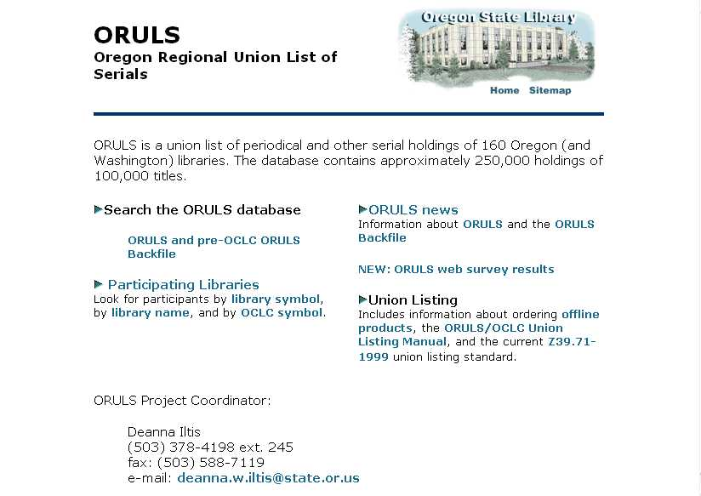
Regional Lists of Journals http://db.osl.state.or.us/oruls1.htm
ORULS - Oregon Regional Union List of Serials

Slide 22
SEARCHING FOR DISSERTATIONS
Most university libraries only catalog that university’s theses and dissertations.
To find an OGI or PSU thesis/dissertation: Search the Library catalog. You can search for by author or title keyword. At OGI you can download the full text of dissertations published after 1996.
To find thesis/dissertation from a different institution: Request the thesis/dissertation on Interlibrary Loan. Many libraries loan their theses/dissertations. However, many do not. Then you must use University Microfilms, Inc. The current cost for an unbound, shrink-wrapped thesis is $28.50

Slide 23
Finding DISSERTATIONS
Use “Dissertation Abstracts International”. This is a Database subscribed to by both OGI and PSU. There are internal links on the web pages.
Digital Dissertations: subscribed to by PSU
http://wwwlib.umi.com/dissertations/search
Dissertation Abstracts Online
http://library.dialog.com/bluesheets/html/bl0035.html

Slide 24
Finding Theses/Dissertations on a Topic
Use “Dissertation Abstracts” to locate theses/dissertations on your topic. Dissertation Abstracts contains PhD dissertations granted at accredited North American universities since 1861. Selected masters theses have been included since 1962.
Beginning in 1988, citations for dissertations from 50 British and European universities have been included. Records included in the database after June 1980 are abstracted.

Slide 25
Dissertation Abstracts
Indexes every American dissertation accepted at an accredited institution, some masters theses, some Canadian dissertations and some foreign.
Size: 1.4 million records
1861 - ; updated monthly.
Covers all subject areas.

Slide 26
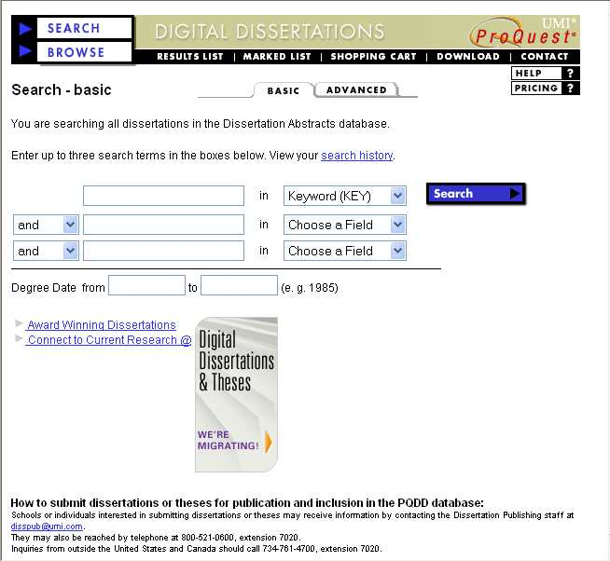
Digital Dissertations http://wwwlib.umi.com/dissertations/search

Slide 27
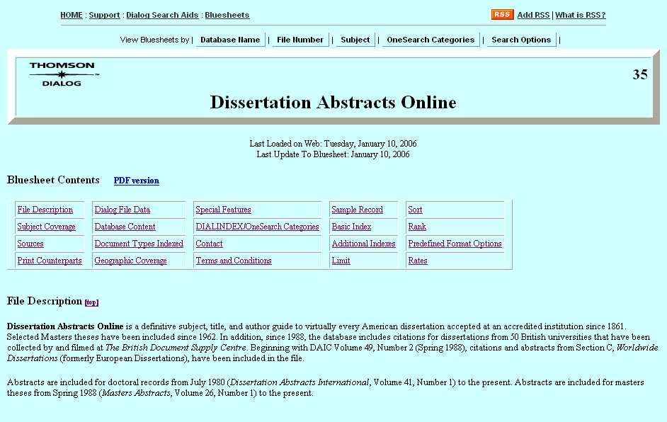
Dissertation Abstracts Online http://library.dialog.com/bluesheets/html/bl0035.html

Slide 28
Applied Science and Technology Abstracts
Indexes 350 periodicals, includes conferences.
Subject: applied sciences and technology.
Coverage: October 1983-
Updated monthly

Slide 29
Compendex
Subjects include civil, energy, environmental, geological, and biological engineering; electrical, automotive, nuclear, and aerospace engineering; and computers, robotics, and industrial robots.
Indexes journals, books, selected government reports, conference proceedings, and web pages.
1970 - ; updated weekly; Engineering Information, Inc. (EI)
Size: 4.1 million records total; adds 220,000 records each year.

Slide 30
Conference Papers Index
Indexes to papers and poster sessions presented at major scientific meetings around the world.
Subject emphasis since 1995 has been in the life sciences, environmental sciences and the aquatic sciences, while older material also covers physics, engineering and materials science.
Coverage: 1989 to the present.
Updated: Bi-monthly. Over 1,026,000 records as of February 1998

Slide 31
Computer Science Bibliographies
Consists of references to journal articles, conference papers, and technical reports.
Subjects include most aspects of computer science.
Indexes 1000 "bibliographies".
Current; updated monthly; Alf-Christian Achilles at the Informatics for Engineering & Science, University of Karlsruhe, Germany
Size: 740,000 records total

Slide 32
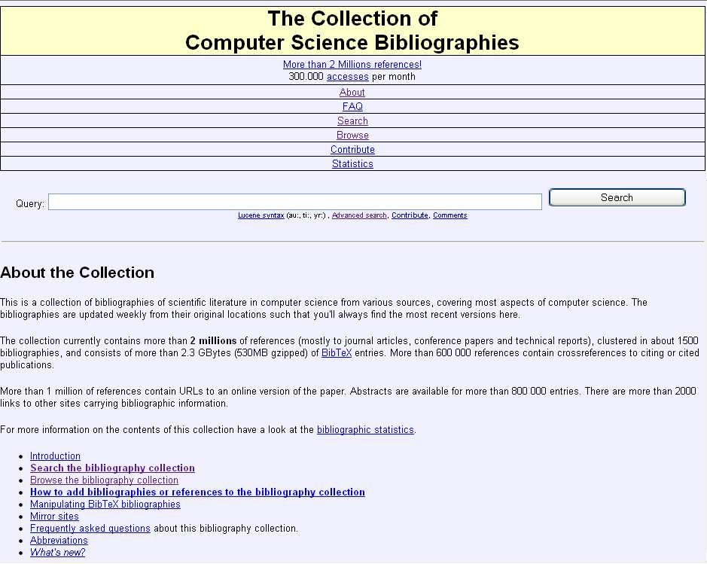
http://liinwww.ira.uka.de/bibliography/index.html

Slide 33
Computer Science Technical Reports
Computer Science Technical Reports NCSTRL (pronounced "ancestral") is an international collection of computer science technical reports from CS departments and industrial and government research laboratories, made available for non-commercial and educational use. NCSTRL includes reports of UC Berkeley Computer Science Division ( and OGI’s reports).

Slide 34
Current Contents Connect
Back issues to late 1997; updated weekly; (ISI) Institute for Scientific Information, Inc. US
Size: records per weekly issue Life (6,000); others (3,000)
Indexes journals Life (1,400 titles): Eng/Comp (1200 titles); others (1,000 titles).
OGI receives 4 sections: Agriculture, Biology, & Environmental Sciences; Engineering, Computing, & Technology; Life Sciences; Physical, Chemical, and Earth Sciences

Slide 35
INSPEC
Subjects include computing and control, electrical engineering & electronics, physics, and information technology.
Indexes journals, books, conference proceedings, and reports.
1969 - present; updated monthly; Institute of Electrical Engineers (IEE)
Size: 5.1 million records total
Need to ask library to do search or take training in STN searching.

Slide 36
Uncover (Carl)
Indexes journals (17,000 titles) in all disciplines, received by CARL members.
Indexes only words from the titles, and authors - NO subject headings.
Can browse table of contents of specific issues of specific journals.
Fall 1988 - present; updated daily; Colorado Alliance of Research Libraries (CARL)
Size: 7,000,000 records total; 4,000 records added daily.

Slide 37
Digital Libraries
Many traditional Journal publishers now have many past issues on line. A few that are useful to the C.S. community are:
ACM
Springer
IEEE

Slide 38
ACM E-Guide to Computing Literature
CD-ROM available in the library, also available at www.acm.org
Subject: aspects of computing.
Indexes US and international journal articles, conference materials, books, theses, and technical reports.
Coverage: January 1980 - December 1996; ACM
Size: over 280,000 entries.

Slide 39
ACM Digital Library
The ACM Digital Library provides full-text coverage of 95% of all ACM journals and proceedings from 1991.
Subject: aspects of computing.
Coverage: 1985 on
Size: nearly 9,000 full-text articles, tables of contents, 5,000 citations to articles published in ACM journals and 15,000 citations to conference proceedings.

Slide 40
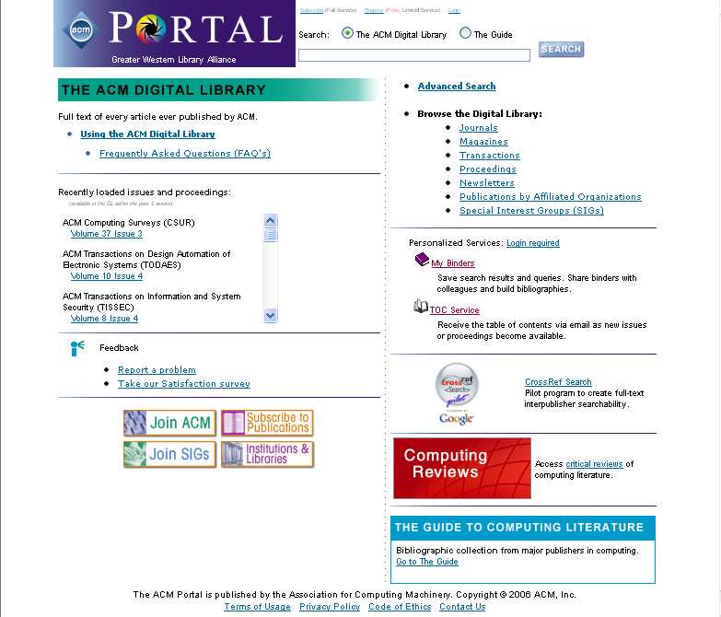
http://portal.acm.org/dl.cfm

Slide 41
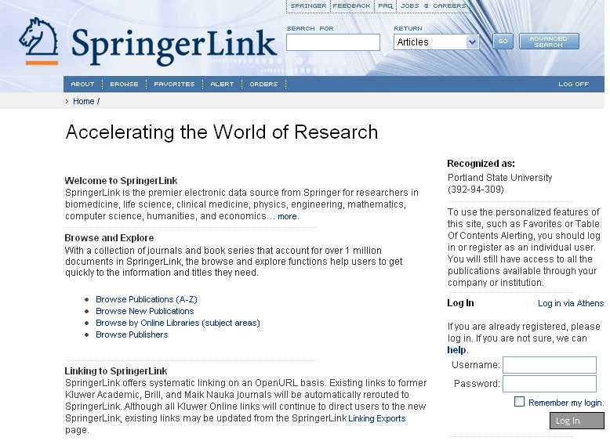
http://www.springerlink.com

Slide 42
IEEE Journals
All on-line Journals of IEEE are available through the “Electronic Journals” link off the PSU library

Slide 43
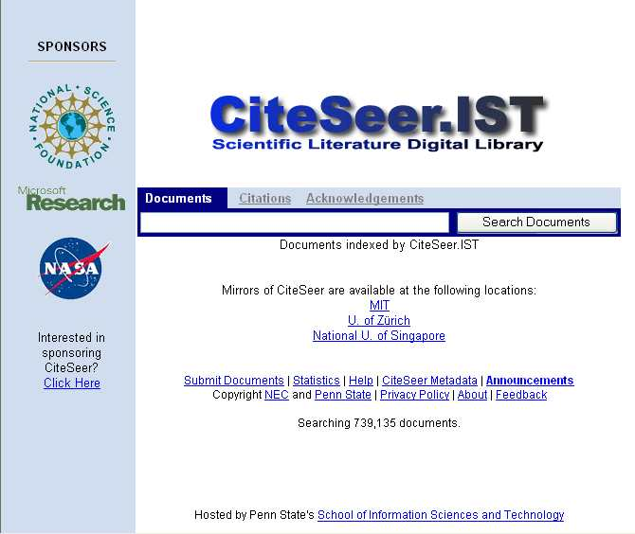
http://citeseer.ist.psu.edu/
CiteSeer allows one to chain forward by finding papers that cite another paper.

Slide 44
Today’s Assignment complete description on the assignments page
Jan 17, due Tuesday, Jan 19, 2006
This exercise is kind of a scavenger hunt in the library. It can be completed without using on-line services. (The next exercise will deal with those.)
What are two journals that frequently publish papers on algorithms? What reference series features algorithms?
What is LNCS? Where is it?
What is the name of one of the journals published by the British Computer Society?
What does XML stand for? Cite a recent article in a trade publication that mentions it.
What does SIAM stand for?
Under what call number are OGI / PSU theses shelved?
Give the names of two regular conferences on software engineering.
Many computer science books are shelved in the vicinity of QA 76. Where can you find another concentration of books relevant to computer science?
Describe the location of the ACM Guide to Computing Literature. List three of the ways it organizes citations.
What organization within ACM published the ACM SIGOIS Bulletin? Why does this publication stop in December 1996?
What reference book can tell you what ENIAC stands for?

