Slide 1
Scholarship Skills
Tim Sheard, PSU & Todd Leen, OHSU
Presentations 1 - Materials
Material © 1996, 1997, 1999, 2000 David Maier
additional Material © 2001, 2005, 2006 Tim Sheard, Todd Leen

Slide 2
Presentations
Organizing material
Preparing the slides
Giving the talk
Standard Conference Talks
  Most conference presentations are 15-30 minutes, time to explain a few pages of material.
  Listener can take away at most one or two ideas.
  Treat such a talk as an advertisement for your research—get listeners to look further
Long Conference Talks (invited, special slot)
  An hour talk needs to educate the audience on the research.
  Listener can take away at most two or three ideas.

Slide 3
Ogilvy on Advertising
David Ogilvy (www.ogilvy.com)—Good advertising makes a promise.
29 January 1996 Newsweek promises:
  A Ford Contour will make driving fun.
  Campbell’s Chunky soups give you a fast, square meal.
  Grand Marnier will add mystery to your life.
  My method will let you optimize large joins in a few seconds.
  Reading my paper will add mystery to your life.
What’s the promise if they read your paper?

Slide 4
Choose Material - Review Paper
Mark examples and graphics to use (or adapt).
Think if you need additional examples.
  to replace formal definitions, for example.
  Examples really help – listeners have seconds to understand something in a talk; then it’s gone forever!
Tick off sections to emphasize, ones to skip.
Consider if another order is better for the talk—listener can’t jump around like a reader can.
  Algorithm, Implementation Details, Performance Results
Difficult sections — might omit if they are hard to explain quickly.
  No proof or derivation details. Avoid large results tables. Avoid complex diagrams (anything that can’t be dissected visually in under a minute).
  In a longer talk, they might be important.

Slide 5
Planning
Calculate the number of slides to use.
  Usually 1.5-3 min./slide, except
    title pages
    content pages
  One minute per slide is impossible!!
  Do a story board (a visual outline).
  Try for at least 1/3 slides with visually interesting feature: Diagram, (SMALL!) Table, Graph, Bullet list of short items. (Unlike these slides, you should avoid page after page of text.)
Draft slides on quarter pages.
  Helps gauge size of slide.
  A good rule of thumb is LESS THAN 12 LINES PER PAGE.

Slide 6
Slides are Prompting Notes
Think of text on the slides as notes a reader might take during the talk.
  Don’t duplicate everything you say.
  But you should talk to a ALL points on slides.
  If you’re not going to talk about it, remove it.
  Abbreviations, sentence fragments okay (helps listener get through written material quickly – easier to follow)
  Next we consider the case where n is strictly between 0 and 1.
  Case 2: 0 < n < 1

Slide 7
Advice from Many Sources
Emphasize results and interpretations over minutiae of techniques. (Even if technique is the contribution, emphasize basics and results obtained.)
Expect to use a non-uniform level of detail.
Consider a contents slide, but not at the beginning of the talk – after introductory problem statement is a good place.
Your talk title need not match the title of your paper.

Slide 8
Advice 2
Don’t forget a slide with name, affiliation, co-investigators, sponsors— (typically the title page)
  if only to mark your arrival & introduce yourself
Can include acknowledgments, references. (Put up the last slide with references while you’re answering questions.)

Slide 9
Advice 3
Involve the audience – e.g. ask a rhetorical question, relate a concept or question to common experience
Build in re-entry points—a place a listener can pick up the thread again
  That was the correctness proof of the algorithm, but you don’t need to master it to understand our performance experiment...
Explanation and definition via example
  plays(MUSICIAN INSTRUMENT YEARS)
  Schikele Hardart 14
  Franklin Glass Harm. 10
  Cage Washtub 2
relation
name
attribute
tuples
value for
attribute

Slide 10
Advice 4
Plan some flexibility into the talk.
  Slides you can omit if your are running long or the audience looks bored.
Remember the listener has a disadvantage over a reader—can’t jump ahead or back
Has only seconds to understand
  Remind people of defs if several slides intervene between first use of variable.
  For example, repeat variables
  |D|*s_{v}
    D - set of examined nodes
    s_{v} - average size of v
  or use mnemonic names
    DONE size(v)
Indicate what to remember – like interpreting a graph or equation in the text; tell people what they’re supposed to see.

Slide 11
Bad Slides
ONE WAY TO MAKE YOUR SLIDES NEARLY UNREADABLE IS TO USE ALL CAPITAL LETTERS IN A SANS-SERIF FONT. THIS GUARANTEES ALMOST A UNIFORM FIELD OF GRAY FROM ANYONE WATCHING FROM THE BACK OF THE ROOM. IT ALSO HELPS IF YOU RUN ITEMS TOGETHER, RATHER THAN STARTING EACH ON A NEW LINE. FILL UP THE SLIDE FROM TOP TO BOTTOM WHILE YOUR ARE AT IT. IF YOU PREPARE SLIDES IN THIS MANNER, THEN YOU SHOULD ALSO READ THEM WORD-FOR-WORD OFF THE SLIDE WHILE KEEPING YOUR BACK TO THE AUDIENCE. TRY TO MAKE YOUR VOICE AS MONOTONOUS AS THE SLIDES. SOMETIMES YOU CAN GET A PAYOFF FROM THE LOCAL OPTOMETRIST FOR THE EYE STRAIN IT CAUSES. SMALL FONTS ALSO HELP A LOT. ONE WAY TO MAKE THIS EVEN WORSE IS TO REPLACE IT WITH A PAGE PHOTOCOPIED FROM THE JOURNAL OR CONFERENCE PAPER. DON’T LAUGH – THIS HAPPENS MORE THAN YOU’D EXPECT.

Slide 12
Distracting the Audience
You paid for all those fancy fonts and features in your text editor; you ought to get your money’s worth out of τηεμ.
If you use enough distracting elements on your slides, the audience will be so pre-occupied they won’t even notice you don’t know what you are talking about.
& don’t forget the dingbats! 
It’s probably a good idea to use different colors, even when they don’t signify anything.

Slide 13
Landscape vs. Portrait Format
Most overhead projectors will handle 11”-by-11” or so
  Transparencies are not used in conferences
  But good for local, informal talks
  Quicker to build (especially with eqns) than ppt.
In-Focus projectors are the modern standard --- and tied to standard video formats (LANDSCAPE FORMAT).

Slide 14
Handwritten vs. Typeset
Handwritten
  Encourages graphics, makes colors easier to use
  Often quicker to produce (especially math)
Typeset
  Can revise slides easily
  Last minute slides are possible if you have a laptop – really GREAT for workshops, can alter material depending on what’s been said before you!

Slide 15
If You Handwrite...
Use pens that can be erased – much easier.
Sketch, then trace, figures.
Use a backing sheet of lined paper.
Have a “vocabulary” for color. (Consider fonts and color as lexical variables.)
Be careful of finger prints.
Number slides, so when you drop them …
>> Write notes to yourself on the separating pages <<

Slide 16
If You Typeset...
Some say serifs, cursive fonts easier to read.
Upper & lower case easier to read than all caps.
Write delivery notes to yourself if your machine supports two screens!

Slide 17
Formatting
Pointsize to use depends on font and plain vs bold.
  Courier: 32pt 24pt 18pt 16pt 12pt 8pt 6pt
  Impact: 32pt 24pt 18pt 16pt 12pt 8pt 6pt
On text slides, use visual elements so audience can keep their place
  bullets, indentation, highlight, different-length lines – but don’t create distracting elements
I’m not sure titles are always necessary.
Number your slides – helps provide reference points for questions

Slide 18
Animation
Having new items appear can help lead audience through material
But
dissolves
Fly-ins
and blinds
are distracting and will make your
audience groan.

Slide 19
Other Considerations
Can be confusing to combine topics on a slide
  Ok not to fill up a slide.
  Blank space is your friend
Authors & date usually good enough for a citation.
  [Launchbury & Sheard 1995]
If you want to refer back to a slide, duplicate it, or place buttons on PowerPoint slides to bounce you back and forth.

Slide 20
Electronic Slides (PowerPoint)
Can make modifications at the last moment
Don’t get too enamoured of fancy graphic and transition effects
  E.g., bullets entering one by one
  Don’t want to distract from content
  But “overlays” can be very effective
  Transitions useful for building sequence
Make sure you have a backup !!
  e.g. link to your web page, carry a CD-rom version as well as your flash-drive

Slide 21
Simplify Charts and Graphs
Fewer significant digits, minimize non-data graphics distractions, align columns
Benchmark Disk I/O CPU Idle
TPC-A 141.3 554.23 53.4%
TPC-B 3559.4 1255.83 22.3%
TPC-C 1298.0 988.65 61.1%
TPC-D 1904.4 1667.56 44.2%

Slide 22
Simplify Charts and Graphs 2
Benchmark Disk I/O CPU Idle
TPC-A 140 550 55%
TPC-B 3560 1250 20%
TPC-C 1300 990 60%
TPC-D 1900 1670 45%

Slide 23
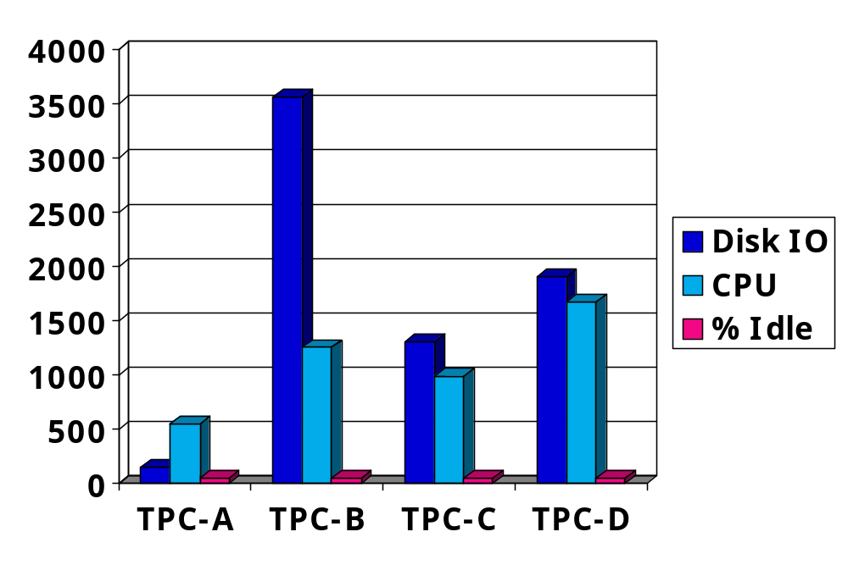
Simplify Charts and Graphs 3

Slide 24
Demos and Poster Sessions
Primary purpose of demo or poster is to start a conversation.
Don’t expect the demo or poster to take the place of you talking — they are visual aids.
Don’t expect someone to read your whole paper off a poster.
  Think about a 15-minute presentation on your paper— then use the slides as the basis of the poster.
Graphics are better than text.
You can say words; use poster space for figures and formulae.

Slide 25
Demos and Poster Sessions 2
Make sure demo is automated enough that you can keep talking.
Don’t forget to show your name and affiliation somewhere.

