Slide 1
Paper Analysis
Implementing Multi-stage Languages Using ASTs, Gensym, and Reflection
by Calcagno, Taha, Huang, and Leroy

Slide 2
What kind of paper is it?
Mostly an analysis paper, analyzing MetaOcaml
  Discussion of under-the-hood implementation of MetaOcaml
  More formalized description of MetaOcaml than the papers we've seen on MetaML
  Mathematical proof of correctness of MetaOcaml
  Performance measurements

Slide 3
What kind of paper is it?
From our point of view, we could also consider it partly a synthesis paper and an extension paper
  Brings staged languages together with mathematical proofs and formalization
  Extends staged languages discussion to more technical and detailed aspects
Not really a new idea paper
  Doesn't seem to do anything not done by MetaML

Slide 4
What previous work is necessary to understand this paper?
Some knowledge of staged languages
Some compiler topics
  Abstract syntax trees
  General idea of what a compiler does

Slide 5
The Problem
Same problems as in the MetaML papers in extending one- and two-stage languages
Approaches it from a different point of view

Slide 6
Structure
General description
Formal syntax of Multi-stage source language
Formal syntax of Single-stage target language
Translation of source to target (and then decompilation)
Proof of correctness
Some implementation details
Performance analysis

Slide 7
Evaluating a multi-stage language
Translate the multi-stage language into a single-stage language
Evaluate the single-stage language
Decompile the result

Slide 8
ASTs, Gensym, Reflection
Abstract Syntax Trees
  Used in translating multi-stage to single-staged
Gensym
  Generating symbols when translating
Reflection?

Slide 9

Multi-stage source language

Slide 10

Single-stage target language

Slide 11
Translation
Translate from multi-stage (source) to single-stage (target)
  Abstract syntax tree building
  Symbol generation (gensym)
  Run (called mor in the translation)

Slide 12
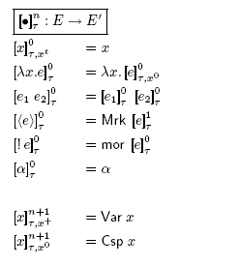
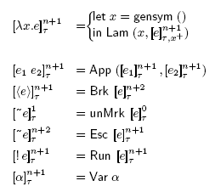
Translation functions

Slide 13
Decompilation
Inverts what happened during translation
Evaluates

Slide 14
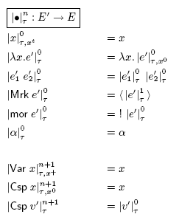
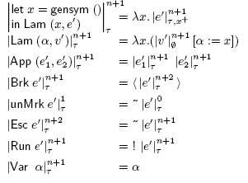
Decompilation functions

Slide 15
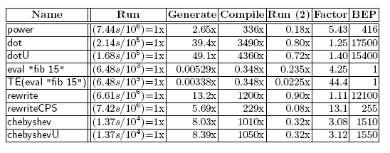
Performance analysis

