Slide 1
A Methodology for Generating Verified Combinatorial Circuits
Kiselyov, Swadi, Taha
CSE 510 Section FSC
Winter 2004

Slide 2
Synopsis
Background
  Resource Aware Programming languages
  Fast Fourier Transforms
  Abstract Interpretation
Relevancy
  Systems engineering
  Performance measurement
Benefits
  Generated programs are well-typed and resource bounded before generation
  Optimization performed at development stage
Notes:
Systems engineering – 5 step methodology
Performance measurement

Slide 3
The Methodology
Implement input-output behavior in expressive type-safe language
Transform the program into monadic style and verify correctness
Identify computational stages between development and deployment platforms
Add staging annotations
Use abstract interpretation to optimize the program (do not traverse inside code)

Slide 4
Fast Fourier Transform
Implement Cooley-Tukey recurrence
Use monads for sharing common expressions
Stage the FFT wrt the size of the input vector
Write staged version of functions

Slide 5
Raw code
int __fun_def(double * x_234 ) {
...
y1_243 = x1_235; y2_244 = y1_236;
y1_245 = x1_239; y2_246 = y1_240;
y1_247 = y1_243 + (1. * y1_245 - 0. * y2_246);
y2_248 = y2_244 + (1. * y2_246 + y1_245 * 0.);
y1_249 = y1_243 - (1. * y1_245 - 0. * y2_246);
y2_250 = y2_244 - (1. * y2_246 + y1_245 * 0.);
y1_251 = x1_237; y2_252 = y1_238;
y1_253 = x1_241; y2_254 = y1_242;
y1_255 = y1_251 + (1. * y1_253 - 0. * y2_254);
y2_256 = y2_252 + (1. * y2_254 + y1_253 * 0.);
y1_257 = y1_251 - (1. * y1_253 - 0. * y2_254);
y2_258 = y2_252 - (1. * y2_254 + y1_253 * 0.);
x_234[0] = y1_247 + (1. * y1_255 - 0. * y2_256);
x_234[1] = y2_248 + (1. * y2_256 + y1_255 * 0.);
x_234[2] = y1_249 + (6.12303176911e-17 * y1_257 - -1. * y2_258);
x_234[3] = y2_250 + (6.12303176911e-17 * y2_258 + y1_257 * -1.);
x_234[4] = y1_247 - (1. * y1_255 - 0. * y2_256);
x_234[5] = y2_248 - (1. * y2_256 + y1_255 * 0.);
x_234[6] = y1_249 - (6.12303176911e-17 * y1_257 - -1. * y2_258);
x_234[7] = y2_250 - (6.12303176911e-17 * y2_258 + y1_257 * -1.);
x_234; return 0;

Slide 6
What’s inefficient?
Repeated sub expressions in computations
Unnecessary assignments
Round-off errors
Trivial but expensive calculations
  Floating point multiplication by 1 and 0

Slide 7
Abstract Interpretation
Use staged algebraic datatype to simplify
datatype maybeVal
= Val of <float>
| Exp of <float>
datatype abstract_code
= Lit of float
| Any of float * maybeVal
Fun conc v = case v of
(Lit x) -> Val <x>
|Any (1, x) => x
|Any (-1, x) => Exp <- ~(mVconc x) >
etc.

Slide 8
Abstract Interpretation
Staging algebraic datatype
fun add_a(n1, n2) =
…
Case (n1, n2) of
(Lit 0, x) => x 0+x=x
|(x, Lit 0) => x x+0=x
…
|(Any (fx,x), Any(fy, y) =>
if fx=fy then Any (fx, mV_add x y)
else …
f*x + f*y = f*(x+y)

Slide 9
Other optimizations
Monadic sharing
  Define monadic operator so that only names are duplicated
Round-off errors
  Since input size is known, compute roots of unity (factors of the FFT) at generation time.

Slide 10
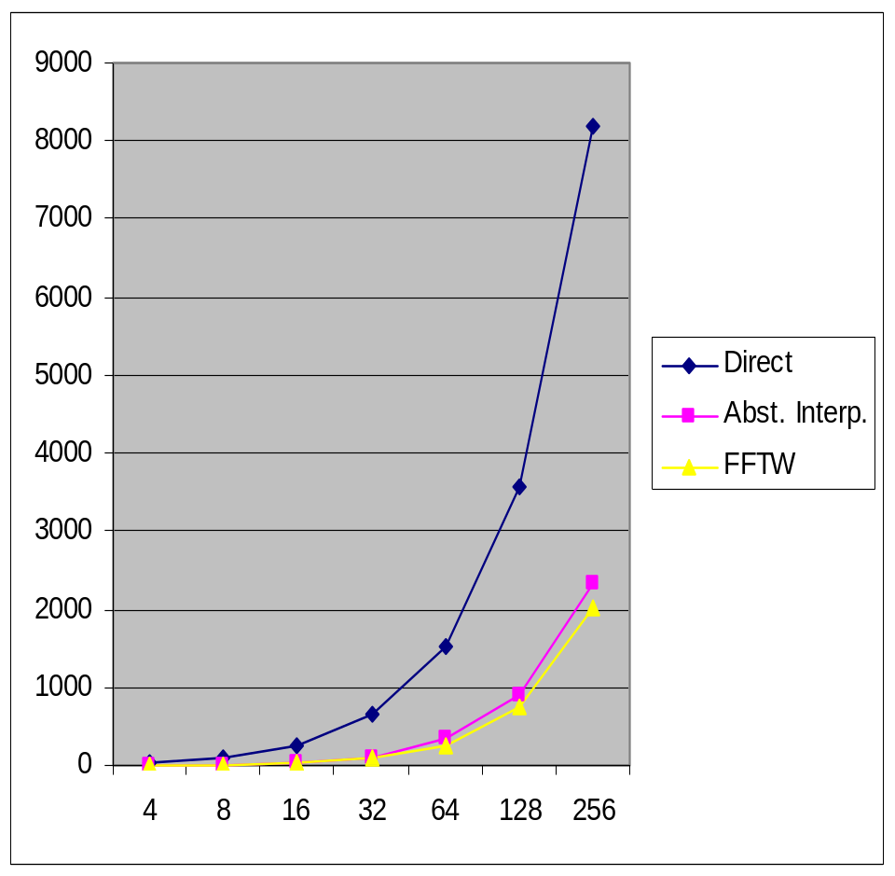
No. of floating point operations per input size
Results
int __fun_def(double * x_382 ) {
...
y1_383 = x_382[0]; y2_384 = x_382[1];
y1_385 = x_382[4]; y2_386 = x_382[5];
y1_387 = y1_383 + y1_385;
y2_388 = y2_384 + y2_386;
y1_389 = y1_383 - y1_385;
y2_390 = y2_384 - y2_386;
y1_391 = x_382[2]; y2_392 = x_382[3];
y1_393 = x_382[6]; y2_394 = x_382[7];
y1_395 = y1_391 + y1_393;
y2_396 = y2_392 + y2_394;
y1_397 = y1_391 - y1_393;
y2_398 = y2_392 - y2_394;
x_382[0] = y1_387 + y1_395;
x_382[1] = y2_388 + y2_396;
x_382[2] = y1_389 + y2_398;
x_382[3] = y2_390 - y1_397;
x_382[4] = y1_387 - y1_395;
x_382[5] = y2_388 - y2_396;
x_382[6] = y1_389 - y2_398;
x_382[7] = y2_390 + y1_397;
x_382; return 0;
}

