Slide 1
Fundamentals of
Staged Computation
Lecture 11: C-Mix and partial evaluation
Tim Sheard
Portland State University
CS510 Section FSC
Winter 2005

Slide 2
Assignments
Remember the ¾-term exam is 2 weeks from today on Tuesday March 8, 2005
Homework #7 is now assigned
  Due Thursday March 3.
Reading Assignment
  Read the very short paper “C-Mix: Making Easily Maintainable C-Programs run Fast”
  Handed out in class today.

Slide 3
Discussion of Homework #6
Homework 6
Use a monad that encodes dynamic alpha renaming
Stage the resulting interpreter

Slide 4
The Monad
datatype 'a M = M of (int -> ('a * int));
fun return x = M(fn n => (x,n));
fun bind (M f) g =
M(fn n => let val (a,n1) = f n
val M h = g a
in h n1 end);
val m = Mon(return,bind);
fun newvar s = M(fn n => (s^(toString n),n+1));
fun fmap f e = Do m { x <- e; Return m (f x) };

Slide 5
Changes to the Abstract Syntax
datatype V =
VI of int
| VF of (V -> V M)
| VC of exp
and exp =
EI of int (* integers *)
| EA of exp * exp (* applications *)
| EL of string * exp (* lambda-abstractions *)
| EV of string (* variables *)
| EB of exp (* brackets *)
| ES of exp (* escape *)
| ER of exp (* run *)
| EC of string * V; (* cross-stage constants *)
Note functions return V M and not V

Slide 6
Remember Covers
fun coverE env e =
case e of
EI i => EI i
| EA(e1,e2) => EA(coverE env e1,coverE env e2)
| EL(x,e1) => EL(x,coverE env e1)
| EV y => env y
| EB e1 => EB(coverE env e1)
| ES e1 => ES(coverE env e1)
| ER e1 => ER(coverE env e1)
| EC(s,v) => EC(s,coverV env v)
and coverV env v =
case v of
VI i => VI i
| VF f => VF(fmap (coverV env) o f)
| VC e => VC(coverE env e);

Slide 7
Monadic Interpreter
fun ev2 e env =
case e of
EI i => Return m (VI i)
| EA(e1,e2) => Do m { VF f <- ev2 e1 env
; x <- ev2 e2 env
; f x }
| EL(x,e1) =>
Return m (VF(fn v => ev2 e1 (ext env x (EC(x,v)))))
| EV x => (case env x of EC(_,v) => Return m v
| w => Return m (VC w))
| EB e1 => Do m { c <- eb2 1 e1 env
; Return m (VC c) }
| ER e1 => Do m { VC c <- ev2 e1 env
; ev2 c env0 }
| EC(s,v) => Return m (coverV env v)
| ES e1 => error "escape at level 0"

Slide 8
Monadic Rebuilding
Fun eb2 n e env =
case e of
EI i => Return m (EI i)
| EA(e1,e2) => Do m { f <- eb2 n e1 env
; x <- eb2 n e2 env
; Return m (EA(f,x)) }
| EL(x,e1) => Do m { x' <- newvar x
; body <- eb2 n e1 (ext env x (EV x'))
; Return m (EL(x',body)) }
| EV y => Return m (env y)
| EB e1 => Do m { c <- eb2 (n+1) e1 env
; Return m (EB c) }
| ES e1 => if n=1
then Do m { VC c <- ev2 e1 env; Return m c }
else Do m { c <- eb2 (n-1) e1 env; Return m (ES c) }
| ER e1 => Do m { c <- eb2 n e1 env; Return m (ER c) }
| EC(s,v) => Return m (EC(s,coverV env v));

Slide 9
Helper Functions
fun apply f x =
(case (f,x) of (VF f,v) => f v);
fun F f = Return m (VF f);

Slide 10
Staged Interpreter
fun ev3 e env =
case e of
EI i => <Return m (VI ~(lift i))>
| EA(e1,e2) => <Do m { f <- ~(ev3 e1 env)
; x <- ~(ev3 e2 env)
; apply f x }>
| EL(x,e1) =>
<F (fn v => ~(ev3 e1 (ext env x <EC(~(lift x),v)>)))>
| EV x => (case env x of <EC(~s,~v)> => <Return m ~v>
| w => <Return m (VC ~w)>)
| EB e1 => <Do m { c <- ~(eb3 1 e1 env)
; Return m (VC c) }>
| ER e1 => <Do m { VC c <- ~(ev3 e1 env)
; run (ev3 c env0) }>
| EC(s,v) => <Return m (coverV (fn x => run (env x)) v)>
| ES e1 => error "escape at level 0"

Slide 11
<fn a => ~( (fn x => <x>) (fn w => <a>) ) 5>
<Do %m { a <- %newvar "a"
; d <- %F (fn b => Do %m { c <- Return %m EC("x",b)
; Return %m VC c })
; g <- %F (fn e => Do %m { f <- Return %m EV a
; Return %m VC f })
; VC h <- %apply d g
; i <- Return %m EI 5
; j <- Return %m EA(h,i)
; k <- Return %m EL(a,j)
; VC l <- Return %m VC k
; m <- run %ev3 l (%env0)
; n <- Return %m VI 3
; VC o <- %apply m n
; run %ev3 o (%env0)
}>

Slide 12
After Monad Laws
<Do %m
{ a <- %newvar "a"
; c <- %F (fn b => Return %m (VC (EC("x",b))))
; e <- %F (fn d => Return %m (VC (EV a)))
; VC f <- %apply c e
; VC g <- Return %m (VC (EL(a,EA(f,EI 5))))
; h <- run %ev3 g %env0
; VC i <- %apply h (VI 3)
; run %ev3 i %env0
}>

Slide 13
The H function
<Do %m { p <- %F (fn a =>
%F (fn b =>
%F (fn c =>
Do %m
{ d <- %apply (VI 7) b
; f <- %F (fn e => Return %m c)
; g <- %apply d f
; o <- %F
(fn h =>
Do %m
{ i <- %newvar "x"
; j <- %apply (VI 7) h
; k <- %apply j (VI 1)
; l <- %apply a k
; VC m <- Return %m c
; VC n <- %apply l
(VC (EA(EA(EC("+",VI 7),EV i),m)))
; Return %m (VC (EA(EL(i,n),EC("n",h))))
})
; %apply g o
})))
; q <- %apply (VI 6) p
; r <- %apply q (VI 3)
; %apply r (VC (EI 4))
}>

Slide 14
The Cmix partial Evaluator
Partial evaluation
  Specialization of a program because some of the arguments are known to be constant
  Source to Source transformation
  Can dramatically speed up program
Analogy to compilation vs intepretation

Slide 15
Xdup.c
123abc
Xdup.c
interpreter
C-compiler
123abc
abcccc
Xdup.exe
abcccc

Slide 16
Xdup.c
123
Xdup.c
specializer
C-compiler
123abc
Xdup123.c
Xdup.exe
C-compiler
abc
abcccc
Xdup123.exe
abcccc

Slide 17
Original Code
#include <stdio.h>
void xdupfun(char counts[], char data[]) {
int i, t ;
for( i=0; counts[i]; i++ ) {
t = counts[i]­'0' ;
while( t­­ )
putchar(data[i]) ;
}
}

Slide 18
Specialized Code
#include <stdio.h>
void
xdupfun(char *residual_arg)
{ char *data;
data = residual_arg;
putchar((int )data[0]);
putchar((int )data[1]);
putchar((int )data[1]);
putchar((int )data[2]);
putchar((int )data[2]);
putchar((int )data[2]);
return ;
}

Slide 19
Xdup.c
Xdupfun(St,Dy)
C-Mix
Xdup-gen.c
123
C-compiler
Xdup-gen.exe
abc
Xdup-123.c
C-compiler
Xdup-123.exe
abbccc

Slide 20
cmix xdup.c ­e 'goal: xdupfun($1,?)'
Next arg is a specializer directive
1st arg static, 2nd arg dynamic
source
Function to specialize

Slide 21
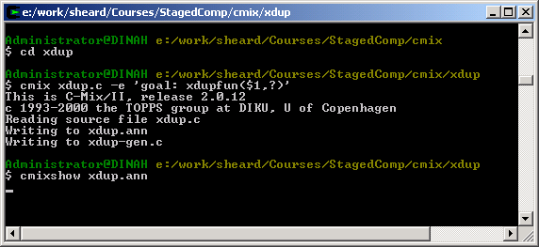

Slide 22
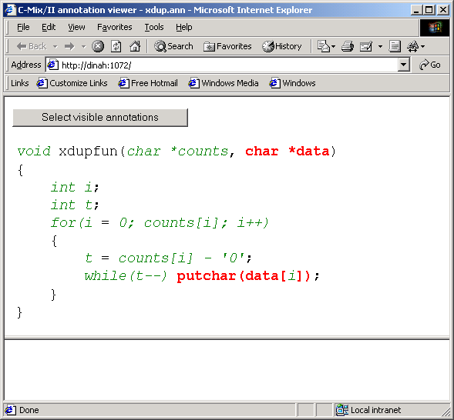

Slide 23
/cmix/xdup
$ cc xdup-gen.c -o xdup-gen -lcmix
/cmix/xdup
$ ls
xdup-gen.c xdup-gen.exe xdup.ann xdup.c
/cmix/xdup
$$ ./xdup-gen 123
/* This program was generated by C-Mix/II
* THIS IS AUTOMATICALLY GENERATED CODE
*/
#include <stdio.h>
void
xdupfun(char *residual_arg)
{
char *data;
data = residual_arg;
putchar((int )data[0]);
putchar((int )data[1]);
putchar((int )data[1]);
putchar((int )data[2]);
putchar((int )data[2]);
putchar((int )data[2]);
return ;
}

Slide 24
