Slide 1
Fundamentals of
Staged Computation
Lecture 11: A Reduction Semantics for MetaML
Tim Sheard
Oregon Graduate Institute
CS510 Section FSC
Winter 2005

Slide 2
Assignments
Projects. By now you should have a project in mind. If you haven’t already done so please write down a 1 page description and send it to me.
Projects are Tentatively due Thursday March 17, 2005
  Projects should include well commented code
  A number of example runs, with results
  A short writeup – several pages – describing the problem, your approach, your code, and any drawbacks you see in your solution.
Homework. There will be no more homeworks. Work on your project instead.

Slide 3
Acknowledgements
This set of slides is an adaption of Chapter 6 from Walid Taha’s thesis
Multi-stage Programming,
Its Theory and Applications.

Slide 4
Map for todays lecture
Reduction semantics for lambda calculus
  Rewrite rules
  Confluence
  Beta-v
Extensions for meta ml
  Rules for code
  Object level reductions
  Intensional analysis

Slide 5
Reduction Semantics
Rules for reducing expressions in a language.
Not all expressions are reducible.
Usually expressed as an (un ordered) set of rewrite rules.
Good for reasoning about terms in the language when the context of the term is vague or unknown (local reasoning).

Slide 6
Expressions and Values
Expressions denote
  Commands
  Computations
  Language constructs that have “work left to be done”
Values denote
  Answers
  Acceptable results
  Expressions that require “no further evaluation”
Values are a subset of Expressions
Syntactic view of the world

Slide 7
Example - λ calculus
Terms
  t ::= x | t t | (t,t) | λ x . t | i | #i t
Values
  v ::= x | λ x . t | (v,v) | i
Need rules for eliminating applications and variables
  In extensions need rules for performing primitive operations, like (+) (so called γ-rules)
  Projecting from tuples, (#1, #2) etc.
  Eta reductions

Slide 8
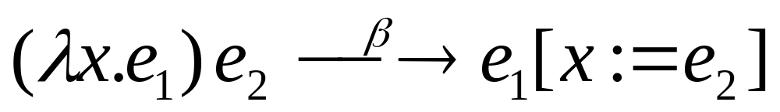
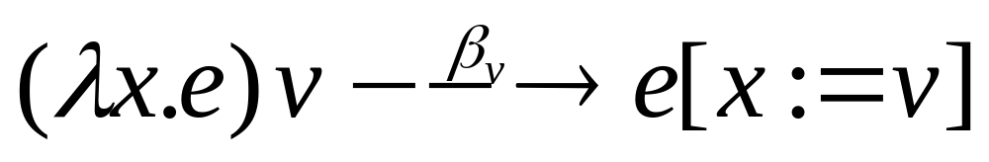
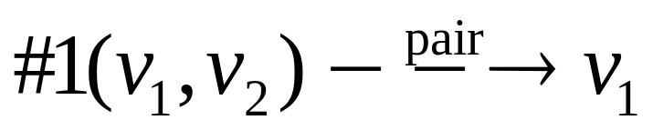
Rewrite rules
Call by Name β rule
Call by Value β rule
Projection rules

Slide 9
Contexts
Expressions with a single “hole”
Denoted C[e]
  C is the context
  e is the hole
Example:
  If C[_] = f x + _
  Then C[e] = f x + e

Slide 10
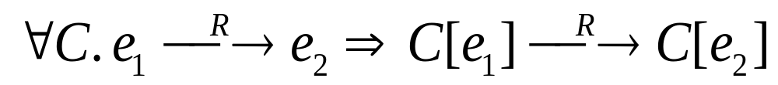
Desired Property of reduction semantics
For all contexts
If e1 rewrites by R to e2
Then C[e1] rewrites by R to C[e2]
Allows “local” rewrites, and “local” reasoning, regardless of the wider enclosing context C.

Slide 11
Coherence & Confluence
Term rewriting systems are non-deterministic.
Any rule that applies can be used at any time.
Applying the rules could get different results.
Coherence – any sequence of rewrites that leads to a ground value leads to the same ground value.
Confluence – Applicable rules can be applied in any order, and this does not affect the set of possible results. I.e. one never goes down a “dead-end”
Confluence implies Coherence

Slide 12
Example
run (power 1 <2>)
*
run < ~<2> * ~<1> >
esc twice
run < 2 * 1 >
δ
run
2 * 1
run 2
δ
run
2

Slide 13
Results
We want coherence
Its often easier to show confluence
Confluence implies coherence
Coherence says if we apply rules and we get to a value, then we’ll always get the same value.
Importance for a deterministic language
  Allows local reasoning to be valid

Slide 14
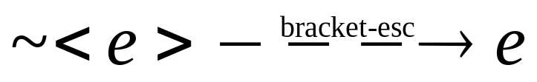
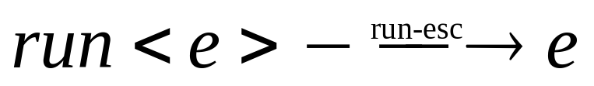
Extending to MetaML
Terms
  e ::= x | e e | λ x . e | i | <e> | ~e | run e
Values
  v ::= x | λ x . e | i | < ? >
Can we add the following rules to β_{v} ?

Slide 15
What goes wrong?
Beta screws up levels
  Every escape is attached to some bracket
  Escape can only appear inside bracket.
  But consider:
< (fn x => ~x) ~<4> >
< ~ ~<4> >

Slide 16
What goes wrong 2?
Beta conflicts with intensional analysis
  I.e. if we allow programmers to pattern match against code.
  And if we allow beta under brackets
  Then we lose coherence
  fun isbeta <~f ~x> = true
  | isbeta _ = false
  isbeta < (fn x => x) (fn y => y) >

Slide 17
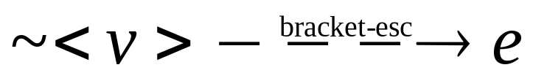
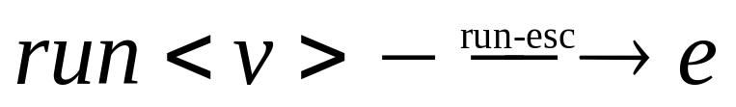
Fixing things up
To fix screwing up levels make the bracket and escape rule like βv, I.e. force the rule only to apply when the thing in brackets is a value.
  Question - What is an appropriate notion of value?

Slide 18
Fixing things up 2
When beta screws up intensional analysis
  Fix 1. Don’t allow intensional analysis, such as pattern matching against code
  Fix 2. Don’t allow beta inside brackets, such as the code optimizations: safe-beta, safe-eta, and let-normalization.
To be sound, we must make one of these choices. MetaML makes neither. MetaML is unsound. The “feature” function allows the programmer to decide which way this should work.

Slide 19
Expression families
e⁰ ::= v | x | e⁰ e⁰ | < e¹ > | run e⁰
  Terms at level 0
e^{n+} ::= i | x | e^{n+} e^{n+} | λx.e^{n+}
| < e^{n++} > | ~ e^{n} | run e^{n+}
  Terms inside n brackets
v ::= i | λx.e⁰ | < e⁰ >
  values

Slide 20
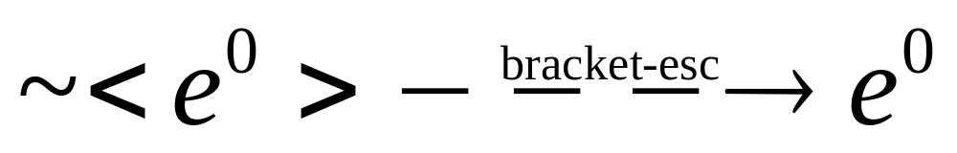
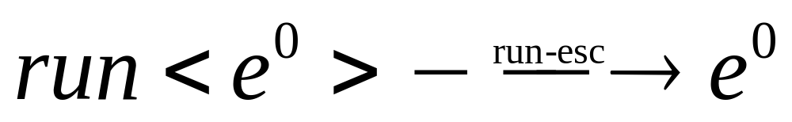
Rules

Slide 21
Applying the rules
fun pow1 n x =
if n=0 then 1
else times x (pow1 (n-1) x);
fun pow2 n x =
if n=0 then <1>
else <times ~x ~(pow2 (n-1) x) >;
Prove by induction on n that :
run (pow2 n <x>) = pow1 n x

Slide 22
N=0
run (pow2 n <x>) = pow1 n x
run (if n=0
then <1>
else <times ~x ~(pow2 (n-1) x) >) =
run <1> =
1 =
pow1 0 x

Slide 23
N <> 0
run (pow2 n <x>) = pow1 n x
run (if n=0
then <1>
else <times ~<x> ~(pow2 (n-1) <x>) >) =
run(<times ~<x> ~(pow2 (n-1) x) >) =
Can’t use run to erase brackets because of escapes inside.
times (run <x>) (run(pow2 (n-1) <x>)) =
times x (pow1 (n-1) x) =
pow1 n x

Slide 24
Are the rules correct?
How do we know the rules are correct?
That requires answering what are the semantics of staged programs.
Two approaches
  Syntactic approach
  Denotational approach
Syntactic approach can be given by an operational, or big-step semantics.
Would like the reduction semantics to be sound with the big-step semantics

Slide 25
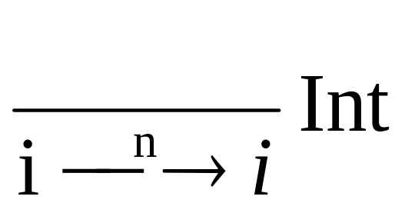
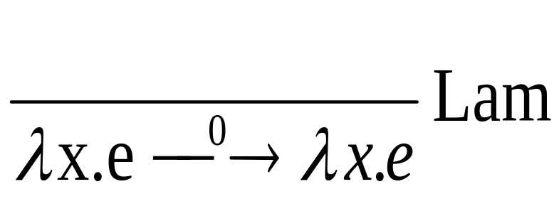
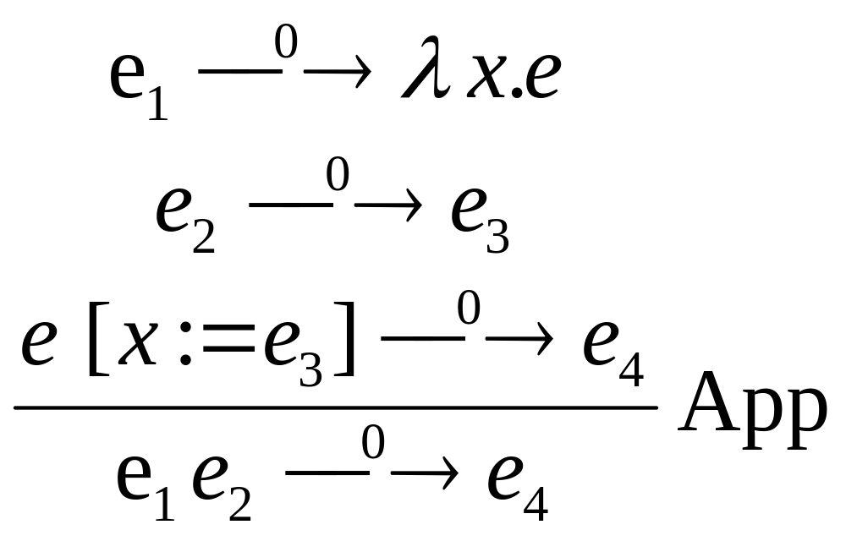
Big-step semantics

Slide 26
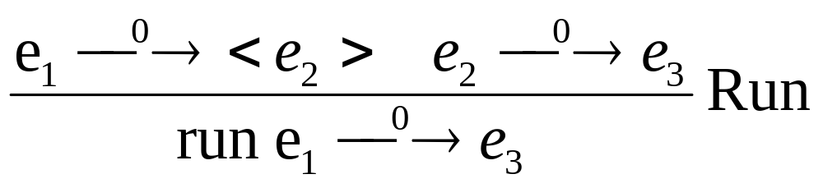
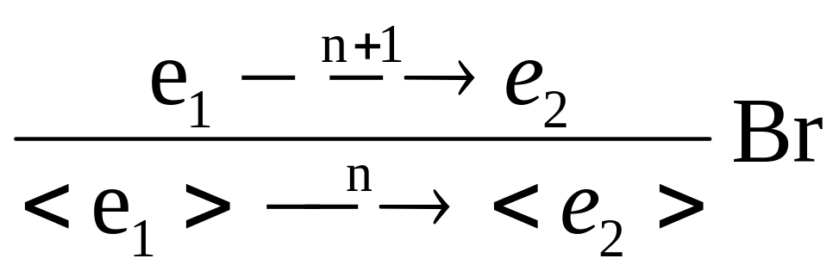
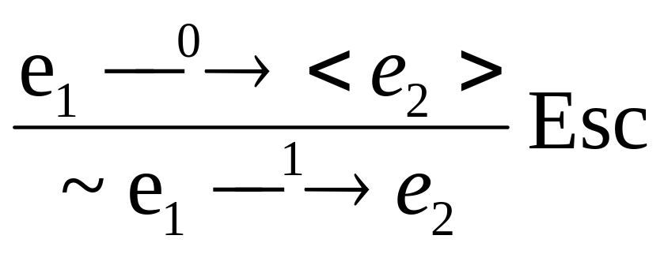

Slide 27
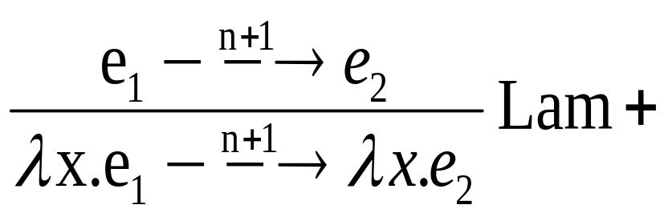
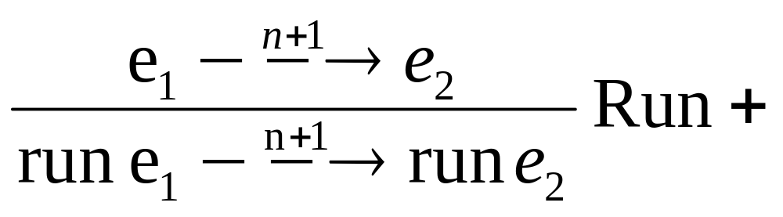
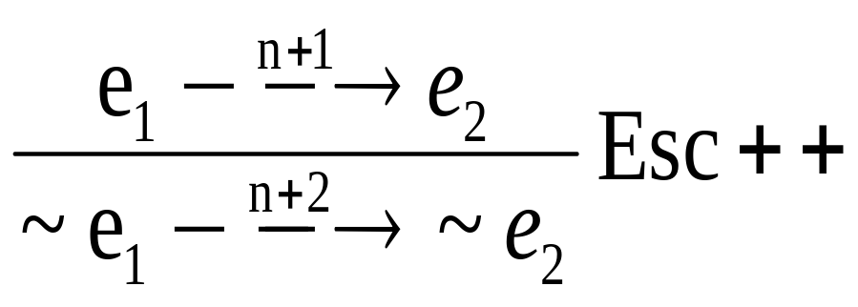
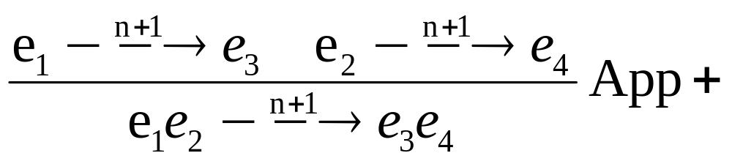

Slide 28
Notes
Big-step semantics is based upon capture free substitution e[x := v]
Two sets of rules
  At level 0
  At level n+1
  Except for escape (at 1 and n+2)
Collapses to normal bigstep semantics for lambda calculus when remove rules for brackest, escape, and run

Slide 29
Contributions
Two Semantics
  Operational
    good when thinking about implementation
  Axiomatic semantics
    good when reasoning
  Soundness (adequacy) w.r.t Operational Semantics
    They mean the same thing
Axiomatic semantics is confluent
  the order in which you apply
  the rules doesn't matter
Static Type checking
  Throws away Faulty terms
  Formal Type system
    how to implement it
  Subject Reduction
    proof that it works

Slide 30
Limitations
This type system rejects some programs that do not reduce to faulty terms
  λx.run ((λy.<y>)x) or
  λx.run (run ((λy.<y>)<x>))
  λx.run x
    Not unreasonable to reject λx.run x
      should not have type: <t> → t
      (λf. <λy.~(f <y>)>) (λx.run x) →* <λy.~y>
Axiomatic Semantics Limitations
  Substitution is defined only on values !
    different kind of semantics necessary for call by name or lazy languages.
  It depends on levels

