Slide 1
Advanced Functional Programming
Profiling in GHC

Slide 2
GHC Profiling
The GHC compiler has extensive support for profiling.
Links to documentation
http://www.haskell.org/ghc/docs/latest/html/users_guide/profiling.html
GHC can perform two kinds of profiling
time profiling
space profiling

Slide 3
Time Profiling
Used to instrument code to see where a program is spending its time.
Useful to find bottlenecks
Overview of use
Compile code with profiling flags
ghc -prof -auto-all sort1.hs
Run code with profiling command-line options
./main.exe +RTS -p -RTS
Inspect the profile-information file produced
edit main.exe.prof

Slide 4
Lets try it.
Our goal is to write a quik-sort routine
We expect it to have n-log(n) behavior
We write it in Haskell (see next page)
It appears to behave like an n² algorithm
We want to know why?

Slide 5
First some tests
test1 = check "null list"
(quik []) ([]::[Int])
test2 = check "one list"
(quik [3]) [3]
test3 = check "1 to 10"
(quik [1,9,2,8,3,7,4,6,5,10])
[1,2,3,4,5,6,7,8,9,10]
tests = [test1,test2,test3]
test = runTestTT (TestList tests)

Slide 6
helper functions
merge [] xs = xs
merge xs [] = xs
merge (x:xs) (y:ys) | x<y = x : merge xs (y:ys)
merge (x:xs) (y:ys) = y : merge (x:xs) ys
smaller x [] = []
smaller x (y:ys) =
if x>y
then y : smaller x ys
else smaller x ys
larger x [] = []
larger x (y:ys) =
if x<=y
then y : larger x ys
else larger x ys

Slide 7
quik [] = []
quik [x] = [x]
quik (x:xs) = merge (merge small [x]) large
where small = quik (smaller x xs)
large = quik (larger x xs)
main =
do { putStrLn ("N = "++show n)
; let l = last(quik xs)
; putStrLn ("The last element is: "++show l)
}

Slide 8
Run the tests
Type :? for help
Main> testall
Cases: 3 Tried: 3 Errors: 0 Failures: 0
Main>

Slide 9
Test time in GHCI
main =
do { let l = last(quik xs)
; putStrLn
("The last element of the sort is: “
++show l)
}
n = 100
xs = concat (replicate 5 [1..n])
for n=100, main, takes 0.06 seconds
for n= 250 about 0.30 seconds
for n = 500 about 1.37
for n = 750 about 2.75
for n = 1000 about 4.95 seconds
for n = 2500 about 31.53 seconds
for n= 5000 about 128.4 seconds

Slide 10
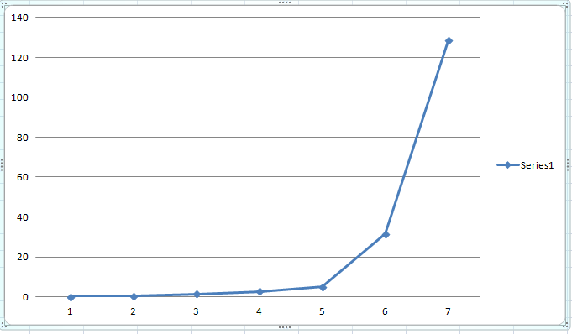
Looks quadratic (or worse) to me.

Slide 11
Use GHC profiling
$ ghc -prof -auto-all --make sort0.hs
[1 of 1] Compiling Main ( sort0.hs, sort0.o )
Linking sort0.exe ...
$ ./sort0.exe +RTS -p -RTS
N = 2500
The last element of the sort is: 2500
edit sort1.prof

Slide 12
Mon May 05 11:38 2014 Time and Allocation Profiling Report (Final)
sort0.exe +RTS -p -RTS
total time = 5.91 secs (5911 ticks @ 1000 us, 1 processor)
total alloc = 2,010,526,712 bytes (excludes profiling overheads)
COST CENTRE MODULE %time %alloc
larger Main 60.9 99.5
smaller Main 38.8 0.0
individual inherited
COST CENTRE MODULE no. entries %time %alloc %time %alloc
MAIN MAIN 37 0 0.0 0.0 100.0 100.0
CAF GHC.IO.Encoding.CodePage 59 0 0.0 0.0 0.0 0.0
CAF GHC.IO.Encoding 56 0 0.0 0.0 0.0 0.0
CAF GHC.IO.Handle.FD 51 0 0.0 0.0 0.0 0.0
CAF Main 44 0 0.0 0.0 100.0 100.0
xs Main 78 1 0.0 0.0 0.0 0.0
n Main 75 1 0.0 0.0 0.0 0.0
main Main 74 1 0.0 0.0 100.0 100.0
main.l Main 76 1 0.0 0.0 100.0 100.0
quik Main 77 40001 0.1 0.1 99.9 100.0
quik.large Main 82 20000 0.0 0.0 60.9 99.6
larger Main 83 62577496 60.9 99.5 60.9 99.5
quik.small Main 80 20000 0.0 0.0 38.8 0.1
smaller Main 81 62577496 38.8 0.0 38.8 0.0
merge Main 79 134991 0.2 0.2 0.2 0.2

Slide 13
Try for finer detail
merge [] xs = xs
merge xs [] = xs
merge (x:xs) (y:ys) | x<y = add1 x (merge xs (y:ys))
merge (x:xs) (y:ys) = add1 y (merge (x:xs) ys)
add1 x xs = x:xs
add2 x xs = x:xs
smaller x [] = []
smaller x (y:ys) =
if x>y
then add2 y (smaller x ys)
else smaller x ys
larger x [] = []
larger x (y:ys) =
if x<=y
then add2 y (larger x ys)
else larger x ys

Slide 14
Mon May 05 11:42 2014 Time and Allocation Profiling Report (Final)
sort1.exe +RTS -p -RTS
total time = 1.76 secs (1763 ticks @ 1000 us, 1 processor)
total alloc = 505,286,712 bytes (excludes profiling overheads)
COST CENTRE MODULE %time %alloc
larger Main 65.2 99.1
smaller Main 34.2 0.1
individual inherited
COST CENTRE MODULE no. entries %time %alloc %time %alloc
MAIN MAIN 37 0 0.1 0.0 100.0 100.0
CAF GHC.IO.Encoding.CodePage 59 0 0.0 0.0 0.0 0.0
CAF GHC.IO.Encoding 56 0 0.0 0.0 0.0 0.0
CAF GHC.IO.Handle.FD 51 0 0.0 0.0 0.0 0.0
CAF Main 44 0 0.0 0.0 99.9 100.0
xs Main 78 1 0.0 0.1 0.0 0.1
n Main 75 1 0.0 0.0 0.0 0.0
main Main 74 1 0.0 0.0 99.9 99.9
main.l Main 76 1 0.0 0.0 99.9 99.9
quik Main 77 20001 0.1 0.2 99.9 99.9
quik.large Main 82 10000 0.0 0.1 65.2 99.1
larger Main 83 15663746 65.2 99.1 65.2 99.1
add2 Main 84 15643750 0.0 0.0 0.0 0.0
quik.small Main 80 10000 0.0 0.1 34.2 0.1
smaller Main 81 15663746 34.2 0.1 34.2 0.1
add2 Main 85 9996 0.0 0.0 0.0 0.0
merge Main 79 67491 0.5 0.5 0.5 0.5
add1 Main 86 47491 0.0 0.0 0.0 0.0

Slide 15
Why so many calls to add1
merge [] xs = xs
merge xs [] = xs
merge (x:xs) (y:ys) | x<y = add1 x (merge xs (y:ys))
merge (x:xs) (y:ys) = add1 y (merge (x:xs) ys)
quik [] = []
quik [x] = [x]
quik (x:xs) = merge (merge small [x]) large
where small = quik (smaller x xs)
large = quik (larger x xs)

Slide 16
Fix that
quik [] = []
quik [x] = [x]
quik (x:xs) = merge small (x:large)
where small = quik (smaller x xs)
large = quik (larger x xs)

Slide 17
Mon May 05 11:45 2014 Time and Allocation Profiling Report (Final)
sort2.exe +RTS -p -RTS
total time = 1.64 secs (1637 ticks @ 1000 us, 1 processor)
total alloc = 503,166,952 bytes (excludes profiling overheads)
COST CENTRE MODULE %time %alloc
larger Main 60.8 99.5
smaller Main 38.9 0.1
individual inherited
COST CENTRE MODULE no. entries %time %alloc %time %alloc
MAIN MAIN 37 0 0.0 0.0 100.0 100.0
CAF GHC.IO.Encoding.CodePage 59 0 0.0 0.0 0.0 0.0
CAF GHC.IO.Encoding 56 0 0.0 0.0 0.0 0.0
CAF GHC.IO.Handle.FD 51 0 0.0 0.0 0.0 0.0
CAF Main 44 0 0.0 0.0 100.0 100.0
xs Main 78 1 0.0 0.1 0.0 0.1
n Main 75 1 0.0 0.0 0.0 0.0
main Main 74 1 0.1 0.0 100.0 99.9
main.l Main 76 1 0.0 0.0 99.9 99.9
quik Main 77 20001 0.1 0.1 99.9 99.9
quik.large Main 82 10000 0.1 0.1 60.9 99.5
larger Main 83 15663746 60.8 99.5 60.8 99.5
add2 Main 84 15643750 0.0 0.0 0.0 0.0
quik.small Main 80 10000 0.0 0.1 38.9 0.1
smaller Main 81 15663746 38.9 0.1 38.9 0.1
add2 Main 85 9996 0.0 0.0 0.0 0.0
merge Main 79 19996 0.0 0.1 0.0 0.1
add1 Main 86 9996 0.0 0.0 0.0 0.0

Slide 18
Its not the algorithm!
It’s the data
N=8
[1,2,3,4,5,6,7,8,1,2,3,4,5,6,7,8,1,2,3,4,5,6,7,8,1,2,3,4,5,6,7,8,1,2,3,4,5,6,7,8]
Well. Maybe it is the algorithm
Choose randomly, or try another approach

Slide 19
Merge Sort
msort n [] = []
msort n [x] = [x]
msort n xs = merge2 (msort m ys) (msort m zs)
where m = n `div` 2 - 1
(ys,zs) = splitAt m xs
merge2 [] xs = xs
merge2 xs [] = xs
merge2 (x:xs) (y:ys)
| x<y = x : merge2 xs (y:ys)
merge2 (x:xs) (y:ys) = y : merge2 (x:xs) ys

Slide 20
$ ghc -prof -auto-all --make sort3.hs
[1 of 1] Compiling Main ( sort3.hs, sort3.o )
Linking sort3.exe ...
sheard@freya /cygdrive/d/work/sheard/Courses/AdvancedFP/web/code/profiling
$ ./sort3.exe +RTS -p -RTS
N = 8
It doesn’t terminate, so ^C

Slide 21
Mon May 05 11:47 2014 Time and Allocation Profiling Report (Final)
sort3.exe +RTS -p -RTS
total time = 8.29 secs (8290 ticks @ 1000 us, 1 processor)
total alloc = 3,515,897,488 bytes (excludes profiling overheads)
COST CENTRE MODULE %time %alloc
msort Main 47.3 77.3
msort.m Main 34.3 15.9
msort.(...) Main 6.2 6.8
msort.zs Main 4.6 0.0
msort.ys Main 4.5 0.0
merge Main 2.6 0.0
individual inherited
COST CENTRE MODULE no. entries %time %alloc %time %alloc
MAIN MAIN 37 0 0.0 0.0 100.0 100.0
CAF GHC.IO.Encoding.CodePage 61 0 0.0 0.0 0.0 0.0
CAF GHC.IO.Encoding 58 0 0.0 0.0 0.0 0.0
CAF GHC.IO.Handle.FD 52 0 0.5 0.0 0.5 0.0
CAF GHC.TopHandler 51 0 0.0 0.0 0.0 0.0
CAF Main 44 0 0.0 0.0 99.5 100.0
xs Main 78 1 0.0 0.0 0.0 0.0
n Main 75 1 0.0 0.0 0.0 0.0
main Main 74 1 0.0 0.0 99.5 100.0
main.l Main 76 1 0.0 0.0 99.5 100.0
msort Main 77 39952817 47.3 77.3 99.5 100.0
msort.zs Main 83 19976406 4.6 0.0 4.6 0.0
msort.m Main 82 19976410 34.3 15.9 34.3 15.9
msort.(...) Main 81 19976410 6.2 6.8 6.2 6.8
msort.ys Main 80 19976410 4.5 0.0 4.5 0.0
merge Main 79 19976410 2.6 0.0 2.6 0.0

Slide 22
Faulty when n==2
msort n xs = merge2 (msort m ys) (msort m zs)
where m = n `div` 2 - 1
(ys,zs) = splitAt m xs
Better
msort n xs = merge2 (msort m ys) (msort (n-m) zs)
where m = n `div` 2
(ys,zs) = splitAt m xs

Slide 23
Mon May 05 11:26 2014 Time and Allocation Profiling Report (Final)
sort4.exe +RTS -p -RTS
total time = 0.00 secs (2 ticks @ 1000 us, 1 processor)
total alloc = 13,181,536 bytes (excludes profiling overheads)
COST CENTRE MODULE %time %alloc
msort.(...) Main 50.0 41.5
CAF GHC.IO.Handle.FD 50.0 0.3
msort Main 0.0 16.4
msort.merge2 Main 0.0 37.5
xs Main 0.0 3.4
individual inherited
COST CENTRE MODULE no. entries %time %alloc %time %alloc
MAIN MAIN 37 0 0.0 0.0 100.0 100.0
CAF GHC.IO.Encoding.CodePage 61 0 0.0 0.0 0.0 0.0
CAF GHC.IO.Encoding 58 0 0.0 0.0 0.0 0.0
CAF GHC.IO.Handle.FD 52 0 50.0 0.3 50.0 0.3
CAF Main 44 0 0.0 0.0 50.0 99.7
xs Main 78 1 0.0 3.4 0.0 3.4
n Main 75 1 0.0 0.0 0.0 0.0
main Main 74 1 0.0 0.1 50.0 96.3
main.l Main 76 1 0.0 0.0 50.0 96.2
msort Main 77 24999 0.0 16.4 50.0 96.2
msort.zs Main 83 12499 0.0 0.0 0.0 0.0
msort.m Main 82 12499 0.0 0.8 0.0 0.8
msort.(...) Main 81 12499 50.0 41.5 50.0 41.5
msort.ys Main 80 12499 0.0 0.0 0.0 0.0
msort.merge2 Main 79 115597 0.0 37.5 0.0 37.5

Slide 24
Space Profiling
It can be quite difficult to tell the lifetime of an object in the heap.(why GC is nice)
Lazy evaluation makes thing even more difficult because we don’t necessarily know when a thunk/closure will be evaluated.
Solution: instrumented programs that record their own space/time behavior.

Slide 25
GHC profiler overview
Compile with “–prof” to instrument the code
(1) ghc –prof Main.hs –o Main
Run with cues to the runtime system to generate a heap profile (*.hp)
(2) ./Main +RTS {options}
Convert the heap profile to Postscript (*.ps) and view it
(3) hp2ps Main.hp
(4) gv Main.ps

Slide 26
GHC profiler options
./Main +RTS {options}
One breakdown option (see right)
And one option to restrict the profile to a specific part of the program (see GHC User’s Guide online)
Option | Breakdown
-hc | By function
-hm | By module
-hy | By type
-hb | By thunk behavior

Slide 27
Thunk behaviors
Output from the –hb option
LAG between creation and first use
USE between first and last use
DRAG from final use until GC’ed
VOID never used
Most suspicious are DRAG and VOID

Slide 28
Program 1
mean :: [Float] -> Float
mean xs = sum xs /
(fromIntegral (length xs))
main = print (mean [0.0 .. 1000000])
xs is lazily computed, must be stored until both sum and length finish.
Program runs out of memory and crashes!

Slide 29
$ ghc -prof program1.hs
$ ./program1 +RTS -hb
Stack space overflow: current size 8388608 bytes.
Use `+RTS -Ksize -RTS' to increase it.
$ hp2ps program1.hp
$ ls
program1.aux program1.o sort0.o sort1.o sort2.o sort3.o sort4.o
program1.exe program1.ps sort0.prof sort1.prof sort2.prof sort3.prof sort4.prof
program1.hi sort0.exe sort1.exe sort2.exe sort3.exe sort4.exe sortA.hs
program1.hp sort0.hi sort1.hi sort2.hi sort3.hi sort4.hi sortAA.hs
program1.hs sort0.hs sort1.hs sort2.hs sort3.hs sort4.hs

Slide 30
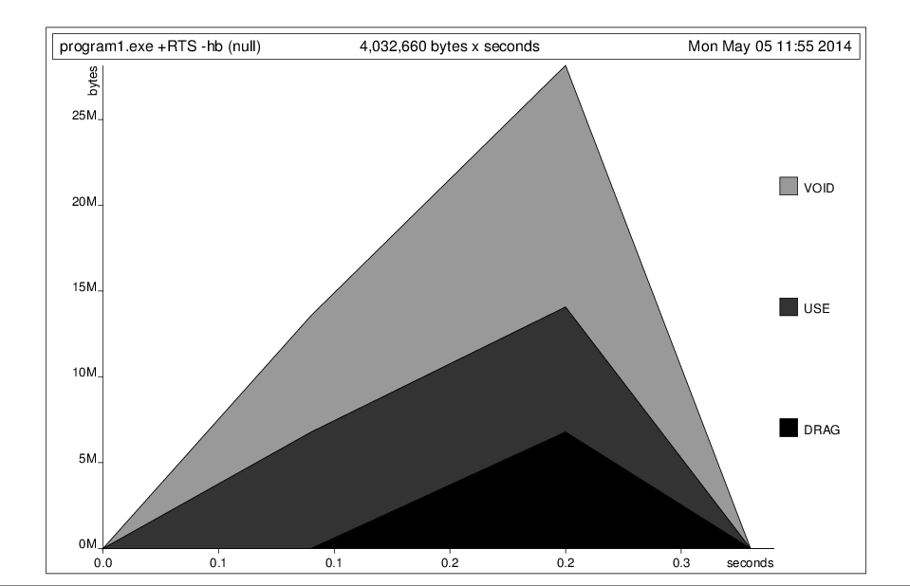
Program 1 (by type)

Slide 31
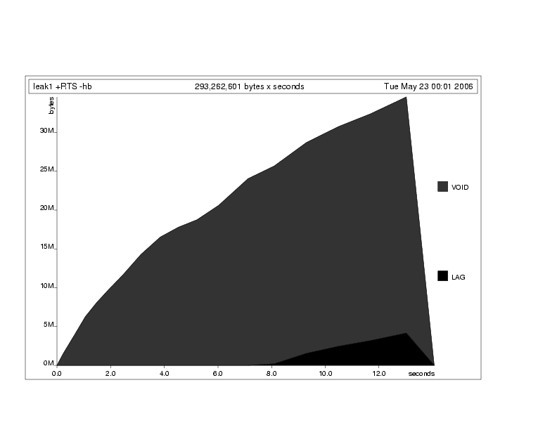
Program 1 (by behavior)

Slide 32
Program 2
mean :: [Float] -> Float
mean xs = loop 0 0 xs where
loop sum len [] = sum / len
loop sum len (x:xs) =
loop (sum+x) (len+1) xs
main = print (mean [0.0 .. 1000000])
Now we only traverse the list once.
But STILL runs out of memory and crashes!

Slide 33
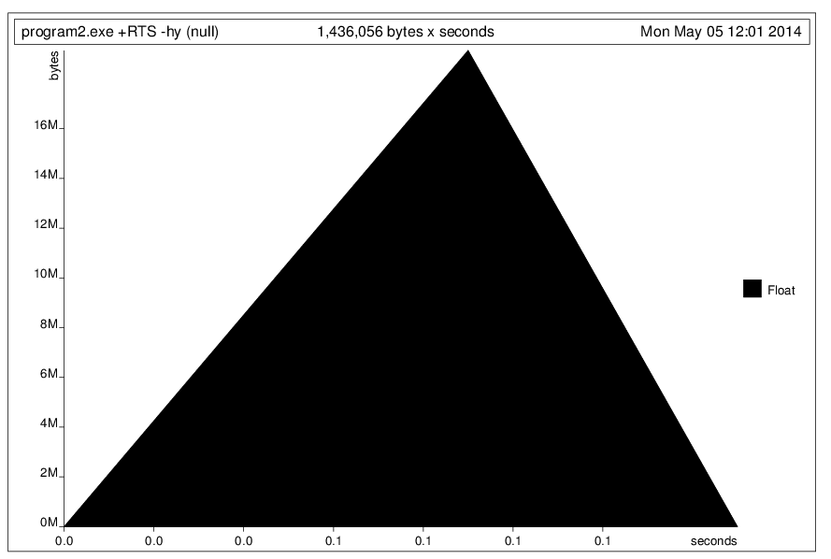
Program 2 (by type)

Slide 34
Strictness operators
seq :: a -> b -> b {- primitive -}
Evaluating seq e₁ e₂ first evaluates e₁ until its top constructor is known and then evaluates e₂ (and returns the value of e₂).
($!) :: (a -> b) -> a -> b
f $! x = seq x (f x)
($!) makes any function strict

Slide 35
Program 3
mean :: [Float] -> Float
mean xs = loop 0 0 xs where
loop sum len [] = sum / len
loop sum len (x:xs) =
(loop $! (sum+x)) $! (len+1)) xs
main = print (mean [0.0 .. 1000000])
No more senselessly growing arithmetic thunks.
Program prints 499940.88 and exits normally

Slide 36
$ ghc -prof program3.hs
[1 of 1] Compiling Main ( program3.hs, program3.o )
Linking program3.exe ...
$ ./program3 +RTS -hy
499940.88
$ hp2ps program3.hp

Slide 37
