Slide 1
Knowledge & Tools for website design

Slide 2
Goals
Understand the difference between absolute and relative links.
Create .html documents with both absolute and relatative links

Slide 3
[C,4] is an absolute address
Go to the intersection Ave C and Street 4.
1
2
3
4
5
6
7
8
9
10
11
12
A
B
C
D
E
F
G
H
I
J
K
L
{South 5, East 4} is a relative address

Slide 4
Absolute vs Relative
Absolute – A fixed position according to the global grid (or position system)
Relative – Directions to somewhere from your current starting position.

Slide 5
Grids are not the only position system
[45 degrees, 4 inches]
45º

Slide 6
Trees
root
absolute{3/1/3}
1
2
3
relative{../5/1}

Slide 7
URLs are trees
http://cs.pdx.edu/~sheard/courses/d&s/index.html
root
com
net
edu
pdx
cs
~sheard

Slide 8
Reading a URL
http://cs.pdx.edu/~sheard/courses/d&s/index.html
http:
com
root
edu
pdx
cs
~sheard
courses
d&s
index.html
net
edu
protocol
http://
means a web page
pdx
cs
~sheard
courses
research
home.html
d&s

Slide 9
Example Links
<A HREF="../index.html">Back to the class page.</A>
<A HREF="http://www.eeoc.gov/index.html">EEOC page</A>
<A HREF="Docs/5minList.html">presentations</A>
<A HREF="Knowledge&Tools4Website.ppt">here</A>
If it starts with http:// its is an absolute link.
Anything else is a relative link.
What does the … mean?

Slide 10
Creating pages
We can create pages with a tool
  Front Page
  Dream Weaver
  Iweb
  Publisher
Or we can edit .html files.
Its worth knowing how to read some html, because this helps you debug

Slide 11
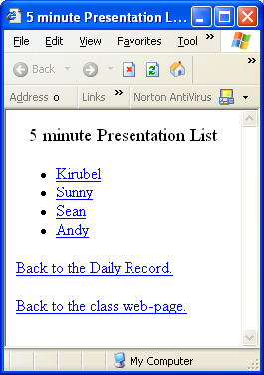
Example
<title>5 minute Presentation List</title>
<CENTER>
<BIG>5 minute Presentation List</BIG>
</CENTER>
<p>
<UL>
<LI> <A HREF="5min/Kirubel.ppt">Kirubel</A>
<LI> <A HREF="5min/Sunny.ppt">Sunny</A>
<LI> <A HREF="5min/Sean.ppt">Sean</A>
<LI> <A HREF="5min/Andy.ppt">Andy</A>
</UL>
<p>
<A HREF="../DailyRecord.html#Today">Back to the Daily Record.</A>
<p>
<A HREF="../index.html">Back to the class web-page.</A>

