Slide 1
Installing Hugs on Windows
March 31, 2009

Slide 2

Installing Hugs
Go to www.haskell.org
Click on the Hugs link under implementations

Slide 3

Hugs online page
Click on the downloading link

Slide 4

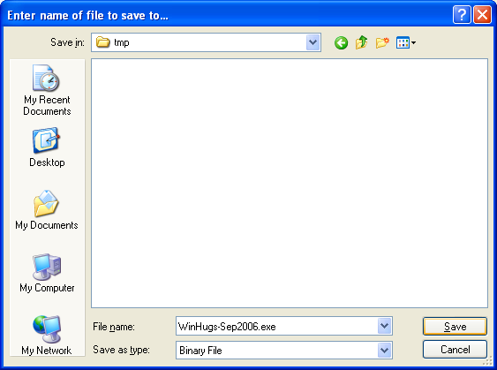
Downloading hugs page
Right click on the winhugs (plus libraries link) and save the installer in a temporary director somewhere

Slide 5
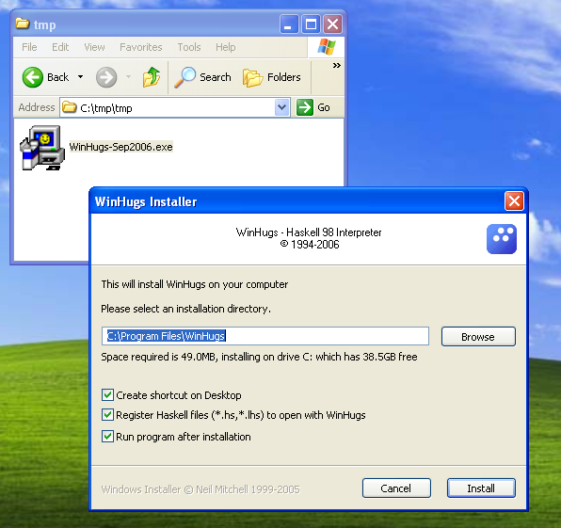
Installing
Go to the temp directory
Double click on the installer
Follow the directions

Slide 6
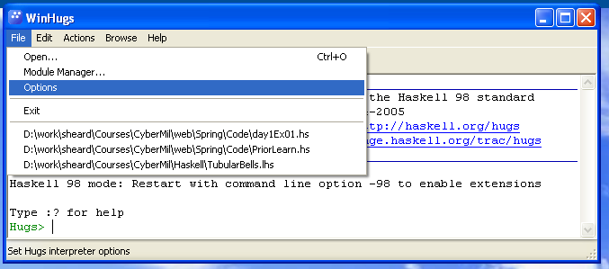
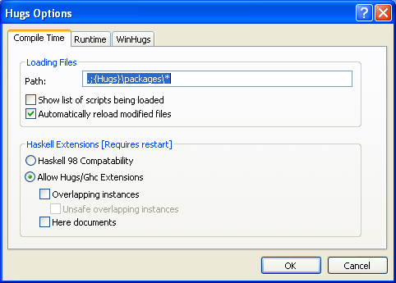
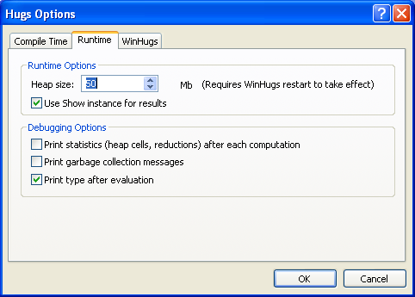
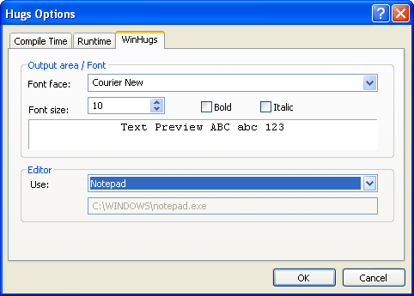
Customizing
We want to customize winhugs to have some useful features
Click “options” link on the file tab
Set the three sub-tabs as follows
  Compile Time (reload,GHC extensions)
  Run Time (50 mb, print type)
  Win Hugs (editor notepad)

