Slide 1


Justice Based Ethics

Slide 2

1. What is our ethical principle?
2. Who developed it?
3. What is its history?
4. In what contexts is it usually applied?

Slide 3


What is our principle
Our principle is Justice based ethics, it is the ethics principle that deals with equality, Justice based ethics was developed over time and by many people, no single person developed any of these types of justice. John Rawls, however, is a prominent figure in the advancement of Justice based Ethics, and has written multiple books on these ethics. It has four main parts:
1. Compensatory Justice
2. Retributive Justice
3. Distributive Justice
4. Procedural Justice

Slide 4
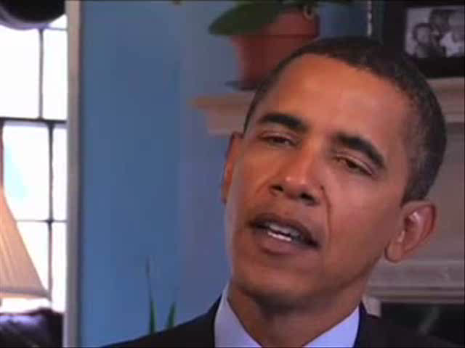
What is our principle
Obama on ethics (Procedural Justice)

Slide 5

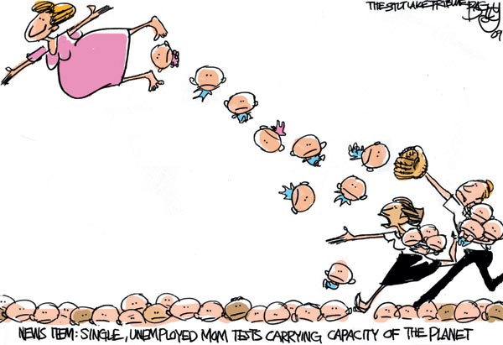
1. What happened?
2. Who are the principle characters?
3. Why is the case controversial?
4. Why did it attract so much media attention?

Slide 6
What Happened: Story of Octo-mom
Girl wanted to grow up and have a big family
Couldn’t get pregnant
Last choice is to get IVF procedures done
Procedure worked successfully
Until she gave birth to octuplets
Society didn’t approve
Her conditions
1) Single
Welfare
Living with parents
Already has 6 other kids
Society also has to
Pay for her irresponsibility
(taxes to welfare)
Controversy

Slide 7

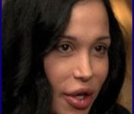
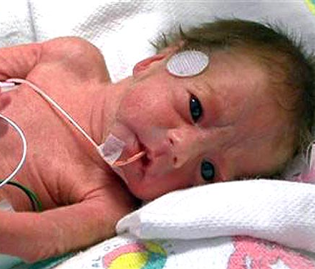
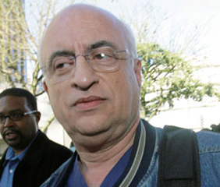


Slide 8
Why is the case controversial & Why did it get media attention?
Why it got so much media attention?
  The mother of the longest surviving octuplets
  She is only the second mother who gave birth to octuplets in the United States
  Worried about the other 6 children
    Two of her older children have autism and one has ADHD
  Considered irresponsible
Why is it controversial?
  Is it ethical in her situation?
    Nadya is unemployed
    She is on welfare
    She is single
    She has six other children
    She has a disability (back problem)
  No law states that you can’t have 14 kids (except China)
  Medical ethics issues are raised about IVF regulations

Slide 9

Stakeholder Analysis
Whose steak is it?

Slide 10
Stakeholder Analysis
Stakeholder | Principle they would use. | Why?
Nadya Suleman (Mother of octuplets) | Procedural | No law broken Why are couples left alone.
Taxpayers | 1. Distributive 2. Compensatory 3. Retributive | 1. Capitalism. 2. Want money back 3. Money was taken from them
Dr. Kamrava | Procedural | No law broken
Octuplets | Procedural | No law broken
Angela Doud (Mother of Nadya) | Distributive | Nadya made a mistake and should be responsible

Slide 11

Application of Justice-based Ethics
Stakeholder | Principle that Should be used. | Why?
Nadya Suleman (Mother of octuplets) | Procedural Distributive Compensatory | Should take responsibility No law broken Compensate Taxpayers
Taxpayers | Distributive Compensatory | 1. Capitalism. 2. Want money back 3. Money was taken from them
Dr. Kamrava | Procedural (Retributive) | Make sure no law was broken Punishment if law was broken

Slide 12

What wrongs need to be righted?
Compensate the American taxpayers
  Take the pornography offer
  Work to pay back the government after kids have grown up
Doctor Kamrava:
  Should have license revoked or suspended
3. Emotional distress caused (fix)
  Public apology
  Explain how you are going to compensate American taxpayers
  Stop being selfish

Slide 13
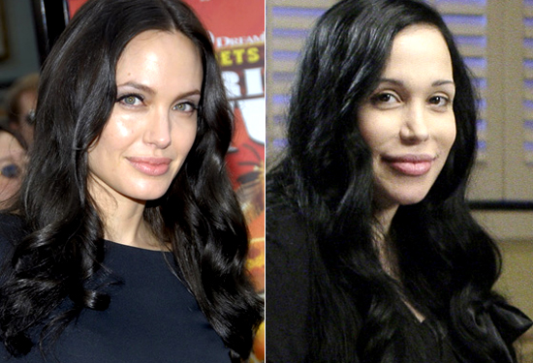
Do they look similar?

