Slide 1
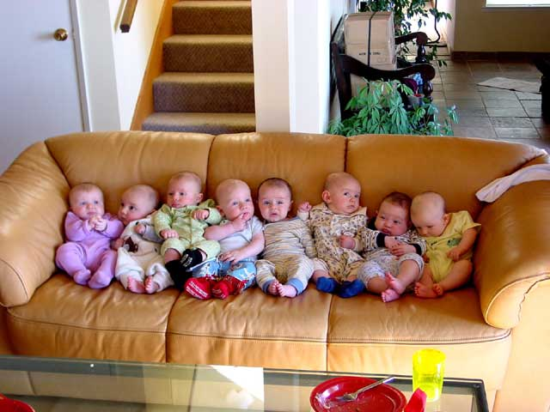
Ethical Egoism
OctoMom….

Slide 2
Nadya Suleman
33 years old
born in Fullerton, California
studied at Mt. San Antonio College
- employed at Metropolitan State Hospital
mother to 14 children
6 of which were born from 2001 – 2006
- currently all 8 of her octopletes are still alive

Slide 3

Brief History
Divorced husband in 2001.
Little employment History.
Quit most recent job before having started having kids.
Received Bachelor Degree in child Development and was pursuing Masters until 2007.

Slide 4
Fiscal Facts
Offered $130,000 a month to consent to a reality show.
Offered free aid from non-profit organization Angels in Waiting.
Offered $500 worth of clothes every month for a year by Custom Kingdom children's clothing line.
Offered $1 Million, health care, and dental to be in pornographic series by Vivid Entertainment.

Slide 5
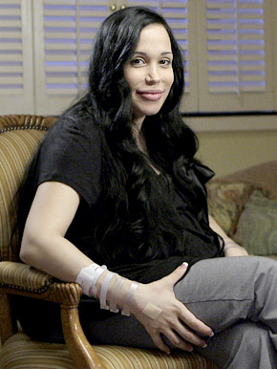
People Associated With the Nadya Suleman Case
Nadya Suleman
David Solomon
Edward and Angela Doud
Michael Kamrava

Slide 6
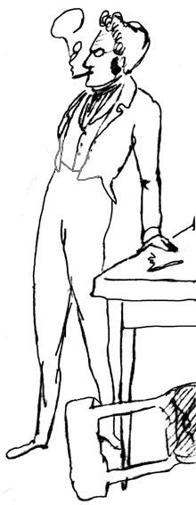
Who created ethical egoism?
-Max Stirner was the first philosopher to call himself an egoist.
-Max Stirner wrote a book called The Ego and His own.
-Attended meetings with famous philosophers such as Karl Marx
-Friedrich Nietzsche has also been given credit for being one of the creators of egoism
egoism

Slide 7
What is Ethical Egoism?
Ethical egosim is the idea the everyone should do whatever is in their self-interest but is not the same as psychological egoism which states that people can only act in their self-interest.
Ethical egoism contradicts ethical altruism which states that people have a responsibility to help others.

Slide 8
Various Types of Ethical Egoism: Individual, Personal, and Universal
Individual ethical egoist:
A person should do what most benefits them.
Personal ethical egoist:
A person should do what most benefits them, but not tell others what to do.
Universal ethical egoist:
A person who thinks everyone should do whatever they want.

Slide 9
Where is Egosim Applied?
All humans are a little Egotistic.
We are at school for our own self-interest.
Self interest for others as well.
Parents.
The School (Your welcome PSU).
Companies.
Society.

