Slide 1
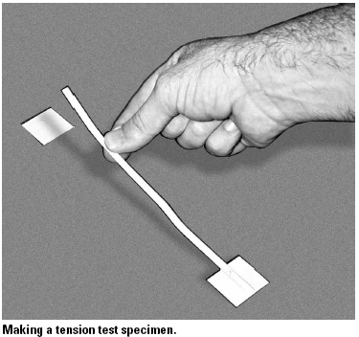
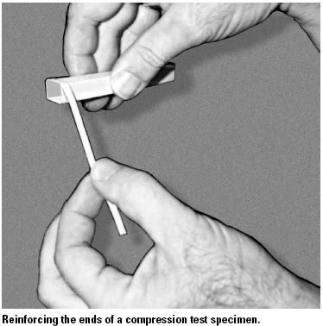
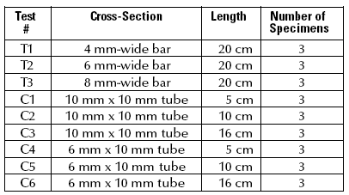
Assigned Wed. Nov 7
Due Wed. Nov. 14
Each group should make a complete set of test specimens. This is described in compete detail on pages 2-13 through 2-15 of bridge building activity 2. We will use them on Wednesday Nov. 14, 2007. They must be built and the glue dry by class time. The size of the specimens is listed in the table below.
Create these in the same way you made the bridge pieces. Each specimen also needs reinforcement at the ends, if we are to test it.
Tensile strength specimens need small squares glued at each end.
Compression strength specimens need a 6mm wide strip glued around
each end.
See the photos at right.

