Slide 1
Design and Society
Winter 2008
Lecture 2
Tim Sheard

Slide 2
There is still room to sign up for courses in writing.
WR 199
  45832 WR 199 001SPST: WRITING FOR COLLEGE 1M TBA DeWeese D.
  44258 WR 199 005SPST: GRAMMAR REFRESHER 2R 14:00-15:50CLY 102 Calvert Z.
WR115
  44247 WR 115 00110 INTRO COLLEGE WRIT 4MWF 10:15-11:20NH 396 Hein M.
  44248 WR 115 00210 INTRO COLLEGE WRIT 4TR 10:00-11:50NH 352 Pesznecker S.
  44250 WR 115 00310 INTRO COLLEGE WRIT 4MW 14:00-15:50NH 352 Phillips G.
  CNCLD WR 115 F0110 INTRO COLLEGE WRIT 4MWF 09:00-10:05STAFF
WR 121
  44251 WR 121 001COLLEGE WRITING 4TR 10:00-11:50NH 472 Crockett K.
  44255 WR 121 0027 COLLEGE WRITING 4MWF 11:30-12:35NH 472 Stafford E.
  44256 WR 121 003COLLEGE WRITING 4TR 12:00-13:50NH 386 Butzner A.
  CNCLD WR 121 004COLLEGE WRITING 4MW 16:40-18:30STAFF
  44257 WR 121 005COLLEGE WRITING 4MWF 10:15-11:20NH 386 Smith E.
  44620 WR 121 006COLLEGE WRITING 4TR 14:00-15:50SB2 108 Gallaher M.
  44254 WR 121 F01COLLEGE WRITING 4MWF 14:00-15:05OND 201 Lipton S.

Slide 3
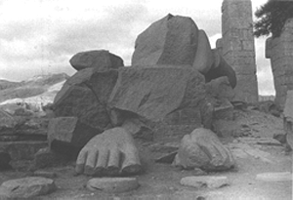
Collapse
How Societies Choose to Fail or Succeed
I met a traveller from an antique land
Who said: Two vast and trunkless legs of stone
Stand in the desert. Near them on the sand,
Half sunk, a shatter'd visage lies, whose frown
And wrinkled lip and sneer of cold command
Tell that its sculptor well those passions read
Which yet survive, stamp'd on these lifeless things,
The hand that mock'd them and the heart that fed.
And on the pedestal these words appear:
"My name is Ozymandias, king of kings:
Look on my works, ye mighty, and despair!"
Nothing beside remains: round the decay
Of that colossal wreck, boundless and bare,
The lone and level sands stretch far away.
Ozymandias (Percy Shelley 1817)

Slide 4
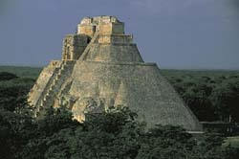
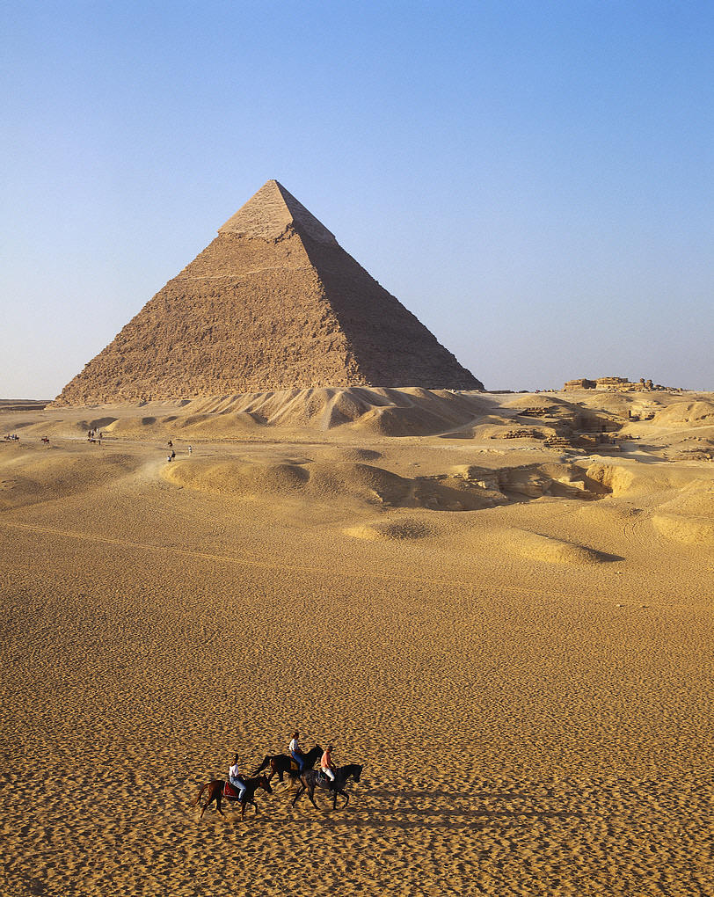
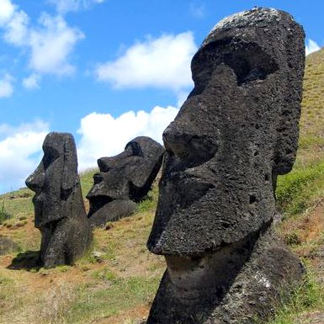
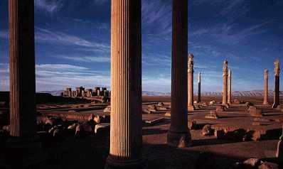

Slide 5
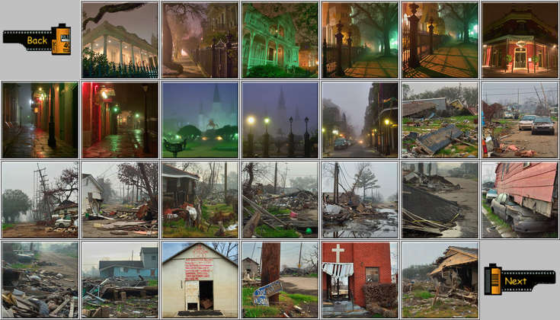
New Orleans 9th Ward
Is New Orleans a modern day Collapse?

Slide 6
Notes on how to read a paper
Reading is more than just passing your eyes over the words in consecutive order.
Reading is understanding

Slide 7
Why Are You Reading the Paper?
To answer a particular question
Looking for help solving a problem
Educating yourself
Learn if your own work or ideas are novel
It has been assigned by someone
Reviewing or abstracting it
Preparing a presentation on it
Looking for inspiration
Waiting for the dentist, got nothing better to do

Slide 8
What should I get out of reading a paper?
The context of the paper
The thesis being investigated
The contribution
The method of investigation
The “power” of the results
The influence of the paper
The applicability of the results
Summary of the technical development
Details of any examples
Thanks to Jim Hook for this list.

Slide 9
Think about Collapse
The context of the book
The thesis of the book
The contribution of the book
The method of investigation
The “power” of the results
The influence of the paper
The applicability of the results
Summary of the technical development
Details of any examples

Slide 10
How to Read
I usually attack a book or paper in several passes, sometimes spread over time.
Pass 1:
Abstract
  to determine relevance
  to determine kind of paper
Pictures
  tables, graphs, and diagrams
  concepts
and References
  do I recognize them or know what they’re about?

Slide 11
Pass 2
Pass 2:
Introduction, Chapters, Section beginnings, Examples, Summary
  to determine organization and content
  might decide on this basis only to read parts of the book or paper
  figure out if authors are good writers
    if you have a choice why not read the well written paper
  help set priority/payoff`

Slide 12
Pass 3
Pass 3:
Full reading
  Often take notes during this phase
  Try to capture main contributions
  What distinguishes it from other work
  What it is similar to
  What are assumptions or line of development
  Questions on what I don’t understand
    write these right on the front (for when you read it again)

Slide 13
Pass 4
Pass 4:
Detailed study
  Go back over hard or unclear parts
  Frame my own questions about what is left un-answered.

Slide 14
Quiz Discussion
1) In your own words, explain what Diamond means when he uses the term "collapse"

Slide 15
Possible Answer
Explain what Diamond means when he uses the term "collapse"
Drastic decrease in human population size and/or political/economic/social complexity, over a considerable area, for an extended time.

Slide 16
Quiz Discussion
2) List some of the reasons Diamond gives to support the claim that "any people can fall into the trap of over-exploiting environmental resources."

Slide 17
Possible Answer
List some of the reasons Diamond gives to support the claim that "any people can fall into the trap of over-exploiting environmental resources."
  Resources seem inexhaustible at first
  Signs of resource depletion are hidden in normal (yearly or decade scale) fluctuations
  Difficult to get people to exercise constraint on sheared resources (tragedy of the commons)
  Complexity of eco-systems makes it hard to predict long term consequences of individual actions

Slide 18
Quiz Discussion
3) On page 11, Diamond writes, "I don’t know of any case in which a society’s collapse can be attributed solely to environmental damage: there are always other contributing factors.” List the 5 sets of contributing factors that Diamond identifies.

Slide 19
5 point framework
Damage that people inadvertently inflict upon the environment. (11)
Climate change (12)
Hostile neighbors (13)
Decreased support by friendly neighbors (14)
The society’s responses to its own problems … [which] depend on its political, economic, and social institutions and on its cultural values.(14)

Slide 20
Question
Describe a major controversy confronting efforts to understand past collapses.

Slide 21
Hint
Think about Diamond’s opinion on the people from these past societies?
  Were they bad stewards of the land?
  Were they good managers living in harmony with the environment?
  How do they compare to people today?

Slide 22
Possible Answers
Managing environmental resources sustainability has always been difficult.
Resources initially seem inexhaustibly abundant, signs of incipient depletion become masked by normal fluctuations in resource levels,
difficult to get people to agree in exercising restraint (tragedy of the commons),
complexity makes consequences hard to predict.
Non-literate people had less access to past information.
Neither ignorant bad managers who deserved to be exterminated or dispossessed,
nor all=knowing conscientious environmentalists who solved problems that we can’t solve today.
They were people like us.

Slide 23
Question
What is “ecocide”?
Diamond groups the processes of past “ecocides” into 8 categories. List them.

Slide 24
Possible Answers
What is “ecocide”?
  large scale mortality or death caused by environmental problems
Diamond groups the processes of past “ecocides” into 8 categories. List them.
  Deforestation,
  habitat destruction,
  soil problems (erosion, salinization, and soil fertility losses),
  water management problems,
  over-hunting, over-fishing,
  effects of introduced species on native species,
  human population growth
  increased per-capita impact of people.

Slide 25
Question
What is the typical course of events in a collapse?

Slide 26
Possible Answers
Population growth forced people to adopt intensified means of agricultural production (irrigation, double-cropping, or terracing), and to expand farming onto marginal lands,
Unsustainable practices led to environmental damage,
Marginal lands had to be abandoned.
Consequences:
  food shortages,
  starvation,
  wars over resources,
  overthrows of governing elites by disillusioned masses.
  Population decrease through starvation, war or disease.
  Society lost political, economic, and cultural complexity it had developed at the peak.

Slide 27
Question
According to Diamond, in addition to the processes listed above, what 4 new environmental problems face us today?

Slide 28
Possible Answers
According to Diamond, in addition to the processes listed above, what 4 new environmental problems face us today?
  Human caused climate change
  Buildup of toxic chemicals in the environment
  Energy shortages
  Full utilization of the Earth’s photosynthetic capacity

Slide 29
Question
Explain how the following factors not only lower, but increase risk of collapse for modern societies:
  Powerful technology
  Globalization
  Modern medicine

Slide 30
Possible Answers
Powerful technology
  solve problems
  have un-intended destructive effects
Globalization
  Disaster relief
  Collapse anywhere affects here at home
  Disease travels quickly
Modern medicine
  Cures or prevents disease
  many people depend on it for their survival

Slide 31
Question
Explain the term “comparative method” or “natural experiment” and describe its importance to this book.

Slide 32
Possible Answers
Science depends upon replicable controlled experiments
  Is it ethical to experiment on large populations by withholding food or killing them to study the effects?
Comparative studies identify factors, then study societies where the factors are naturally present or absent
Use statistical methods when the sample sizes are large enough
  Depends upon lots of accurate information about many details
  often hard to know about past societies.

Slide 33
Question
Diamond comments that the plan of the book “resembles a boa constrictor that has swallowed two very large sheep.” In this analogy, what does each sheep represent?

Slide 34
Possible Answers
A large detailed study of 1 past and 1 present day society.
  Montana (present day)
  Greenland (past)

Slide 35
Question
Are there Modern Day Collapses?

Slide 36
Possible Answers
Are there Modern Day Collapses?
  Haiti
  Somalia
  Rwanda
  The Soviet Union
  What about today’s headlines
    Unrest in Pakistan
    Unrest in Kenya

Slide 37
Question
Based on your reading of the Prologue, do you think that Diamond is an objective researcher? Why or why not?

