Slide 1
Lesson 4: Conditional Statements
Programming Solutions

Slide 2
Exercise 1
When the program is started, play a buzz sound if the touch sensor is pressed, else play a descending sweep sound if the touch sensor is not pressed.

Slide 3
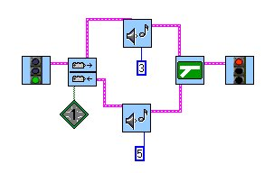
Exercise 1: Solution
If the touch sensor is not pressed,
play sound #3 (desc. sweep).
Use a touch
sensor fork
Don’t forget
the fork merge!
If the touch sensor is pressed,
play sound #5 (buzz).

Slide 4
Exercise 2
If the light sensor is over a white piece of paper, turn on only motor A. If the light sensor is over a black piece of paper, turn on only motor C. Do this forever.

Slide 5
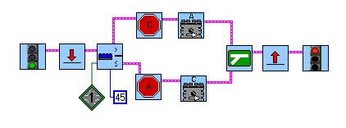
Exercise 2: Solution
The Jump/Land pair runs
this program forever.
Use a light sensor
fork.
Don’t forget to turn off the
other motor in each branch!

Slide 6
Exercise 3
Start by turning on motor A in the forward direction. If the rotational sensor has made 3 rotations, turn off motor A and exit the program. Otherwise, play a beep, wait for 1 second, and continue to check the rotational sensor.

Slide 7
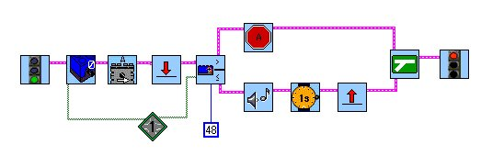
Exercise 3: Solution
When using a rotational
sensor fork, you must
reset the sensor.
…and
land here.
If greater than 3,
turn off the motor.
Turn on
the motor
48 ticks =
3 rotations
If less than 3, beep,
wait 1 second, jump...

Slide 8
Exercise 4
If the light sensor is over the white paper, then if the touch sensor is pressed in, turn on motor A in the forward direction, otherwise, turn on motor A in the reverse direction. Else, if the light sensor is over the black paper, then if the touch sensor is pressed in, turn on motor C in the forward direction, otherwise, turn on motor C in the reverse direction. For all conditions, the motor should run for 4 seconds, then stop.

Slide 9
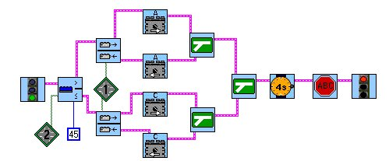
Exercise 4: Solution
This stop sign stops
all motors. It doesn’t
care which one is on.
This is an example of nested
conditional statements.
Don’t forget to
specify different
sensor ports.
Merge the forks from
the inside back out.

Slide 10
Lesson 4: Conditional Statements
Troubleshooting Tips

Slide 11
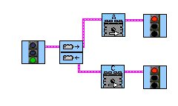
Problem 4a
What’s wrong with this program?

Slide 12
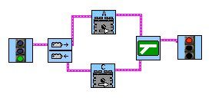
Solution 4a
Remember: All forks need a fork merge.

Slide 13
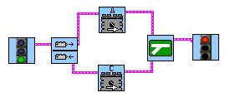
Problem 4b
This program is supposed to turn on motor A if the touch sensor is pressed, otherwise turn on motor C. What’s wrong?

Slide 14
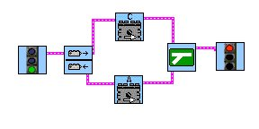
Solution 4b
The branches of the fork are mixed up. This is a common mistake.

Slide 15
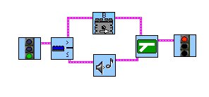
Problem 4c
In this program, if the light sensor reads a value above 80, it should turn on motor B. Otherwise, it should beep. Why doesn’t it work?
Hint: What is the default
light level value?

Slide 16
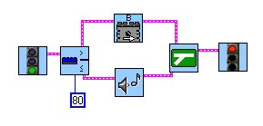
Solution 4c
The default light level value is 55. To specify a different value, you must use a numeric constant modifier.

Slide 17
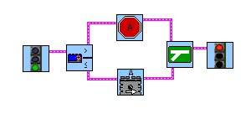
Problem 4d
What’s missing from this program?

Slide 18
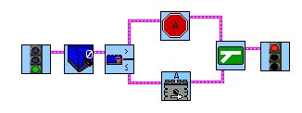
Solution 4d
Before every rotational sensor fork, you must reset the rotational sensor.
Rotational sensor reset

