Slide 1
Scholarship Skills
Tim Sheard & Todd Leen
Oregon Graduate Institute of Science & Technology
© 1996, 1997, 1999, 2000 David Maier
© 2001 Todd Leen

Slide 2
5 Minute Presentations
At PSU
  Day: Friday 2/24
  Time: 14:30-17:00
  Room: CH 225 (Cramer Hall)
At OGI
  Day: Wednesday 2/22
  Time: 14:30-17:00
  Room: TBA
Sign up today for a time.

Slide 3
Assignments
Homework 9
  Rewrite an abstract from one of your papers.
  See handout for details
Project 4
  Rewrite 2-page summary.
  Exact details of what to hand in are on the assignments web page.

Slide 4
References
Goals: Make clear what the source is, make it reasonably easy for the reader to obtain it.
Seems like each journal or organization has its own style.
I will talk about van Leunen’s style, with a couple of suggested changes.
Basic parts
  I. Author.
  II. Title.
  III. Bibliographic Info.

Slide 5
Examples
Book
  Marla Scott.
  Effective Programming in C.
  Addison-Wesley, 1992.
Journal paper
  Craig Chambers and Guy T. Leavens.
  Type checking and modules for multimethods.
  ACM Transactions on Programming Languages and Systems 17(6), pages 805-843, November 1995.

Slide 6
Examples 2
Proceedings paper
  S. Heiler and A. Rosenthal.
  G-Whiz, a visual interface for the functional model with recursion.
  Proceedings of the XI International Conference on Very Large Databases, pages 11-23, Stockholm, Sweden, August 1985.

Slide 7
Examples 3
Article in collection
  Umeshwar Dayal and John M. Smith.
  PROBE: A knowledge-oriented database system.
  In M. C. Brodie and J. Mylopoulos, editors, On Knowledge Based Management Systems, pages 81-93, Springer-Verlag, New York, 1986.

Slide 8
Getting the Right Information
Get information from
  the title page of a book
  the first page of an article
Paper titles
  Make sure that proper names get capitalized
  Finding hamiltonian circuits using pascal.
  Usually capitalize after a colon, unless the subtitle only describes what kind of paper.
  The stable-marriage problem: a parallel solution.
  The stable-marriage problem: an informal survey.

Slide 9
Web Pages
Problem—lack of author, title or date
Problem—transitory nature
  Robert Burns.
  Spiders on the web.
  URL:<http://www.dead-poets.com/
  arachnid.html>, revised 12 December 1886.

Slide 10
Web Pages 2
Another example
  University of Chicago, Department of Economics.
  Our favorite Nobel prizes.
  URL:<http://www.econ.uc.edu/nobel>, version of 13 January 1999.
Check out
http://www.columbia.edu/cu/cup/cgos/idx_basic.html
http://www.cas.usf.edu/english/walker/mla.html

Slide 11
Manuals
Cite a manual as a book, with company as author if no person listed.
  MassStore, Inc.
  DiscPac 2000 Installation Guide.
  2400 Briarcliff Road, Gary, Indiana 50304, July 1988.

Slide 12
LaTex
LaTex is a very popular type-setting tool used by many computer scientists and mathematicians
It has great support for type-setting mathematics (including a sophisticated macro system)
It comes with supporting tools for managing bibliographic information – bibTex
Source is text and can be managed with Revision control systems like CVS and RCS
Since source is text, tools can create input for tables and figures.

Slide 13
Resources for LaTex
The most common version (As of Feb. 2006) of LatTex is version LaTex2e
Online help for Latex
  http://www.emerson.emory.edu/services/latex/latex2e/latex2e_toc.html
  http://www-h.eng.cam.ac.uk/help/tpl/textprocessing/teTeX/latex/latex2e-html/ltx-2.html
  http://www.giss.nasa.gov/tools/latex/
  http://nwalsh.com/tex/texhelp/LaTeX.html
  http://www-ccs.ucsd.edu/latex/
Free online book on LaTex
  “The Not So Short Introduction to LaTex2e”
  By Tobias Oetiker. Hubert Partl, Irene Hyna and Elisabeth Schlegl
  http://www.ctan.org/tex-archive/info/lshort/english/lshort.pdf
  http://people.ee.ethz.ch/~oetiker/lshort/

Slide 14
Markup Commands
LaTex is a markup-language
  Text and commands are interspersed in the same document
  Commands are alpha-strings preceded by a backslash
  Commands can have arguments and options
    Arguments appear inside { } . If a command has arguments you must supply them.
    Options appear inside [ ] . Options need not be supplied (they have default values)
  Examples
    \alpha
    \begin{document}
    \documentstyle[twoside]{report}
    \begin{array}[t]{cl}
  Many commands come in pairs
    \begin{centering}
    \end{centering}

Slide 15
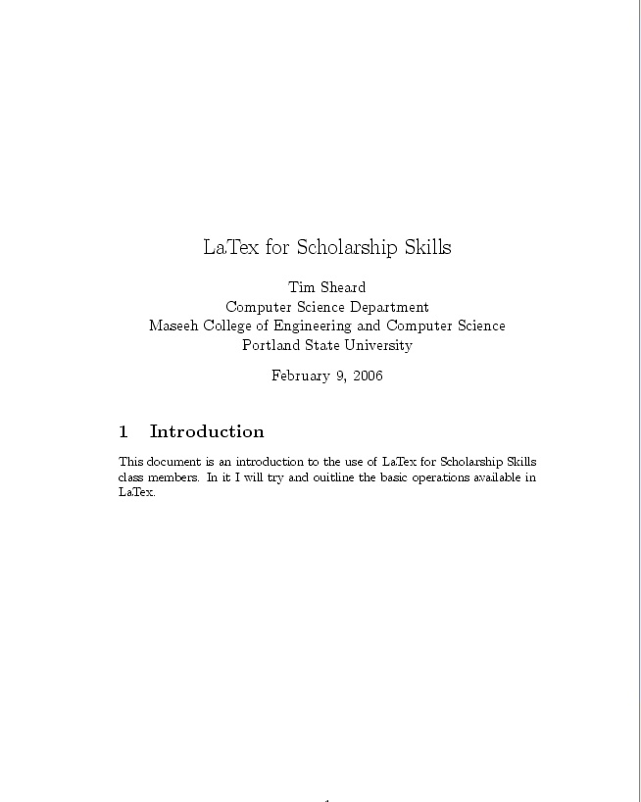
Basic Setup
\documentclass[12pt]{article}
\begin{document}
\title{LaTex for Scholarship Skills}
\author{
Tim Sheard\\
Computer Science Department\\
Maseeh College of Engineering and Computer Science\\
Portland State University\\
}
\maketitle
\section{Introduction}
This document is an introduction to the use of LaTex for Scholarship Skills class members. In it I will try and outline the basic operations available in LaTex.
\end{document}

Slide 16
Structure
Specifies what type of document and the default font size.
\documentclass[12pt]{article}
\begin{document}
\title{LaTex for Scholarship Skills}
\author{
Tim Sheard\\
Computer Science Department\\
Maseeh College of Engineering and Computer Science\\
Portland State University\\
}
\maketitle
\section{Introduction}
This document is an introduction to the use of LaTex for Scholarship Skills class members. In it I will try and outline the basic operations available in LaTex.
\end{document}
Title and author are specified with \title{ …} and \author{ …}
Every document begins and ends with \begin{document}
And ends with
\end{document}
\maketitle tells where in the document the title should appear.
The \section{ … } command introduces a new section whose name is …

Slide 17
Separating commands from text
In a LaTex source file only certain characters are allowed. All other characters are created in the output by using commands.
Allowed Characters
  Upper Case Alpha - ABCDEFGHIJKLMNOPQRSTUVWXYZ
  Lower Case Alpha - abcdefghijklmnopqrstuvwxyz
  Digits - 0123456789
  Punctuation - .:;,?!`’()[]-/*@
  Unless these are inside commands they appear in the output if they are in the input.
Special Characters
  Used only inside LaTex commands
    #$%&~_^\{}
  Used in Math Formulas
    +=|<>

Slide 18
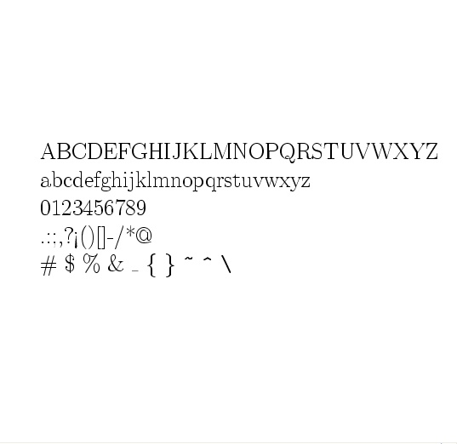
LaTex Sources
\documentclass[12pt]{article}
\begin{document}
ABCDEFGHIJKLMNOPQRSTUVWXYZ
abcdefghijklmnopqrstuvwxyz
0123456789
.:;,?!`’()[]-/*@
\# \$ \% \& \_ \{ \} \verb+~+
\verb+^+ \verb+\+
\end{document}
Special characters require special commands to produce.

Slide 19
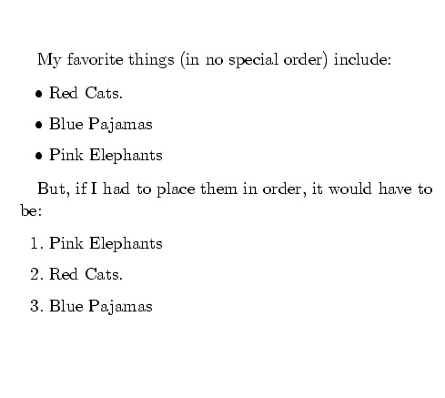
Itemized lists
My favorite things (in no
special order) include:
\begin{itemize}
\item Red Cats.
\item Blue Pajamas
\item Pink Elephants
\end{itemize}
But, if I had to place them in order, it would have to be:
\begin{enumerate}
\item Pink Elephants
\item Red Cats.
\item Blue Pajamas
\end{enumerate}

Slide 20
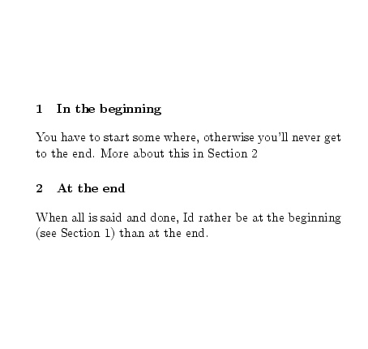
Labels and references
\documentclass[12pt]{article}
\begin{document}
\section{In the beginning}\label{alpha}
You have to start some where,
otherwise you'll never get to the end.
More about this in Section \ref{omega}.
\section{At the end}\label{omega}
When all is said and done, Id rather be
at the beginning (see Section
\ref{alpha}) than at the end.
\end{document}

Slide 21
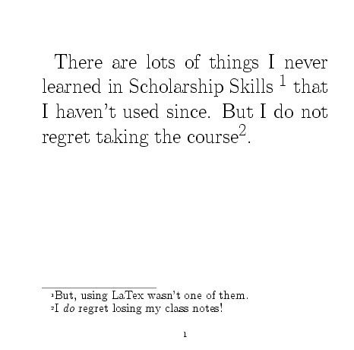
Footnotes
\documentclass[14pt]{article}
\begin{document}
There are lots of thing I never learned in Scholarship Skills \footnote{But, using LaTex wasn't one of them.} that I haven't used since. But I do not regret taking the course\footnote{I {\em do} regret losing my class notes!}.
\end{document}

Slide 22
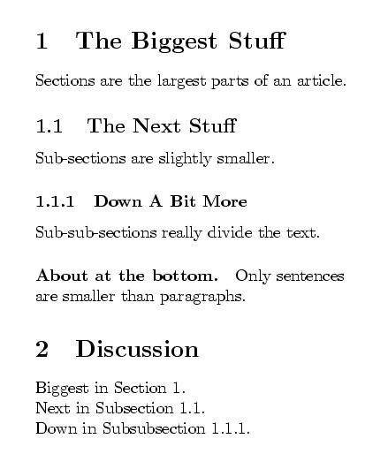
Sectioning
\section{The Biggest Stuff}\label{A}
Sections are the largest
parts of an article.
\subsection{The Next Stuff}\label{B}
Sub-sections are slightly
smaller.
\subsubsection{Down A Bit More}\label{C}
Sub-sub-sections really divide
the text.
\paragraph{About at the bottom.}
Only sentences\\ are smaller
than paragraphs.
\section{Discussion}
Biggest in Section \ref{A}.\\
Next in Subsection \ref{B}.\\
Down in Subsubsection \ref{C}.\\

Slide 23
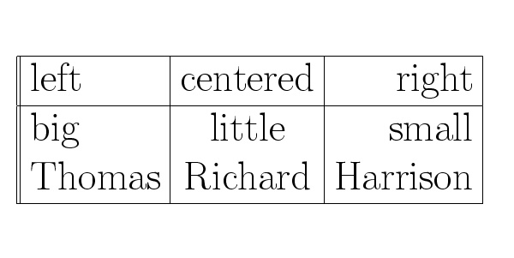
Tables
\begin{tabular}{||l|c|r|} \hline
left & centered & right\\ \hline
big & little & small \\
Thomas & Richard & Harrison \\ \hline
end{tabular}

Slide 24
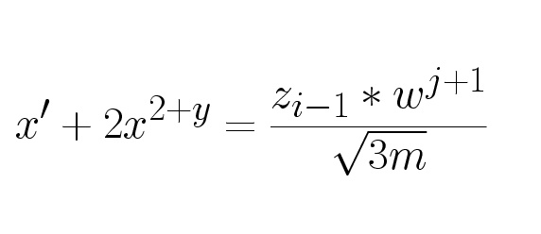
Mathematics
\documentclass[14pt]{article}
\begin{document}
\[ x' + 2x^{2+y} =
\frac{z_{i-1} * w^{j+1}}
{\sqrt{3m}} \]
\end{document}

Slide 25
Begin typesetting math
Exponentiation by superscripting
\[
x' + 2x^{2+y} =
\frac{z_{i-1} * w^{j+1}}
{\sqrt{3m}}
\]
The top part of a fraction
subscripting
The bottom part of a fraction
End typesetting math

Slide 26
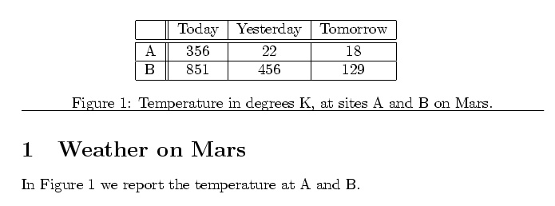
Figures
\section{Weather on Mars}
\begin{figure}
\hspace*{1in}
\begin{tabular}{|l||c|c|c|} \hline
& Today & Yesterday & Tomorrow \\ \hline \hline
A & 356 & 22 & 18 \\ \hline
B & 851 & 456 & 129 \\ \hline
\end{tabular}
\caption{Temperature in degrees K, at sites A and B on Mars.}
\label{mars} \hrule
\end{figure}
In Figure \ref{mars} we report the temperature at A and B.

Slide 27
Citations
\documentclass[14pt]{article}
\begin{document}
We studied four papers in lecture. The first, by Scott\cite{Scott92}, is a book. Then second, by Cambers and Leavens\cite{Chambers95}, is a journal paper. The third, by Heiler and Rosenthal\cite{Heiler85}, is a paper in a proceedings. The last paper, by Dayal and Smith\cite{Dayal85}, is in a collection of papers.
\bibliographystyle{plain}
\bibliography{myBib}
\end{document}

Slide 28
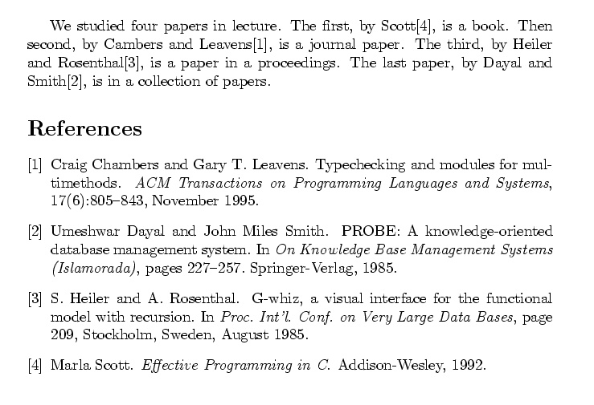
Result

Slide 29
References
References in LaTex are kept in a .bib file.
One uses bib.tex to create the text that goes in the reference section of the paper
The Mantra is:
  latex paper
  bibtex paper
  latex paper
  latex paper
Creates the .aux file with a list of all citation keys
Finds the references in .bib and creates text
Inserts text for references
Gets the cross references right, the second time.

Slide 30
The bib file
The bibfile stores all the data about individual papers.
Every paper is given a key.
It is the key used in the citation
  \cite{paperkey}
There are many kinds of references
We will look at 4 common kinds
  Book, journal article, proceedings paper, collection paper
Other interesting ones are
  Thesis and tech report. There are many others.

Slide 31
Book
@Book{Scott92,
author = "Marla Scott",
title = "Effective
Programming in {C}",
year = "1992",
publisher = "Addison-Wesley"
}

Slide 32
Journal Article
@Article{Chambers95,
author = "Craig Chambers and Gary T. Leavens",
title = "Typechecking and Modules for
Multimethods",
journal = "ACM Transactions on
Programming Languages
and Systems",
volume = "17",
number = "6",
pages = "805--843",
month = nov,
year = "1995"
}

Slide 33
Proceedings paper
@InProceedings{Heiler85,
author = "S. Heiler and A. Rosenthal",
title = "{G}-Whiz, a Visual Interface for
the Functional Model
with Recursion",
booktitle = "Proc. Int'l. Conf. on Very Large
Data Bases",
pages = "209",
address = "Stockholm, Sweden",
month = aug,
year = "1985",
keywords = "VLDB",
}

Slide 34
Collections paper
@InProceedings{Dayal85,
title = "{PROBE}: {A} Knowledge-Oriented
Database Management System",
author = "Umeshwar Dayal and
John Miles Smith",
year = "1985",
booktitle = "On Knowledge Base Management
Systems (Islamorada)",
publisher = "Springer-Verlag",
city = "New York",
pages = "227--257",
}

Slide 35
Don’t Forget to Sign Up
At PSU
  Day: Friday 2/24
  Time: 14:30-17:00
  Room: CH 225 (Cramer Hall)
At OGI
  Day: Wednesday 2/22
  Time: 14:30-17:00
  Room: TBA
Sign up today for a time.

