Slide 1
Scholarship Skills
Tim Sheard, PSU
Todd Leen, OGI-OHSU
Lecture 21:
How to get a Phd. Compiled by Tim Sheard
How to Succeed. By Dave Maier
All material © 1996, 1997, 1999, 2000
David Maier, © 2006 Todd Leen, Tim Sheard

Slide 2
Instructions for 15 minute Talk
If you haven’t already done so, Sign-up for a slot.
You must email to both Todd and Tim a copy of your slides.
Be sure we receive it by 5:00 PM the day before the talk.
Don’t use any special stuff, without checking with us, as our versions of powerpoint and PDF-viewer may not be exactly the same as yours.

Slide 3
How to succeed and get a Ph.D.
Want a Ph.D.
Want to finish.
  If you don’t have a target date. You’ll never finish
Find the right advisor.
Organize your time.
Focus.
Write something every day.
Take at least one class a quarter
  Try to take classes in an area you don’t know. You never know what will come in handy.
Emulate successful colleagues.
Publish papers.

Slide 4

Part of a Community
Participatory model of student-faculty interaction
  Lecturers expect student interaction in lectures
  Faculty expect students to initiate interaction on research interests
  Most faculty members have an “open door” policy
  The community is your best resource – Use It!

Slide 5
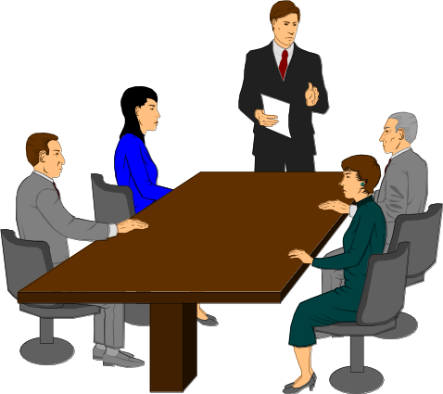
Participation in Research Groups
Reading Groups
  Meet weekly
  Read and discuss current literature
Attend group meetings
Publish and present papers externally
  Plan to submit your masters thesis someplace
  Establish yourself before you graduate!
Attend conferences and meetings
If you don’t find a research topic you will never get a Ph.D.

Slide 6
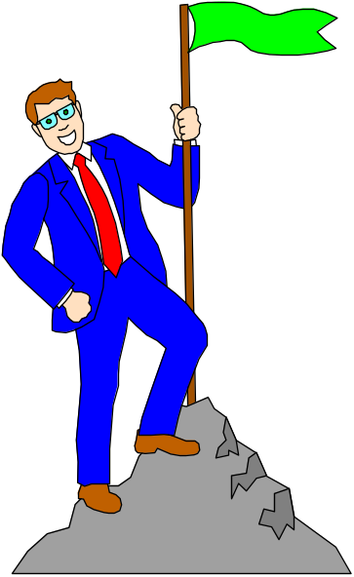
Selecting an Advisor
You must find an advisor. Advisors will not come looking for you.
Advisor
  Guides the student
  Advocates for student
  Assesses progress at
  evaluation hurdles
  Secures resources

Slide 7

Funding and Support
Support
  Stipend
  Tuition
  Equipment
  Travel funds (conferences)
The best source of support is from faculty with grants to support RAs
Other Possibilities
  T.A. for a course
  Program for a research center/department
  Industry internship

Slide 8
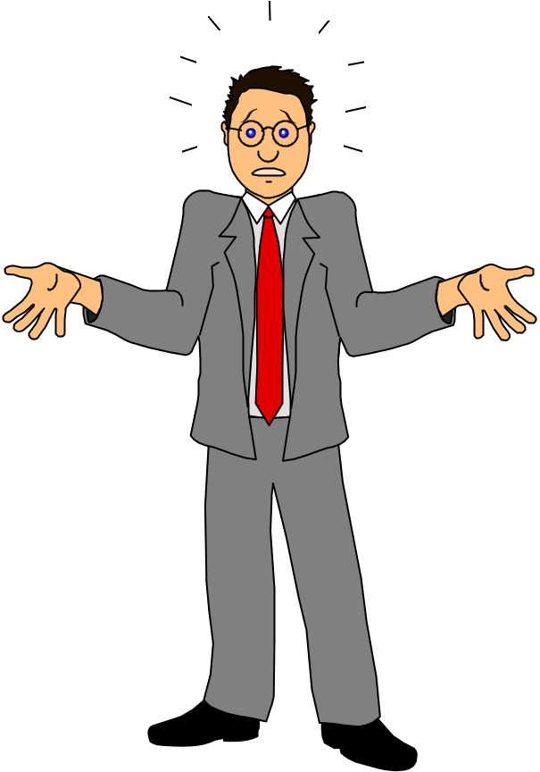
Stress
Graduate School in general, (the
first academic year in particular), are high stress periods.
Contributing factors:
  Forging new relationships
  Living in a new environment
  Academic challenge
  Personal finance issues

Slide 9
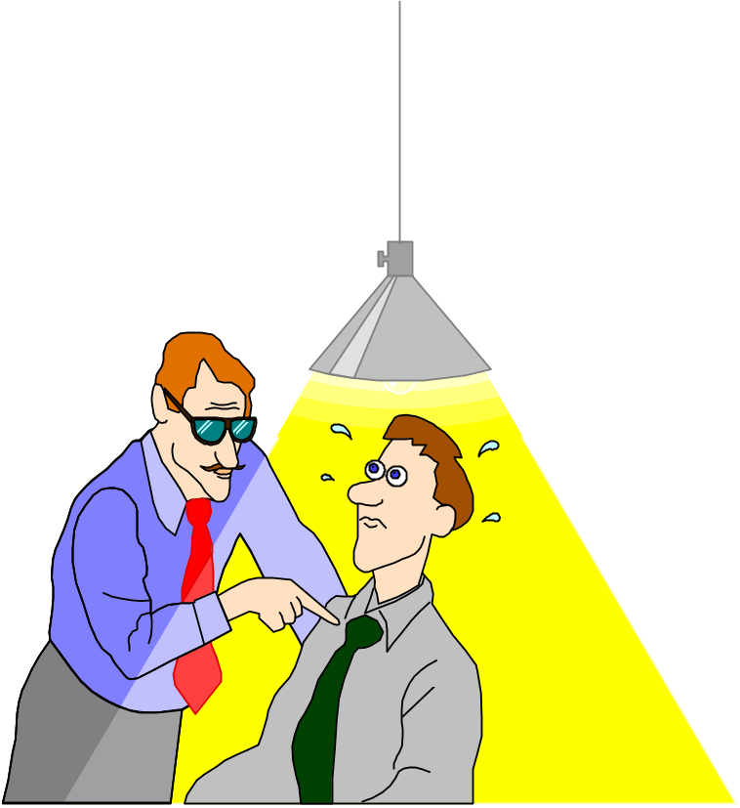
Stress (cont)
Resources:
  Employee Assistance Program
    At PSU 503-288-5882 or 1-800-927-9432
  Talk with faculty
  Talk to each other
  If you get behind, talk to your lecturers early!
  They are on your side!

Slide 10
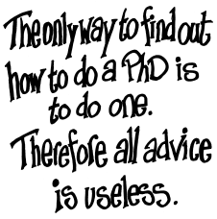
Advice 1
Richard Butterworth
http://www.cs.mdx.ac.uk/staffpages/richardb/PhDtalk.html

Slide 11
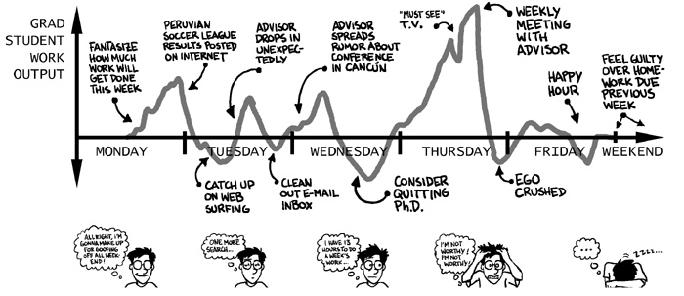
Advice 2
It’s a rocky road.
http://www.cs.manchester.ac.uk/mentors/howto.php
http://www.phdcomics.com/

Slide 12
Advice 3
Andrew M. Butler
  http://www.art.man.ac.uk/english/manuscript/backiss/content/howphd1.html
A thesis begins with a single word: PANIC!.
The Wrong Reasons for Doing a PhD:
You’ve got a first and it seems a shame to waste it. It will keep you off the dole for another few years.
The Right Reasons for Doing a PhD:
It will hurt even more not doing it than doing it. Er, that’s it.

Slide 13
Advice 4
How to get a Phd
  Estelle M. Phillips' and Derek S. Pugh's
Be aware of the seven ways of not getting a PhD:
Not wanting a PhD;
Overestimating what is required;
Underestimating what is required;
Having a supervisor who does not know what is required
Losing contact with your supervisor
Not having a 'thesis' (i.e. position, argument) to maintain
Taking a new job before completing.

Slide 14
Advice 5
Do you have what it takes?
  http://www.cs.purdue.edu/homes/dec/essay.phd.html
Intelligence
Time
Creativity
Intense curiosity
Adaptability
Self-Motivation
Competitiveness
Maturity

Slide 15
Quotes for prospective Ph.D.s
"Don't let school get in the way of your education.“
  Mark Twain
"The difference between people who exercise initiative and those who don't is literally the difference between night and day. I'm not talking about a 25 to 50 percent difference in effectiveness; I'm talking about a 5000-plus percent difference, particularly if they are smart, aware, and sensitive to others."
  Stephen R. Covey, The 7 Habits of Highly Effective People
"Let me tell you the secret that has led me to my goal. My strength lies solely in my tenacity."
  Louis Pasteur

Slide 16
On writing
"Failing to plan is planning to fail.“
  Author unknown to me
"What is written without effort is, in general, read without pleasure.“
  Samuel Johnson
"Present to inform, not to impress; if you inform, you will impress. "
  Fred Brooks

Slide 17
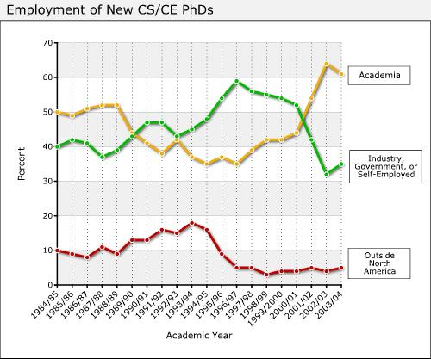
Taulbee Survey

Slide 18
http://philip.greenspun.com/careers/
THIS IS YOUR EDUCATION, THIS IS YOUR SALARY
!
$50K!
! **
! ** *
$40K! ** * Any Questions?
! ** *
! ***** *
$30K! **** *
! **** *
! ***** *
$20K! ***** *
! ***** *
! *** *
$10K! *** *
!** *
! *
0
+--------+----------+-----------+------------+---------+--*--------->
no high some Bachelor's Master's Doctor
high school college Degree Degree of
school diploma Philosophy
diploma

Slide 19
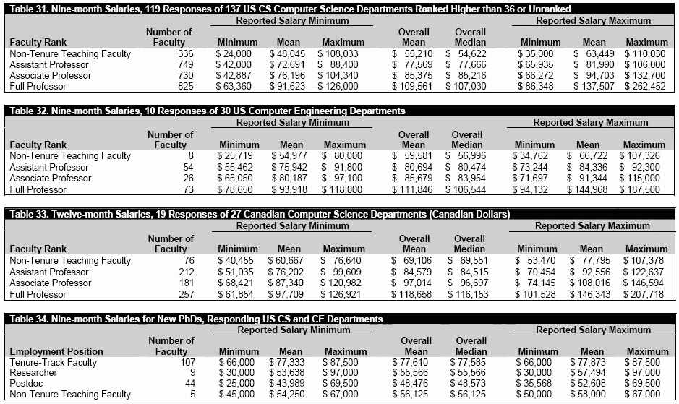
Taulbee Survey

Slide 20
How to Succeed – by Dave Maier
Make yourself incomparable
Very little is irrelevant
Humor and creativity are epsilon apart
  they are both based on incongruity
Be nimble—don’t feel obligated to “the way things are done”
Say when you are guessing

Slide 21
Success 2
Having one example during system design is better than zero examples
  at least you get a consistent set of design decisions
Time spent writing proposals is seldom wasted
People feel good if you can make them understand something they didn’t before.
Learn how to deal with secretaries and other support people

Slide 22
Success 3
You can negotiate based on your own happiness
Do one thing at a time
Plan as you go
Stress is okay
Ask yourself “Will it matter in 50 years?”
Learn to do preprocessing
  pre-thinking questions you might be asked
  mentally walking through a meeting

Slide 23
Success 4
Pick what you do carefully
  Learn to say no
    Have a list of criteria to say yes
  Just because you’d be the best person isn’t a reason to say yes
  Just because it won’t happen if you don’t do it isn’t a reason to say yes
  You get a better reputation doing 100% of a moderate task than a moderate amount of a difficult task.
  Make time for your family
If you agree to do something, do it gladly, not grumpily

