Slide 1
Applied Algorithms
Lecture #1
Introduction, class information, first problems

Slide 2
Contact Details:
Tim Sheard:
  Office: FAB 120-04
  Telephone: (503) 725 2410
  Email: sheard@cs.pdx.edu
CS 410 Top: Applied Algorithms Home Page
  http://www.cs.pdx.edu/~sheard/course/appliedalg/index.html

Slide 3
Time and Location:
Currently scheduled
  FAB 145
  Fridays, 13:00 – 15:40

Slide 4
Methods of assessment:
Element | Weight
Homework (mostly small programming assignments using the “judge”) | 40%
Midterm | 20%
Class Participation | 20%
Final project or exam | 20%
TOTAL | 100%

Slide 5
Class Participation
This is a discussion class.
I expect everyone to join in the discussion
You will be required to stand up and give your opinion.
Some problems we will solve together at the white board.
You may be asked to lead such a discussion.
Points are assigned for your participation.
I will keep records of how much you participate and this will count towards your grade.

Slide 6
Policies:
By default, all deadlines are firm.
We follow the standard PSU guidelines for academic integrity.
  Discussion is good;
  Items turned in should be your own, individual work
  No exceptions (minimum penalty is a 0 on that assignment).

Slide 7
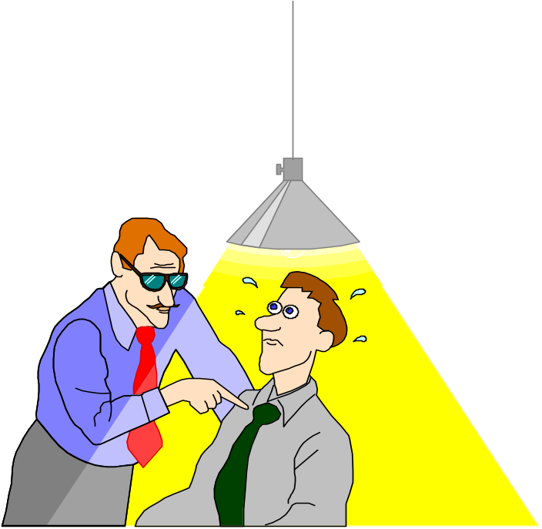
Academic Integrity
Students are expected to be honest in their academic dealings. Dishonesty is dealt with severely.
Homework. Pass in only your own work.
Program assignments. Program independently.
Examinations. Notes and such,
only as the instructor allows.
Homework. OK to discuss how to solve
problems with other students, but each
student should write up, debug, and
turn in his own solution.

Slide 8
Prerequisites:
Programming knowledge.
  Knowledge of C is a plus (because that is what is used in the textbook) but not necessary if you’re willing to pick it up as we proceed
  Students may choose any language supported by the “Robot Judge”. Other languages may be accepted by advance negotiation.
Knowledge of data structures and algorithm design equivalent to that learned in CS350.
Curiosity about what makes a good program.

Slide 9
Course Text:
“Programming Challenges”
  The programming contest training manual
  Stephen S. Skiena & Miguel A. Revilla
  Isbn 0-387-00163-8
Readings assigned in class. Readings will be posted on the class web page as the course proceeds.

Slide 10
Team Programming
We will experiment with different styles of team programming. See http://www.pairprogramming.com/ where this description comes from:
Two programmers working side-by-side, collaborating on the same design, algorithm, code or test. One programmer, the driver, has control of the keyboard/mouse and actively implements the program. The other programmer, the observer, continuously observes the work of the driver to identify tactical (syntactic, spelling, etc.) defects and also thinks strategically about the direction of the work. On demand, the two programmers can brainstorm any challenging problem. Because the two programmers periodically switch roles, they work together as equals to develop software.

Slide 11
Mock Contest
About 5 weeks into the term, we will hold a mock contest.
Students will organize themselves into teams of 3.
Each team will try and solve as many problems as possible in the time allowed.
No grade will be assigned to the results of the mock contest, but class participation points will be assigned.

Slide 12
Introductions
Your Name
Your class
Your experience as a programmer
  Your first program
Your favorite programming language
The biggest program you ever wrote
The program you are proudest of

Slide 13
The Robot Judge
http://www.programming-challenges.com
Creating an account
Official errata list
List of all problems in the text
Download the data files
You may also use the alternate site
  http://online-judge.uva.es/problemset/

Slide 14
Lets get started
How do I attack a new programming problem?
Read the problem
Read it again.
Think
Do not jump right in a start programming

Slide 15
Problem notes
Input – Output
  Size
  Shape and structure
  types
What is being asked for?
What data structures might be used?
What algorithms?
Are there any Gotcha’s?

Slide 16
Program Design
What are my variables?
  Use good names, document each variable
What functions will I use?
  Write a contract for each function.
    Inputs
    Outputs
  Write comments before you write the function
  Write at least 3 test cases before you write the function.

Slide 17
Data structure design
What structures will I use.
  Strings
  Arrays
  Trees
  Lists
  Heaps
  Stacks
  Queues
Do I need to define my own?

Slide 18
Today’s Assignments
  Readings
  Chapter 1 of the text. pp 1-26
  Programming assignment
    1.6.4 LCD Display
    Page 18
    Register with the robot judge
    Write a solution
    Submit your solution (until you get it right)
    Hand in both your program, and the judge output.

