Slide 1
Lecture 10, Oct. 29, 2004
Special Rescheduled Friday Lecture
Today’s Topics
  Pictures
  Low level graphics bit-maps: G.Region
  From Region to G.Region
    Shape to G.Region
  Drawing G.Region
  Reactive Pictures
Reading Assignment
  Read Chapter 10: Drawing Regions
Reminder: Homework Assignment #5 (was assigned last Monday but is due next Wednesday, the day of the midterm)

Slide 2
Remember, Guest Lecture and Exam
Sun Mon Tue Wed Thu Fri Sat
31
Nov 1
2
3
Midterm
exam
4
5
6
Guest Lect.
Tom Harke
The Haskell
Class System

Slide 3
Pictures
Drawing Pictures
  Pictures are composed of Regions
    Regions are composed of shapes
  Pictures add Color
data Picture = Region Color Region
| Picture `Over` Picture
| EmptyPic
deriving Show
Must be careful to use SOEGraphics, but
SOEGraphics has its own Region datatype.
import SOEGraphics hiding (Region)
import qualified SOEGraphics as G (Region)

Slide 4
Recall our Region datatype
data Region =
Shape Shape -- primitive shape
| Translate Vector Region -- translated region
| Scale Vector Region -- scaled region
| Complement Region -- inverse of region
| Region `Union` Region -- union of regions
| Region `Intersect` Region -- intersection of regions
| Empty
deriving Show
How will we draw things like the intersection of two regions, or the complement of two regions. These are hard things to do, and require hardware support to do efficiently. The G.Region type interfaces to this hardware support.

Slide 5
G.Region
The G.Region datatype interfaces to the hardware. It is essentially a two dimensional array or “bit-map”, storing a binary value for each pixel in the window.

Slide 6
Hardware support
There is efficient hardware support for combining two bit-maps using binary operators.
Operations are fast, but data (space) intensive, and this space needs to be explicitly allocated and de-allocated.
+
=

Slide 7
Interface
createRectangle :: Point -> Point -> IO G.Region
createEllipse :: Point -> Point -> IO G.Region
createPolygon :: [Point] -> IO G.Region
andRegion :: G.Region -> G.Region -> IO G.Region
orRegion :: G.Region -> G.Region -> IO G.Region
xorRegion :: G.Region -> G.Region -> IO G.Region
diffRegion :: G.Region -> G.Region -> IO G.Region
deleteRegion :: G.Region -> IO ()
drawRegion :: G.Region -> Graphic
These functions are defined in the SOEGraphics library
module.

Slide 8
Drawing G.Region
To draw things quickly, turn them into a G.Region, then turn the G.Region into a graphic object and then use all the machinery we have built up so far.
drawRegionInWindow::Window -> Color -> Region -> IO ()
drawRegionInWindow w c r =
drawInWindow w
(withColor c (drawRegion (regionToGRegion r)))
All we need to define then is: regionToGRegion
  we’ll come back to regionToGRegion in a minute

Slide 9
Drawing Pictures
Pictures combine multiple regions into one big picture. They provide a mechanism for placing one sub-picture on top of another.
drawPic :: Window -> Picture -> IO ()
drawPic w (Region c r) = drawRegionInWindow w c r
drawPic w (p1 `Over` p2) = do { drawPic w p2
; drawPic w p1
}
drawPic w EmptyPic = return ()

Slide 10
Overview
We have a rich calculus of Shapes, which we can draw, take the perimeter of, and tell if a point lies within.
We extend this with a richer type Region, which allows more complicated ways of combination (intersection, complement, etc.).
  We gave Region a mathematical semantics as a set of points in the 2-dimensional plane.
  We defined some interesting operators like containsR which is the characteristic function for a region.
  The rich combination ability make Region hard to draw efficiently, so we use a lower level datatype supported by the hardware: G.Region which is essentially a bit-map.
We enrich this even further with the Picture type.
G.Region is low level, relying on features like overwriting, and explicit allocation and deallocation of memory.
  We think of Region, as a highlevel interface to G.Region which hides the low level details.

Slide 11
Turning a Region into a G.Region
Experiment with a smaller problem to illustrate a lurking efficiency problem.
data NewRegion = Rect Side Side -- Abstracts G.Region
regToNReg1 :: Region -> NewRegion
regToNReg1 (Shape (Rectangle sx sy))
= Rect sx sy
regToNReg1 (Scale (x,y) r)
= regToNReg1 (scaleReg (x,y) r)
where scaleReg (x,y) (Shape (Rectangle sx sy))
= Shape (Rectangle (x*sx) (y*sy))
scaleReg (x,y) (Scale s r)
= Scale s (scaleReg (x,y) r)
Note, scaleReg distributes over Scale

Slide 12
Problem
Consider
(Scale (x1,y1)
(Scale (x2,y2)
(Scale (x3,y3)
... (Shape (Rectangle sx sy))
… )))
If the Scale level is N-deep, how many traversals does regToNReg1 do of the Region tree?

Slide 13
We’ve seen this before
Believe it or not we have encountered this problem before. Recall the definition of reverse
  reverse [] = []
  reverse (x:xs) = (reverse xs) ++ [x]
  where [] ++ zs = zs
  (y:ys) ++ zs = y : (ys ++ zs)
How did we solve this? Use an extra accumulating parameter.
  reverse xs = revhelp xs []
  where revhelp [] zs = zs
  revhelp (x:xs) zs = revhelp xs (x:zs)

Slide 14
Accumulate a complex Scale
regToNReg2 :: Region -> NewRegion
regToNReg2 r = rToNR (1,1) r
where rToNR :: (Float,Float) -> Region -> NewRegion
rToNR (x1,y1) (Shape (Rectangle sx sy))
= Rect (x1*sx) (y1*sy)
rToNR (x1,y1) (Scale (x2,y2) r)
= rToNR (x1*x2,y1*y2) r
To solve our original problem Repeat this for all the constructors of Region (not just Shape and Scale) and use G.Region instead of NewRegion, We also need to handle translation as well as scaling

Slide 15
Final Version
regToGReg1 :: Vector -> Vector -> Region -> G.Region
regToGReg1 trans sca (Shape s) = shapeToGRegion trans sca s
regToGReg1 (x,y) sca (Translate (u,v) r)
= regToGReg1 (x+u, y+v) sca r
regToGReg1 trans (x,y) (Scale (u,v) r)
= regToGReg1 trans (x*u, y*v) r
regToGReg1 trans sca Empty = createRectangle (0,0) (0,0)
regToGReg1 trans sca (r1 `Union` r2)
= let gr1 = regToGReg1 trans sca r1
gr2 = regToGReg1 trans sca r2
in orRegion gr1 gr2
Assuming of course we can write:
shapeToGRegion :: Vector -> Vector -> Shape -> G.Region
and write rules for Intersect, Complement etc.

Slide 16
A matter of style
While the function on the previous page shows how to solve the problem, there are several stylistic issues that could make it more readable and understandable.
The style of defining a function by patterns, becomes cluttered when there are many parameters (other than the one which has the patterns).
The pattern of explicitly allocating and deallocating (bit-map) G.Region’s will be repeated in cases for intersection and for complement, so we should abstract it, and give it a name.

Slide 17
Abstract the low level bit-map details
primGReg trans sca r1 r2 op
= let gr1 = regToGReg trans sca r1
gr2 = regToGReg trans sca r2
in op gr1 gr2

Slide 18
Redo with a case expression
regToGReg :: Vector -> Vector -> Region -> G.Region
regToGReg (trans @ (x,y)) (sca @ (a,b)) shape =
case shape of
(Shape s) -> shapeToGRegion trans sca s
(Translate (u,v) r) -> regToGReg (x+u, y+v) sca r
(Scale (u,v) r) -> regToGReg trans (a*u, b*v) r
(Empty) -> createRectangle (0,0) (0,0)
(r1 `Union` r2) -> primGReg trans sca r1 r2 orRegion
(r1 `Intersect` r2) -> primGReg trans sca r1 r2 andRegion
(Complement r) -> primGReg trans sca winRect r diffRegion
where winRect :: Region
winRect = Shape (Rectangle
(pixelToInch xWin) (pixelToInch yWin))
regionToGRegion :: Region -> G.Region
regionToGRegion r = regToGReg (0,0) (1,1) r
Pattern renaming

Slide 19
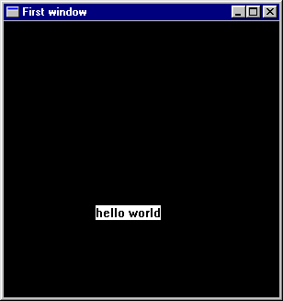
Shape to G.Region: Rectangle
xWin2 = xWin `div` 2
yWin2 = yWin `div` 2
shapeToGRegion1
:: Vector -> Vector -> Shape -> IO G.Region
shapeToGRegion1 (lx,ly) (sx,sy) (Rectangle s1 s2)
= createRectangle (trans(-s1/2,-s2/2)) (trans (s1/2,s2/2))
where trans (x,y) = ( xWin2 + inchToPixel ((x+lx)*sx),
yWin2 - inchToPixel ((y+ly)*sy) )
scaling details
s1
( xWin2,
yWin2)
s1/2
S2/2
s2
( xWin,
yWin )
Translation details

Slide 20
Ellipse
shapeToGRegion1 (lx,ly) (sx,sy) (Ellipse r1 r2)
= createEllipse (trans (-r1,-r2)) (trans ( r1, r2))
where trans (x,y) =
( xWin2 + inchToPixel ((x+lx)*sx),
yWin2 - inchToPixel ((y+ly)*sy) )
r2
r1

Slide 21
Polygon and RtTriangle
shapeToGRegion1 (lx,ly) (sx,sy) (Polygon pts)
= createPolygon (map trans pts)
where trans (x,y) =
( xWin2 + inchToPixel ((x+lx)*sx),
yWin2 - inchToPixel ((y+ly)*sy) )
shapeToGRegion1 (lx,ly) (sx,sy) (RtTriangle s1 s2)
= createPolygon (map trans [(0,0),(s1,0),(0,s2)])
where trans (x,y) =
( xWin2 + inchToPixel ((x+lx)*sx),
yWin2 - inchToPixel ((y+ly)*sy) )

Slide 22
A matter of style, again
shapeToGRegion1 has the same problems as regToGReg1
  The extra translation and scaling parameters obscure the pattern matching
  There is a repeated pattern, we should give it a name.
shapeToGRegion (lx,ly) (sx,sy) s =
case s of
Rectangle s1 s2 -> createRectangle
(trans (-s1/2,-s2/2))
(trans (s1/2,s2/2))
Ellipse r1 r2 -> createEllipse
(trans (-r1,-r2))
(trans ( r1, r2))
Polygon pts -> createPolygon (map trans pts)
RtTriangle s1 s2 -> createPolygon
(map trans [(0,0),(s1,0),(0,s2)])
where trans (x,y) = ( xWin2 + inchToPixel ((x+lx)*sx),
yWin2 - inchToPixel ((y+ly)*sy) )

Slide 23
Drawing Pictures, Sample Regions
draw :: Picture -> IO ()
draw p
= runGraphics (
do w <- openWindow "Region Test" (xWin,yWin)
drawPic w p
spaceClose w
)
r1 = Shape (Rectangle 3 2)
r2 = Shape (Ellipse 1 1.5)
r3 = Shape (RtTriangle 3 2)
r4 = Shape (Polygon [(-2.5,2.5), (-3.0,0),
(-1.7,-1.0),
(-1.1,0.2), (-1.5,2.0)] )

Slide 24
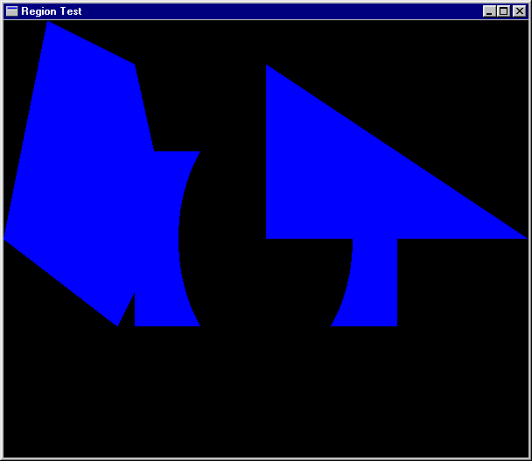
Sample Pictures
reg1 = r3 `Union` --RtTriangle
r1 `Intersect` -- Rectangle
Complement r2 `Union` -- Ellispe
r4 -- Polygon
pic1 = Region Cyan reg1
Main1 = draw pic1
Recall the precedence
of Union and Intersect

Slide 25
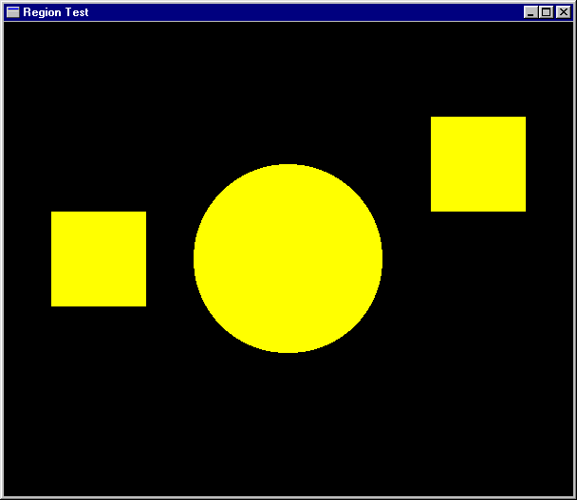
More Pictures
reg2 = let circle = Shape (Ellipse 0.5 0.5)
square = Shape (Rectangle 1 1)
in (Scale (2,2) circle)
`Union` (Translate (2,1) square)
`Union` (Translate (-2,0) square)
pic2 = Region Yellow reg2
main2 = draw pic2

Slide 26
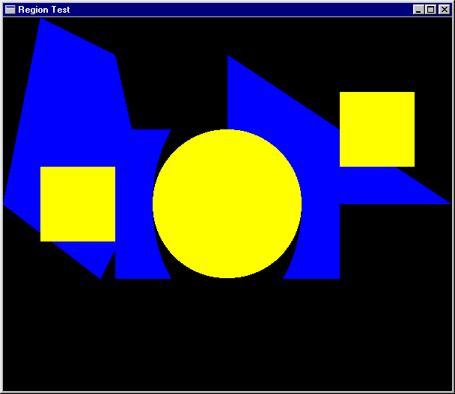
Another Picture
pic3 = pic2 `Over` pic1
main3 = draw pic3

Slide 27
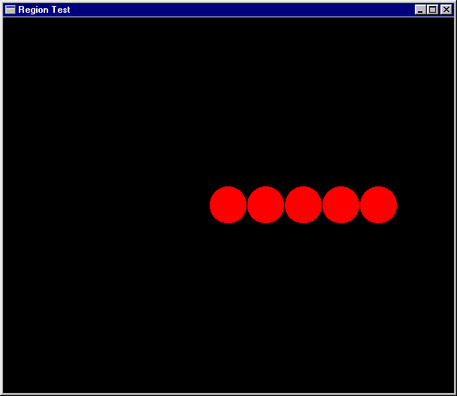
Separate computation from action
oneCircle = Shape (Ellipse 1 1)
manyCircles
= [ Translate (x,0) oneCircle | x <- [0,2..] ]
fiveCircles = foldr Union Empty (take 5 manyCircles)
pic4 = Region Magenta (Scale (0.25,0.25) fiveCircles)
main4 = draw pic4

Slide 28
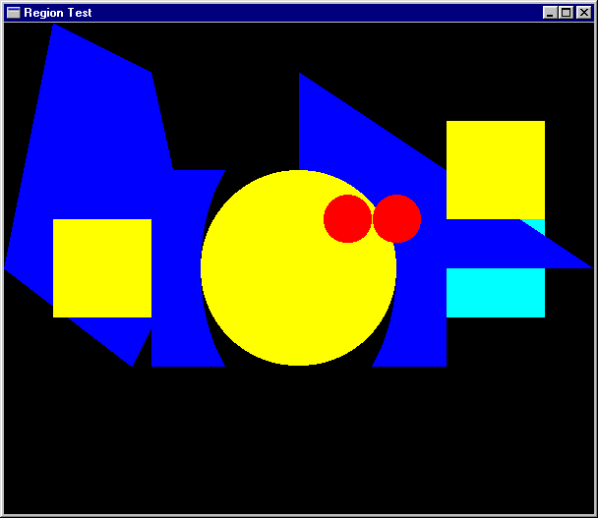
Ordering Pictures
pictToList :: Picture -> [(Color,Region)]
pictToList EmptyPic = []
pictToList (Region c r) = [(c,r)]
pictToList (p1 `Over` p2)
= pictToList p1 ++ pictToList p2
pic6 = pic4 `Over` pic2 `Over` pic1 `Over` pic5
pictToList pic6 - - - >
[(Magenta,?), (yellow,?),(Cyan,?),(Cyan,?)]
Recovers the Regions from top to bottom
possible because Picture is a datatype that can be analysed

Slide 29
An Analogy
pictToList EmptyPic = []
pictToList (Region c r) = [(c,r)]
pictToList (p1 `Over` p2)
= pictToList p1 ++ pictToList p2
drawPic w (Region c r) = drawRegionInWindow w c r
drawPic w (p1 `Over` p2) = do { drawPic w p2
; drawPic w p1}
drawPic w EmptyPic = return ()
Something to prove:
sequence .
(map (uncurry (drawRegionInWindow w))) . Reverse . pictToList
= drawPic w

Slide 30
Pictures that React
Find the Topmost Region in a picture that “covers” the position of the mouse when a left button click appears.
Search the picturelist for the the first Region that contains the mouse position.
Re-arrange the list, bring that one to the top
adjust :: [(Color,Region)] -> Vertex ->
(Maybe (Color,Region), [(Color,Region)])
adjust [] p = (Nothing, [])
adjust ((c,r):regs) p =
if r `containsR` p
then (Just (c,r), regs)
else let (hit, rs) = adjust regs p
in (hit, (c,r) : rs)

Slide 31
Doing it Non-recursively
adjust2 regs p
= case (break (\(_,r) -> r `containsR` p) regs) of
(top,hit:rest) -> (Just hit, top++rest)
(_,[]) -> (Nothing, [])
break:: (a -> Bool) -> [a] -> ([a],[a])
is from the Prelude.
Break even [1,3,5,4,7,6,12]
([1,3,5],[4,7,6,12])

Slide 32
Putting it all together
loop :: Window -> [(Color,Region)] -> IO ()
loop w regs =
do clearWindow w
sequence [ drawRegionInWindow w c r |
(c,r) <- reverse regs ]
(x,y) <- getLBP w
case (adjust regs (pixelToInch (x - xWin2),
pixelToInch (yWin2 - y) )) of
(Nothing, _ ) -> closeWindow w
(Just hit, newRegs) -> loop w (hit : newRegs)
draw2 :: Picture -> IO ()
draw2 pic
= runGraphics (
do w <- openWindow "Picture demo" (xWin,yWin)
loop w (pictToList pic))

Slide 33
Try it out
p1,p2,p3,p4 :: Picture
p1 = Region Magenta r1
p2 = Region Cyan r2
p3 = Region Green r3
p4 = Region Yellow r4
pic :: Picture
pic = foldl Over EmptyPic [p1,p2,p3,p4]
main = draw2 pic

Slide 34
A matter of style, 3
loop2 w regs
= do clearWindow w
sequence [ drawRegionInWindow w c r |
(c,r) <- reverse regs ]
(x,y) <- getLBP w
let aux (_,r) = r `containsR`
( pixelToInch (x-xWin2),
pixelToInch (yWin2-y) )
case (break aux regs) of
(_,[]) -> closeWindow w
(top,hit:bot) -> loop w (hit : (top++bot))
draw3 :: Picture -> IO ()
draw3 pic
= runGraphics (
do w <- openWindow "Picture demo" (xWin,yWin)
loop2 w (pictToList pic) )

