Slide 1
A Type System for MetaML
MetaML types as an Omega program
Lecture 12

Slide 2
Assignments
No programming assignment this week.
The paper
  “ML Like Inference for Classifiers”
  To be discussed today Feb 17, 2005
New Paper Reading Assignment
  Search-Based Binding Time Analysis using Type-Directed Pruning
  Tim Sheard and Nathan Linger
  Available on class web site.
Project proposal
  A 1 page written project proposal is due next Tuesday, Feb. 22.

Slide 3
How do we describe type systems?
How do we type: 5 or 12 ?
  All Integer constants have type int
How do we type f x ?
  If f has type (a -> b)
  And x has type a
  Then f x has type b

Slide 4
Type Derivation notation
Programming language researchers have developed a notation to describe type systems, sometimes called a sequent or derivation
f :: a -> b
x :: a
f x :: b

Slide 5
Handling Variables
What type does x have?
  It depends on context
  The notation uses a s Greek symbol (usually Γ or Σ ) to represent a function that encodes the context.
We treat Γ as a function from variables to types
Γ x ═ a
Γ├ x : a

Slide 6
Extending Contexts
If a context is a function, we can build a new function which knows about more variables
Γ(x,a) is a function that maps x to a and every other variable to the type that Γ maps it to
Γ(x,a) ├ e :: b
Γ ├ (fn x => e) :: a -> b

Slide 7
DeBruijn Indices
DeBruijn indices are used to indicate variables by position, rather than by name.
Name based
(fn x => (x, fn y => (x,y))
Equivalent Index based
(fn => (v0, fn => (v1,v0))
The index of a variable indicates how many lambdas to walk over to reach the binding lambda.

Slide 8
DeBruijn Contexts
Contexts are just lists of types (we know which variable they belong to by their position in the list). Usually the lists “grow” from the right.
Γ(a)(b) ├ e :: c
Γ(a) ├ fn => e :: b -> c
Γ ├ (fn => fn => e) :: a -> b -> c

Slide 9
DeBruijn Rule for variables
Γ(a)├ V0 : a
Γ├ V(n-1) : b
Γ(a)├ Vn : b

Slide 10
MetaML: Type system
past
present
future
Γ−3
Γ−2
Γ−1
Γ0
Γ1
Γ2
Γ3
Typing judgment contains a "sliding band" of type contexts. The lambda fragment binds and looks up variables in the "present"
  Staging operations slide the pointer

Slide 11
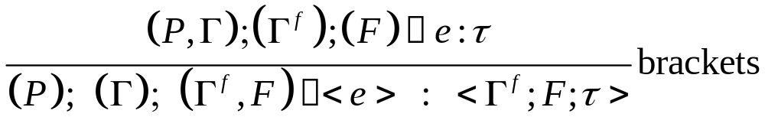
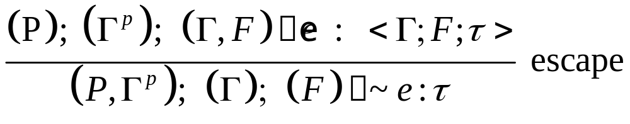

Slide 12
Overview of Omega
Object language is an algebraic datatype with type indexes
It is indexed by some semantic property
  Type
Omega-Programs check and maintain that the index property is manipulated in a consistent manner.
This lets us build and test type systems interactively.

Slide 13
Other features of Omega.
Omega is a Haskell-like language with following additional features
  Support for equality qualified types
    The type system automatically propagates and manipulates type equalities
  Complex kind system
    Allows the programmer to define new kinds
    Polymorphic kind system
  Staging
    MetaML-style code

Slide 14
Omega: An Example
kind Nat = Zero | Succ Nat
data List :: *0 ~> Nat ~> *0 where
Nil :: List a Zero
Cons :: a -> List a m -> List a (Succ m)
A kind of natural numbers (Nat)
  Classifies types Zero, Succ Zero, Succ(Succ Zero) …
    These types do not classify any runtime computations
Think of them as Lists with length n
  List a n : a list with whose length is n
We call the parameter n a type index.

Slide 15
Indexes describe invariants or properties
map :: (a -> b) -> (List a n) -> (List b n)
map f Nil = Nil
map f (Cons x xs) = Cons (f x) (map f xs)
Function map preserves length of lists
What about more complex invariants
  Function append:
  (List a m) -> (List a n) -> (List a (m+n))

Slide 16
Append
sum :: Nat ~> Nat ~> Nat
{sum Zero x} = x
{sum (Succ y) x} = Succ {sum y x}
app :: List a n -> List a m -> List a {sum n m}
app Nil ys = ys
app (Cons x xs) ys = Cons x (app xs ys)

Slide 17
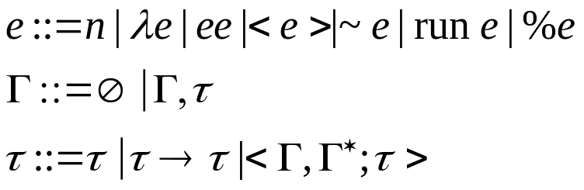
A Staged Object Langauge
A staged object language MetaML
  A standard lambda calculus fragment
  Staging fragment
    Brackets, escape, run, and CSP
  Sequences of contexts (or environments)
    Past, present, future
  Use type indexes to describe types of terms and shapes of contexts

Slide 18
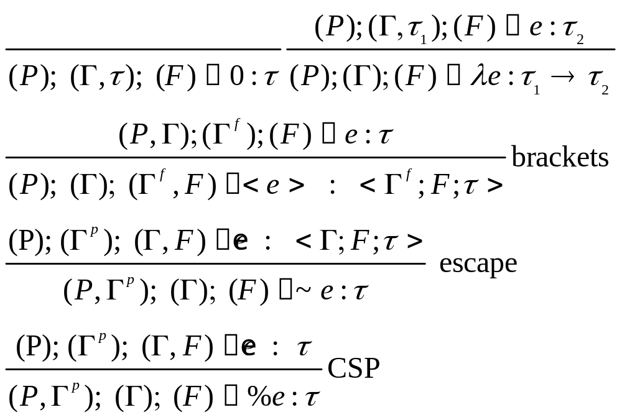

Slide 19
MetaML in Omega
data Cd n f t = Cd (forall p . Exp p n f t)
data Var:: *0 ~> *0 ~> *0 where
Z:: Var (b,a) a
S:: Var w x -> Var (w,y) x
data Exp:: *0 ~> *0 ~> *0 ~> *0 ~> *0 where
Const:: t -> Exp past now future t
V:: Var now t -> Exp past now future t
Abs:: Exp p (n,s) f t -> Exp p n f (s -> t)
App:: Exp p n f (t1->t) -> Exp p n f t1 -> Exp p n f t
Br:: Exp (p,n) c f t -> Exp p n (c,f) (Cd c f t)
Esc:: Exp p b (n,f) (Cd n f t) -> Exp (p,b) n f t
Csp:: Exp p b (n,f) t -> Exp (p,b) n f t
Pair:: Exp p n f s -> Exp p n f t -> Exp p n f (s,t)
Run:: (forall x . Exp p n (x,f) (Cd x f t))
-> Exp p n f t

Slide 20
Example Variables
data Var:: *0 ~> *0 ~> *0 where
Z:: Var (b,a) a
S:: Var w x -> Var (w,y) x
prompt> Z
Z : (forall a b . Var (a,b) b)
prompt> S Z
(S Z) : (forall a b c . Var ((a,b),c) b)
prompt> S(S Z)
(S (S Z)) : (forall a b c d . Var (((a,b),c),d) b)
prompt> V(S Z)
(V (S Z)) : (forall a b c d e . Exp a ((b,c),d) e c)
The “value” of the variable (Z = 0, S Z = 1, S(S Z)=2, …) indicates how many pairs to climb over

Slide 21
DeBruijn Notation in nested pairs
((((_,x3),x2),x1),x0)
The number indicates number of “steps” to the “left” before accessing the “right” component.
( _ , x0 )
( _ , x1)
( _ , x2)

Slide 22
Example expressions
x0 = V Z
x1 = V(S Z)
prompt> x0
(V Z) : (forall a b c d . Exp a (b,c) d b)
prompt> x1
(V (S Z)) : (forall a b c d e . Exp a (b,(c,d)) e c)
prompt> Abs x0
(Abs (V Z)) :
(forall a b c d . Exp a b c (d -> d))
prompt> Abs x1
(Abs (V (S Z))) :
(forall a b c d e . Exp a (b,c) d (e -> c))
prompt> Abs (Abs (App x1 x0))
(Abs (Abs (App (V (S Z)) (V Z)))) :
(forall a b c d e . Exp a b c ((d -> e) -> d -> e))

Slide 23
Comparison
Note how the constructor functions are like type system rules
App ::
Exp a b c (d -> e) ->
Exp a b c d ->
Exp a b c e
f :: d -> e
x :: d
f x :: e

Slide 24
Contexts
The second index acts like a DeBruijn context
Abs :: Exp a (Γ,b) d e ->
Exp a Γ d (b -> e)
Γ(b) ├ w :: e
Γ ├ (fn => w) :: b -> e

Slide 25
MetaML: Type system
past
present
future
Γ−3
Γ−2
Γ−1
Γ0
Γ1
Γ2
Γ3
Typing judgment contains a "sliding band" of type contexts. The lambda fragment binds and looks up variables in the "present"
  Staging operations slide the pointer
  First and third index are “stacks” of contexts

Slide 27
Interpreter
Decision: How to represent code
  Code is just an Exp…
  … but not just any exp
data Cd n f t =
Cd (forall p . Exp p n f t)
Why polymorphic in the past?
  Polymorphic in the past = no escapes
  Polymorphic in the present = is a closed term
  Polymorphic in the future = contains no brackets

Slide 28
Structure of the Interpreter
A family of functions
  Eval
    "level zero"
    Evaluates the lambda calculus fragment in the usual way
  Build
    Performs two slightly different functions
      Splices escaped code (level 1 in MetaML)
      Rebuilds code keeping track of levels

Slide 29
eval :: Exp past now future t -> now -> t
eval (Const n) env = n
eval (V Z) (x,y) = y
eval (V (S v)) (x,y) = eval (V v) x
eval (App f x) env = (eval f env) (eval x env)
eval (Abs e) env = \ v -> eval e (env,v)
eval (Pair x y) env = (eval x env, eval y env)
eval (Br e) env = Cd (bd (EnvZ env) e)
eval (Run e) env =
case eval e env of { Cd x -> eval x () }
The lambda fragment is standard
When encountering a code bracket
  Invokes the build function (bd), remembering the current environment

Slide 30
eval < < < e > > > = bd1 << e >> =
< bd2 < e > > =
< < bd3 e > >
bd1 :: Exp (a,b) n f t ->
Exp z n f t
bd2 :: Exp ((a,b),c) n f t ->
Exp (z,c) n f t
bd3 :: Exp (((a,b),c),d) n f t ->
Exp ((z,c),d) n f t
bd4 :: Exp ((((a,b),c),d),e) n f t ->
Exp (((z,c),d),e) n f t

Slide 31
Building code
data Env:: *0 ~> *0 ~> *0 where
EnvZ:: a -> Env (b,a) c
EnvS:: Env a b -> Env (a,c) (b,c)
bd :: Env a z -> Exp a n f t -> Exp z n f t
Build takes an expression and rebuilds it
  Relation (Env x y) relates the past of the argument and the result expression
    The base case is when env is created by invocation from eval
      Store the environment with which the build was invoked to give as an argument to eval in case of escapes
      The past of the result expression is polymorphic so that it can be formed into code

Slide 32
(Env x y) continued:
  Inductive case
    EnvS: (Env x y) -> (Env (x,a) (y,a))
    Going under brackets enlarges the past

Slide 33
build
bd :: Env a z -> Exp a n f t -> Exp z n f t
bd env (Const n) = Const n
bd env (V z) = V z
bd env (App x y) = App (bd env x) (bd env y)
bd env (Abs e) = Abs(bd env e)
bd env (Pair x y) = Pair (bd env x) (bd env y)
bd env (Br e) = Br(bd (EnvS env) e)
bd env (Run e) = Run(bd env e)
bd (EnvZ env) (Esc e) =
case eval e env of { Cd x -> x}
bd (EnvS r) (Esc e) =
case bd r e of { Br x -> x; y -> Esc y }
bd (EnvZ env) (Csp e) = Const(eval e env)
bd (EnvS r) (Csp e) = Csp(bd r e)
Escape
  Two cases depending on the environment
  Bracket (increment the environment)
The lambda fragment is simply rebuilt

Slide 34
Run
data Exp past now future t =... ... ...
| Run (forall n . Exp past now (n,future) (Cd n future t))
eval env (Run e) = case eval env e of { Cd x -> eval () x }
Polymorphism to encode run
  Recall: an expression polymorphic in the present contains no free variables
  Therefore it can be executed in any environment (including the empty environment)

Slide 35
Programs rejected
-- <fn x => ~(run <x>)>
-- b2 = Abs (Esc (Run (Br (V Z))))
b1 = Br(V Z)
b1 :: Exp a b ((c,d),e) (Cd (c,d) e d))
Run ::
(forall e . Exp a b (e,c) (Cd e c d))
-> Exp a b c d
Not polymorphic in “now” since it has a free variable.

Slide 36
Puzzle
val puzzle =
run ((run <fn a =>
~( (fn x => <x>)
(fn w => <a>) )
5>)
3);
-- (fn x => <x>)
exp1 = Abs (Br (Csp(V Z)))
-- fn w => <a>)
exp2 = Abs (Br ( (V (S Z))))
-- ~((fn x => <x>) (fn w => <a>))
exp3 = Esc(App exp1 exp2)
--- <fn a => ~( (fn x => <x>) (fn w => <a>) ) 5>
exp4 = Br(Abs(App exp3 (Const 5)))

Slide 37
Note type of inner term
-- <fn a => ~( (fn x => <x>) (fn w => <a>) ) 5>
prompt> exp4
(Br (Abs (App (Esc (App (Abs (Br (Csp (V Z))))
(Abs (Br (V (S Z))))))
(Const 5)))) ::
Exp a b ((c,d),e)
(Cd (c,d) e (a1 -> Cd ((c,d),a1) e d)))

Slide 38
Further questions
OK, so this is not exactly MetaML?
  How do we embed MetaML into MetaL?
    Provide a translation
    How does it relate to other MetaML type systems? Are there programs it rejects/accepts that others don't?
      We conjecture it is similar to environment classifiers, but need to formalize this notion
Code type carries the type of the environment?
  Is this really a problem?
    Types may grow (arbitrarily) large
    But the power function works!!!

