Slide 1
Preparing for FRP
Shapes, Regions, and Drawing

Slide 2
Shape types from the Text
data Shape = Rectangle Float Float
| Ellipse Float Float
| RtTriangle Float Float
| Polygon [ (Float,Float) ]
deriving Show
Deriving Show
tells the system to build an show function for the type Shape
Using Shape - Functions returning shape objects
circle radius = Ellipse radius radius
square side = Rectangle side side

Slide 3
Functions over Shape
Functions over shape can be defined using pattern matching
area :: Shape -> Float
area (Rectangle s1 s2) = s1 * s2
area (Ellipse r1 r2) = pi * r1 * r2
area (RtTriangle s1 s2) = (s1 *s2) / 2
area (Polygon (v1:pts)) = polyArea pts
where polyArea :: [ (Float,Float) ] -> Float
polyArea (v2 : v3 : vs) = triArea v1 v2 v3 +
polyArea (v3:vs)
polyArea _ = 0
Note use of prototype
Note use of nested patterns
Note use of wild card pattern (matches anything)

Slide 4
Poly = [A,B,C,D,E,F]
A
Area = Area(Triangle [A,B,C]) +
Area(Poly[A,C,D,E,F])
B
F
E
C
D

Slide 5
TriArea
triArea v1 v2 v3 =
let a = distBetween v1 v2
b = distBetween v2 v3
c = distBetween v3 v1
s = 0.5*(a+b+c)
in sqrt (s*(s-a)*(s-b)*(s-c))
distBetween (x1,y1) (x2,y2)
= sqrt ((x1-x2)^2 + (y1-y2)^2)

Slide 6
Interacting with the world through graphics
Our first example of an action is found in chapter 3
The action is to pop up a window and to draw pictures in the window.

Slide 7
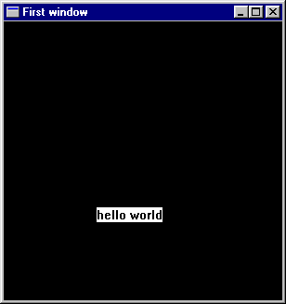
Hello World with Graphics Lib
This imports a
library,
SOE,
it contains many
functions
module Main where
import SOE
ex0 =
runGraphics(
do { w <- openWindow "First window" (300,300)
; drawInWindow w (text (100,200) "hello world")
; k <- getKey w
; closeWindow w
} )

Slide 8
Graphics Operators
openWindow :: String -> (Int,Int) -> IO Window
opens a titled window of a particular size
drawInWindow :: Window -> Graphic -> IO ()
Takes a window and a Graphic object and draws it
Note the return type of IO()
getKey :: Window -> IO Char
Waits until any key is pressed and then returns that character
closeWindow :: Window -> IO ()
closes the window
try it out

Slide 9
A Bug in the code?
getKey :: Window -> IO Char
getKey win = do
ch <- getKeyEx win True
if (ch == '\x0') then return ch
else getKeyEx win False
getKey :: Window -> IO Char
getKey win = do
ch <- getKeyEx win True
if not(ch == '\x0') then return ch
else getKeyEx win False

Slide 10
An Action to Wait for a Space
spaceClose :: Window -> IO ()
spaceClose w =
do { k <- getKey w
; if k == ' ' then closeWindow w
else spaceClose w
}
ex1 =
runGraphics(
do { w <- openWindow "Second Program" (300,300)
; drawInWindow w (text (100,200) "hello Again")
; spaceClose w
} )

Slide 11
Drawing Primitive Shapes
The Graphics libraries contain primitives for drawing a few primitive shapes.
We will build complicated drawing programs from these primitives
ellipse :: Point -> Point -> Graphic
shearEllipse ::
Point -> Point -> Point -> Graphic
line :: Point -> Point -> Graphic
polygon :: [Point] -> Graphic
polyline :: [Point] -> Graphic

Slide 12
Coordinate Systems
Increasing x-axis
(0,0)
Increasing y-axis

Slide 13
Example Program
ex2 =
runGraphics(
do { w <- openWindow "Draw some shapes" (300,300)
; drawInWindow w (ellipse (0,0) (50,50))
; drawInWindow w
(shearEllipse (0,60) (100,120) (150,200))
; drawInWindow w
(withColor Red (line (200,200) (299,275)))
; drawInWindow w
(polygon [(100,100),(150,100),(160,200)])
; drawInWindow w
(withColor Green
(polyline [(100,200),(150,200),
(160,299),(100,200)]))
; spaceClose w
} )

Slide 14
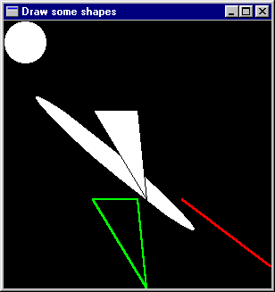
The Result
; drawInWindow w
(ellipse (0,0) (50,50))
; drawInWindow w
(shearEllipse (0,60)
(100,120)
(150,200))
; drawInWindow w
(withColor Red
(line (200,200)
(299,275)))
; drawInWindow w
(polygon [(100,100),
(150,100),
(160,200)])
; drawInWindow w
(withColor Green
(polyline
[(100,200),(150,200),
(160,299),(100,200)]))

Slide 15
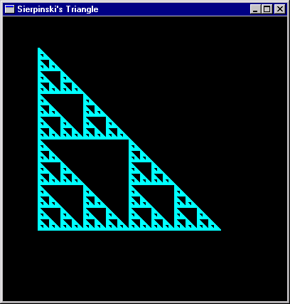
Building Programs
We’d like to build bigger things from these small pieces
Perhaps things such as fractals
Example:
Sierpinski’s Triangle
a repeated drawing of
a triangle at repeatedly
smaller sizes.
Key Idea
Separate pure computation
from action

Slide 16
Geometry Isosceles Right Triangles
Remember y increases
as we go down the page
(x,y-size)
size * size + size * size = hyp * hyp
size
hyp
size / 2
(x+ (size / 2), y - (size / 2))
(x, y - (size / 2))
(x , y)
(x+ size, y)
size

Slide 17
Draw 1 Triangle
fillTri x y size w =
drawInWindow w
(withColor Blue
(polygon [(x,y),
(x+size,y),
(x,y-size)]))
minSize = 8
(x,y)
size

Slide 18
Sierpinski’s Triangle
(x,y-size)
sierpinskiTri w x y size =
if size <= minSize
then fillTri x y size w
else let size2 = size `div` 2
in do { sierpinskiTri w x y size2
; sierpinskiTri w x (y-size2) size2
; sierpinskiTri w (x + size2) y size2
}
ex3 =
runGraphics(
do { w <- openWindow "Sierpinski's Tri" (400,400)
; sierpinskiTri w 50 300 256
; spaceClose w
} )
(x+ (size / 2),
y - (size / 2))
(x, y - (size / 2))
(x , y)
(x+ size, y)

Slide 19
Question?
What’s the largest triangle sierpinskiTri ever draws?
How come the big triangle is drawn?

Slide 20
Abstraction
Drawing a polygon in a particular window, with a particular color is a pretty common thing. Lets give it a name.
drawPoly w color points =
drawInWindow w
(withColor color (polygon points))

Slide 21
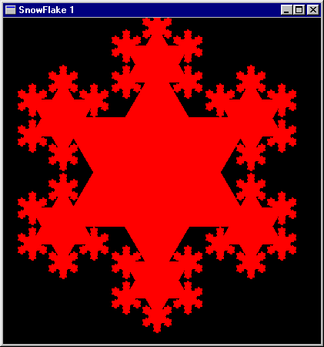
Draw a snowflake

Slide 22
Geometry of Snow flakes
Snow flakes are six sided
They have repeated patterns
An easy six sided figure is the Star of David
Constructed from two equilateral triangles
side
radius
side
height
Radius = 2/3 * height
height = sqrt(side*side - (side*side)/4)

Slide 23
2 triangles with common center

Slide 24
Compute the corners
(x,y)
eqTri side (x,y) =
let xf = fromIntegral x
yf = fromIntegral y
sideDiv2 = side / 2.0
height = sqrt( side*side -
(sideDiv2 * sideDiv2) )
h1third = height / 3.0
h2third = h1third * 2.0
f (a,b) = (round a,round b)
in (map f [(xf, yf - h2third),
(xf - sideDiv2,yf + h1third),
(xf + sideDiv2,yf + h1third)],
map f [(xf - sideDiv2,yf - h1third),
(xf + sideDiv2,yf - h1third),
(xf,yf + h2third)])
side

Slide 25
Now repeat twice and draw
drawStar color1 color2 w side (x,y) =
do { let (a,b) = eqTri side (x,y)
; drawPoly w color1 a
; drawPoly w color2 b
}
ex4 =
runGraphics(
do { w <- openWindow "Star of david”
(400,400)
; drawStar Red Green w 243 (200,200)
; spaceClose w
} )

Slide 26
For a snowflake repeat many times
snow1 w color size (x,y) =
if size <= minSize
then return ()
else do { drawStar color color
w (fromIntegral size) (x,y)
; sequence_ (map smaller allpoints)
}
where (triangle1,triangle2) =
eqTri (fromIntegral size) (x,y)
allpoints = (triangle1 ++ triangle2)
smaller x = snow1 w color (size `div` 3) x

Slide 27
To Draw pick appropriate sizes
ex5 =
runGraphics(
do { w <- openWindow "SnowFlake 1”
(400,400)
; snow1 w Red 243 (200,200)
; spaceClose w
} )
Why 243?

Slide 28
Multiple Colors
snow2 w colors size (x,y) =
if size <= minSize
then return ()
else do { drawPoly w (colors !! 0) triangle2
; drawPoly w (colors !! 1) triangle1
; sequence_ (map smaller allpoints)
}
where (triangle1,triangle2) = eqTri (fromIntegral size) (x,y)
allpoints = (triangle1 ++ triangle2)
smaller x = snow2 w (tail colors) (size `div` 3) x
ex6 =
runGraphics(
do { w <- openWindow "Snowflake" (400,400)
; snow2 w (cycle[Red,Blue,Green,Yellow]) 243 (200,200)
; spaceClose w
} )

Slide 29
What Happened?
The list of colors was too short for the depth of the recursion
ex6 =
runGraphics(
do { w <- openWindow "Snowflake 2" (400,400)
; snow2 w [Red,Blue,Green,Yellow,White] 243 (200,200)
; spaceClose w
} )
ex7 = runGraphics(
do { w <- openWindow "Snowflake" (400,400)
; snow2 w (cycle [Red,Blue,Green,Yellow])
243 (200,200)
; spaceClose w
} )

Slide 30
Lets make it better
snow3 w colors size (x,y) =
if size <= minSize
then return ()
else do { drawPoly w (colors !! 0) triangle2
; drawPoly w (colors !! 1) triangle1
; snow3 w colors (size `div` 3) (x,y)
; sequence_ (map smaller allpoints) }
where (triangle1,triangle2) = eqTri (fromIntegral size) (x,y)
allpoints = (triangle1 ++ triangle2)
smaller x = snow3 w (tail colors) (size `div` 3) x
ex8 =
runGraphics(
do { w <- openWindow "Snowflake" (400,400)
; snow3 w (cycle [Red,Blue,Green,Yellow,White]) 243 (200,200)
; spaceClose w } )

Slide 31
Recall the Shape Datatype
data Shape = Rectangle Side Side
| Ellipse Radius Radius
| RtTriangle Side Side
| Polygon [ Vertex ]
deriving Show
type Vertex = (Float,Float)
-- We call this Vertex (instead of Point) so
-- as not to confuse it with Graphics.Point
type Side = Float
type Radius = Float

Slide 32
Properties of Shape
Note that some shapes are position independent
Rectangle Side Side
RtTriangle Side Side
Ellipse Radius Radius
But the Polygon [Vertex] Shape is defined in terms of where it appears in the plane.
Shape’s Size and Radius components are measured in inches.
The Window based drawing mechanism of the last lecture was based upon pixels.

Slide 33
Considerations
Where to draw position independent shapes?
Randomly?
In the upper left corner (the window origin)
In the middle of the window
We choose to draw them in the middle of the window.
We consider this the shape module origin
So our model has both a different notion of “origin” and of coordinate system (pixels vs inches)
We need to handle this.
Many systems draw about 100 pixels per inch.

Slide 34
Visualize
Window Coordinate system
Shape Coordinate system
(200,200) pixels
or
(1,-1) inches

Slide 35
Coercion Functions
inchToPixel :: Float -> Int
inchToPixel x = round (100*x)
pixelToInch :: Int -> Float
pixelToInch n = (intToFloat n) / 100
intToFloat :: Int -> Float
intToFloat n = fromInteger (toInteger n)

Slide 36
Setting up the Shape window
xWin, yWin :: Int
xWin = 600
yWin = 500
trans :: Vertex -> Point
trans (x,y) = ( xWin2 + inchToPixel x,
yWin2 - inchToPixel y )
xWin2, yWin2 :: Int
xWin2 = xWin `div` 2
yWin2 = yWin `div` 2
( xWin2,
yWin2)
( xWin,
yWin )

Slide 37
Translating Points
trans :: Vertex -> Point
trans (x,y) = ( xWin2 + inchToPixel x,
yWin2 - inchToPixel y )
transList :: [Vertex] -> [Point]
transList [] = []
transList (p:ps) = trans p : transList ps

Slide 38
Translating Shapes
Convert a Shape (Rectangle, Ellipse, …) into a graphic Draw object (using the window functions line, polygon, … see file Draw.hs)
shapeToGraphic :: Shape -> Graphic
shapeToGraphic (Rectangle s1 s2)
= let s12 = s1/2
s22 = s2/2
in polygon
(transList [(-s12,-s22),(-s12,s22),
(s12,s22),(s12,-s22)])
shapeToGraphic (Ellipse r1 r2)
= ellipse (trans (-r1,-r2)) (trans (r1,r2))
shapeToGraphic (RtTriangle s1 s2)
= polygon (transList [(0,0),(s1,0),(0,s2)])
shapeToGraphic (Polygon pts)
= polygon (transList pts)
Note, first three are
position independent,
centered about the
origin

Slide 39
Define some test Shapes
sh1,sh2,sh3,sh4 :: Shape
sh1 = Rectangle 3 2
sh2 = Ellipse 1 1.5
sh3 = RtTriangle 3 2
sh4 = Polygon [(-2.5,2.5),
(-1.5,2.0),
(-1.1,0.2),
(-1.7,-1.0),
(-3.0,0)]

Slide 40
Draw a Shape
ex9
= runGraphics (
do w <- openWindow "Drawing Shapes" (xWin,yWin)
drawInWindow w
(withColor Red (shapeToGraphic sh1))
drawInWindow w
(withColor Blue (shapeToGraphic sh2))
spaceClose w
)

Slide 41
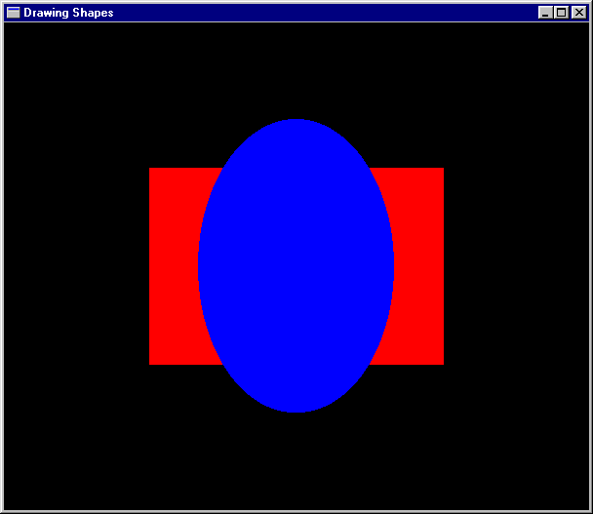

Slide 42
Draw multiple Shapes
type ColoredShapes = [(Color,Shape)]
shs :: ColoredShapes
shs = [(Red,sh1),(Blue,sh2),
(Yellow,sh3),(Magenta,sh4)]
drawShapes :: Window -> ColoredShapes -> IO ()
drawShapes w [] = return ()
drawShapes w ((c,s):cs)
= do drawInWindow w
(withColor c (shapeToGraphic s))
drawShapes w cs

Slide 43
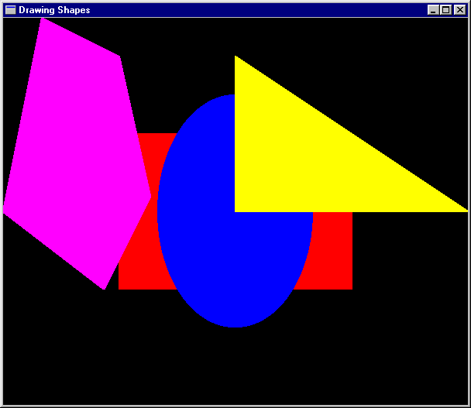
Make an Action
ex10
= runGraphics (
do w <- openWindow
"Drawing Shapes" (xWin,yWin)
drawShapes w shs
spaceClose w )

Slide 44
Another Example
ex11
= runGraphics (
do w <- openWindow "Drawing Shapes" (xWin,yWin)
drawShapes w (reverse coloredCircles)
spaceClose w
)
conCircles = map circle [0.2,0.4 .. 1.6]
coloredCircles =
zip [Black, Blue, Green, Cyan, Red, Magenta, Yellow, White]
conCircles

Slide 45
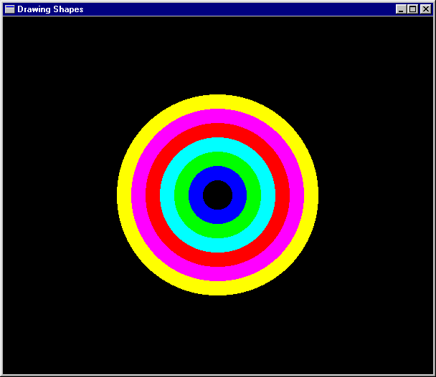

Slide 46
The Region datatype
A region represents an area on the two dimensional plane
Its represented by a tree-like data-structure
-- A Region is either:
data Region =
Shape Shape -- primitive shape
| Translate Vector Region -- translated region
| Scale Vector Region -- scaled region
| Complement Region -- inverse of region
| Region `Union` Region -- union of regions
| Region `Intersect` Region -- intersection of regions
| Empty
deriving Show

Slide 47
Regions and Trees
Why is Region tree-like?
What’s the strategy for writing functions over Regions?
Is there a fold-function for Regions?
How many parameters does it have?
What is its type?
Can one make infinite regions?
What does a region mean?

Slide 48
The Region datatype
A region represents an area on the two dimensional plane
-- A Region is either:
data Region =
Shape Shape -- primitive shape
| Translate Vector Region -- translated region
| Scale Vector Region -- scaled region
| Complement Region -- inverse of region
| Region `Union` Region -- union of regions
| Region `Intersect` Region -- intersection of regions
| Empty
deriving Show
type Vector = (Float, Float)

Slide 49
Why Regions?
Regions are interesting because
They allow us to build complicated “shapes” from simple ones
They illustrate the use of tree-like data structures
What makes regions tree-like?
They “solve” the problem of only having rectangles and ellipses centered about the origin.
They make a beautiful analogy with mathematical sets

Slide 50
What is a region?
A Region is all those points that lie within some area in the 2 dimensional plane.
This often (almost always?) an infinite set.
An efficient representation is as a characteristic function.
What do they look like? What do they represent?

Slide 51
(u,v)
Translate (u,v) r
r

Slide 52
scale (x,y) r =
[ (a*x,b*y) | (a,b) <- r ]
(1,2)
(2,1)
(1,-1)
(3,-1)
(-1,-1)
(1,-3)
(3,-3)

Slide 53
r
Complement r

Slide 54
Region Characteristic functions
We define the meaning of a region by its characteristic function.
containsR :: Region -> Coordinate -> Bool
How would you write this function?
Recursion, using pattern matching over the structure of a Region
What are the base cases of the recursion?
Start with a characteristic function for a primitive Shape

Slide 55
Rectangle
(Rectangle s1 s2) `containsS` (x,y)
= let t1 = s1/2
t2 = s2/2
in -t1<=x && x<=t1 && -t2<=y && y<=t2
s1
t1
t2
s2

Slide 56
Ellipse
(Ellipse r1 r2) `containsS` (x,y)
= (x/r1)^2 + (y/r2)^2 <= 1
r2
r1

Slide 57
Left of a line that bisects the plane
For a Ray specified by two points
(A,B), and facing in the direction
from A to B, a Vertex (px,py) is to
the left of the line when:
B = (bx,by)
(px,py)
isLeftOf :: Vertex -> Ray -> Bool
(px,py) `isLeftOf` ((ax,ay),(bx,by))
= let (s,t) = (px-ax, py-ay)
(u,v) = (px-bx, py-by)
in s*v >= t*u
A = (ax,ay)

Slide 58
Inside a (Convex) Polygon
A Vertex, P, is inside a (convex) polygon if it is to the left of every side, when they are followed in (counter-clockwise) order
P

Slide 59
Polygon
(Polygon pts) `containsS` p
= let shiftpts = tail pts ++ [head pts]
leftOfList =
map isLeftOfp(zip pts shiftpts)
isLeftOfp p' = isLeftOf p p'
in foldr (&&) True leftOfList

Slide 60
RtTriangle
(RtTriangle s1 s2) `containsS` p
= (Polygon [(0,0),(s1,0),(0,s2)])
`containsS` p
(0,s2)
s2
(0,0)
(s1,0)
s1

Slide 61
Putting it all together
containsS :: Shape -> Vertex -> Bool
(Rectangle s1 s2) `containsS` (x,y)
= let t1 = s1/2
t2 = s2/2
in -t1<=x && x<=t1 && -t2<=y && y<=t2
(Ellipse r1 r2) `containsS` (x,y)
= (x/r1)^2 + (y/r2)^2 <= 1
(Polygon pts) `containsS` p
= let shiftpts = tail pts ++ [head pts]
leftOfList =
map isLeftOfp(zip pts shiftpts)
isLeftOfp p' = isLeftOf p p'
in foldr (&&) True leftOfList
(RtTriangle s1 s2) `containsS` p
= (Polygon [(0,0),(s1,0),(0,s2)]) `containsS` p

Slide 62
containsR using patterns
containsR :: Region -> Vertex -> Bool
(Shape s) `containsR` p =
s `containsS` p
(Translate (u,v) r) `containsR` (x,y) =
r `containsR` (x-u,y-v)
(Scale (u,v) r) `containsR` (x,y) =
r `containsR` (x/u,y/v)
(Complement r) `containsR` p =
not (r `containsR` p)
(r1 `Union` r2) `containsR` p =
r1 `containsR` p || r2 `containsR` p
(r1 `Intersect` r2) `containsR` p =
r1 `containsR` p && r2 `containsR` p
Empty `containsR` p = False

Slide 63
Pictures
Drawing Pictures
Pictures are composed of Regions
Regions are composed of shapes
Pictures add Color
data Picture = Region Color Region
| Picture `Over` Picture
| EmptyPic
deriving Show
Must be careful to use SOEGraphics, but
SOEGraphics has its own Region datatype.
import SOEGraphics hiding (Region)
import qualified SOEGraphics as G (Region)

Slide 64
Recall our Region datatype
data Region =
Shape Shape -- primitive shape
| Translate Vector Region -- translated region
| Scale Vector Region -- scaled region
| Complement Region -- inverse of region
| Region `Union` Region -- union of regions
| Region `Intersect` Region -- intersection of regions
| Empty
deriving Show
How will we draw things like the intersection of two regions, or the complement of two regions. These are hard things to do, and require hardware support to do efficiently. The G.Region type interfaces to this hardware support.

Slide 65
G.Region
The G.Region datatype interfaces to the hardware. It is essentially a two dimensional array or “bit-map”, storing a binary value for each pixel in the window.

Slide 66
Hardware support
There is efficient hardware support for combining two bit-maps using binary operators.
Operations are fast, but data (space) intensive, and this space needs to be explicitly allocated and de-allocated.
+
=

Slide 67
Interface
createRectangle :: Point -> Point -> IO G.Region
createEllipse :: Point -> Point -> IO G.Region
createPolygon :: [Point] -> IO G.Region
andRegion :: G.Region -> G.Region -> IO G.Region
orRegion :: G.Region -> G.Region -> IO G.Region
xorRegion :: G.Region -> G.Region -> IO G.Region
diffRegion :: G.Region -> G.Region -> IO G.Region
deleteRegion :: G.Region -> IO ()
drawRegion :: G.Region -> Graphic
These functions are defined in the SOE library
module.

Slide 68
Drawing G.Region
To draw things quickly, turn them into a G.Region, then turn the G.Region into a graphic object and then use all the machinery we have built up so far.
drawRegionInWindow::Window -> Color -> Region -> IO ()
drawRegionInWindow w c r =
drawInWindow w
(withColor c (drawRegion (regionToGRegion r)))
All we need to define then is: regionToGRegion
we’ll come back to regionToGRegion in a minute

Slide 69
Drawing Pictures
Pictures combine multiple regions into one big picture. They provide a mechanism for placing one sub-picture on top of another.
drawPic :: Window -> Picture -> IO ()
drawPic w (Region c r) = drawRegionInWindow w c r
drawPic w (p1 `Over` p2) = do { drawPic w p2
; drawPic w p1
}
drawPic w EmptyPic = return ()

Slide 70
Overview
We have a rich calculus of Shapes, which we can draw, take the perimeter of, and tell if a point lies within.
We extend this with a richer type Region, which allows more complicated ways of combination (intersection, complement, etc.).
We gave Region a mathematical semantics as a set of points in the 2-dimensional plane.
We defined some interesting operators like containsR which is the characteristic function for a region.
The rich combination ability make Region hard to draw efficiently, so we use a lower level datatype supported by the hardware: G.Region which is essentially a bit-map.
We enrich this even further with the Picture type.
G.Region is low level, relying on features like overwriting, and explicit allocation and deallocation of memory.
We think of Region, as a highlevel interface to G.Region which hides the low level details.

Slide 71
Turning a Region into a G.Region
Experiment with a smaller problem to illustrate a lurking efficiency problem.
data NewRegion = Rect Side Side -- Abstracts G.Region
regToNReg1 :: Region -> NewRegion
regToNReg1 (Shape (Rectangle sx sy))
= Rect sx sy
regToNReg1 (Scale (x,y) r)
= regToNReg1 (scaleReg (x,y) r)
where scaleReg (x,y) (Shape (Rectangle sx sy))
= Shape (Rectangle (x*sx) (y*sy))
scaleReg (x,y) (Scale s r)
= Scale s (scaleReg (x,y) r)
Note, scaleReg distributes over Scale

Slide 72
Problem
Consider
(Scale (x1,y1)
(Scale (x2,y2)
(Scale (x3,y3)
... (Shape (Rectangle sx sy))
… )))
If the Scale level is N-deep, how many traversals does regToNReg1 do of the Region tree?

Slide 73
You’ve probably seen this before
Believe it or not you probably have encountered this problem before. Recall the definition of reverse
reverse [] = []
reverse (x:xs) = (reverse xs) ++ [x]
where [] ++ zs = zs
(y:ys) ++ zs = y : (ys ++ zs)
How did we solve this? Use an extra accumulating parameter.
reverse xs = revhelp xs []
where revhelp [] zs = zs
revhelp (x:xs) zs = revhelp xs (x:zs)

Slide 74
Accumulate a complex Scale
regToNReg2 :: Region -> NewRegion
regToNReg2 r = rToNR (1,1) r
where rToNR :: (Float,Float) -> Region -> NewRegion
rToNR (x1,y1) (Shape (Rectangle sx sy))
= Rect (x1*sx) (y1*sy)
rToNR (x1,y1) (Scale (x2,y2) r)
= rToNR (x1*x2,y1*y2) r
To solve our original problem Repeat this for all the constructors of Region (not just Shape and Scale) and use G.Region instead of NewRegion, We also need to handle translation as well as scaling

Slide 75
Final Version
regToGReg1 :: Vector -> Vector -> Region -> G.Region
regToGReg1 trans sca (Shape s) = shapeToGRegion trans sca s
regToGReg1 (x,y) sca (Translate (u,v) r)
= regToGReg1 (x+u, y+v) sca r
regToGReg1 trans (x,y) (Scale (u,v) r)
= regToGReg1 trans (x*u, y*v) r
regToGReg1 trans sca Empty = createRectangle (0,0) (0,0)
regToGReg1 trans sca (r1 `Union` r2)
= let gr1 = regToGReg1 trans sca r1
gr2 = regToGReg1 trans sca r2
in orRegion gr1 gr2
Assuming of course we can write:
shapeToGRegion :: Vector -> Vector -> Shape -> G.Region
and write rules for Intersect, Complement etc.

Slide 76
A matter of style
While the function on the previous page shows how to solve the problem, there are several stylistic issues that could make it more readable and understandable.
The style of defining a function by patterns, becomes cluttered when there are many parameters (other than the one which has the patterns).
The pattern of explicitly allocating and deallocating (bit-map) G.Region’s will be repeated in cases for intersection and for complement, so we should abstract it, and give it a name.

Slide 77
Abstract the low level bit-map details
primGReg trans sca r1 r2 op
= let gr1 = regToGReg trans sca r1
gr2 = regToGReg trans sca r2
in op gr1 gr2

Slide 78
Redo with a case expression
regToGReg :: Vector -> Vector -> Region -> G.Region
regToGReg (trans @ (x,y)) (sca @ (a,b)) shape =
case shape of
(Shape s) -> shapeToGRegion trans sca s
(Translate (u,v) r) -> regToGReg (x+u, y+v) sca r
(Scale (u,v) r) -> regToGReg trans (a*u, b*v) r
(Empty) -> createRectangle (0,0) (0,0)
(r1 `Union` r2) -> primGReg trans sca r1 r2 orRegion
(r1 `Intersect` r2) -> primGReg trans sca r1 r2 andRegion
(Complement r) -> primGReg trans sca winRect r diffRegion
where winRect :: Region
winRect = Shape (Rectangle
(pixelToInch xWin) (pixelToInch yWin))
regionToGRegion :: Region -> G.Region
regionToGRegion r = regToGReg (0,0) (1,1) r
Pattern renaming

Slide 79
Shape to G.Region: Rectangle
xWin2 = xWin `div` 2
yWin2 = yWin `div` 2
shapeToGRegion1
:: Vector -> Vector -> Shape -> IO G.Region
shapeToGRegion1 (lx,ly) (sx,sy) (Rectangle s1 s2)
= createRectangle (trans(-s1/2,-s2/2)) (trans (s1/2,s2/2))
where trans (x,y) = ( xWin2 + inchToPixel ((x+lx)*sx),
yWin2 - inchToPixel ((y+ly)*sy) )
scaling details
s1
( xWin2,
yWin2)
s1/2
S2/2
s2
( xWin,
yWin )
Translation details

Slide 80
Ellipse
shapeToGRegion1 (lx,ly) (sx,sy) (Ellipse r1 r2)
= createEllipse (trans (-r1,-r2)) (trans ( r1, r2))
where trans (x,y) =
( xWin2 + inchToPixel ((x+lx)*sx),
yWin2 - inchToPixel ((y+ly)*sy) )
r2
r1

Slide 81
Polygon and RtTriangle
shapeToGRegion1 (lx,ly) (sx,sy) (Polygon pts)
= createPolygon (map trans pts)
where trans (x,y) =
( xWin2 + inchToPixel ((x+lx)*sx),
yWin2 - inchToPixel ((y+ly)*sy) )
shapeToGRegion1 (lx,ly) (sx,sy) (RtTriangle s1 s2) = createPolygon (map trans [(0,0),(s1,0),(0,s2)]) where trans (x,y) =
( xWin2 + inchToPixel ((x+lx)*sx), yWin2 - inchToPixel ((y+ly)*sy) )

Slide 82
A matter of style, again
shapeToGRegion1 has the same problems as regToGReg1
The extra translation and scaling parameters obscure the pattern matching
There is a repeated pattern, we should give it a name.
shapeToGRegion (lx,ly) (sx,sy) s =
case s of
Rectangle s1 s2 -> createRectangle
(trans (-s1/2,-s2/2))
(trans (s1/2,s2/2))
Ellipse r1 r2 -> createEllipse
(trans (-r1,-r2))
(trans ( r1, r2))
Polygon pts -> createPolygon (map trans pts)
RtTriangle s1 s2 -> createPolygon
(map trans [(0,0),(s1,0),(0,s2)])
where trans (x,y) = ( xWin2 + inchToPixel ((x+lx)*sx),
yWin2 - inchToPixel ((y+ly)*sy) )

Slide 83
Drawing Pictures, Sample Regions
draw :: Picture -> IO ()
draw p
= runGraphics (
do w <- openWindow "Region Test" (xWin,yWin)
drawPic w p
spaceClose w
)
r1 = Shape (Rectangle 3 2)
r2 = Shape (Ellipse 1 1.5)
r3 = Shape (RtTriangle 3 2)
r4 = Shape (Polygon [(-2.5,2.5), (-3.0,0),
(-1.7,-1.0),
(-1.1,0.2), (-1.5,2.0)] )

Slide 84
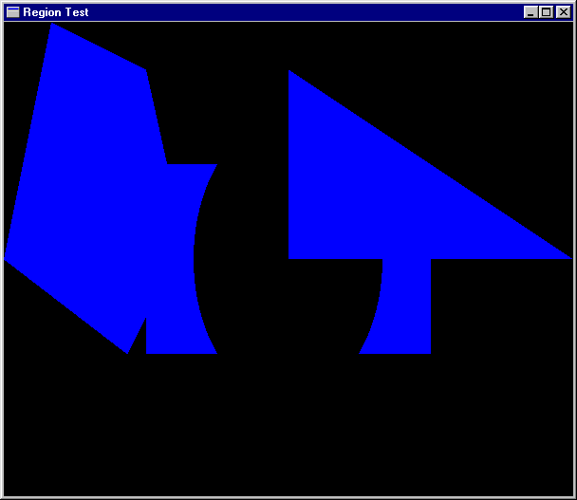
Sample Pictures
reg1 = r3 `Union` --RtTriangle
r1 `Intersect` -- Rectangle
Complement r2 `Union` -- Ellispe
r4 -- Polygon
pic1 = Region Cyan reg1
ex12 = draw
“first region picture”
pic1
Recall the precedence
of Union and Intersect

Slide 85
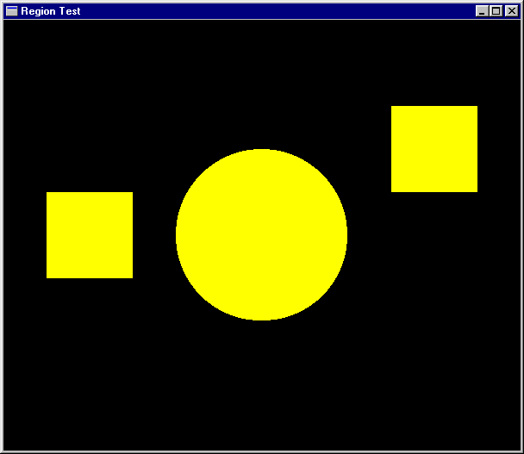
More Pictures
reg2 = let circle = Shape (Ellipse 0.5 0.5)
square = Shape (Rectangle 1 1)
in (Scale (2,2) circle)
`Union` (Translate (2,1) square)
`Union` (Translate (-2,0) square)
pic2 = Region Yellow reg2
ex13 =
draw “Ex 13” pic2

Slide 86
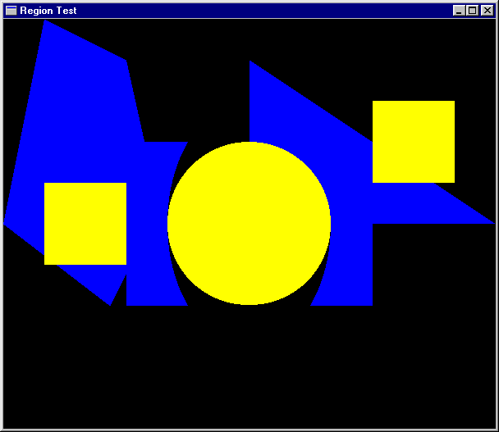
Another Picture
pic3 = pic2 `Over` pic1
ex14 = draw “ex14” pic3

Slide 87
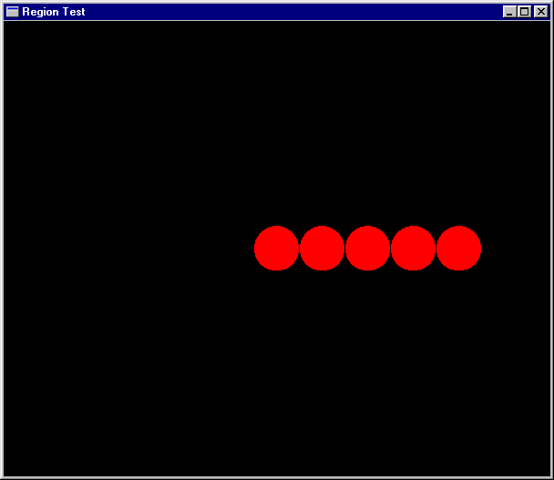
Separate computation from action
oneCircle = Shape (Ellipse 1 1)
manyCircles
= [ Translate (x,0) oneCircle | x <- [0,2..] ]
fiveCircles = foldr Union Empty (take 5 manyCircles)
pic4 = Region Magenta (Scale (0.25,0.25) fiveCircles)
ex15 = draw “Ex15” pic4

Slide 88
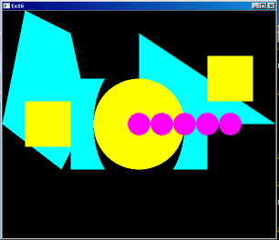
Ordering Pictures
pictToList :: Picture -> [(Color,Picture.Region)]
pictToList EmptyPic = []
pictToList (Region c r) = [(c,r)]
pictToList (p1 `Over` p2)
= pictToList p1 ++ pictToList p2
pic6 = pic4 `Over` pic2 `Over` pic1 `Over` pic3
Recovers the Regions from top to bottom
possible because Picture is a datatype that can be analysed

Slide 89
An Analogy
pictToList EmptyPic = []
pictToList (Region c r) = [(c,r)]
pictToList (p1 `Over` p2)
= pictToList p1 ++ pictToList p2
drawPic w (Region c r) = drawRegionInWindow w c r
drawPic w (p1 `Over` p2) = do { drawPic w p2
; drawPic w p1}
drawPic w EmptyPic = return ()
Something to prove:
sequence .
(map (uncurry (drawRegionInWindow w))) . Reverse . pictToList
= drawPic w

Slide 90
Pictures that React
Find the Topmost Region in a picture that “covers” the position of the mouse when a left button click appears.
Search the picturelist for the the first Region that contains the mouse position.
Re-arrange the list, bring that one to the top
adjust :: [(Color,Picture.Region)] -> Vertex ->
(Maybe (Color,Picture.Region)
, [(Color,Picture.Region)])
adjust [] p = (Nothing, [])
adjust ((c,r):regs) p =
if r `containsR` p
then (Just (c,r), regs)
else let (hit, rs) = adjust regs p
in (hit, (c,r) : rs)

Slide 91
Doing it Non-recursively
adjust2 regs p
= case (break (\(_,r) -> r `containsR` p) regs) of
(top,hit:rest) -> (Just hit, top++rest)
(_,[]) -> (Nothing, [])
break:: (a -> Bool) -> [a] -> ([a],[a])
is from the Prelude.
Break even [1,3,5,4,7,6,12]
([1,3,5],[4,7,6,12])

Slide 92
Putting it all together
loop :: Window -> [(Color,Picture.Region)] -> IO ()
loop w regs =
do clearWindow w
sequence [ drawRegionInWindow w c r |
(c,r) <- reverse regs ]
(x,y) <- getLBP w
case (adjust regs (pixelToInch (x – (xWin `div` 2)),
pixelToInch ((yWin `div` 2) - y) )) of
(Nothing, _ ) -> closeWindow w
(Just hit, newRegs) -> loop w (hit : newRegs)
draw2 :: Picture -> IO ()
draw2 pic
= runGraphics (
do w <- openWindow "Picture demo" (xWin,yWin)
loop w (pictToList pic))

Slide 93
Try it out
p1,p2,p3,p4 :: Picture
p1 = Region Magenta r1
p2 = Region Cyan r2
p3 = Region Green r3
p4 = Region Yellow r4
pic :: Picture
pic = foldl Over EmptyPic [p1,p2,p3,p4]
main = draw2 pic

Slide 94
A matter of style, 3
loop2 w regs
= do clearWindow w
sequence [ drawRegionInWindow w c r |
(c,r) <- reverse regs ]
(x,y) <- getLBP w
let aux (_,r) = r `containsR`
( pixelToInch (x-xWin2),
pixelToInch (yWin2-y) )
case (break aux regs) of
(_,[]) -> closeWindow w
(top,hit:bot) -> loop w (hit : (top++bot))
draw3 :: Picture -> IO ()
draw3 pic
= runGraphics (
do w <- openWindow "Picture demo" (xWin,yWin)
loop2 w (pictToList pic) )

