Slide 1
GADTs
GADTs in Haskell

Slide 2
ADT vs GADT
Algebraic Datatype
Generalized Algebraic Datatype
Data List a
= Nil
| Cons a (List a)
Data Tree a b =
Tip a
| Node (Tree a b) b
| Fork (Tree a b) (Tree a b)
Data List a where
Nil:: List a
Cons:: a -> List a -> List a
Data Tree a b where
Tip a : Tree a b
Node: Tree a b ->
b ->
Tree a b
Fork:: Tree a b ->
Tree a b ->
Tree a b
Note that types than can be expressed as an ADT always have the identical range types on all their constructors

Slide 3
GADTs relax the range restriction
data Even n where
Base:: Even Z
NE:: Odd n -> Even (S n)
data Rep:: * -> * where
Int:: Rep Int
Char:: Rep Char
Float:: Rep Float
Bool :: Rep Bool
Pair:: Rep a -> Rep b -> Rep (a,b)
List :: Rep a -> Rep [a]
The range is always the type being defined, (Even & Rep) but that type’s arguments can vary. We call an argument that varies and index.

Slide 4
Examples
Length indexed lists
Balanced Trees
Redblack trees
2-threes trees
AVL trees
Representation types
Well-typed terms
Terms as typing judgements
Tagless interpreters
Subject reduction
Type inference
Witnesses
Odd and Even
Well formed join and cross product in relational algebra
Well structured paths in trees
Units of measure (inches, centimeters, etc)
Provable Equality
Proof carrying code

Slide 5
Length indexed lists
Note we introduce uninhabited types that have the structure of the Natural numbers to serve as indexes to LList
data Z
data S n
data LList :: * -> * -> * where
LNil:: LList a Z
LCons:: a -> LList a n -> LList a (S n)
Note the range type is always LList
But they differ in the indexes.

Slide 6
Promotion
As of GHC version 7 GHC allows indexes to be ordinary datatypes.
One says the datatype is promoted to the type level.
This is very usefull, as it enforces a typing system on the indexes.
For example does (LList Int String) make any sense. The index is supposed to be drawn from Z and S

Slide 7
Length indexed lists again
An ordinary algebraic datatype
data Nat = Zero | Succ Nat
data Vec:: * -> Nat -> * where
Nil :: Vec a Zero
Cons:: a -> Vec a n -> Vec a (Succ n)
The type Nat is promoted to a Kind
The index is always drawn from well typed values of type Nat, so values of type Nat are promoted to Types

Slide 8
GADTs as proof objects
data EvenX:: Nat -> * where
BaseX:: EvenX Zero
NEX:: OddX n -> EvenX (Succ n)
data OddX:: Nat -> * where
NOX:: EvenX n -> OddX (Succ n)
What type does NEX (NOX BaseX) have?

Slide 9
The Curry-Howard isomorphism
The Curry-Howard isomorphism says that two things have exactly the same structure.
A term has a type
A proof proves a proposition
NEX (NOX BaseX) :: EvenX (Succ (Succ Zero))
Note that there is no term with type: EvenX (Succ Zero)
A term
Has a type
A proof
Proves a proposition

Slide 10
Proofs and witnesses
GADTs make the Curry-Howard isomorphism useful in Haskell.
Sometime we say a term “witnesses” a property. I.e the term NEX (NOX BaseX) witnesses that 2 is even.
We use GADTs has indexes to show that some things are not possible.

Slide 11
Paths and Trees
data Shape = Tp | Nd | Fk Shape Shape
data Path :: Shape -> * where
Here:: Path Nd
Left:: Path x -> Path (Fk x y)
Right:: Path y -> Path (Fk x y)
data Tree:: Shape -> * -> * where
Tip :: Tree Tp a
Node:: a -> Tree Nd a
Fork :: Tree x a -> Tree y a -> Tree (Fk x y) a
Note there are no paths with index Tp

Slide 12
Well formed paths
find:: Eq a => a -> Tree sh a -> [Path sh]
find n Tip = []
find n (Node m) =
if n==m then [Here] else []
find n (Fork x y) =
(map Left (find n x)) ++
(map Right (find n y))

Slide 13
Using a path. No possibility of failure
extract:: Eq a => Tree sh a -> Path sh -> a
extract (Node n) (Here) = n
extract (Fork l r) (Left p) = extract l p
extract (Fork l r) (Right p) = extract r p
-- No other cases are possible,
-- Since there are no Paths with index Tp

Slide 14
Balanced Trees
Balanced trees are used as binary search mechanisms.
They support log(n) time searches for trees that have n elements
They rely on the trees being balanced.
Usually saying that all paths from root to leaf have roughly the same length
Indexes make perfect tools to represent these invariants.

Slide 15
Red Black Trees
A red-black tree is a binary search tree with the following additional invariants:
Each node is colored either red or black
The root is black
The leaves are black
Each Red node has Black children
for all internal nodes, each path from that node to a descendant leaf contains the same number of black nodes.
We can encode these invariants by thinking of each internal node as having two attributes: a color and a black-height.

Slide 16
Red Black Tree as a GADT
data Color = Red | Black
data SubTree :: Color -> Nat -> * where
LeafRB :: SubTree Black Zero
RNode :: SubTree Black n -> Int ->
SubTree Black n -> SubTree Red n
BNode :: SubTree cL m -> Int ->
SubTree cR m ->
SubTree Black (Succ m)
data RBTree where
Root:: (forall n. (SubTree Black n)) -> RBTree

Slide 17
AVL Trees
In an AVL tree, the heights of the two child sub trees of any node differ by at most one;
data Balance:: Nat -> Nat -> Nat -> * where
Same :: Balance n n n
Less :: Balance n (Succ n) (Succ n)
More :: Balance (Succ n) n (Succ n)
data Avl:: Nat -> * where
TipA:: Avl Zero
NodeA:: Balance i j k -> Avl i -> Int ->
Avl j -> Avl (Succ k)
data AVL = forall h. AVL (Avl h)
A witness type that witnesses only the legal height differences.

Slide 18
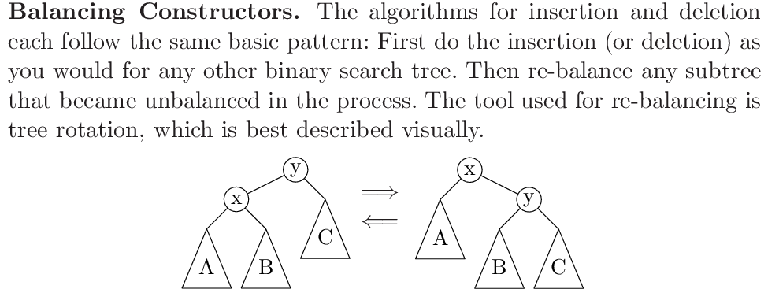

Slide 19
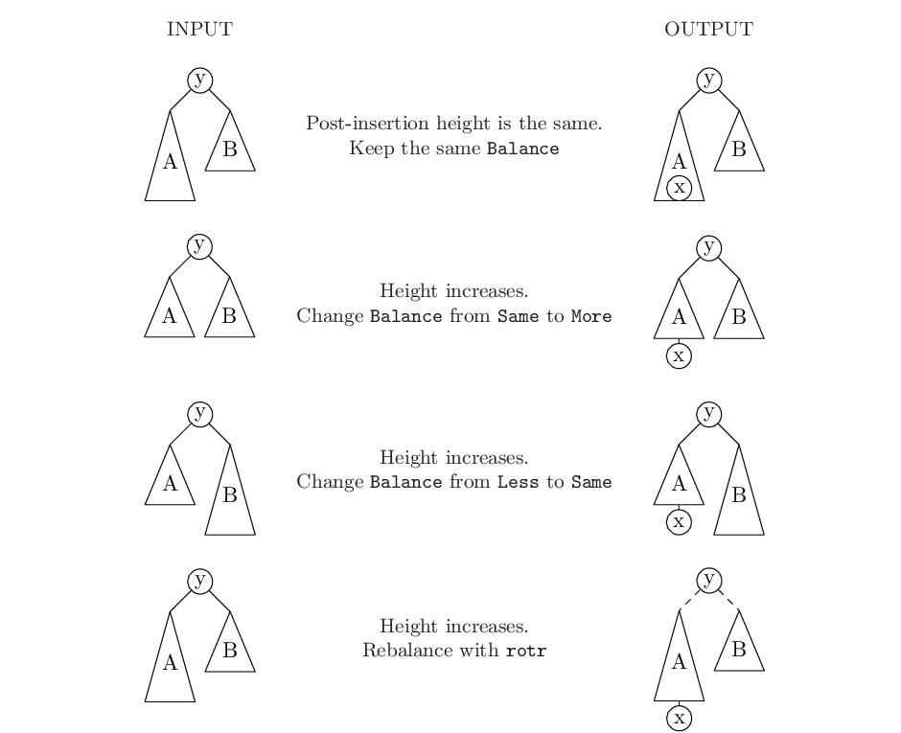

Slide 20
Insertion
insert :: Int -> AVL -> AVL
insert x (AVL t) = case ins x t of L t -> AVL t; R t -> AVL t
ins :: Int -> Avl n -> (Avl n + Avl (Succ n))
ins x TipA = R(NodeA Same TipA x TipA)
ins x (NodeA bal lc y rc)
| x == y = L(NodeA bal lc y rc)
| x < y = case ins x lc of
L lc -> L(NodeA bal lc y rc)
R lc ->
case bal of
Same -> R(NodeA More lc y rc)
Less -> L(NodeA Same lc y rc)
More -> rotr lc y rc -- rebalance
| x > y = case ins x rc of
L rc -> L(NodeA bal lc y rc)
R rc -> case bal of
Same -> R(NodeA Less lc y rc)
More -> L(NodeA Same lc y rc)
Less -> rotl lc y rc -- rebalance
Note the rotations in red

Slide 21
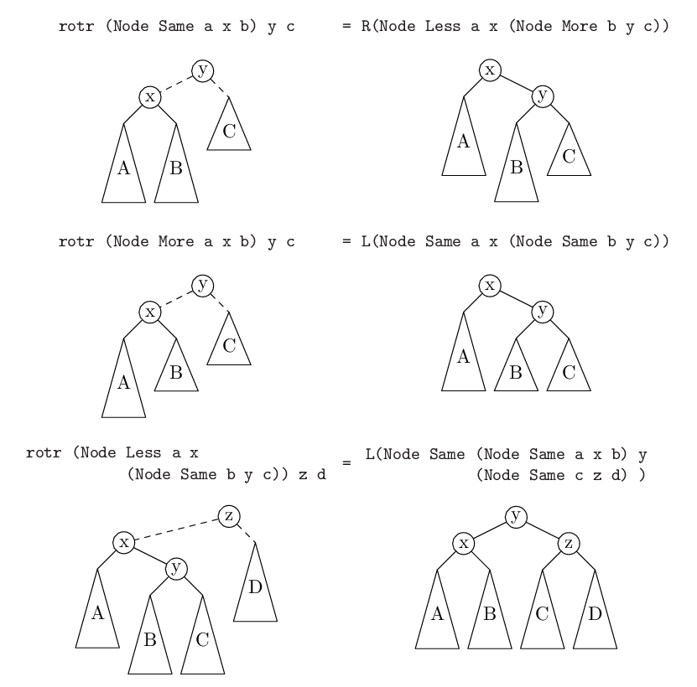

Slide 22
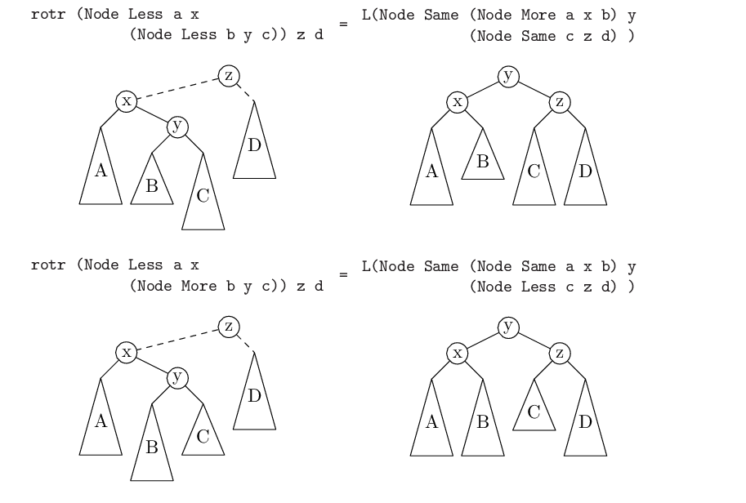

Slide 23
Example code The rest is in the accompanying Haskell file
data (+) a b = L a | R b
rotr :: Avl(Succ(Succ n)) -> Int -> Avl n ->
(Avl(Succ(Succ n))+Avl(Succ(Succ(Succ n))))
-- rotr Tip u a = unreachable
rotr (NodeA Same b v c) u a = R(NodeA Less b v (NodeA More c u a))
rotr (NodeA More b v c) u a = L(NodeA Same b v (NodeA Same c u a))
-- rotr (NodeA Less b v TipA) u a = unreachable
rotr (NodeA Less b v (NodeA Same x m y)) u a =
L(NodeA Same (NodeA Same b v x) m (NodeA Same y u a))
rotr (NodeA Less b v (NodeA Less x m y)) u a =
L(NodeA Same (NodeA More b v x) m (NodeA Same y u a))
rotr (NodeA Less b v (NodeA More x m y)) u a =
L(NodeA Same (NodeA Same b v x) m (NodeA Less y u a))

Slide 24
At the top level
Insertion may make the height of the tree grow.
Hide the height of the tree as an existentially quantified index.
data AVL = forall h. AVL (Avl h)

Slide 25
2-3-Tree
a tree where every node with children (internal node) has either two children (2-node) and one data element or three children (3-nodes) and two data elements. Nodes on the outside of the tree (leaf nodes) have no children and zero, one or two data elements
data Tree23:: Nat -> * -> * where
Three :: (Tree23 n a) -> a ->
(Tree23 n a) -> a ->
(Tree23 (Succ n) a)
Two:: (Tree23 n a) -> a ->
(Tree23 n a) -> (Tree23 (Succ n) a)
Leaf1 :: a -> (Tree23 Zero a)
Leaf2 :: a -> a -> (Tree23 Zero a)
Leaf0 :: (Tree23 Zero a)

Slide 26
Witnessing equality
Sometimes we need to prove that two types are equal.
We need a type that represents this proposition.
We call this a witness, since legal terms with this type only witness that the two types are the same.
This is sometimes called provable equality (since it is possible to write a function that returns an element of this type).
data Equal:: k -> k -> * where
Refl :: Equal x x

Slide 27
Representation types
data Rep:: * -> * where
Int:: Rep Int
Char:: Rep Char
Float:: Rep Float
Bool :: Rep Bool
Pair:: Rep a -> Rep b -> Rep (a,b)
List :: Rep a -> Rep [a]
Some times this is called a Universe, since it witnesses only those types representable.

Slide 28
Generic Programming
eq:: Rep a -> a -> a -> Bool
eq Int x y = x==y
eq Char x y = x==y
eq Float x y = x==y
eq Bool x y = x==y
eq (Pair t1 t2)(a,b) (c,d) =
(eq t1 a c) && (eq t2 b d)
eq (List t) xs ys
| not(length xs == length ys) = False
| otherwise = and (zipWith (eq t) xs ys)

Slide 29
Using provable equality
We need a program to inspect two Rep types (at runtime) to possible produce a proof that the types that they represent are the same.
test:: Rep a -> Rep b -> Maybe(Equal a b)
This is sort of like an equality test, but reflects in its type that the two types are really equal.

Slide 30
Code for test
test:: Rep a -> Rep b -> Maybe(Equal a b)
test Int Int = Just Refl
test Char Char = Just Refl
test Float Float = Just Refl
test Bool Bool = Just Refl
test (Pair x y) (Pair m n) =
do { Refl <- test x m
; Refl <- test y n
; Just Refl }
test (List x) (List y) =
do { Refl <- test x y
; Just Refl}
test _ _ = Nothing
When we pattern match against Refl, the compiler know that the two types are statically equal in the scope of the match.

Slide 31
Well typed terms
data Exp:: * -> * where
IntE :: Int -> Exp Int
CharE:: Char -> Exp Char
PairE :: Exp a -> Exp b -> Exp (a,b)
VarE:: String -> Rep t -> Exp t
LamE:: String -> Rep t ->
Exp s -> Exp (t -> s)
ApplyE:: Exp (a -> b) ->
Exp a -> Exp b
FstE:: Exp(a,b) -> Exp a
SndE:: Exp(a,b) -> Exp b

Slide 32
Typing judgements
Well typed terms have the exact same structure as a typing judgment.
Consider the constructor ApplyE
ApplyE:: Exp (a -> b) -> Exp a -> Exp b
Compare it to the typing judgement

Slide 33
Tagless interpreter
An interpreter gives a value to a term.
Usually we need to invent a value datatype like
data Value
= IntV Int
| FunV (Value -> Value)
| PairV Value Value
We also need to store Values in an environment
data Env = E [(String,Value)]

Slide 34
Valueless environments
data Env where
Empty :: Env
Extend :: String -> Rep t -> t ->
Env -> Env
Note that the type variable “t” is existentially quantified.
Given a pattern (Extend var rep t more) There is not much we can do with t, since we do not know its type.

Slide 35
Tagless interpreter
eval:: Exp t -> Env -> t
eval (IntE n) env = n
eval (CharE c) env = c
eval (PairE x y) env = (eval x env, eval y env)
eval (VarE s t) Empty =
error ("Variable not found: "++s)
eval (LamE nm t body) env =
(\ v -> eval body (Extend nm t v env))
eval (ApplyE f x) env = (eval f env) (eval x env)
eval (FstE x) env = fst(eval x env)
eval (SndE x) env = snd(eval x env)
eval (v@(VarE s t1)) (Extend nm t2 value more)
| s==nm = case test t1 t2 of
Just Refl -> value
Nothing -> error "types don't match"
| otherwise = eval v more

Slide 36
Units of measure
data TempUnit = Fahrenheit
| Celsius
| Kelvin
data Degree:: TempUnit -> * where
F:: Float -> Degree Fahrenheit
C:: Float -> Degree Celsius
K:: Float -> Degree Kelvin
add:: Degree u -> Degree u -> Degree u
add (F x) (F y) = F(x+y)
add (C x) (C y) = C(x+y)
add (K x) (K y) = K(x+y)

Slide 37
N-way zip
zipN 1 (+1) [1,2,3] → [2,3,4]
zipN 2 (+) [1,2,3] [4,5,6]
→ [5,7,9]
zipN 3 (\ x y z -> (x+z,y))[2,3]
[5,1] [6,8]
→ [(8,5),(11,1)]

Slide 38
The Natural Numbers with strange types
data Zip :: * -> * -> * where
Z:: Zip a [a]
S:: Zip b c -> Zip (a -> b) ([a] -> c)
Z :: Zip a [a]
(S Z) :: Zip (a -> b) ([a] -> [b])
(S (S Z)) ::
Zip (a -> a1 -> b) ([a] -> [a1] -> [b])
(S(S (S Z))) ::
Zip (a -> a1 -> a2 -> b)
([a] -> [a1] -> [a2] -> [b])

Slide 39
Why these types.
f :: (a -> b -> c -> d)
(f x) :: (b -> c -> d)
(f x y) :: (c -> d)
(f x y z) :: d
(zip f) :: ([a] -> [b] -> [c] -> [d])
(zip f xs) :: ([b] -> [c] -> [d])
(zip f xs ys) :: ([c] -> [d])
(zip f xs ys za) :: [d]

Slide 40
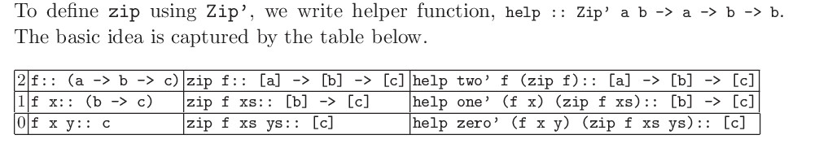
zero’ = Z
one’ = S Z
two’ = S (S Z)
help:: Zip a b -> a -> b -> b
help Z x xs = x:xs
help (S n) f rcall =
(\ ys -> case ys of
(z:zs) -> help n (f z) (rcall zs)
other -> skip n)

Slide 41
Code
skip:: Zip a b -> b
skip Z = []
skip (S n) = \ ys -> skip n
zipN:: Zip a b -> a -> b
zipN Z = \ n -> [n]
zipN (n@(S m)) =
let zip f = help n f (\ x -> zip f x)
in zip

