Slide 1
Monads

Slide 2
A monad orders actions
An action is any computation that has a natural notion of order. I.e. one thing happens before another.
IO is the action of altering the real world.
There are many other styles of computation that have a natural notion of order
A Monad is Haskell’s way of specifying which actions come before others.
The “do” operator provides this control over the order in which computations occur
do { var <- location x -- the first action
; write var (b+1) -- the next action
}

Slide 3
Observations
Actions are first class.
They can be abstracted (parameters of functions)
Stored in data structures. -- It is possible to have a list of actions, etc.
Actions can be composed.
They can be built out of smaller actions by glueing them together with do and return
They are sequenced with do much like one uses semi-colon in languages like Pascal and C.
Actions can be performed (run).
separation of construction from performance is key to their versatility.
IO actions are “run” as the “main” function, or interactively in GHCI
Actions of type: Action() are like statements in imperative languages.
They are used only for their side effects.

Slide 4
The Monad Class
class Applicative m =>
Monad (m :: * -> *) where
(>>=) :: m a -> (a -> m b) -> m b
(>>) :: m a -> m b -> m b
return :: a -> m a
fail :: String -> m a

Slide 5
Functor and Applicative
class Functor (f :: * -> *) where
fmap :: (a -> b) -> f a -> f b
class Functor f =>
Applicative (f :: * -> *)
where
pure :: a -> f a
(<*>) :: f (a -> b) -> f a -> f b

Slide 6
Do syntactic sugar replaces (>>=)
do { a; b } = do { _ <- a; b }
do { x <- a
; do { y <- b
; do { z <- c
; d }}} = do {x <- a; y <- b;
z <- c; d }
= do x <- a
y <- b
z <- c
d -- uses indentation
-- rather than { ; }

Slide 7
Do: syntax, types, and order
Int
IO Int
actions without
v <- ... must have
type (M a) for some
monad M
do { x <- f
; y <- g 7
; putChar y
; return (x + 4)
}
last action must
must have type M a
which is the type of do
cannot have v <- ...
semi colons separate actions, I think it is good style to line ; up with
opening { and closing }

Slide 8
Monads have Axioms
Order matters (and is maintained by Do)
do { x <- do { y <- b; c }
; d } =
do { y <- b; x <- c; d }
Return introduces no effects
do { x <- Return a; e } = e[a/x]
do { x <- e; Return x } = e

Slide 9
Sample Monads
data Id x = Id x
data Exception x = Ok x | Fail
data Env e x = Env (e -> x)
data Store s x = Store (s -> (x,s))
data Mult x = Mult [x]
data Output x = Output (x,String)

Slide 10
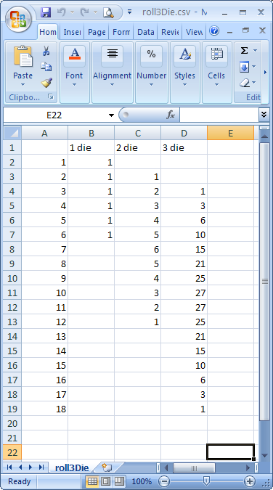
Sample Problem Importing Excel tables into Haskell
(["1 die","2 die","3 die"]
,[("1",[Just 1,Nothing,Nothing])
,("2",[Just 1,Just 1,Nothing])
,("3",[Just 1,Just 2,Just 1])
,("4",[Just 1,Just 3,Just 3])
,("5",[Just 1,Just 4,Just 6])
,("6",[Just 1,Just 5,Just 10])
,("7",[Nothing,Just 6,Just 15])
,("8",[Nothing,Just 5,Just 21])
,("9",[Nothing,Just 4,Just 25])
,("10",[Nothing,Just 3,Just 27])
,("11",[Nothing,Just 2,Just 27])
,("12",[Nothing,Just 1,Just 25])
,("13",[Nothing,Nothing,Just 21])
,("14",[Nothing,Nothing,Just 15])
,("15",[Nothing,Nothing,Just 10])
,("16",[Nothing,Nothing,Just 6])
,("17",[Nothing,Nothing,Just 3])
,("18",[Nothing,Nothing,Just 1])]
)

Slide 11
Strategy
Write Excel table into a comma separated values file.
Use the CSV library to import the comma separated values file into Haskell as a [[String]]
Process each sublist as a single line of the Excel table
Interpret each string in the sublist as the correct form of data. E.g. an Int, or Bool, or list element, etc
Note that order matters. The first element might be an Int, but the second might be a Bool.

Slide 12
[["","1 die„
,"2 die","3 die"],
["1","1","",""],
["2","1","1",""],
["3","1","2","1"],
["4","1","3","3"],
["5","1","4","6"],
["6","1","5","10"],
["7","","6","15"],
["8","","5","21"],
["9","","4","25"],
["10","","3","27"],
["11","","2","27"],
["12","","1","25"],
["13","","","21"],
["14","","","15"],
["15","","","10"],
["16","","","6"],
["17","","","3"],
["18","","","1"],[""]]
(["1 die","2 die","3 die"]
,[("1",[Just 1,Nothing,Nothing])
,("2",[Just 1,Just 1,Nothing])
,("3",[Just 1,Just 2,Just 1])
,("4",[Just 1,Just 3,Just 3])
,("5",[Just 1,Just 4,Just 6])
,("6",[Just 1,Just 5,Just 10])
,("7",[Nothing,Just 6,Just 15])
,("8",[Nothing,Just 5,Just 21])
,("9",[Nothing,Just 4,Just 25])
,("10",[Nothing,Just 3,Just 27])
,("11",[Nothing,Just 2,Just 27])
,("12",[Nothing,Just 1,Just 25])
,("13",[Nothing,Nothing,Just 21])
,("14",[Nothing,Nothing,Just 15])
,("15",[Nothing,Nothing,Just 10])
,("16",[Nothing,Nothing,Just 6])
,("17",[Nothing,Nothing,Just 3])
,("18",[Nothing,Nothing,Just 1])]
)

Slide 13
Pattern
There is a pattern to the process
Take a [String] as input
Interpret 1 or more elements to produce data
Return the data and the rest of the strings
f:: [String] -> (Result,[String])
Repeat for the next piece of data
Interpretation is different depending upon the data we want to produce.

Slide 14
What’s involved
Lets observe what happens for the 6th line of the Excel table
Read a string
Read 3 values to get a [Int]
Note the order involved

Slide 15
Write some code
getString:: [String] -> (String,[String])
getString (s:ss) = (s,ss)
getString [] =
error "No more strings to read a 'String' from"
getInt:: [String] -> (Int,[String])
getInt (s:ss) = (read s,ss)
getInt [] =
error "No more strings to read an 'Int' from"
Interpret as a string. I.e. do nothing
Interpret as an Int. Use read

Slide 16
How can we get a list of Int?
getInts:: Int -> [String] -> ([Int],[String])
getInts 0 ss = ([],ss)
getInts n ss =
case getInt ss of
(x,ss2) -> case getInts (n-1) ss2 of
(xs,ss3) -> (x:xs,ss3)
Note that the order is enforced by data dependencies, and we use the case to implement it.

Slide 17
Now get line 6
getLine6:: [String] ->
((String,[Int]),[String])
getLine6 ss =
case getString ss of
(count,ss2) ->
case getInts 3 ss2 of
(rolls,ss3) -> ((count,rolls),ss3)
Note how the ordering is enforced again. We can do better than this

Slide 18
There are three patterns
Threading of the list of strings in the function types
getString:: [String] -> (String,[String])
Threading in the use of the list
(count,ss2) ->
case getInts 3 ss2 of
Use of the case to create data dependencies that enforce ordering
This is a Monad

Slide 19
Parts of a Monad
A Monad encapsulates some hidden structure
A Monad captures a repeated pattern
A Monad enforces ordering

Slide 20
The State Monad
import Control.Monad.State
Defines the type constructor (State t a)
It behaves like
data State s a = State (s -> (a,s))
Use the do notation to compose and order actions (without performing them)
Use the function evalState to perform actions

Slide 21
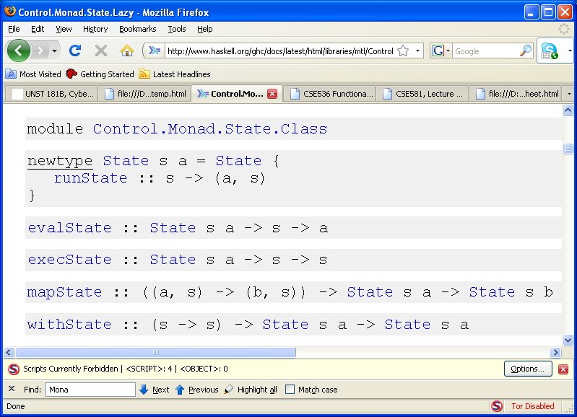
One of the standard libraries
Use these functions, plus do and return to solve problems

Slide 22
Part of the code
import Control.Monad.State
type Line a = State [String] a
type Reader a = State [[String]] a
getLine6b :: Line (String,[Maybe Int])
getLine6b =
do { count <- string
; rolls <- list 3 (blank int)
; return(count,rolls)
}

Slide 23
The first line is different
getLine1 :: Line [String]
getLine1 =
do { skip
; list 3 string
}

Slide 24
What do int and string etc look like?
int:: Line Int
int = mapState f (return ())
where f ((),s:ss) = (read s,ss)
f ((),[]) =
error "No more strings to read an 'Int' from"
list:: Int -> Line a -> Line [a]
list 0 r = return []
list n r = do { x <- r; xs <- list (n-1) r; return(x:xs)}
blank:: Line a -> Line(Maybe a)
blank (State g) = State f
where f ("":xs) = (Nothing, xs)
f xs = case g xs of
(y,ys) -> (Just y,ys)

Slide 25
From lines to files
type Reader a = State [[String]] a
lineToReader:: Line a -> Reader a
lineToReader l1 = State g
where g (line:lines) = (evalState l1 line, lines)
getN :: Int -> Line a -> Reader [a]
getN 0 line = return []
getN n line =
do { x <- lineToReader line
; xs <- getN (n-1) line
; return(x:xs)
}

Slide 26
Reading a whole file
getFile :: Reader ([String],[(String,[Maybe Int])])
getFile =
do { labels <- lineToReader getLine1
; pairs <- getN 18 getLine6b
; return(labels,pairs)
}
importCSV :: Reader a -> String -> IO a
importCSV reader file =
do { r <- parseCSVFromFile file; (f r)}
where f (Left err) =
error ("Error reading from file: "++
file++"\n"++show err)
f (Right xs) = return(evalState reader xs)
test1 = importCSV getFile "roll3Die.csv"

Slide 27
Thoughts
We use state monad at two different states
Lines where the state is [String]
Files where the state is [[String]]
The use of the do notation makes the ordering explicit and is much cleaner than using nested case and threading (although this still happens)
We have defined higher-order programs like list, blank, and lineToReader

Slide 28
Can we do better?
Recall that monadic computations are first class.
Can we capture patterns of use in our example to make things even simpler and more declarative.
What patterns do we see again and again?

Slide 29
Patterns
getFile =
do { labels <- lineToReader getLine1
; pairs <- getN 18 getLine6b
; return(labels,pairs)
}
getN n line =
do { x <- lineToReader line
; xs <- getN (n-1) line
; return(x:xs)
}
getLine6b =
do { count <- string
; rolls <- list 3 (blank int)
; return(count,rolls)
}
Run two computations in order and then combine the two results

Slide 30
Generic Monad Operations
infixr 3 `x`
x :: Monad m => m b -> m c -> m(b,c)
r1 `x` r2 = do { a <- r1; b <- r2; return(a,b) }
many :: Monad m => Int -> m c -> m [c]
many n r = sequence (replicate n r)
sequence [] = return []
sequence (c:cs) =
do { x <- c; xs <- sequence cs; return(x:xs)}

Slide 31
Declarative description
row:: (a -> b) -> Line a -> Reader b
row f line1 = lineToReader line2
where line2 = do { x <- line1; return(f x) }
get3DieEx2::Reader ([[Char]],[([Char],[Maybe Int])])
get3DieEx2 = (row snd (skip `x` list 3 string))
`x` (many 18 (row id cols2_18))
where cols2_18 = (string `x` list 3 (blank int))

Slide 32
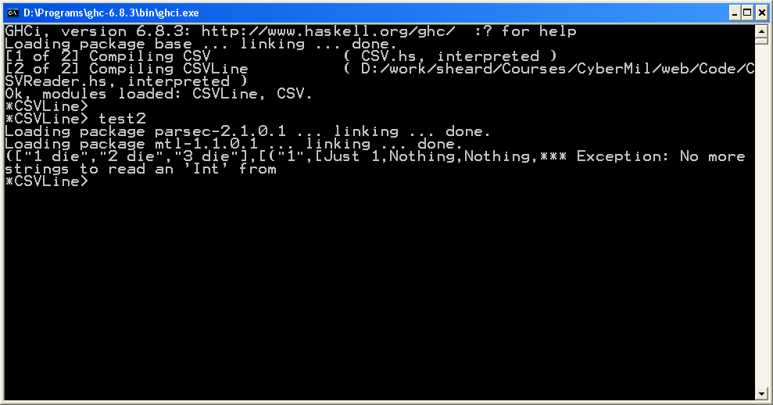
What if we get it wrong?
get3DieEx2 = (row snd (skip `x` list 3 string))
`x` (many 18 (row id cols2_18))
where cols2_18 = (string `x` list 4 (blank int))
Not very informative about where the error occurred

Slide 33
Thread more information in the state
type Line a = State (Int,Int,[String]) a
type Reader a = State (Int,[[String]]) a
Where do we need to make changes?
Remarkably, very few places
Line and column information
Line information

Slide 34
Only at the interface to the monad
report l c message =
error ("\n at line: "++show l++
", column: "++show c++
"\n "++message)
bool:: Line Bool
bool = (State f) where
f (l,c,"True" : ss) = (True,(l,c+1,ss))
f (l,c,"False" : ss) = (False,(l,c+1,ss))
f (l,c,x:xs) =
report l c ("Non Bool in reader bool: "++x)
f (l,c,[]) =
report l c "No more strings to read a 'Bool' from"

Slide 35
string:: Line String
string = State f
where f (l,c,s:ss) = (s,(l,c+1,ss))
f (l,c,[]) = report l c
"No more strings to read a 'String' from"
int:: Line Int
int = mapState f (return ())
where f ((),(l,c,s:ss)) = (read s,(l,c+1,ss))
f ((),(l,c,[])) = report l c
"No more strings to read an 'Int' from"
skip:: Line ()
skip = State f
where f (l,c,s:ss) = ( (), (l,c+1,ss))
f (l,c,[]) = report l c "No more strings to 'skip' over"
blank:: Line a -> Line(Maybe a)
blank (State g) = State f
where f (l,c,"":xs) = (Nothing, (l,c+1,xs))
f xs = case g xs of
(y,ys) -> (Just y,ys)

Slide 36
Some thoughts
lineToReader:: Line a -> Reader a
lineToReader l1 = mapState f (return ())
where f ((),(l,line:lines)) =
(evalState l1 (l,1,line),(l+1,lines))
Changes occur only where they matter
Other functions use the same monadic interface
The “plumbing” is handled automatically, even in the generic monad functions like `x` and `many`

Slide 37
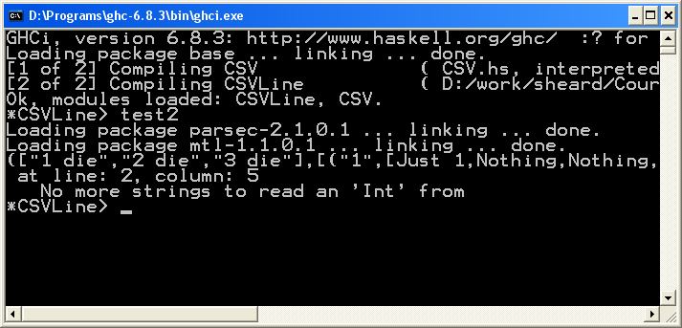
We can see where the error occurred

