Slide 1
Getting Started with Haskell
Tim Sheard

Slide 2
Learning a new language
Goals
Learn how to design and use data structures
Learn to write programs using the programming language Haskell.
Learn by example.
Watch others, study programs
Demo programs
Peer evaluation
Code walk throughs
Write your own programs
Worksheets
Crib Sheets
Assignments
Pair programming

Slide 3
Peer Evaluation
You can’t learn to program unless you write programs.
You learn to write better programs by getting feedback.
I can’t give enough feedback to a class of size 30.
Peer evaluation is utilizing students to provide feedback to other students about their programs.
This is serious business
Both the program author and the peer evaluator can learn a lot from this practice.

Slide 4
Pair programming
Work in pairs.
Two sets of eyes and brains is better than one.
One person “drives” – works the keyboard.
One person “navigates” – decides strategy and looks for errors.
Switch roles at least every half hour.
Think before you type!

Slide 5
Code walk throughs
The author of a program explains his code line by line to a group evaluators.
The evaluators
ask questions about what they don’t understand
Suggest improvements to code
Suggest code restructuring
Code structure (use of abstractions, functions, modules etc), comments, indentation are all subject to suggesstion.

Slide 6
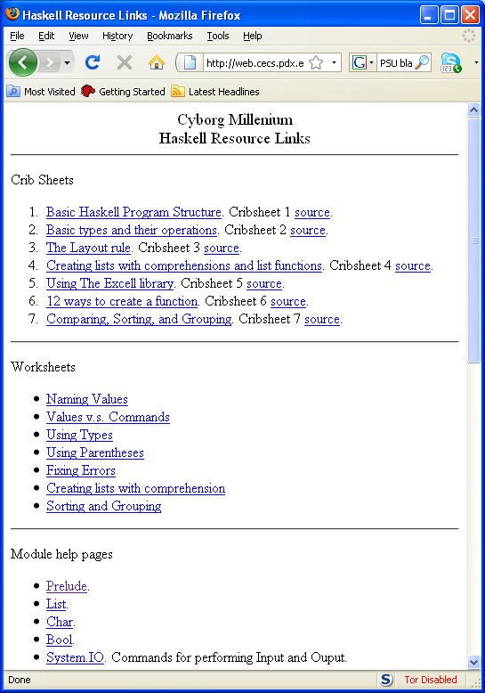
The programming resource link

Slide 7
In class programming worksheets
We will often use worksheets in class
Go to the programming resource link page
Download the worksheet to your own computer
Work in pairs to complete the worksheet.
When your pair is finished. Get up from your table and find a pair that could use some assistance.
Over their shoulder (don’t touch the computer!) help them to finish the worksheet
When everyone is standing we’ll move on to the next unit.

Slide 8
Using resources
Study the resources provided.
Try and recognize what makes a program good.
Learn the “structure” of programs. Many errors are silly misspellings or forgotten punctuation.
Always ask for help! Many times another pair of eyes will immediately see what’s wrong.

Slide 9
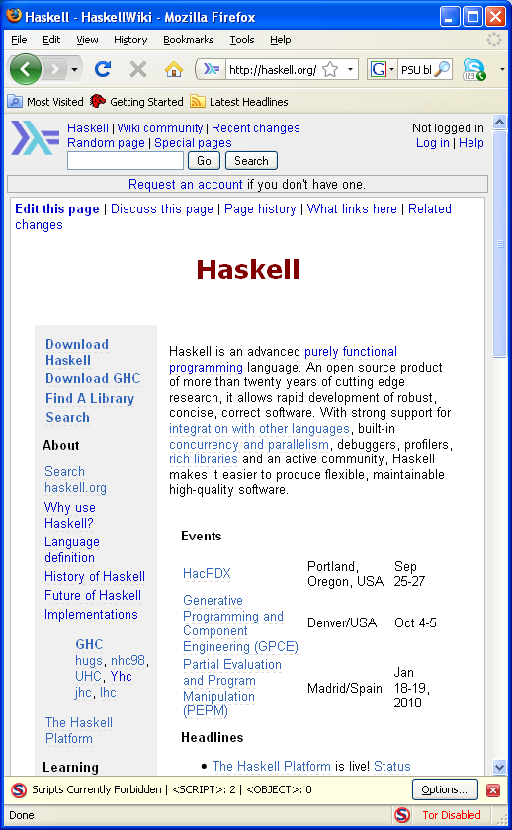
Installing GHCI
We will use GHC 6.10.4
Goto haskell.org
Click on the Haskell platform

Slide 10
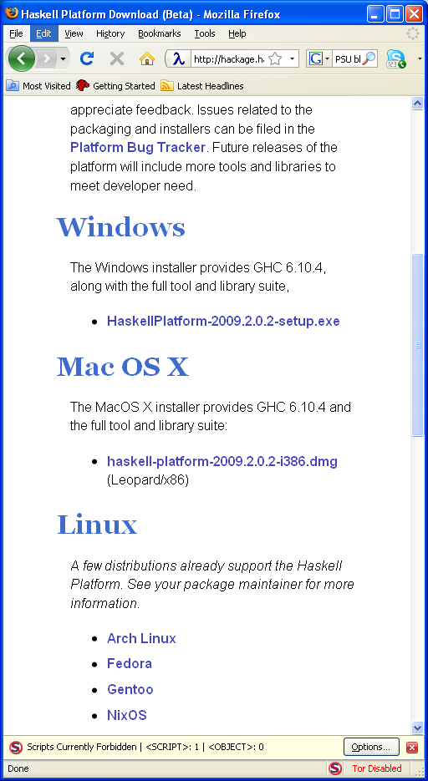
Installing the platform
Choose your operating system
Windows
Mac
Linux
On Debian
apt-get install ghc6
Follow directions
Ask me if you have problems

Slide 11
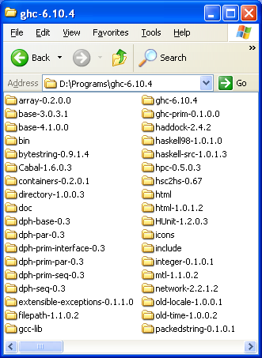
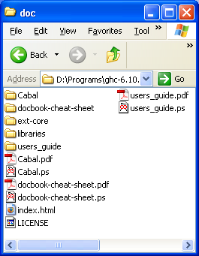
Getting Help
In the directory where GHC is installed, there is a directory called “doc”
In this directory is file called “index.html”
Book mark this in your browser

Slide 12
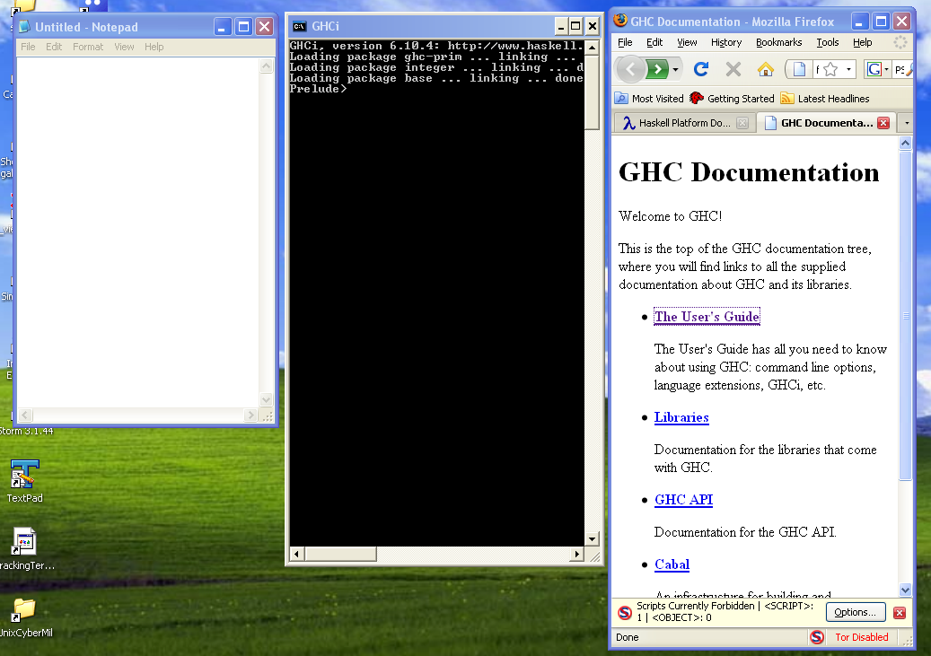
Advice
Arrange your screen with side by side windows
Editor
GHCI
Help

Slide 13
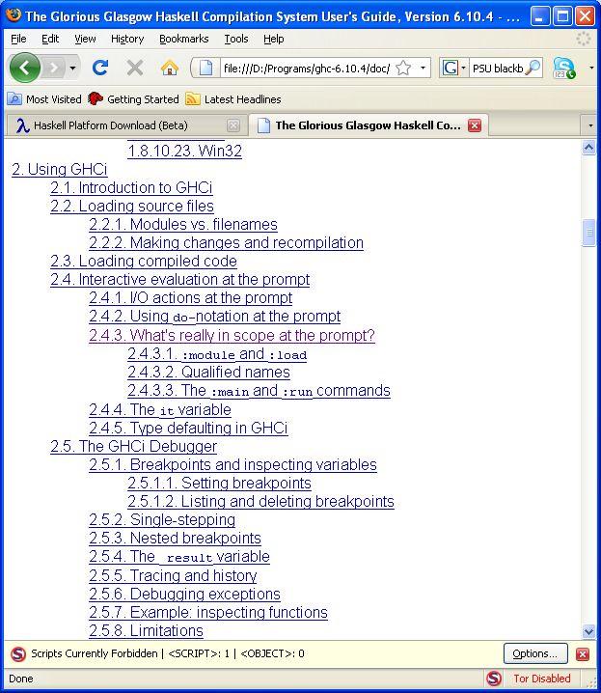
Learning what’s possible
From the index page click on “The Users Guide”
Scroll down to “Using GHCI”
Explore

Slide 14
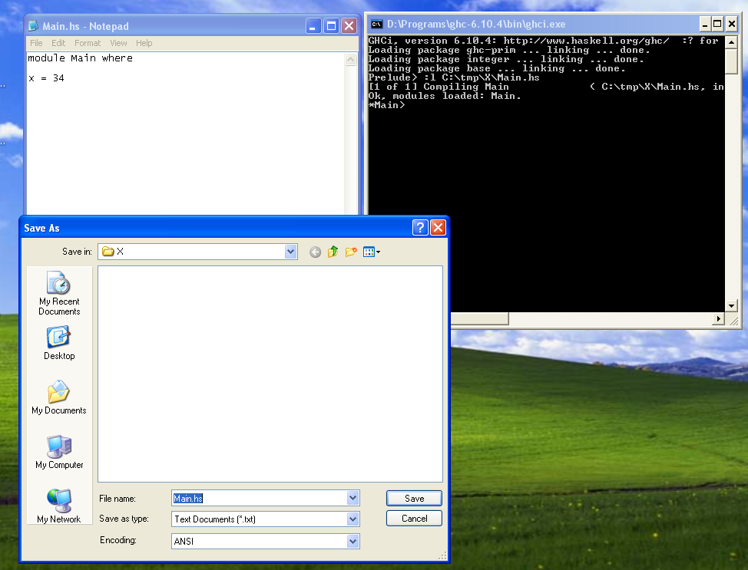
Writing a program
Start up an editor
Start up ghci
Write a program in the editor,
save the file
“open” the file in ghci by using
:l C:\tmp\X\Main.hs

Slide 15
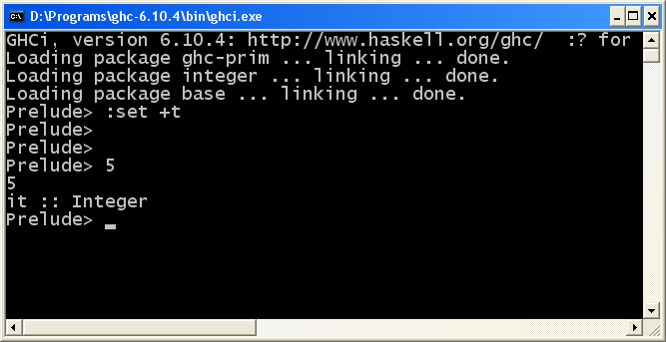
Setting Options
GHCi allows the user to set many options.
I recommend use of the “show type option” especially for new users
:set +t

Slide 16
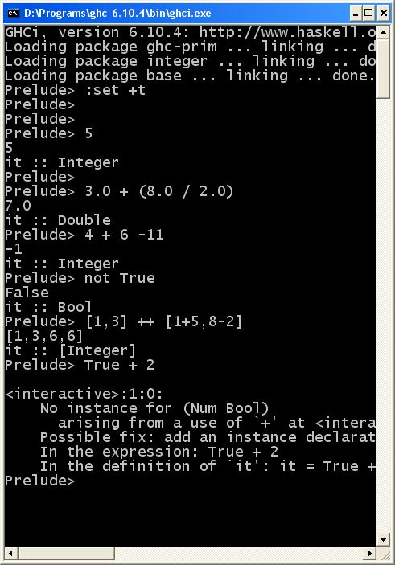
Interaction in Ghci
Type an expression
GHCI checks that it is well formed
Well-typed
Evaluates the expression
Carries out the computation
Prints the result
And the Type

Slide 17
What is data?
Measurements of some kind stored in a computer.
Examples
Simple: numbers, text, truth values …
Structured: sequences, sets, records …
Complex: dictionaries, music, pictures …

Slide 18
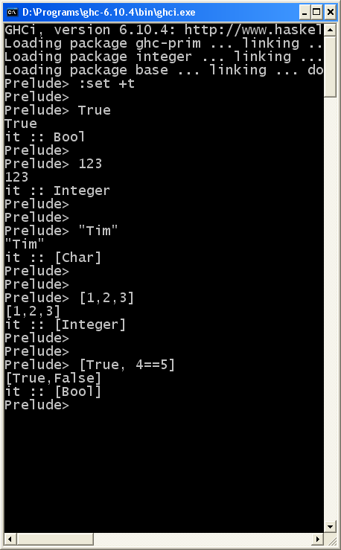
Data in Haskell
Numbers – Int, Integer, Double etc.
23
67.3
Truth Values – Bool
True False
Text – String
“Tim”
“23”
Sequences – List
[1,3,4]
[True,False]

Slide 19
What kinds of Data can we use?
There are many different kinds of data.
Haskell comes with a set of predefined data
For now – Integer, Bool, List, String
Later we will learn how to define our own (new) kinds of data
Stack, Queue, Tree, Table, Hash, …

Slide 20
Operations on data
To do anything interesting we need operations that compute new data from old data
Examples
Integer: div mod (+) (-) (*)
Bool: (&&) (||) not
List: (++) head tail reverse length
Operations come in two forms
Prefix: div 8 2
Infix : 8 * 2
We write surround infix operators with parentheses (*) when we want to talk about them (but not when we use them)

Slide 21
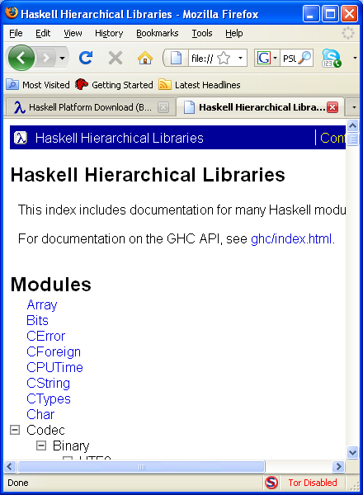
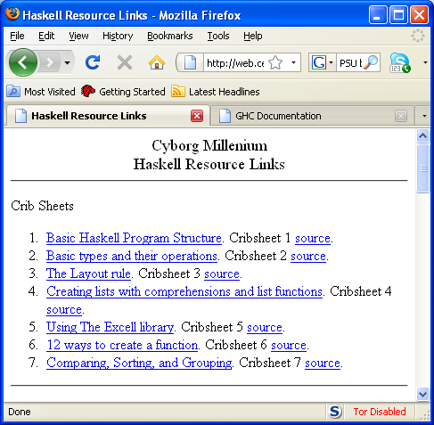
What operations are there?
Many different ways to find operations
Click on the Libraries link from the users guide
Use one of the crib sheets from the Haskell Resource Links

Slide 22
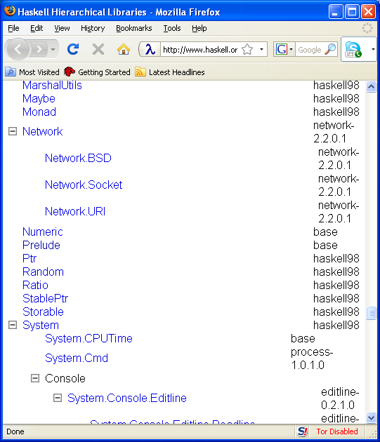
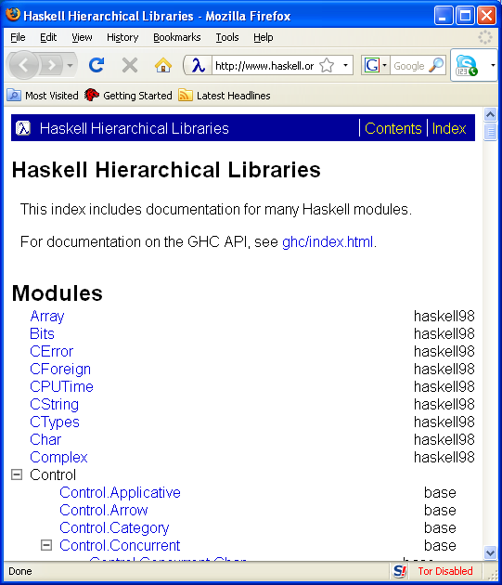
Hierarchical Libraries
Click “Libraries” from the users guide
Slide down to the “Prelude” library

Slide 23
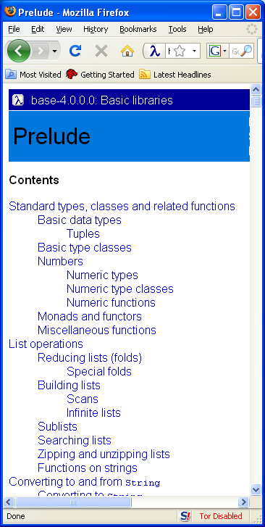
Explore the Prelude
Once the prelude window is found -
Click the links and explore all the predefined operations in Haskell

Slide 24
Naming Values
X = 3 + 4
Name
expression
equality
Many program are just a series of named values.

Slide 25
Using implicit types
Every legal expression has a type.
Examples
Integer
String
Char
Double
[Integer]
Bool

Slide 26
Overloading
Some expressions have more than one type.
The numeric constants are especially bothersome
These will cause you many headaches until you get used to the error messages.
Example
5:: Integer
5:: Double
5:: Int
5:: Num t => t

Slide 27
Commands
Commands cause an action on the world.
Most commonly used commands perform Input and Output.
Read from the key board
getLine, getContents
Print to the console
putStrLn, print
Read from files
readFile, writeFile

Slide 28
Writing functions

Slide 29
Making lists

Slide 30
Example functions
Factorial
99 beer song
Rolling two die
12 days of christmas
Digitval and string to value
Sort maximum, elemIndices, take , drop
Maximum, filter, (++)

