Slide 1
Lecture #5, Jan. 23, 2006
Finite State automata
Lexical analyzers
NFAs
DFAs
NFA to DFA (the subset construction)
Lex tools
SML LEX

Slide 2
Assignments
Read the project description (link on the web page) which describes the Java like language we will build a compiler for.
  The first project will be assigned next week, so its important to be familiar with the language we will be compiling
Programming exercise 5 is posted on the website. It requires you download a small file and add to it. It is due Wednesday.

Slide 3
Finite Automata
A non-deterministic finite automata (NFA) consists of
  An input alphabet Σ, e.g. Σ = {a,b}
  A set of states S, e.g. {1,3,5,7,11,97}
  A set of tranisitions from states to states labeled be elements of Σ or ε
  A start state e.g. 1
  A set of final states e.g. {5,97}
a
a
11
5
1
b
b
ε
a
7
ε
b
97
3
b

Slide 4
Small Example
a
0
a
1
b
b
2
3
b
ε
Can be written as a transition table
state | a | b | ε
0, start | {0,1} | {0} | -
1 | - | {2} | {3}
2, final | - | {3} | -
3, final | - | - | -
An NFA accepts the string x if there is a path from start to final state labeled by the characters of x
Example: NFA above accepts “aaabbabb”

Slide 5
Acceptance
An NFA accepts the language L if it accepts exactly the strings in L.
Example: The NFA on the previous slide accpets the language defined by the R.E. (a*b*)*a(bb|ε)
Fact: For every regular language L, there exists An NFA that accepts L
In lecture 2 we gave an algorithm for constructing an NFA from an R.E., such that the NFA accepts the language defined by the R.E.

Slide 6
Rules
ε
“x”
AB
A|B
A*
ε
x
A
B
ε
A
ε
ε
ε
B
ε
ε
ε
A
ε

Slide 7
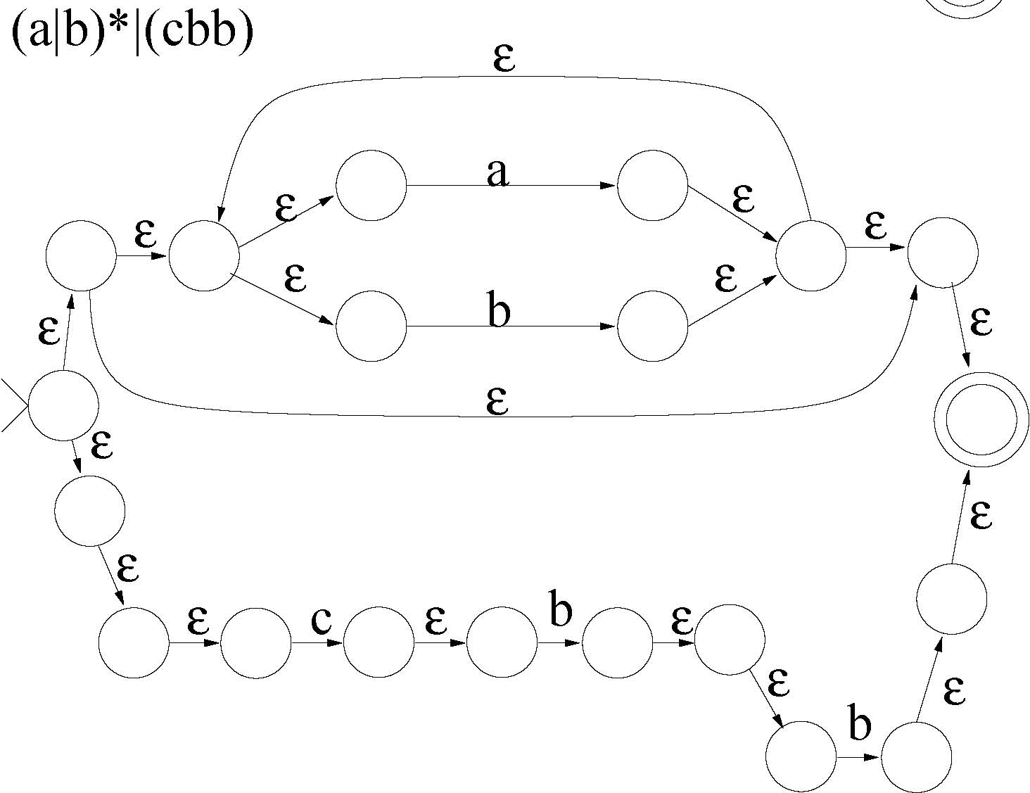
Rich Example

Slide 8
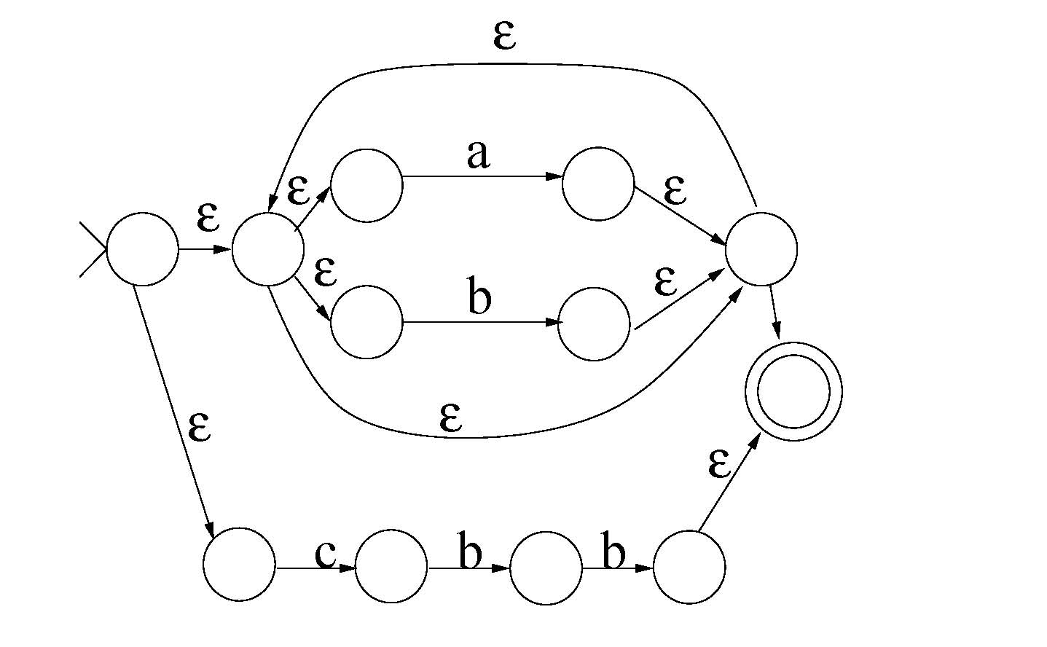
Simplify
We can simplify NFA’s by removing useless empty-string transitions

Slide 9
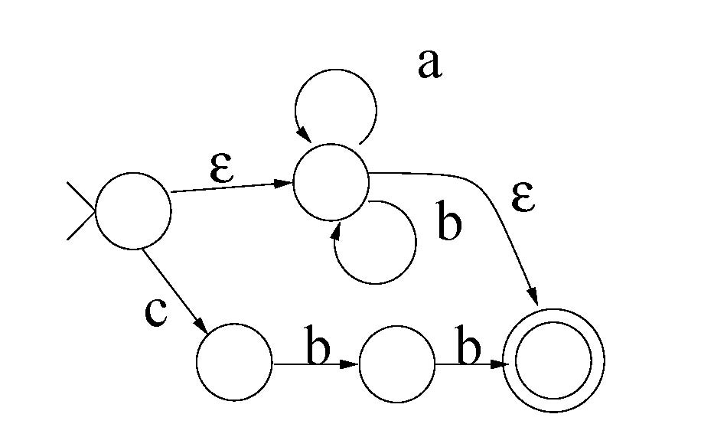
Even better

Slide 10
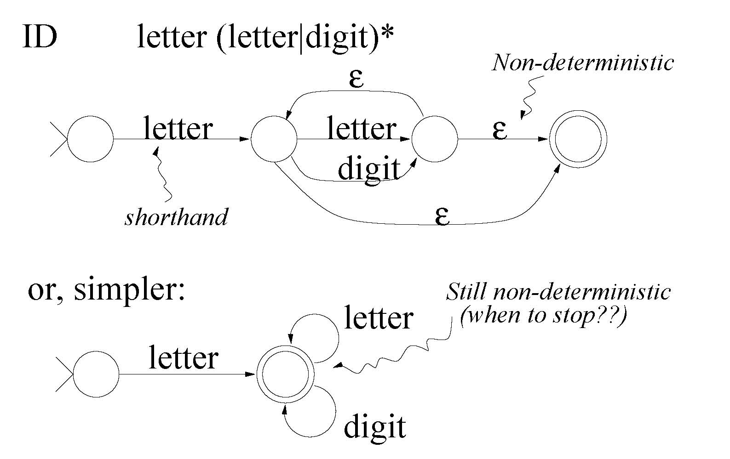
Lexical analyzers
Lexical analyzers break the input text into tokens.
Each legal token can be described both by an NFA and a R.E.

Slide 11
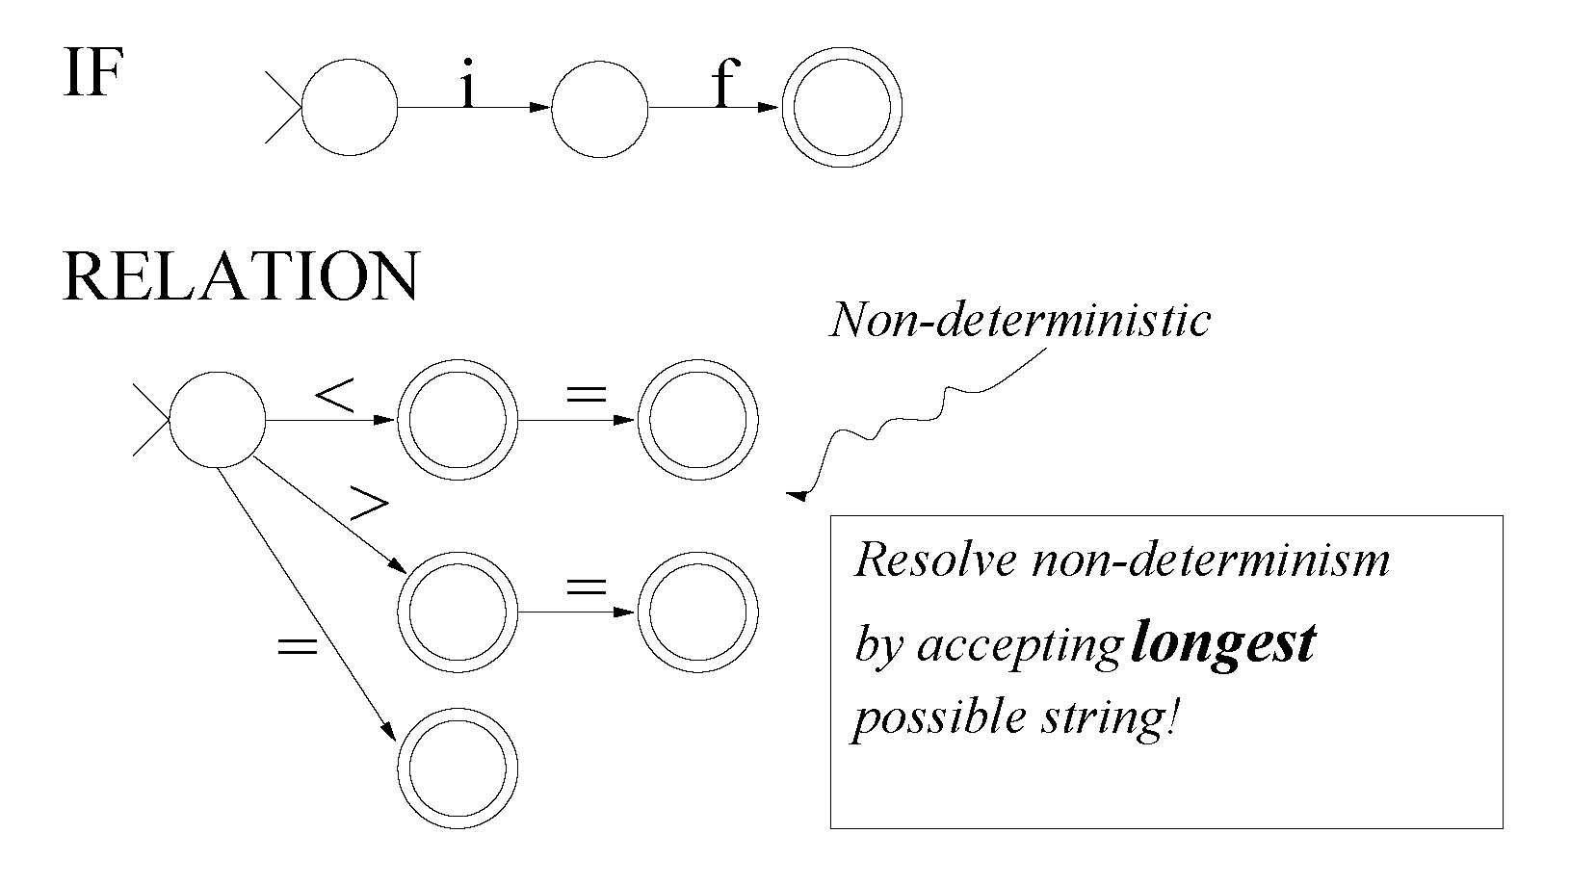
Key words and relational operators

Slide 12
Using NFAs to build Lexers
Lexical analyzer must find the best match among a set of patterns
Algorithm
  Try NFA for pattern #1
  Try NFA for pattern #2
  …
  Finally, try NFA for pattern #n
Must reset the input string after each unsuccessful match attempt.
Always choose the pattern that allows the longest input string to match.
Must specify which pattern should ‘win’ if two or more match the same length of input.

Slide 13
Alternatively
Combine all the NFAs into one giant NFA, with distinguished final states:
NFA for pattern #1
ε
ε
F1
ε
NFA for pattern #2
ε
F2
. . .
ε
NFA for pattern #n
ε
Fn
We now have non-determinism between patterns, as well as within a single patterns.

Slide 14
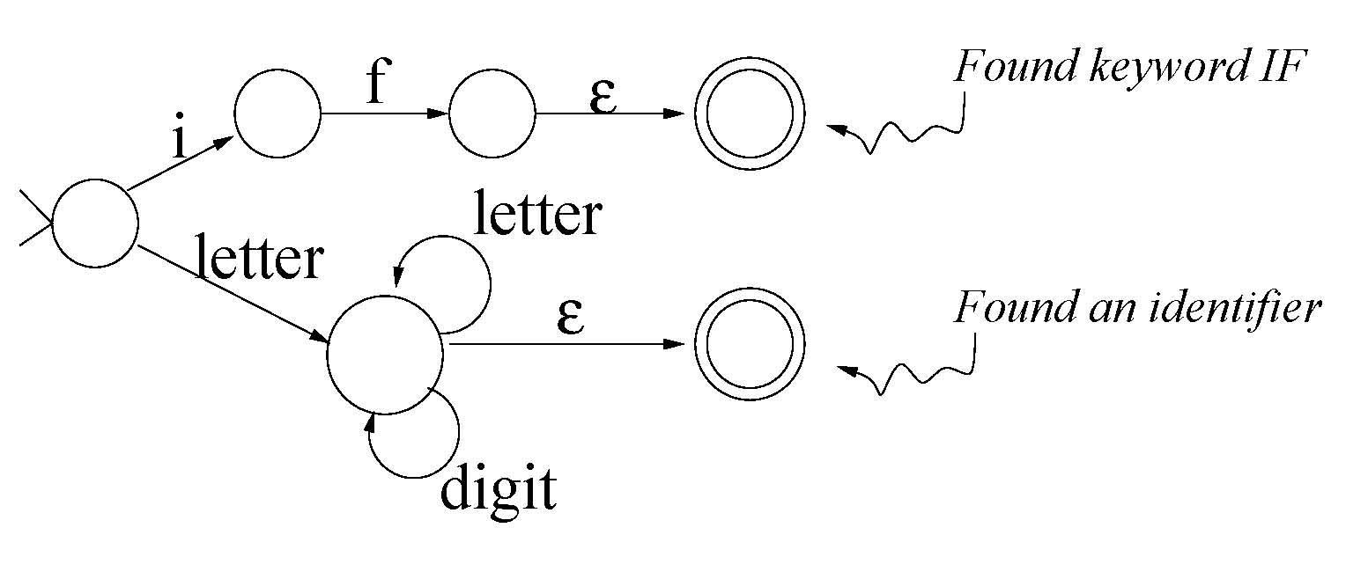
Non-determinism

Slide 15
Implementing Lexers using NFAs
Behavior of an NFA on a given input string is ambiguous.
So NFA's don't lead to a deterministic computer programs.
Strategy: convert to deterministic finite automaton (DFA).
  Also called “finite state machine”.
  Like NFA, but has no ε-transitions and no symbol labels more than one transition from any given node.
  Easy to simulate on computer.

Slide 16
Constructing DFAs
There is an algorithm (“subset construction”) that can convert any NFA to a DFA that accepts the same language.
Alternative approach: Simulate NFA directly by pretending to follow all possible paths “at once”. We saw this last lecture 3 with the function “nfa” and “transitionOn”
To handle ``longest match'' requirement, must keep track of last final state entered, and backtrack to that state (“unreading” characters) if get stuck.

Slide 17
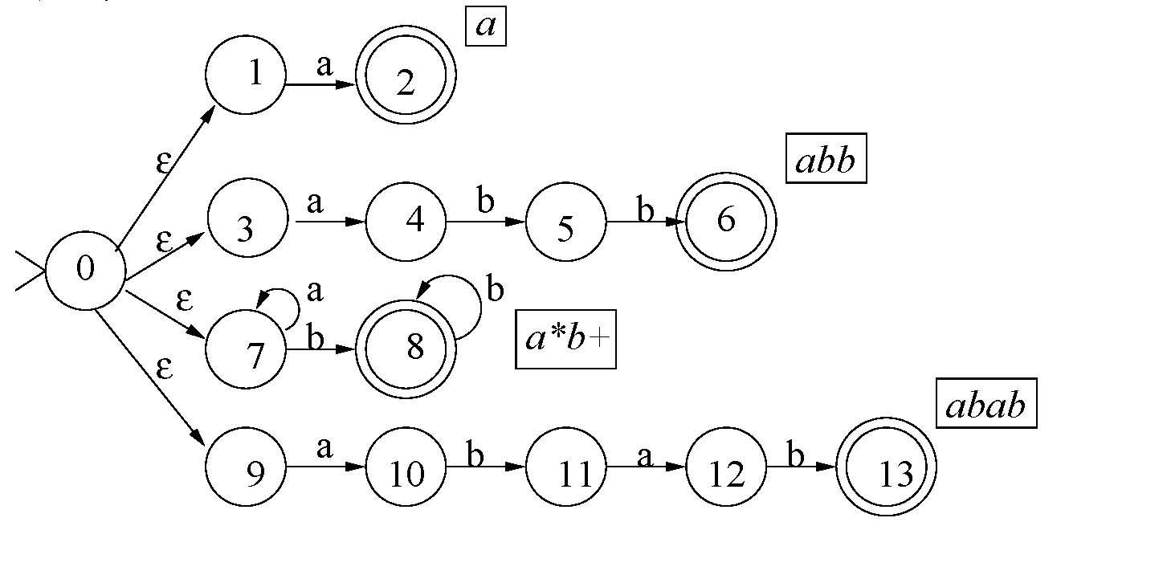
DFA and backtracking example
Given the following set of patterns, build a machine to find the longest match; in case of ties, favor the pattern listed first.
  a
  abb
  a*b+
  Abab
First build NFA

Slide 18
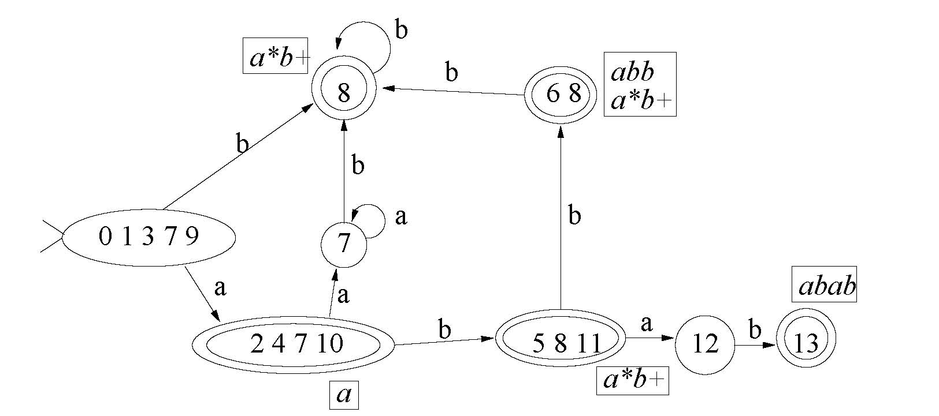
Then construct DFA
Consider these inputs
  abaa
    Machine gets stuck after aba in state 12
    Backs up to state (5 8 11)
    Pattern is ab+
    Lexeme is ab, final aa is pushed back onto input and will be read again
  abba
    Machine stops after second b in state (6 8)
    Pattern is abb because it was listed first in spec

Slide 19
The subset construction
Start state is 0
Worklist = [eclosure [0]] → [ [0,1,3,7,9] ]
Current state = hd worklist → [0,1,3,7,9]
Compute: on a → [2,4,7,10] → eclosure [2,4,7,10] → [2,4,7,10]
on b → [8] → eclosure [8] → [8]
New worklist = [[2,4,7,10] , [8] ]
Continue until worklist is empty

Slide 20
Step by step
worklist [0,1,3,7,9]
Oldlist []
[0,1,3,7,9] --a--> [2,4,7,10]
[0,1,3,7,9] --b--> [8]
worklist [2,4,7,10]; [8]
Oldlist [0,1,3,7,9]
[2,4,7,10] --a--> [7]
[2,4,7,10] --b--> [5,8,11]
worklist [7]; [5,8,11]; [8]
oldlist [2,4,7,10]; [0,1,3,7,9]
[7] --a--> [7]
[7] --b--> [8]
worklist [5,8,11]; [8]
old [7]; [2,4,7,10]; [0,1,3,7,9]
[5,8,11] --a--> [12]
[5,8,11] --b--> [6,8]
Note, that both [7] and [8] are already known so they are not added to the worklist.

Slide 21
More Steps
worklist [12]; [6,8]; [8]
old [5,8,11]; [7]; [2,4,7,10]; [0,1,3,7,9]
[12] --b--> [13]
worklist [13]; [6,8]; [8]
old [12]; [5,8,11]; [7]; [2,4,7,10]; [0,1,3,7,9]
worklist [6,8]; [8]
old [13]; [12]; [5,8,11]; [7]; [2,4,7,10]; [0,1,3,7,9]
[6,8] --b--> [8]
worklist [8]
old [6,8]; [13]; [12]; [5,8,11];
[7]; [2,4,7,10]; [0,1,3,7,9]
[8] --b--> [8]

Slide 22
Algorithm with while-loop
fun nfa2dfa start edges =
let val chars = nodup(sigma edges)
val s0 = eclosure edges [start]
val worklist = ref [s0]
val work = ref []
val old = ref []
val newEdges = ref []
in while (not (null (!worklist))) do
( work := hd(!worklist)
; old := (!work) :: (!old)
; worklist := tl(!worklist)
; let fun nextOn c = (Char.toString c
,eclosure edges (nodesOnFromMany (Char c) (!work) edges))
val possible = map nextOn chars
fun add ((c,[])::xs) es = add xs es
| add ((c,ss)::xs) es = add xs ((!work,c,ss)::es)
| add [] es = es
fun ok [] = false
| ok xs = not(exists (fn ys => xs=ys) (!old)) andalso
not(exists (fn ys => xs=ys) (!worklist))
val new = filter ok (map snd possible)
in worklist := new @ (!worklist);
newEdges := add possible (!newEdges)
end
);
(s0,!old,!newEdges)
end;

Slide 23
Algorithm with accumulating parameters
fun nfa2dfa2 start edges =
let val chars = nodup(sigma edges)
val s0 = eclosure edges [start]
fun help [] old newEdges = (s0,old,newEdges)
| help (work::worklist) old newEdges =
let val processed = work::old
fun nextOn c = (Char.toString c
,eclosure edges
(nodesOnFromMany (Char c)
work edges))
val possible = map nextOn chars
fun add ((c,[])::xs) es = add xs es
| add ((c,ss)::xs) es = add xs ((work,c,ss)::es)
| add [] es = es
fun ok [] = false
| ok xs = not(exists (fn ys => xs=ys) processed)
andalso
not(exists (fn ys => xs=ys) worklist)
val new = filter ok (map snd possible)
in help (new @ worklist) processed
(add possible newEdges) end
in help [s0] [] [] end;

Slide 24
Lexical Generators
Lexical generators translate Regular Expressions into Non-Deterministic Finite state automata.
Their input is regular expressions.
These regular expressions are encoded as data structures.
The generator translates these regular expressions into finite state automata, and these automata are encoded into programs.
These FSA “programs” are the output of the generator.
We will use a lexical generator ML-Lex to generate the lexer for the mini language.

Slide 25
lex & yacc
Languages are a universal paradigm in computer science
Frequently in the course of implementing a system we design languages
Traditional language processors are divided into at least three parts:
  lexical analysis: Reading a stream of characters and producing a stream of “logical entities ” called tokens
  syntactic analysis: Taking a stream of tokens and organizing them into phrases described by a grammar .
  semantics analysis: Taking a syntactic structure and assigning meaning to it
ml-lex is a tool for building lexical analysis programs automatically.
Sml-yacc is a tool building parsers from grammars.

Slide 26
lex & yacc
For reference the C version of Lex and Yacc:
  Levine, Mason & Brown, lex & yacc, O’Reilly & Associates
  The supplemental volumes to the UNIX programmers manual contains the original documentation on both lex and yacc.
SML version Resources
  ML-Yacc Users Manual, David Tarditi and Andrew Appel
    http://www.smlnj.org/doc/ML-Yacc/
  ML-Lex Andrew Appel, James Mattson , and David Tarditi
    http://www.smlnj.org/doc/ML-Lex/manual.html
  Both tools are included in the SML-NJ standard distribution files.

Slide 27
A trivial integrated example
Simplified English (even simpler than in the one in lecture 1) Grammar:
  <sentence> ::= <noun phrase> <verb phrase>
  <noun phrase> ::= <proper noun>
  | <article> <noun>
  <verb phrase> ::= <verb>
  | <verb> <noun phrase>
Simple lexicon (terminal symbols)
  Proper nouns: Anne, Bob, Spot
  Articles: the, a
  Nouns: boy, girl, dog
  Verbs: walked, chased, ran, bit
Lexical Analyser turns each terminal symbol string into a token.
In this example we have 1 token for each of: Proper-noun, Article, Noun, and Verb

Slide 28
Specifying a lexer using Lex
Basic paradigm is pattern-action rule
Patterns are specified with regular expressions (as discussed earlier)
Actions are specified with programming annotations
Example:
  Anne|Bob|Spot { return(PROPER_NOUN); }
This notation is for illustration only. We will describe the real notation in a bit.

Slide 29
A very simplistic solution
If we build a file with only the rules for our lexicon above, e.g.
        Anne|Bob|Spot {return(PROPER_NOUN);}
        a|the {return(ARTICLE);}
        boy|girl|dog {return(NOUN);}
        walked|chased|ran|bit {return(VERB);}
This is simplistic because it will produce a lexical analyzer that will echo all unrecognized characters to standard output, rather than returning an error of some kind.

Slide 30
Specifying patterns with regular expressions
SML-Lex “lexes” by compiling regular expressions in to simple “machines” that it applies to the input.
The language for describing the patterns that can be compiled to these simple machines is the language of regular expressions
SML-Lex’s input is very similar to the rules for forming regular expressions we have studied.

Slide 31
Basic regular expressions in Lex
The empty string
    ““
A character
    a
One regular expression concatenated with another
    ab
One regular expression or another
    a|b
Zero or more instances of a regular expression
    a*
You can use ()’s
    (0|1|2|3|4|5|6|7|8|9)*

Slide 32
R.E. Shorthands
One or more instances by +
i.e. A+ = A | AA | AAA | ...
A+ = A* - {""}
One or No instances (optional)
i.e. A? = A | <empty>
Character Classes:
[abc] = a | b | c
[0-5] = 0 | 1 | 2 | 3 | 4 | 5

Slide 33
Derived forms
Character classes
    [abc]
    [a-z]
    [-az]
Complement of a character class
    [^b-y]
Arbitrary character (except \n)
    .
Optional (zero or 1 occurrences of r)
    r?
Repeat one or more times
    r+

Slide 34
Derived forms (cont.)
Repeat n times
    r{n}
Repeat between n and m times
    r{m,n}
Meta characters for positions
  Beginning of line
    ^

Slide 35
Structure of lex source files
Three sections separated by %%
First section allows definitions and declarations of “header information”
Second section contains definitions appropriate for the tool (definitions see next slide)
Third section contains the pattern action pairs
Some examples can be found in the directory:
  http://www.cs.pdx.edu/~sheard/course/Cs321/LexYacc/

Slide 36
Regular Definitions
Regular definitions are a sequence of definitions of names to regular expressions, and the names can be used in the regular expressions.
A Convention is needed to separate the Names from the strings being recognized, in SML-lex we surround Names by { }’s when used.
alpha = [A-Z] | [a-z]
digit = [0-9]
id = {alpha}({alpha} | {digit})*

Slide 37
Sml example: english.lex
type lexresult = unit;
type pos = int;
type svalue = int;
exception EOF;
fun eof () = (print "eof"; raise EOF);
%%
%%
[\t\ ]+
=> ( lex() (* ignore whitespace *) ) ;
Anne|Bob|Spot
=> ( print (yytext^": is a proper noun\n"));
a|the
=> ( print(yytext^": is an article\n") );
boy|girl|dog
=> ( print(yytext^": is a noun\n") );
walked|chased|ran|bit
=> ( print(yytext^": is a verb\n") );
[a-zA-Z]+
=> ( print(yytext^": Might be a noun?\n") );
.|\n
=> ( print yytext (* Echo the string *) );
Declaration part is empty

Slide 38
What the tools build in Sml
lex spec
foo.lex
ml-lex foo.lex
foo.lex.sml
sml structure
Mlex
sml window
use “foo.lex.sml”;

Slide 39
Using Sml-lex
file: english.make.sml
use "english.lex.sml”;
fun getnchars n = (inputc std_in n);
val run =
let val next = Mlex.makeLexer getnchars;
fun lex () = (next(); lex () )
in lex end;
sml interaction window
- use "english.make.sml";
[opening english.make.sml]
[opening english.lex.sml]
structure Mlex : sig ...
val makeLexer : (int -> string) -> unit -> unit
end
val it = () : unit
val getnchars = fn : int -> string
val run = fn : unit -> 'a
val it = () : unit

Slide 40
Exercise, What will it do?
On:
  the boy chased the dog
  the 99 boy chased the dog
  theboychasedthedog
  the boys chased the dog
  the boy chased the dog!
Note the Boiler plate for tying SML style lexers together (see previous slide) can be found in the directory:
  http://www.cs.pdx.edu/~sheard/course/Cs321/LexYacc/boilerplate

Slide 41
Running the Sml-lexer
- run ();
the dog ate the cat?
the: is an article
dog: is a noun
ate: Might be a noun?
the: is an article
cat: Might be a noun?
?
((((5
((((5
eof
uncaught exception EOF

Slide 42
Standard “Tricks”
We may want to add the following:
Ignore white space
  [\ \t]+ => ( lex() );
Count new lines
  \n => ( (line_no := !line_no + 1) );
Signal error on an unrecognized word
  [A-Za-z]* => ( error(“unrecognized word “^yytext) );
Ignore all other punctuation
  . => ( print yytext );

Slide 43
Another SML-Lex example
type lexresult = token;
type pos = int;
type svalue = int;
exception EOF;
fun eof () = (print “Eof”; raise EOF);
%%
%%
[\t\n\ ] => ( lex () );
\| => ( Bar );
\* => ( Star );
\# => ( Hash );
\( => ( LP );
\) => ( RP );
[a-zA-Z] => ( Single(yytext) );
. => ( print (yytext^"\n");
raise bad_input );

Slide 44
Compiling
Always load datatype declarations (usually in another file) before using the XXX.lex.sml file
- exception bad_input;
datatype token = Eof | Bar | Star | Hash
| LP | RP | Single of string;
- use "regexp.lex.sml";
[- fun getnchars n = (inputc std_in n);
val getnchars = fn : int -> string
- val next = Mlex . makeLexer getnchars;
val next = fn : unit -> token
- next();
(a|b)*abb
val it = LP : token
- next();
val it = Single "a" : token
- next();
val it = Bar : token
- next();
val it = Single "b" : token

Slide 45
Next time
More on using ML-Lex next time on wednesday
Also the First project will be assigned next Monday.
Don’t forget to download today’s homework, It is due Wednesday.

Slide 46
CS321 Prog Lang & Compilers Assignment # 5
Assigned: Jan 29, 2007 Due: Wed. Jan 31, 2007
======================================================================
1) Your job is to write a function that interprets regular expressions
as a set of strings.
- reToSetOfString;
val it = fn : RE -> string list
To do this you will need the definition of regular expressions (the datatype RE) and the functions that implemenent sets of strings as lists of strings without duplicates. Tou will also need the "cross“ operator from lecture 4. All these functionas can be found in the file "assign5Prelude.html" which can be downloaded from the assignments page of the course website. The first line of your solution should include this file by using
use "assign5Prelude.html";
"reToSetOfString" is fairly easy to write (use pattern matching), except some regular expressions represent an infinite set of strings. These come from use of the Star operator. To avoid this we will write a function that computes an approximate set of strings. Star will produce 0,1,2, and 3 repetitions only. For example:
reToSetOfString (Concat (C #"a",Star (C #"b"))) ---> ["abbb","abb","ab","a"]
BONUS 10 points. Write a version reToN which given an interger n
creates exactly 0,1, ... n repetitions exactly.
reToN 2 (Concat (C #"a",Star (C #"b"))) ---> ["abb","ab","a"]
reToN 4 (Concat (C #"a",Star (C #"b"))) ---> ["abbbb","abbb","abb","ab","a"]

