Slide 1
Programming 1
Tim Sheard

Slide 2
Spring Quarter
Goals of the class
  Learn to write simple programs using the programming language Haskell.
  Learn by example.
    Watch others, study programs
      Demo programs
    Write your own programs
      Worksheets
      Crib Sheets
      Assignments
  Pair programming

Slide 3
Pair programming
Work in pairs.
Two sets of eyes and brains is better than one.
One person “drives” – works the keyboard.
One person “navigates” – decides strategy and looks for errors.
Switch roles at least every half hour.
Think before you type!

Slide 4
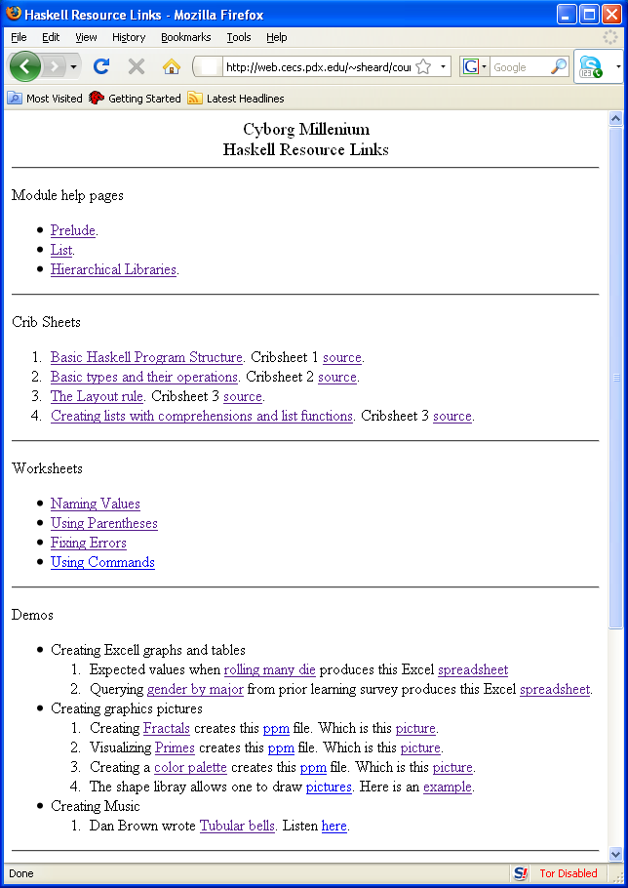
The programming resource link
http://web.cecs.pdx.edu/~sheard/course/CyberMil/HaskellLinks.html

Slide 5
In class programming worksheets
We will often use worksheets in class
  Go to the programming resource link page
  Download the worksheet to your own computer
  Work in pairs to complete the worksheet.
  When your pair is finished. Get up from your table and find a pair that could use some assistance.
    Over their shoulder (don’t touch the computer!) help them to finish the worksheet
  When everyone is standing we’ll move on to the next unit.

Slide 6
Using resources
Study the resources provided.
Try and recognize what makes a program good.
Learn the “structure” of programs. Many errors are silly misspellings or forgotten punctuation.
Always ask for help! Many times another pair of eyes will immediately see what’s wrong.

Slide 7
Goals of the programming unit
Create simple programs
Use simple programs to answer questions that cannot easily be done by hand
Use simple programs to find patterns in real world data
Process
  Acquire data
  Manipulate data
  Visualize data

Slide 8
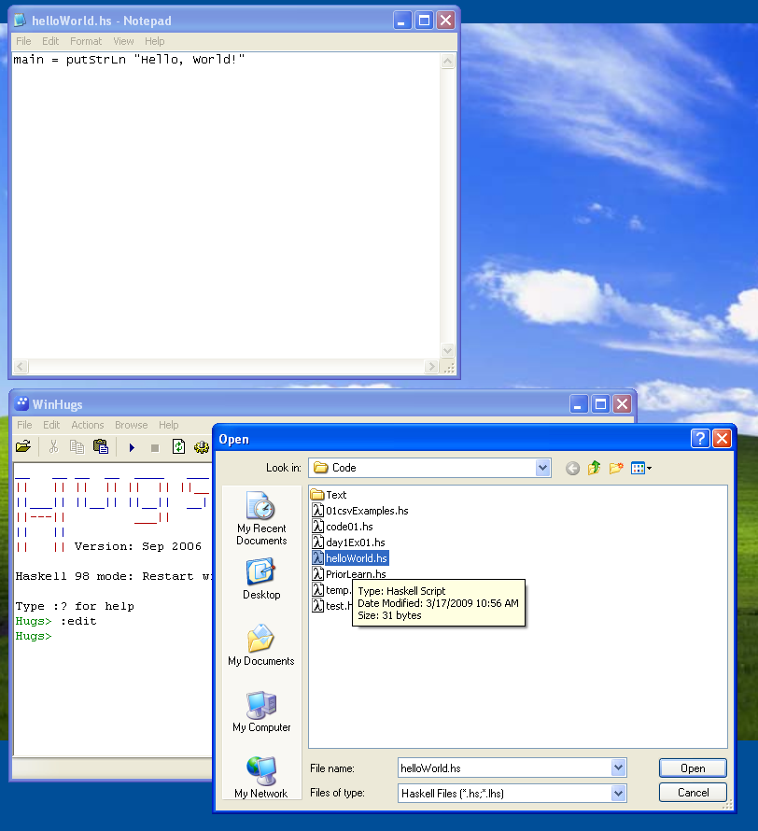
Writing a program
Start up an editor
Start up winhugs
Write a program in the editor, save the file
“open” the file in winhugs, under the file tab
Type “main” in winhugs

Slide 9
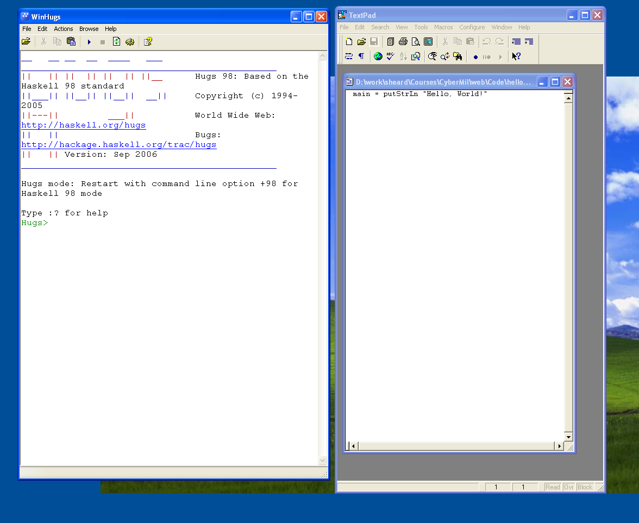
Advice
Arrange your screen with side by side windows

Slide 10
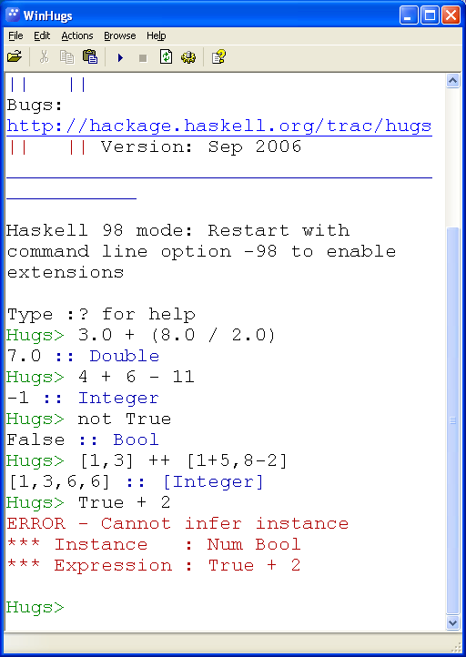
Interaction in winhugs
Type an expression
Winhugs checks that it is well formed
  Well-typed
Evaluates the expression
  Carries out the computation
Prints the result
And the Type

Slide 11
What is data?
Measurements of some kind stored in a computer.
  Examples
    Simple: numbers, text, truth values …
    Structured: sequences, sets, records …
    Complex: dictionaries, music, pictures …

Slide 12
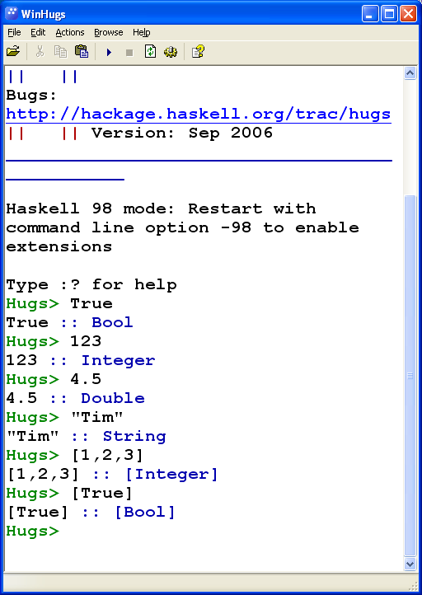
Data in Haskell
Numbers – Integer and Double
  23
  67.3
Truth Values – Bool
  True False
Text – String
  “Tim”
  “23”
Sequences – List
  [1,3,4]
  [True,False]

Slide 13
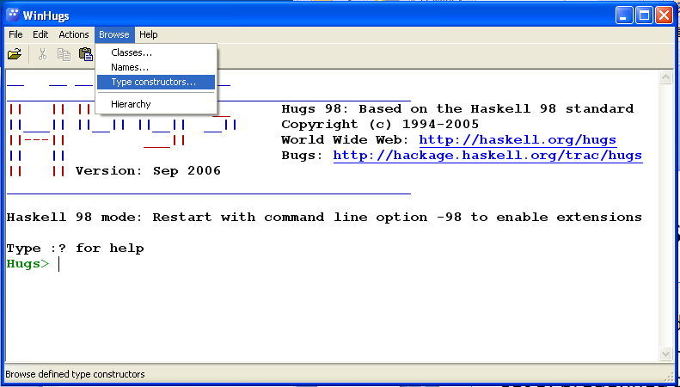
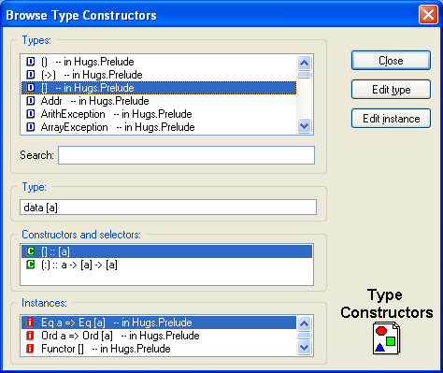
What kinds of Data can we use?
There are many different kinds of data.
Haskell comes with a set of predefined data
Later we will learn how to define our own (new) kinds of data
To see what’s available, click the “Type constructors” under the browse tab.
For now – Integer, Bool, List, String

Slide 14
Operations on data
To do anything interesting we need operations that compute new data from old data
Examples
  Integer: div mod (+) (-) (*)
  Bool: (&&) (||) not
  List: (++) head tail reverse length
Operations come in two forms
  Prefix: div 8 2
  Infix : 8 * 2
We write surround infix operators with parentheses (*) when we want to talk about them (but not when we use them)

Slide 15
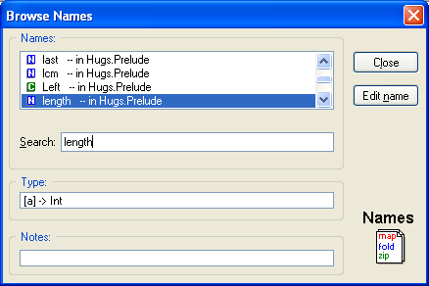
What operations are there?
Two different ways to find operations
  “name” in the “Browse” tab
  “Hierarchical Libraries” in the “Help” Tab
Use the slider to look for an operation
Or, type its name into the “search” field

Slide 16
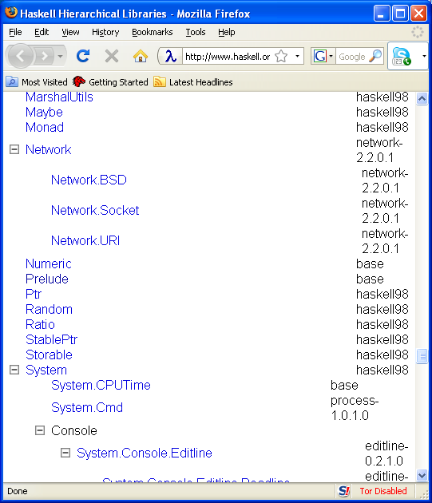
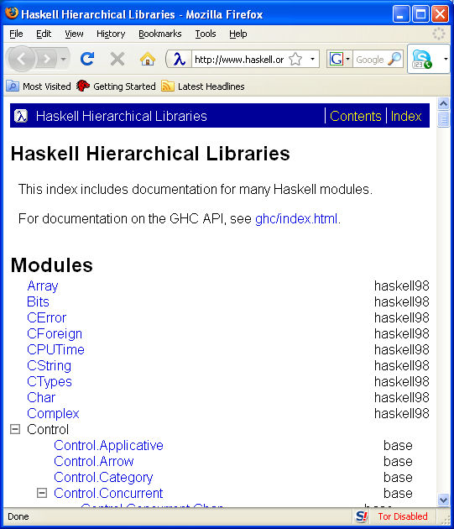
Hierarchical Libraries
Click “Hierarchical Libraries” in the “help” tab.
An internet browser is launched.
Slide down to the “Prelude” library

Slide 17
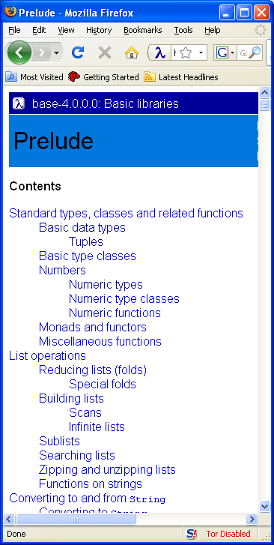
Explore the Prelude
Once the prelude window is found -
Click the links and explore all the predefined operations in Haskell

Slide 18
Naming Values
X = 3 + 4
Name
expression
equality
Many program are just a series of named values.

Slide 19
Using implicit types
Every legal expression has a type.
Examples
  Integer
  String
  Char
  Double
  [Integer]
  Bool

Slide 20
Overloading
Some expressions have more than one type.
The numeric constants are especially bothersome
These will cause you many headaches until you get used to the error messages.
Example
  5:: Integer
  5:: Double
  5:: Int
  5:: Num t => t

Slide 21
Commands
Commands cause an action on the world.
Most commonly used commands perform Input and Output.
  Read from the key board
    getLine, getContents
  Print to the console
    putStrLn, print
  Read from files
    readFile, writeFile

Slide 22

Writing functions

Slide 23
Making lists

Slide 24
Example functions
Factorial
99 beer song
Rolling two die
12 days of christmas
Digitval and string to value
Sort maximum, elemIndices, take , drop
  Maximum, filter, (++)

