Slide 1
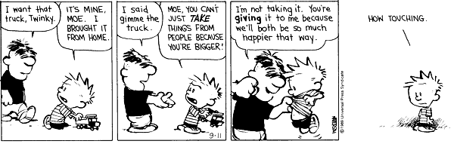
By David Lazar, Sam Fiscu, Joe Fort, Andre, and Austin Angelus
Utilitarianism

Slide 2
Ethical utilitarianism is a principle where the best choice is the one that does the most good for the most people. The morality of the action is determined solely by the outcome.

Slide 3
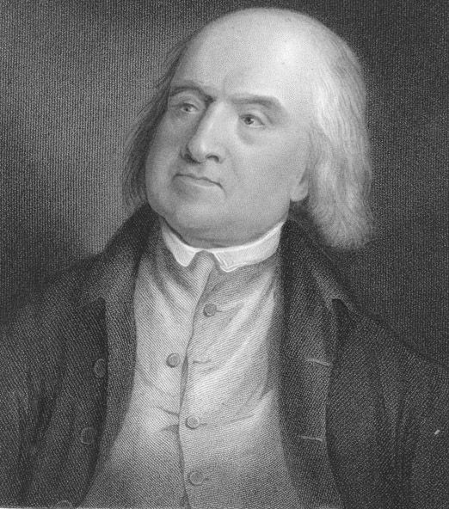
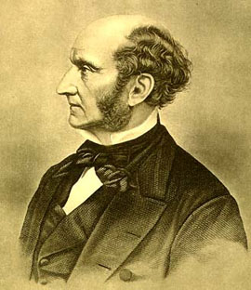
Jeremy Bentham (1748-1832)
“…nature has placed mankind under the governance of two sovereign masters, pain and pleasure.”
John Stewart Mill (1806-1873)
“…actions are right in proportion as they tend to promote happiness, wrong as they tend to produce the reverse of happiness.”
Utilitarianism, 1863

Slide 4
Jim is an explorer who stumbles into a South American village where 20 Indians are about to be shot. The captain says that as a mark of honor to Jim as a guest, he will be invited to shoot one of the Indians, and the other 19 will be set free. If Jim refuses, all 20 Indians will be shot.
What should Jim do?

Slide 5
George is a scientist who is out of work. He is offered a job in a laboratory which does research into chemical and biological weapons. George is strongly opposed to the manufacture of chemical and biological weapons. If he does not take the job, his wife and his children will suffer. And if he does not take the job, it will be given to someone else who will pursue the research with fewer inhibitions.
Should George take the job?

Slide 6

Nadya Suleman
Unemployed on welfare
Unmarried
Six children in addition to the octuplets
Implanted with six embryos instead of the typical one

Slide 7


Slide 8
Stakeholders
Nadya Suleman
Nadya’s children
Doctors
Other women in need of in vitro fertilization
Tax payers

Slide 9
Taxpayers
Women may be inclined to follow in Nadya’s footsteps.
Taxes would increase to handle expenses of unemployed single mothers
Eventually the welfare system could not handle more “Octomoms”

Slide 10
In Vitro Doctors & Patients
Some doctors are concerned that there are will be an investigation into Suleman’s pregnancy.
Investigation could lead to laws regulating IVF
Regulations would make doctor’s job harder and make it more difficult for women to use IVF.

