Slide 1

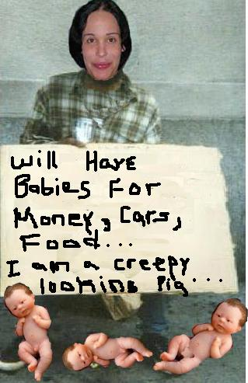
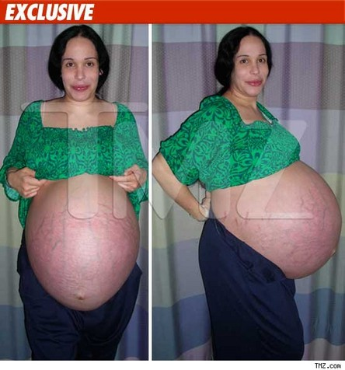
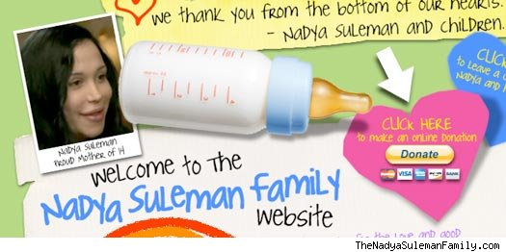

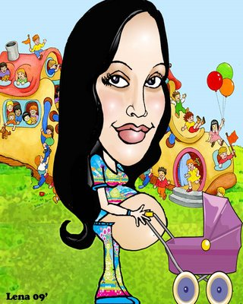
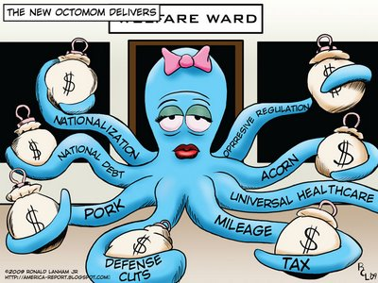
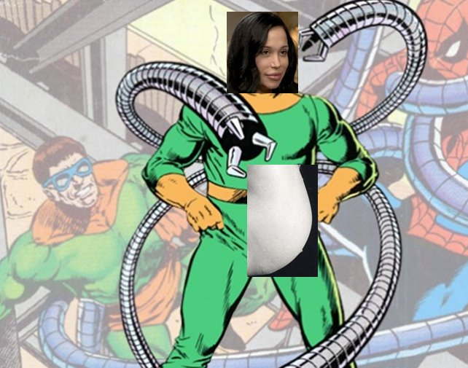
Ethical Relativism
Jacqueline Ebert
Tony Roy
Kylee Page
Ryan Souza
Sean

Slide 2
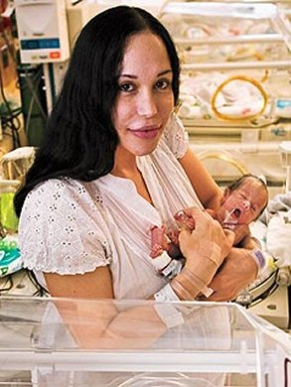
Ethical Relativism
No universal standards.
Cannot judge others.
Personal judgment of actions.
Society may affect personal morals
Personal morals are not used to judge others.
1

Slide 3
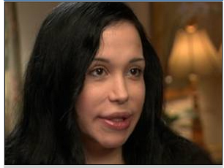
Nadya’s Childhood
She was an only child.
Considers her childhood and family was dysfunctional.
Dreamed of having more siblings and a larger family.
Says she was “spoiled” by her father.
2

Slide 4
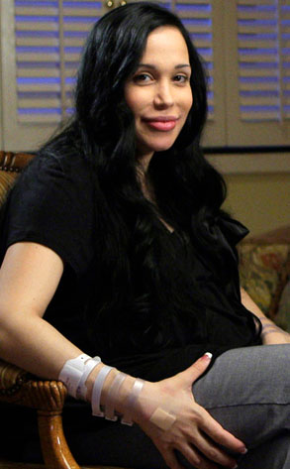
Nadya’s Present, Schooling and Marriage
She was married to Marcos Gutierrez; 1996 and divorced; 2008.
She has a Psychiatric Technician License and worked at Metropolitan State Hospital.
She filled claim for worker’s compensation in 1999 and also in 2001 and received about $165,000.
She received Bachelor of Science degree in child and adolescent development in 2006 from Cal State Fullerton.
3

Slide 5
Nadya Suleman’s Life Now
    Nadya Suleman, 33 recently purchased a $565 thousand home in La Habra, California.
    The new house has had all floors replaced, air ducts cleaned, and its’ safety was approved by the hospital.
    Nadya plans on attending college as soon as her children get older in order to offer them a more suitable life.
    Her appearance on Dr.Phil has allowed her to share her story and answer questions for critics. As well as collect donations and positive feedback for the octuplets and her six other children.
    Nadya has set up her own website for supporters to leave donations and comments, as well as view photos of her family.
4

Slide 6
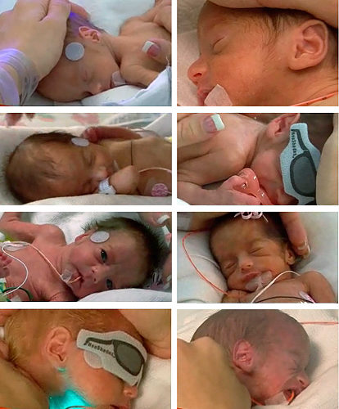
Nadya Suleman and Children
    Nadya recently accepted an offer from Angles in Waiting (a nonprofit organization established in 2005) for around the clock care for her octuplets.
    The octuplets are in perfect health and ready to be released to their mother.
    On March 18th, 2009, two of the octuples (Noah and Isaiah) were released from Kaiser Permanente Medical Center and into Nadya Suleman’s hands.
    Before two of the octuplets were brought home, Nadya dedicated a day of fun to her older children and treated them Knott’s Berry Farm, and to preview their new home.
    With newly found support from her family, care from Angles in Waiting, and donations made by people all over the world, Nadya believes she can successfully care for all 14 of children, and keep them in perfect health.
5

Slide 7
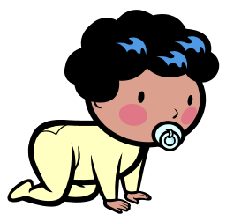

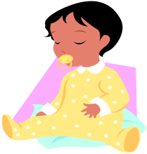
Octo-mom and Ethical Relativism
American Society allows individuals to choose their own lifestyle.
Nadya Suleman is entitled to have as many children as she wants so long as she provides for them.
Nadya Suleman will be receiving childcare from Angels in Waiting, a non-profit organization.
What’s right for others may not be right for me, therefore I shouldn’t judge.
6

Slide 8
Ethical Questions
Why did she want to have 14 children?
How is Nadya Suleman going to support her children with no job and no husband?
No single mother should be allowed to have 14 children. Why doesn’t the state take her kids away?
Her sanity is questionable. Shouldn’t the state take her kids away?
7

