Slide 1
Design and Society
Lecture 7

Slide 2
Today
Hand back parts 1 & 2 of project 1
Assigned chapt 6-12 of Brunelleschi’s dome
Sign up for individual meetings
  be sure and get an appointment sheet with map
Look at superior solutions for part 1 & 2
In class Reading exercise.
In mentor session discuss what is a good Pugh Chart, what is a good design-alternative
Postpone Project 1 part 4 due date till Friday.

Slide 3
Project 1
Project 1 is winding to its conclusion
  Part 3 is due today
  Part 4 (was due wednesday) now due Friday
  Part 5 – The design poster, and the Design Fair is next Monday.
Notes on parts 1-3
What is wanted for part 4?
What is the poster like?

Slide 4
Notes on Part 1
List of ideas
A problem statement
An observation plan

Slide 5
Superior Idea list
People who smoke have trouble lighting their cigarettes in the wind/rain.
The weather in Oregon is very unpredictable and it is hard to find one jacket that can be worn every day.
Shelves in refrigerators are adjustable but many things still do not fit properly.
The pipes running along the wall in many rooms in the Broadway building make it difficult to hang posters.
Beds in the Broadway building can be adjusted to sit very high off the ground but it is difficult to get into the bed when it is this high up.
There is often no room for a bedside table in small dorm rooms but people still need a place to put their alarm clocks and other bedside items.
Carrying a purse is inconvenient when you are also carrying a backpack but many backpacks do not have an easily-accessible place to put a wallet, cell phone, or keys.
Many hikers enjoy taking photographs of their surroundings but most hiking backpacks are not designed to carry a large camera or other photography equipment like lenses and filters.
When doing laundry in a dormitory laundry room, there is no way to assure that your laundry will not be stolen.
Bicycles parked outside are often submitted to the rainy Oregon weather but bicycle lockers are expensive and take up a lot of space.

Slide 6
Superior Problem Statements
People need a window covering that will allow them to see out, and also to let light to come in, without allowing people outside of the room to see in. I chose this idea because I think it’s very bothersome for people living in the dorms and I think it’s marketable. The rooms are very dark with the blinds drawn all the time, but if the blinds are open people can easily see into the room.
While the mobility of laptop computers satisfy the needs of most consumers, some computer enthusiasts need to have the power of their desktop computer available in more than just one room of their house. We need a way to interact seamlessly with our desktop computers in several separate rooms of a house without being forced to purchase a new laptop with overpriced high-performance specifications or physically move the desktop computer every time we need it in a different room.

Slide 7
Superior Observation Plan
Who: People commuting on TRIMET
What: How they carry personal belongings (bags, hands, head, pockets, etc…)
Where: MAX Yellow train from Lombard TC to Downtown and theStreetcar from Downtown to PSU.
When: Monday and Tuesday on my commute to and from school (Mon 1130 AM to 1230 PM. and 5pm to 6 PM. Tues 9am to 10 am and 4 pm to 5 pm)
Why: People commuting on public transportation would be one of my target markets for selling this product.
How: With my digital camera I’ll take pictures of how people carry things, and the types of bags they use. I will also take notes of the times I cannot take pictures and things I was thinking were key at the time I took the picture.

Slide 8
Notes on Part 2
Observations
Conclusions
Criteria

Slide 9
Superior Observations
Disposable coffee cups
  Young woman in gray hoodie with blue skirt. Orders an Americano. Once her drink is given to her she pulls her left sleeve over her hand and uses that to protect her hand from the hot cup. She goes outside and smokes.
  Two young men order drinks (one tea, one coffee) both use the available cardboard sleeves. They play chess. The young man that ordered tea won. As they leave, both throw away their cups and the sleeves.
Lighting Cigarettes
  On person I was riding in a car with used their car lighter to smoke in the car. The lighter wasn’t effective at first. The person tried to light a cigar and the car lighter was not hot enough. He then pushed it back into its charger and left it there for several minutes. It finally lit the cigar but it took a while to do so.
  Someone attempted to smoke at this soccer field down by Delta Park. He was trying to use matches and since he was outside the wind kept blowing his match out before he could light his cigarette. He had to go in his car to light the cigarette then come back out.
On heating food in the cafeteria
  Down in the basement of cramer hall a young guy walked toward the microwave area when a clear plastic container. It was around 4:24 PM. He was wearing a blue hoodie sweater and dark jeans. The container was a circular shape and the lid was also clear. He opened the microwave and set the container inside the black microwave. He punched in 3:00 minutes and stood there and waited for his food to heat up. After 3 minutes the microwave beeped and he propped it open and took on the container & quickly set it down on top of the microwave before blowing at his fingers. He waited a few seconds before picking up the container again and walked off.

Slide 10
Superior Conclusions
Footware for people who stand all day
  Shoes are not meeting the standards of comfort or supportability required. People are suffering from constant aches and pains because the shoes on the market are seemingly inadequate. People switch from shoe to shoe, wasting tons of money, to find comfort but always fall short. Working on your feet all day leads to tension throughout the whole body. There needs to be a mass produced shoe that provides more comfort and stability at a more affordable price.
Easy to use duvet covers
  This is a difficult task for a first-time user. … Inserting the duvet is not the hard part. I observed the difficult part to be the straightening and arranging the comforter in side the duvet. The corners of the comforter rarely fill out the corners. All of the users were influence by the environment, everyone performed the task in the bedroom on top of the bed because there is no other place large enough to do so. … There is a need for a larger opening that would allow the user to insert and arrange the comforter with ease.

Slide 11
Superior Criteria
On thief-proof laundry room design
  Equitable Use – Design should be usable by anyone who can already use the washers and dryers in the laundry room.
  Simple and Intuitive Use – If someone can understand how to use the coin operated washers and dryers in the laundry room, they should be able to use the new design just as easily. It should require little to no explanation.
On heating food in the cafeteria
  Safety because something that heats up can cause minor burn and injuries if not cautious. Will have clear instructions and prevent any hazardous situations for users.
  Easy to keep clean and sanitary, such as a removable part that can be put into a dishwasher.
Footware for people who stand all day
  . Equitable Use- Lace less shoes or slip-on shoes will be useful and marketable to people with diverse abilities.

Slide 12
Part 4 – Due Friday
Documentation will include the documentation of the previous steps in the process as well as the final result.
If you did a thorough job on the preceding steps you can just insert them into the final document with just a few additions.
Include:
  Idea list, and the reasons for selecting a particular problem. It should involve some personal reflection as well as more objective reasons. Why choose this problem?
  Problem statement.
  User observations.
  Pugh matrix, with clear and succinct descriptions of the design criteria and design alternatives.
Document final design.
  May be one of previous alternatives, but may be modified.
  Probably requires a sketch. Does require a brief description.
  Add enough details to the description of the chosen design to clearly explain important features and how those features satisfy the criteria.
Grading: 50 points.
  Problem Statement/Motivation (5),
  Observations and Criteria (10),
  Alternatives (10),
  Evaluation and conclusions (5),
  Sketch and description of final design (20)

Slide 13
Notes on Part 4
Part 4 is due Friday. This is to give you time to incorporate feedback into your project.
Note, you get to fix up any problems you had with parts 1, 2, 3a, and 3b. This is an opportunity to redo things, like fixing grammar and strengthen your problem statement and observations, or your Pugh matrix.
Hand in a fresh document with all parts 1-4

Slide 14
Poster and Design Fair
In the poster you provide the highlights of your project.
You cannot include all the ideas, only a sample of the most important ones.
Visuals matter.
A poster is a tool that helps you explain to others what you have done. Most of the information is in your comments. The poster gives you something to point to, and reminds you of important points.

Slide 15
Guidelines for Posters
Keep visuals simple and uncluttered
  Restrict text to 8-12 lines per “panel”. (Monolithic poster designs may have larger panels.)
  Use color and font changes to carry a message (e.g. related concepts or experimental results in the same colors), not arbitrarily.
  Use LARGE fonts. The smallest type on your poster should be readable (without opera glasses or the HST) from 4 feet away.
Use graphics rather than words where possible.
Put keywords on poster to help you remember script.

Slide 16
The Quad Chart
One way to organize a poster is to use a quad-chart.
Break your poster into 4 equal parts.
Each part tells a story
Here is a Quad-chart I once made

Slide 17
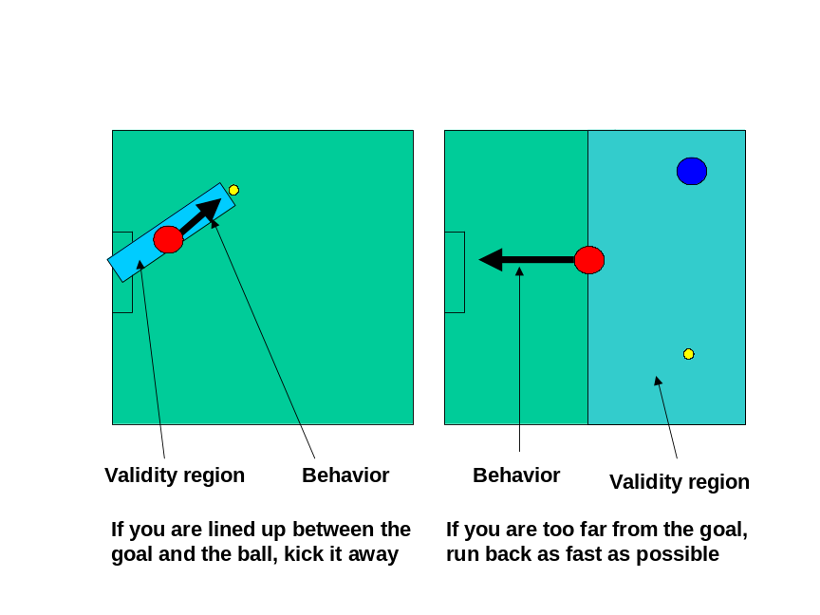
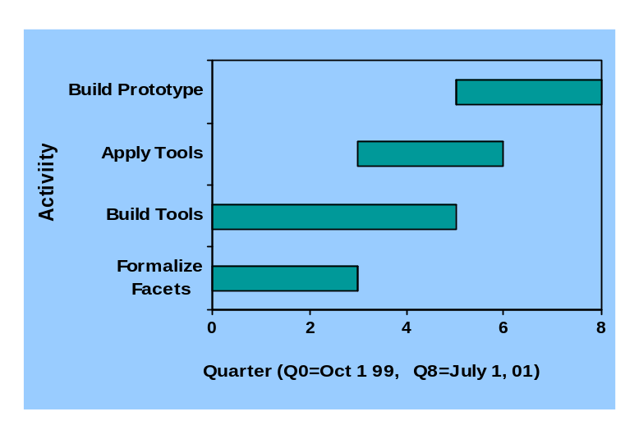
Trustworthy Software: When Computers Serve as Proxies for Humans
Control from the composition of independent behaviors depending on situation.
New ideas
Separating concerns of functionality from concerns of accountability and trust.
Compositionality = scaling. Meaning of a component must depend only on the meaning of its sub-components to minimize unintended component interaction
Meta-programming is a generic framework for manipulating programs in a high-level and semantically coherent way.
Impact
Integration of components of various sources to make components with predictable behavior.
Systems that alter behavior depending on context (composition of control systems) and which commit to and execute complex parameterized behaviors (control systems) based on situation (planning, learning)
Schedule
Tim Sheard - Oregon Graduate Institute & John Peterson - Yale University

Slide 18
Project 1 Quad-Chart Poster
The quad-chart fits our project nicely.
Each part fits in one of the 4 panels.
Make each panel be an 8.5” x 11” piece of paper. Total poster size is then 17” x 22”
Example for visual reference only

Slide 19
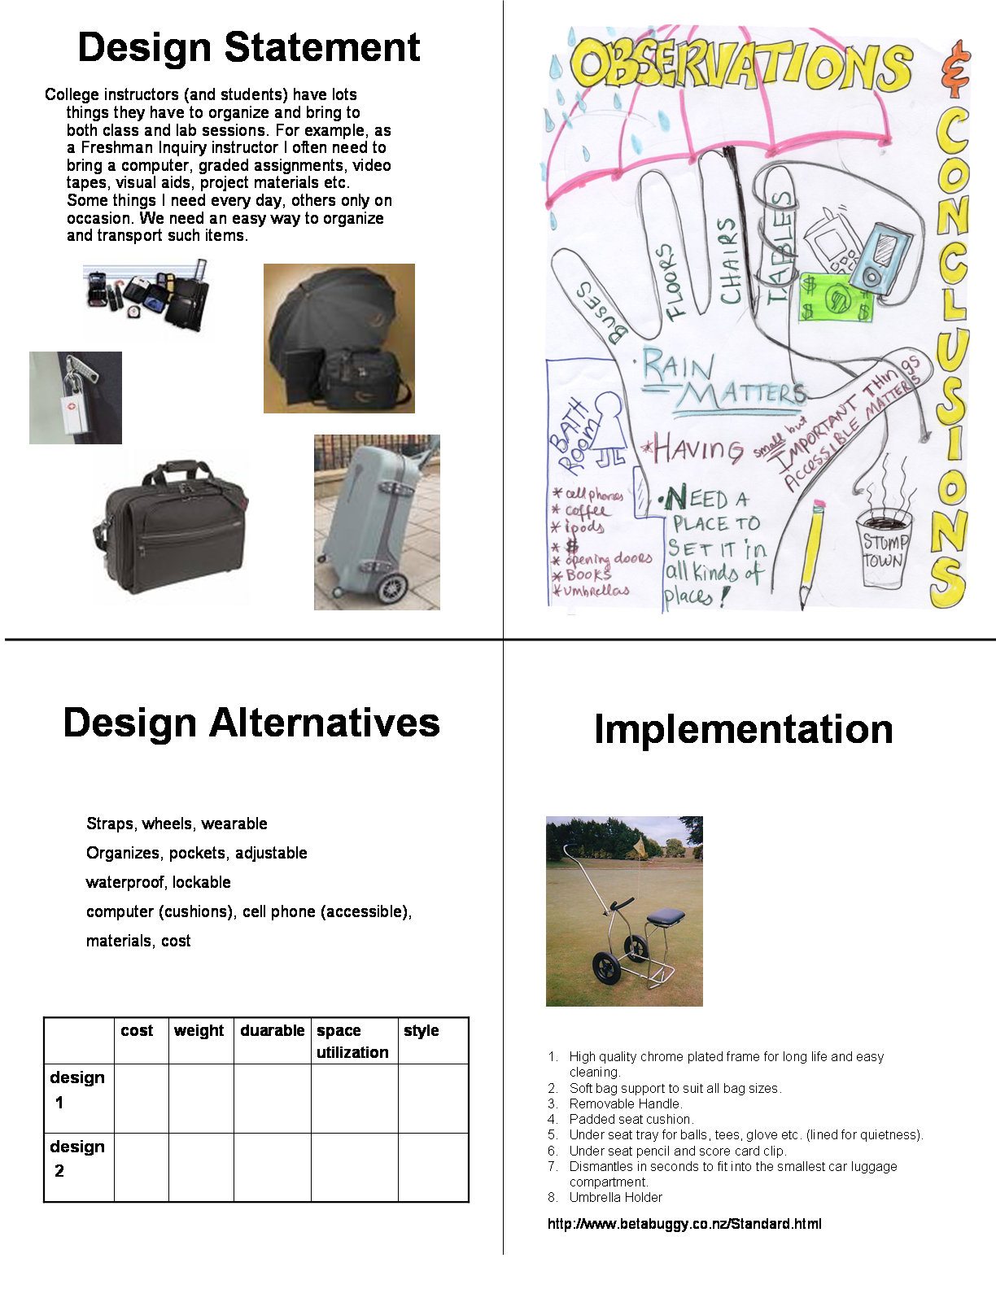
This is NOT a particularly good example of what I want. But notice some features.
A quad for each part of the project.
Different media are allowed
Each panel is uncluttered
Only important ideas listed
Lots of visual material

Slide 20
Frinq writing help offered through the PSU Writing Center.
DROP IN HOURS:
SEE DANEEN BERGLAND AT
  THE WRITING CENTER (CH188F) ANY WEDNESDAY, 11-1PM
  AND CRAMER HALL RM. 101 ANY FRIDAY, 11-1PM

