Slide 1
Design and Society
Strings and Domes Slides

Slide 2
Great Speaker
Dr. Henry Petroski will speak about Engineering and Design
Wednesday, October 31st , 5:30-7:30pm.
At Portland State's Northwest Center for Engineering, Science, and Technology, at 1930 SW Fourth Avenue
He is the Author of books
  To Engineer is Human
  How Everday Artifacts From Forks and Pins to Paper Clips and Zippers Came to be as They are
  The Role of Failure in Successful Design and The Evolution of Useful Things

Slide 3
Part 4 results
x
x
x
x x
xxxxxxxx
x xxxxxxxx x
-------------------
4 5
0 0

Slide 4
Bridge Design
Teams will be finalized in mentor session
Each team must have all the supplies 1 week from today.
You must read Learning activity 1 by Monday or you won’t know what to do.
Each team should have 1 hard copy of learning activity 1.

Slide 5
Assembling a bibliography
You are to go to the library and find 5 items that you will use in your research paper. You must bring these five item to class on Wednesday, Oct 31.
  You will be graded in class on the 5 items you bring
You must include at least one book, and at least one peer reviewed journal article.
When you find the books keep good records, because you must also create a bibliography. I.e. a written a list of the books. It includes the necessary information that other people could use to find the same item. This includes title, author, dates, pages etc.
We will use the MLA bibliography style. If you follow the link, there is an online resource you can use to learn how to construct such a bibliography. The sections on "works cited" are particularly useful. Use them as your guide.
Bring the books and articles to class.
Bring a hard copy of your bibliography in MLA style.
Also upload a copy of your bibiography to webCT.

Slide 6
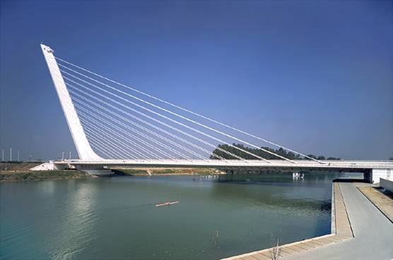
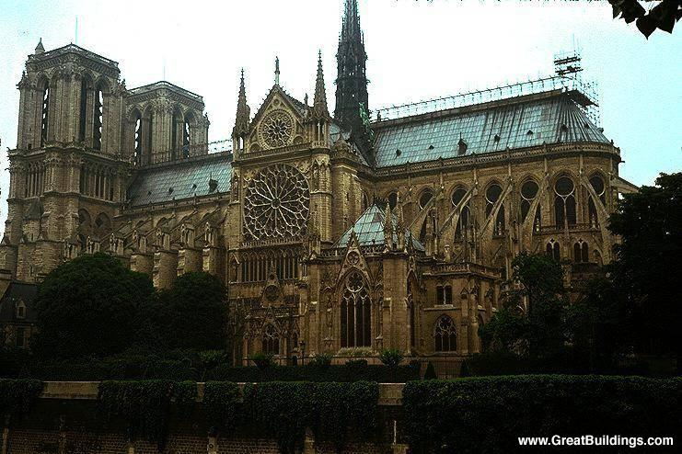
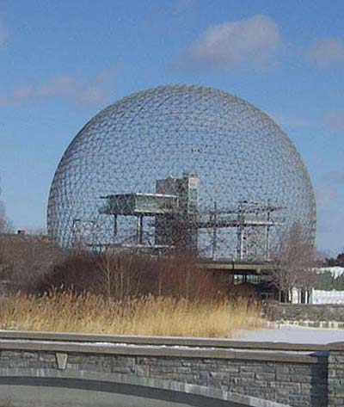
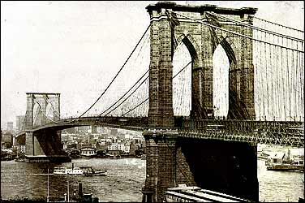
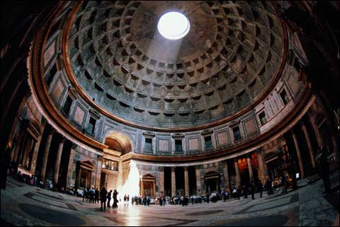
What do these have in Common?
http://www.greatbuildings.com/buildings/Notre_Dame_Cathedral.html
http://encarta.msn.com/media_121625849_701610428_-1_1/Alamillo_Bridge.html
http://en.wikipedia.org/wiki/Buckminster_Fuller
http://www.pbs.org/wgbh/buildingbig/wonder/structure/brooklyn.html
http://www.monolithic.com/thedome/pantheon/

Slide 7
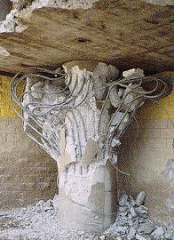
Reasons to Study Structure in Design
Safety – Real and Perceived
Beauty in Structure
Structural form driving Design form
Buildability
Economy/Optimization

Slide 8
Studying Structure
You already know a great deal about structure
We’re going to tap into that knowledge
We’ll be studying the broad brushstrokes rather than fine details
There are graphical, or pictorial, ways to analyze structure as well as analytical which we will review

Slide 9
Tension and Compression
100 #
100 #
100 #
Tension
200 #
Compression
100 #
100#
100 #
300 #
Hanging Weight
Weight Supported by a Column of Material
Free Body Diagrams
Tension attempts to pull the string apart while compression tries to push the column together.

Slide 10
Cables and Strings
A cable is a structure that only can carry tensile force

Slide 11
Cable with a Point Load
4 oz.
A cable holding one weight deforms in a vee shape (neglecting the cable selfweight)
A cable always deforms with respect to the loads imposed upon it. We call the shape it makes “funicular” from the Latin “funiculus”, or string.

Slide 12
Funicular Shapes
If the cable had been a little longer, or a little shorter, it would have deformed in a similar configuration.
We call this a family of funicular lines.

Slide 13
Funicular Shapes
If we flip over the structure, and make it out of sticks, we now have a compressive structure with a funicular shape.

Slide 14
Parabolic Cable
Load
A cable with a uniformly distributed load forms a parabolic shape.

Slide 15
Parabolic Cable
A cable with a uniformly distributed load forms a parabolic shape.

Slide 16
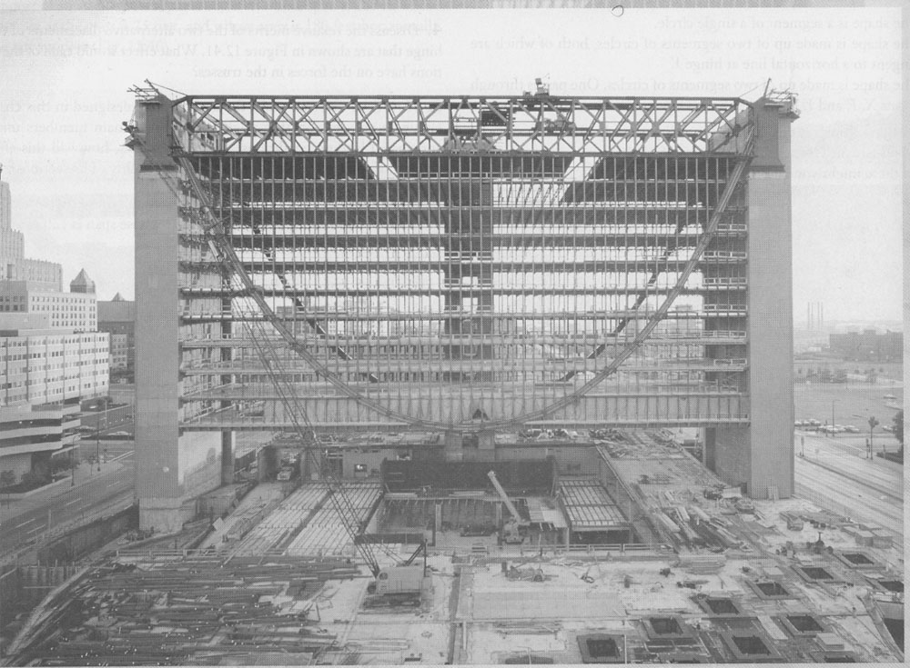
Building with a Cable Support
What do I do?
These pictures are taken from Shaping Structures: Statics, by Waclaw Zalewski and Edward Allen, with drawings by Joseph Iano.

Slide 17
Parabolic Arch
Invert the structure and you have an arch in compression.

Slide 18
Parabolic Arch
Thrust
Sum of the Thrust and the Weight Support is in the direction of the end of the arch
Weight Support
Invert the structure and you have an arch in compression.

Slide 19
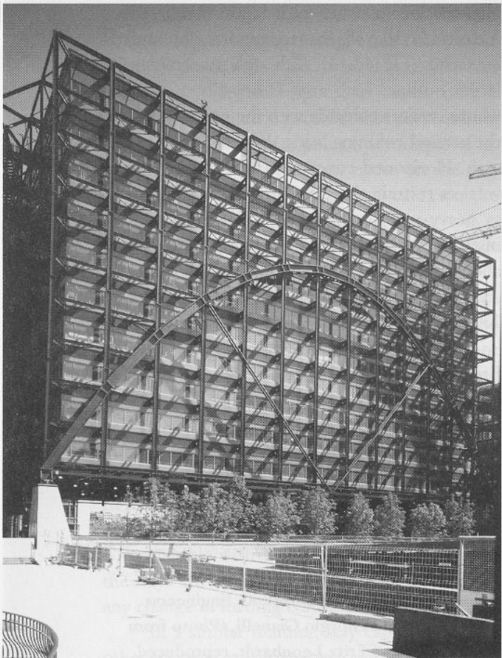
Building with an Arch Support
These pictures are taken from Shaping Structures: Statics, by Waclaw Zalewski and Edward Allen, with drawings by Joseph Iano.

Slide 20
Parabolic Arch
Thrust
Sum of the Thrust and the Weight Support is in the direction of the end of the arch
Weight Support
Taller arches have less thrust than shallow arches.

Slide 21
Arch Stability
Thrust
The vertical forces make the arch want to rotate clockwise, while the horizontal forces make the arch want to rotate counter-clockwise. These effects balance one another in a stable arch.
Weight
Thrust
Weight Support

Slide 22
Domes
A Dome is a three-dimensional arch.

Slide 23
Dome Stability
In a dome, the thrust is usually carried by a “tension ring” at the base, and by the butted connections or a “compression ring” at the top.

