Slide 1
Gears, Gears and More Gears
Robotics Academy 2002. All Rights Reserved.

Slide 2
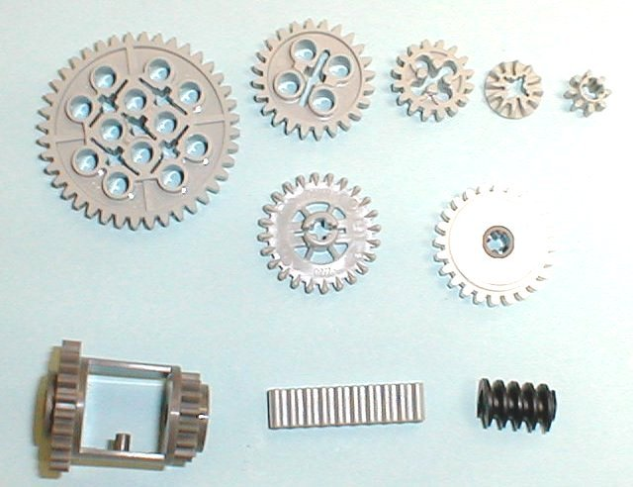
What is a gear?
A gear is a wheel with teeth that mesh together with other gears.
Gears change the
speed
torque (rot. force)
direction
of rotating axles.

Slide 3
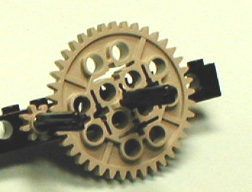
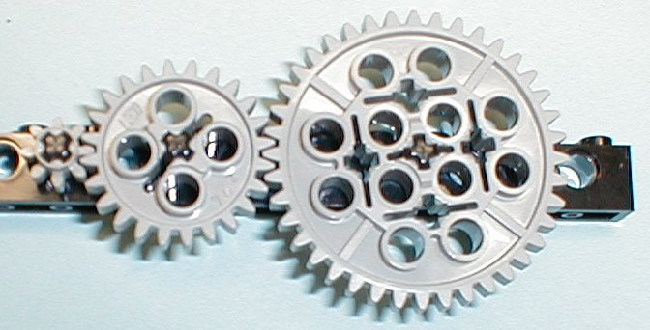
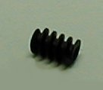
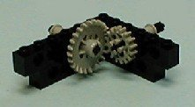
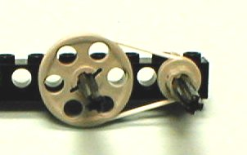
Different types of gears
Spur gears
Idler gears
Worm gears
Bevel gears
Belts & Pulleys

Slide 4
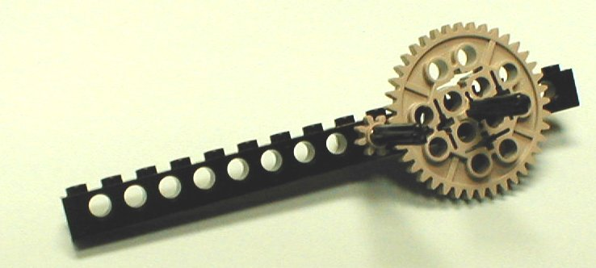
Spur Gears
Most “common” type of gear, a wheel with teeth.
(put bushings on
the back side)
Build the following...
Spur gears do three things.
1. Change rot. speed
2. Change torque
3. Change direction
1x16 beam
#6 axle
8 tooth gear
40 tooth gear
Make sure there isn’t too much friction between the
gears and the beam. The gears should spin easily.

Slide 5
Gear Ratios
The gear ratio is the ratio of the number of teeth on one gear to the number of teeth on the other gear.
40 teeth
8 teeth
Gear ratio = 40 to 8 or, simplifying, 5 to 1.
That means it takes 5 revolutions of the smaller gear to get 1 revolution of the larger gear. Try it!

Slide 6
Gear Ratios
The gear ratio tells you the change in speed and torque
of the rotating axles.
If it takes 5 turns of the 8 tooth gear for every 1 turn of
the 40 tooth gear, that means the 40 tooth gear will rotate
5 times slower than the 8 tooth gear.
BUT, it also means the 40 tooth gear’s axle has 5 times
the torque (rotational force) as the 8 tooth gear’s axle.

Slide 7
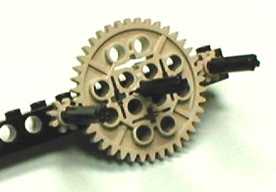
Idler Gears
An idler gear is a gear that is inserted between 2 other gears.
Build the following. Add another
8 tooth gear to the right of the
40 tooth gear.
idler gear
How many turns of the 8 tooth
gear on the left does it take to
make 1 turn of the new 8 tooth
gear on the right?

Slide 8
Idler Gears
Answer: 1! It’s as if the 8 tooth gears are meshed together.
Idler gears DO NOT change the gear ratio.
Idler gears DO…
make both 8 tooth gears rotate in the same direction,
add spacing between gears.

Slide 9
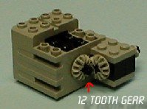
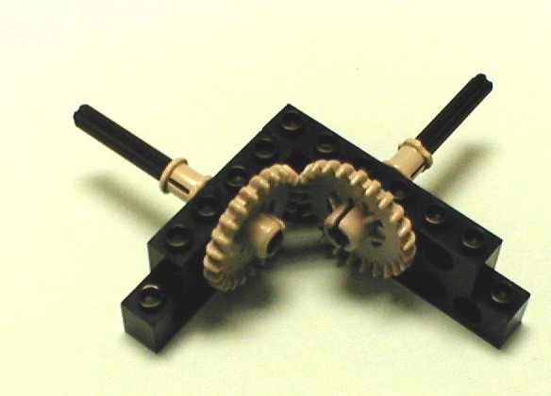
Bevel Gears
Bevel gears are spur gears that mesh at a 90 degree angle. The gear ratio rules remain the same, but the axles are perpendicular to one another.
These 12 tooth bevel gears
can only mesh with them-selves.

Slide 10
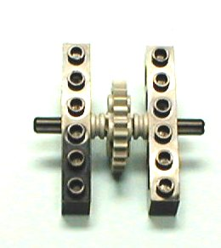
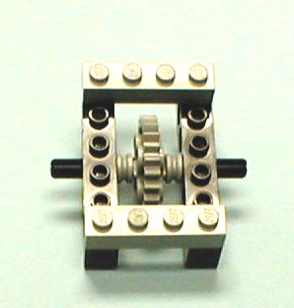
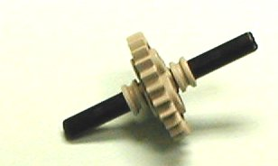
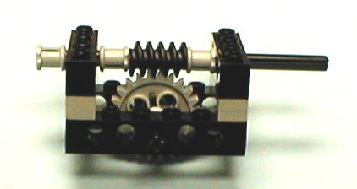
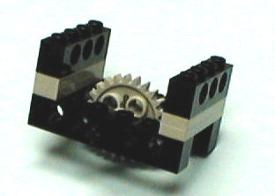
Worm Gears
Build the following….
1x6 beam
2 1x4 plates
1
#6 axle
2
3
half bushing
24 tooth gear
worm gear
4
1x4 beam
5
full
bushing
#10 axle

Slide 11
Worm Gears
Worm gears have some special properties.
1: The axles are perpen-dicular, like bevel gears.
2: How many rotations of the
worm gear does it take for 1
rotation of the spur gear?
ANSWER: 24!
The worm gear acts like a gear with 1 tooth! This gives
very large gear ratios.

Slide 12
Worm Gears
Worm gears are not back-driveable.
You can turn the worm gear’s axle, but you can’t turn the spur gear’s axle.
This property is used as a
locking mechanism.

Slide 13
Belts & Pulleys
Belts & pulleys are related to gears. They change speed and torque, but with a few differences...
Pulleys transfer their force by the friction of the belts, rather than direct contact with the teeth of gears.
This can cause the belts to slip.
Unlike gears, the pulleys
rotate in the same direction.

Slide 14
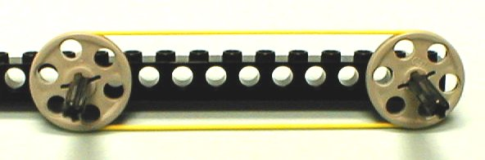
Belts & Pulleys
Belts can transfer force across long distances.
Like gears, however, belts and pulleys do have a “gear
ratio.” It is the ratio of the diameters of the pulleys.

